Slide 1
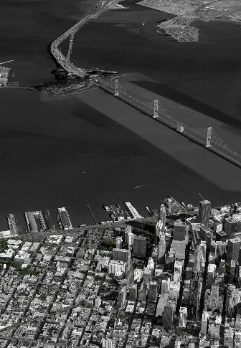
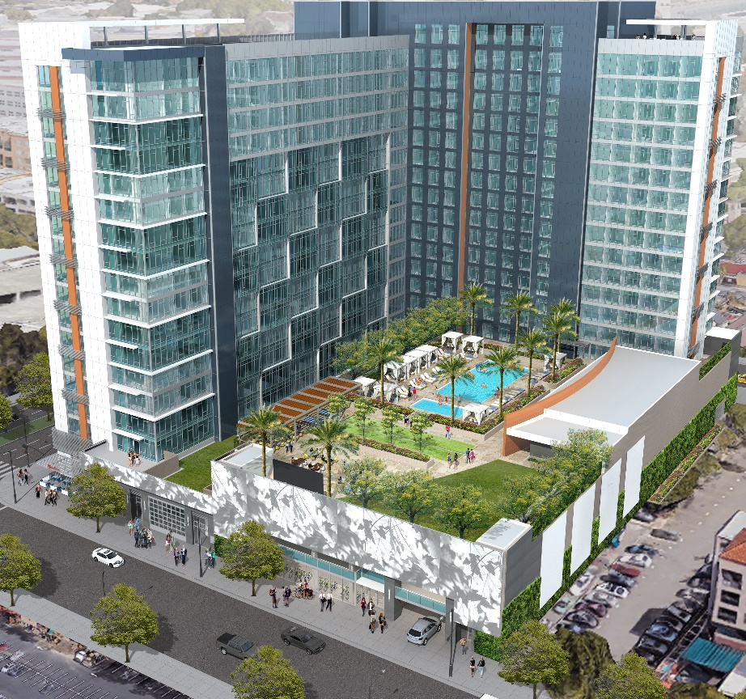




The Graduate
90 E. SAN CARLOS ST. SAN JOSE, CA
EB-5 | SAN JOSE STATE UNIVERSITY
SILICON VALLEY STUDENT
HOUSING PROJECT
260 Apartments / 1,000+ Beds
Rare Silicon Valley student housing Location 468 ft from to San Jose State University
100% Minimum Job Creation Requirement 100% Completed
$500,000 EB-5
100% of Job Creation Already Completed
BRC has 100% USCIS Approval history¹
DEVELOPMENT TEAM
AMCAL – Over 118,000 student housing beds developed
Swenson – Silicon Valley contractor with over 100 year history
Star America Infrastructure Partners – $5 Billion AUM
INVESTOR FRIENDLY
Flexible investment term
Partial capital payment schedule
Minor Aged Investors Accepted
Investor APP and paperless Subscription process
Full EB-5 investment cycle services
INVESTMENT
SOURCES OF CAPITAL
Loan style investment
Projects market value estimate is 8.7x the EB-5 Investment
Construction completion guaranteed
Secured by 100% equity pledge
Minimum job creation requirement already completed
BANK LOAN
$112 MILLION
DEVELOPER
EQUITY
$46 MILLION
25%
60%
15%
EB-5 INVESTOR
CAPITAL
$28.5 MILLION
www.behringcompanies.com | info@behringcompanies.com
3860 Blackhawk Rd, Suite 160, Danville, CA 94506 | +1(925)575-9634

Slide 2
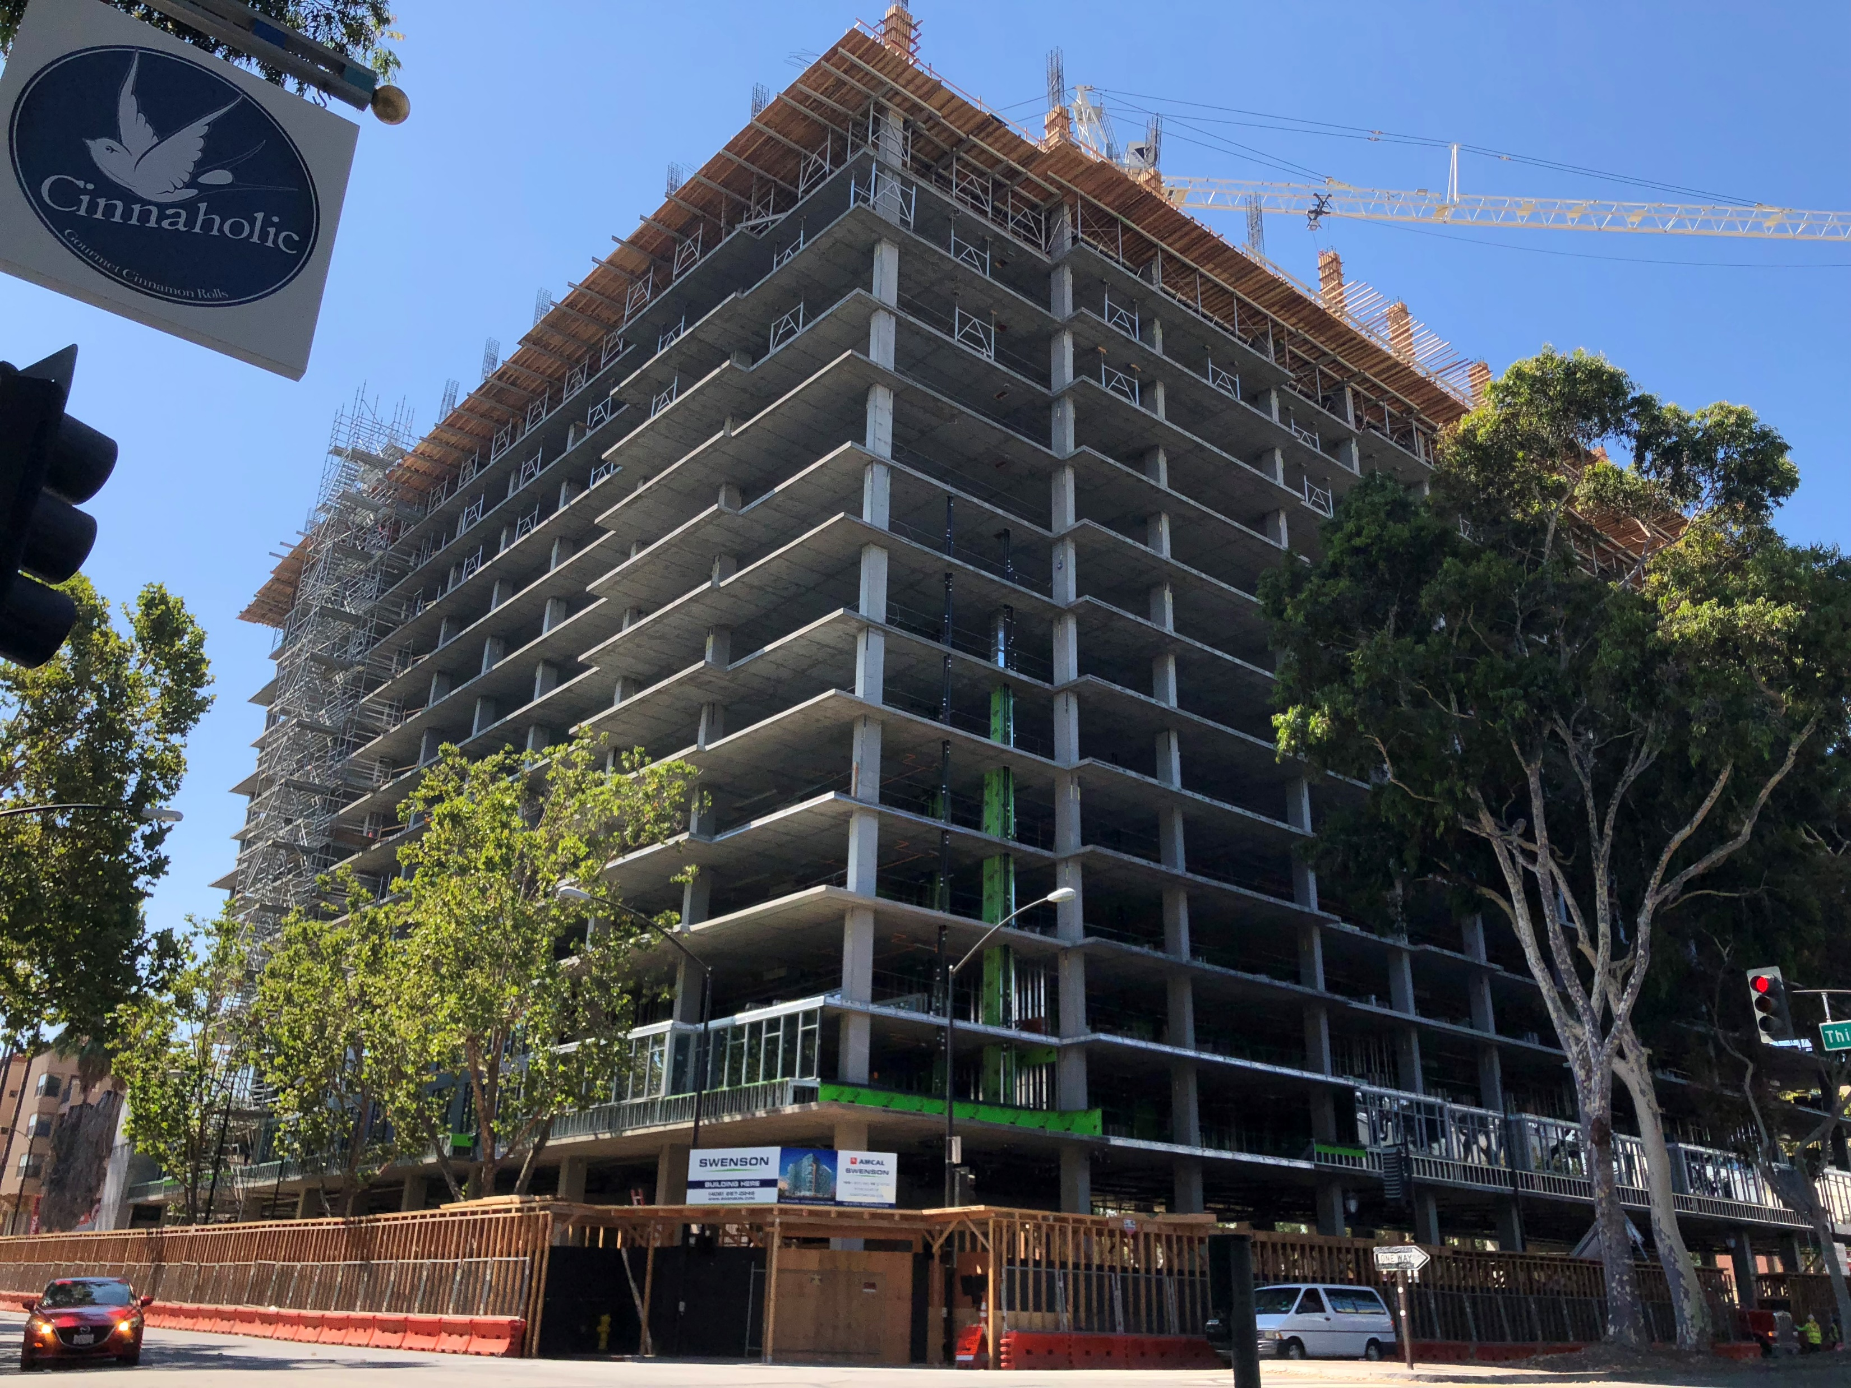
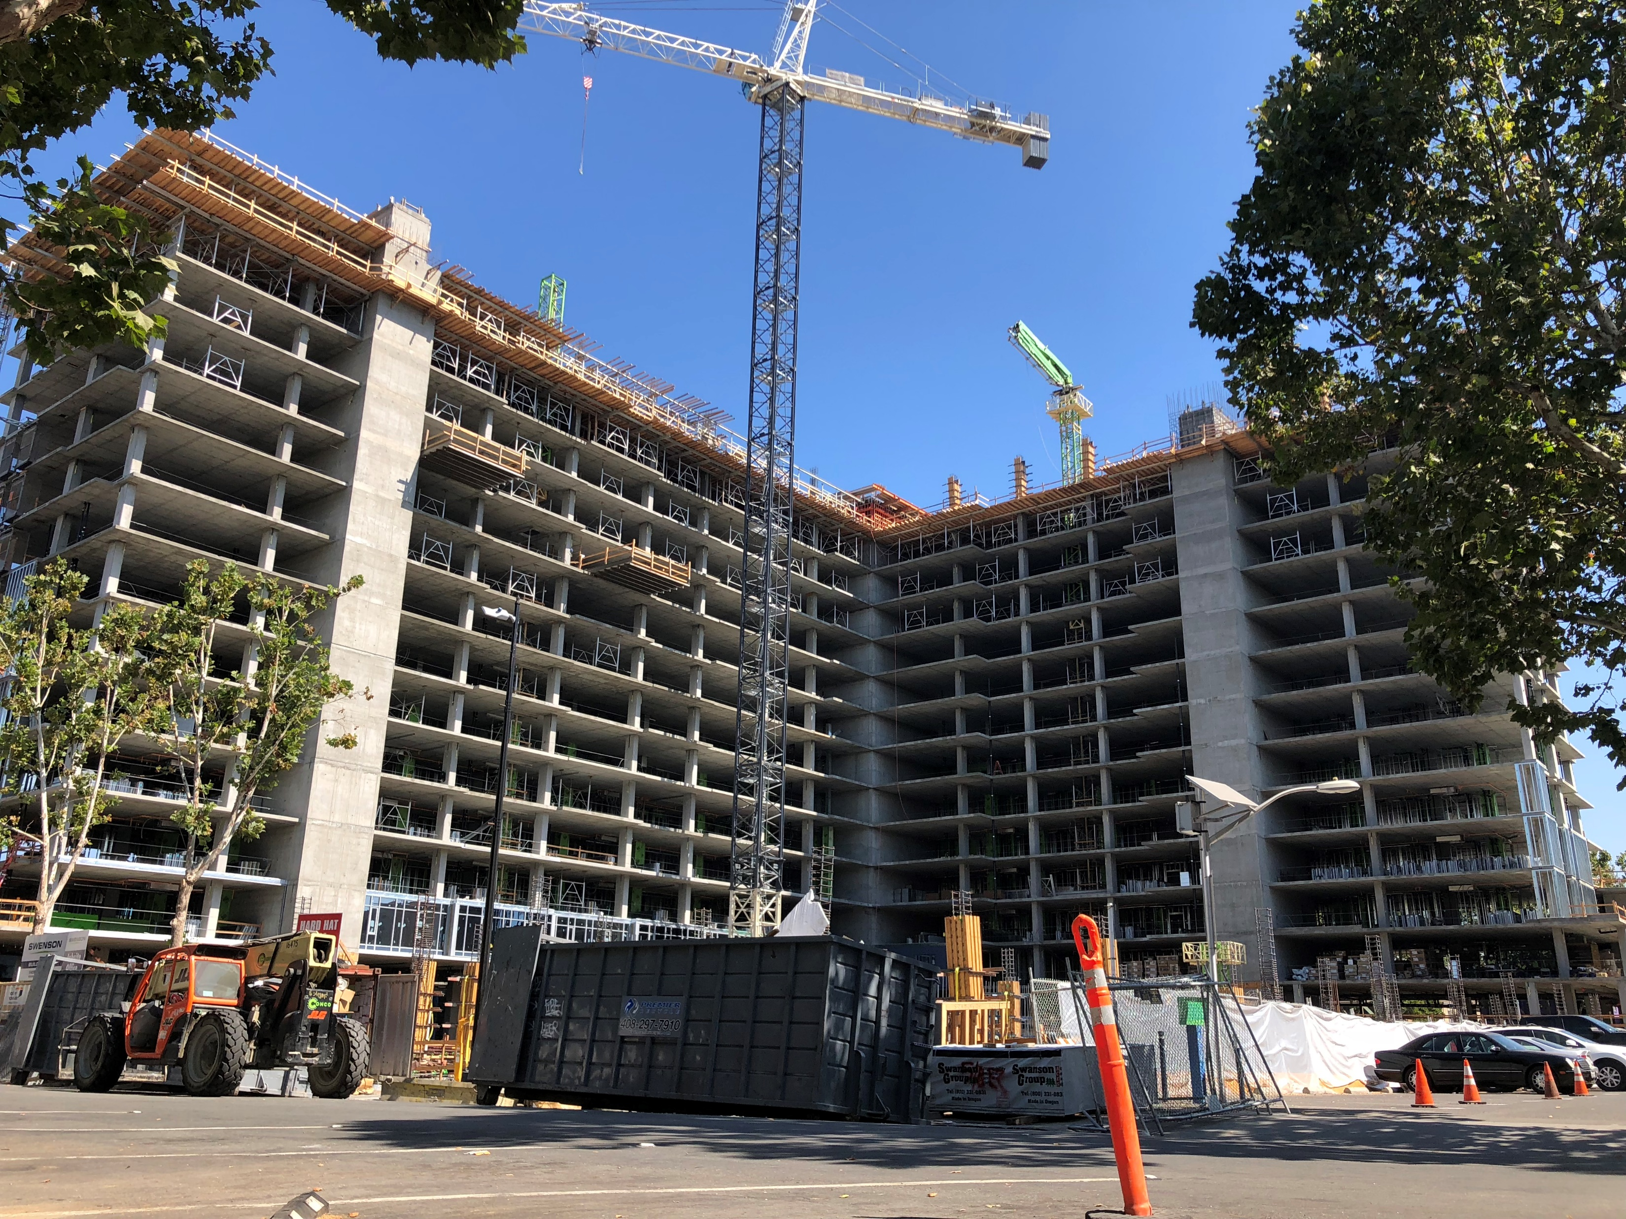
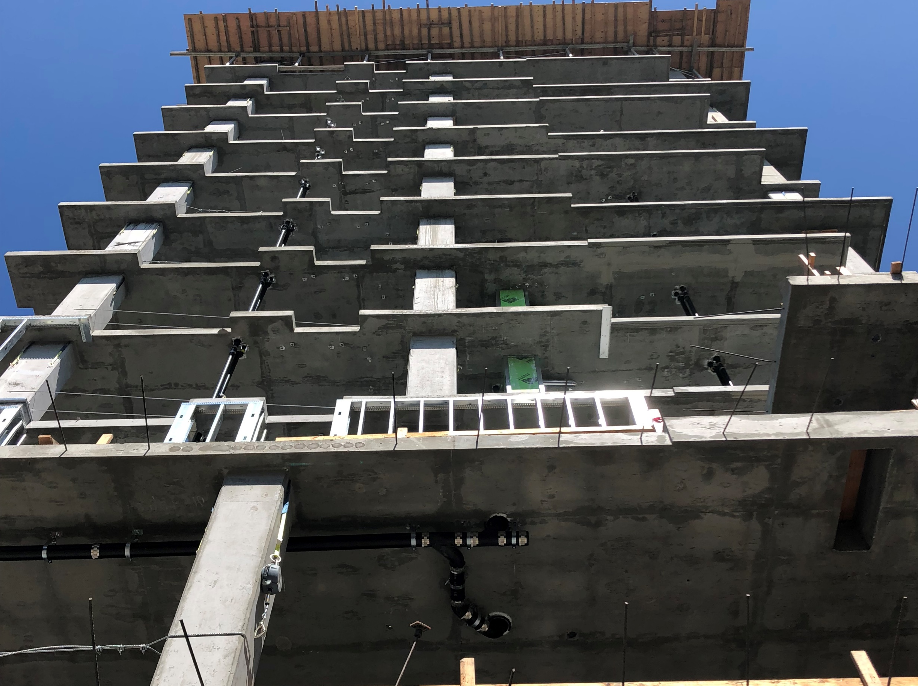
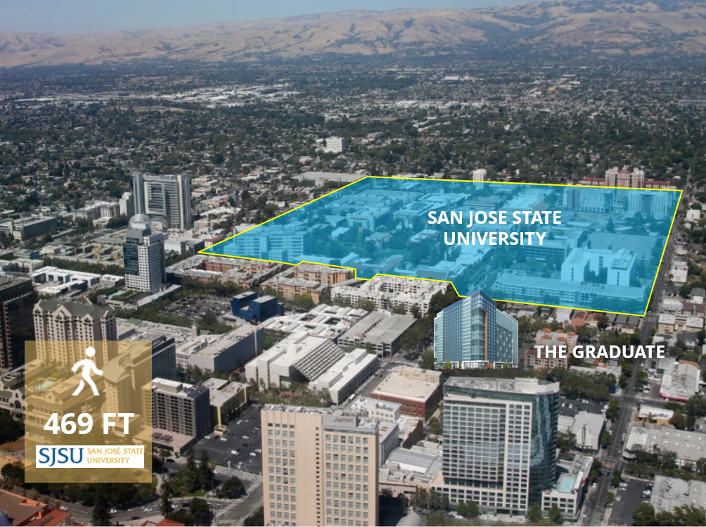
IMPORTANT INFORMATION
This is not an offer to sell securities in any way. Only a formal privately distributed offering memorandum and appropriate securities documents, fully executed will represent a sale of investment. This Project Flier (PF) was prepared specifically for the Behring Companies “Behring” and prospective partners that are pre-identified and qualified for investment as Accredited Investors in terms of the United States SEC or otherwise accepted under SEC regulations or exemptions. These materials are distributed in confidentiality, are internally sensitive, and are subject to internal corporate confidentiality policies. Those who have received this PF in error should destroy its contents immediately. PF materials are prepared specifically for prospective Behring partners and investors review. Those outside this scope who are privileged with access to this packet, whether on a consulting or investment basis, should acknowledge this packet may contain what the industry refers to as “Forward Looking Statements” or “Projections” from the Behring. The words “intend”, “believe”, “expect”, “anticipate”, “target” and other similar language herein that identify such projections. The projections that are included in this document are those opinions of the fund about future operations. Therefore, these projections are subject to uncertainties and changes, many of which are beyond the control of the Behring, which may cause the relevant actual results to be materially different from the results expressed or implied by such projections. No assurance or representation is made by any person that any forecast or projection will be achieved. Therefore, nothing contained herein should be relied upon as a promise, forecast, guarantee or a representation as to the future. This packet is informational in its intent and this document, any financial models, feasibility studies or other documentation may change without notification. If outside sources or other documentation or information appears different or in conflict, contact Behring companies for verification on receiving the latest drafts or identifying accurate data. Information prepared on electronic media such as PowerPoint, Prezi, websites, blogs, WeChat or other methods of delivery are often truncated and summarized to improve readability whereas details of any legal nature should only be respected through the specific Confidential Offering Documents provided by Behring.
www.behringcompanies.com | info@behringcompanies.com
3860 Blackhawk Rd, Suite 160, Danville, CA 94506 | +1(925)575-9634

Slide 3

The Graduate
90 E. SAN CARLOS ST. SAN JOSE, CA
EB-5 | SAN JOSE STATE UNIVERSITY
SILICON VALLEY STUDENT
HOUSING PROJECT
260 Apartments / 1,000+ Beds
Rare Silicon Valley student housing Location 468 ft from to San Jose State University
SECURE PATH TO GREEN CARD
$500,000 EB-5 (T.E.A.)
Strong Job Creation, 244% extra jobs
Berkeley Regional Center has 100% Approval history on all EB-5 investor Petitions to date
INVESTOR FRIENDLY
Flexible investment terms
Partial capital payment schedule
Negotiable fees
Investor APP and paperless Subscription process
Full investment cycle services
DEVELOPMENT TEAM
AMCAL – Over 118,000 student housing beds developed
Swenson – Silicon Valley developer & contractor with over 100 year history
Star America Infrastructure Partners – $5 Billion AUM
INVESTMENT
SOURCES OF CAPITAL
Loan style investment
Projects market value is 8.7x the EB-5 Investment
Construction completion guaranteed
Secured by 100% equity pledge
Construction & job creation has already started
BANK LOAN
$112 MILLION
DEVELOPER
EQUITY
$46 MILLION
25%
60%
15%
EB-5 INVESTOR
CAPITAL
$28.5 MILLION
www.behringcompanies.com | info@behringcompanies.com
3860 Blackhawk Rd, Suite 160, Danville, CA 94506 | +1(925)575-9634

Slide 4
The Graduate
90 E. SAN CARLOS ST. SAN JOSE, CA
EB-5 | SAN JOSE STATE UNIVERSITY
SILICON VALLEY STUDENT
HOUSING PROJECT
260 Apartments / 1,000+ Beds
Rare Silicon Valley student housing Location 468 ft from to San Jose State University
$500,000 EB-5 (T.E.A.)
SECURE PATH TO GREEN CARD
Strong Job Creation, 244% extra jobs
Berkeley Regional Center has 100% Approval history on all EB-5 investor Petitions to date
DEVELOPMENT TEAM
AMCAL – Over 118,000 student housing beds developed
Swenson – Silicon Valley contractor with over 100 year history
Star America Infrastructure Partners – $5 Billion AUM
INVESTOR FRIENDLY
Flexible investment terms
Partial capital payment schedule
Negotiable fees
Investor APP and paperless Subscription process
Full EB-5 investment cycle services
INVESTMENT
SOURCES OF CAPITAL
Loan style investment
Projects market value is 8.7x the EB-5 Investment
Construction completion guaranteed
Secured by 100% equity pledge
Construction & job creation has already started
BANK LOAN
$112 MILLION
DEVELOPER
EQUITY
$46 MILLION
25%
60%
15%
EB-5 INVESTOR
CAPITAL
$28.5 MILLION
www.behringcompanies.com | info@behringcompanies.com
3860 Blackhawk Rd, Suite 160, Danville, CA 94506 | +1(925)575-9634

Slide 5
IMPORTANT INFORMATION
[insert legal disclaimers]

Slide 6
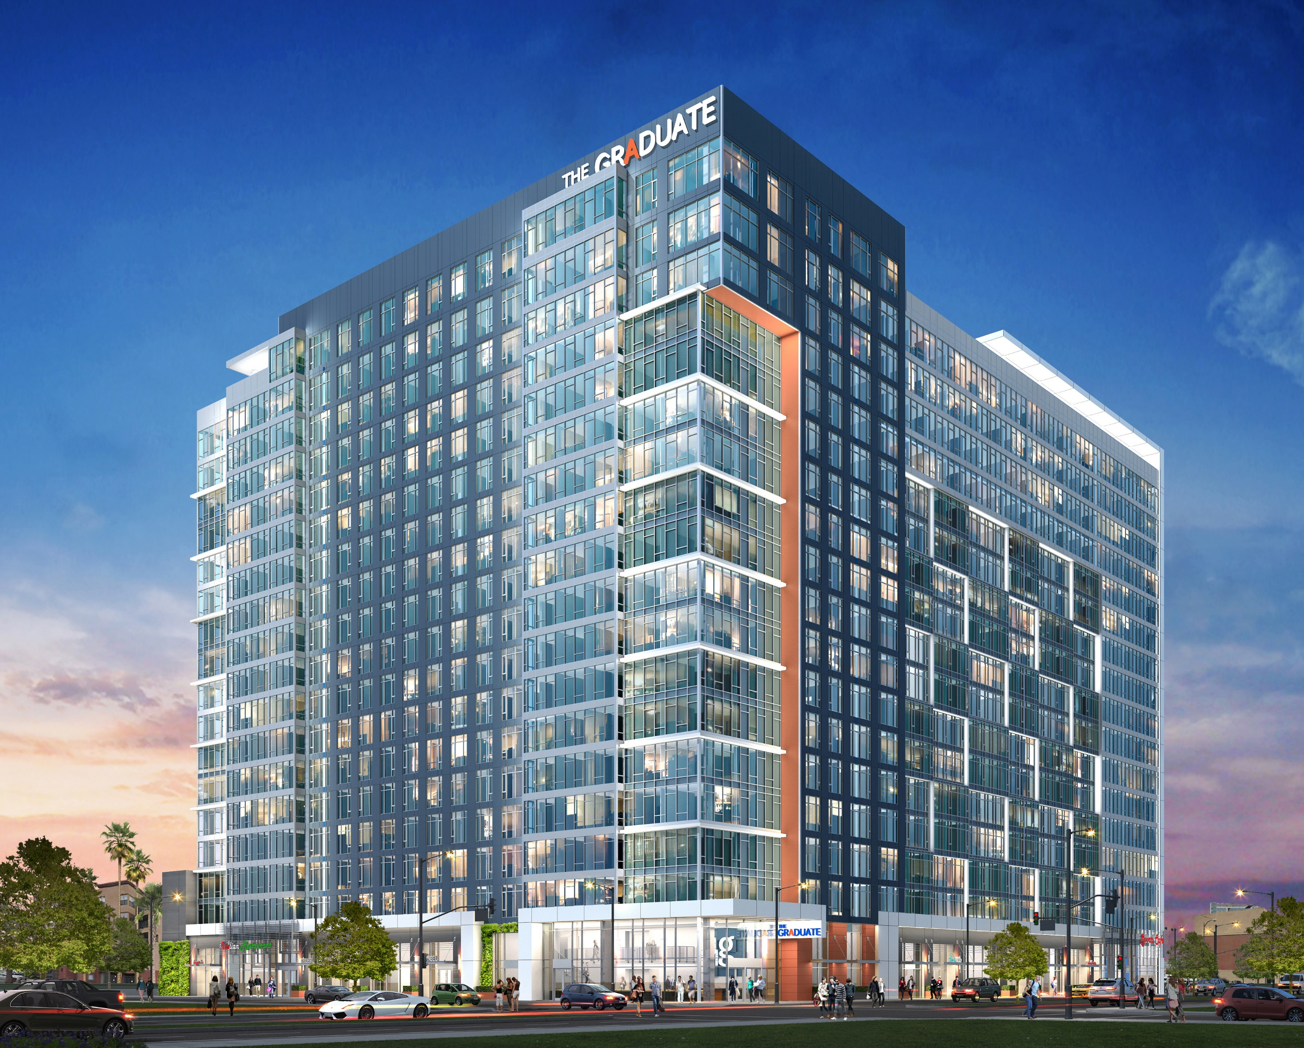
The Graduate
USCIS Jobs Requirement Already 100% Complete
90 E. SAN CARLOS ST. SAN JOSE, CA
EB-5 | SAN JOSE STATE UNIVERSITY
Full Stack EB-5 Protections
100% Approval History on all Investor Adjudicated Petitions to Date
Construction Completion Guaranteed, Estimated Completion of June 2020
100% Approval History on all Investor Adjudicated Petitions to Date

Slide 7
DEBT
(LOAN STYLE)
PREFERRED EQUITY
EQUITY
0.25%
4%
8%
Preferred Return
+ Profit Sharing

