Slide 1
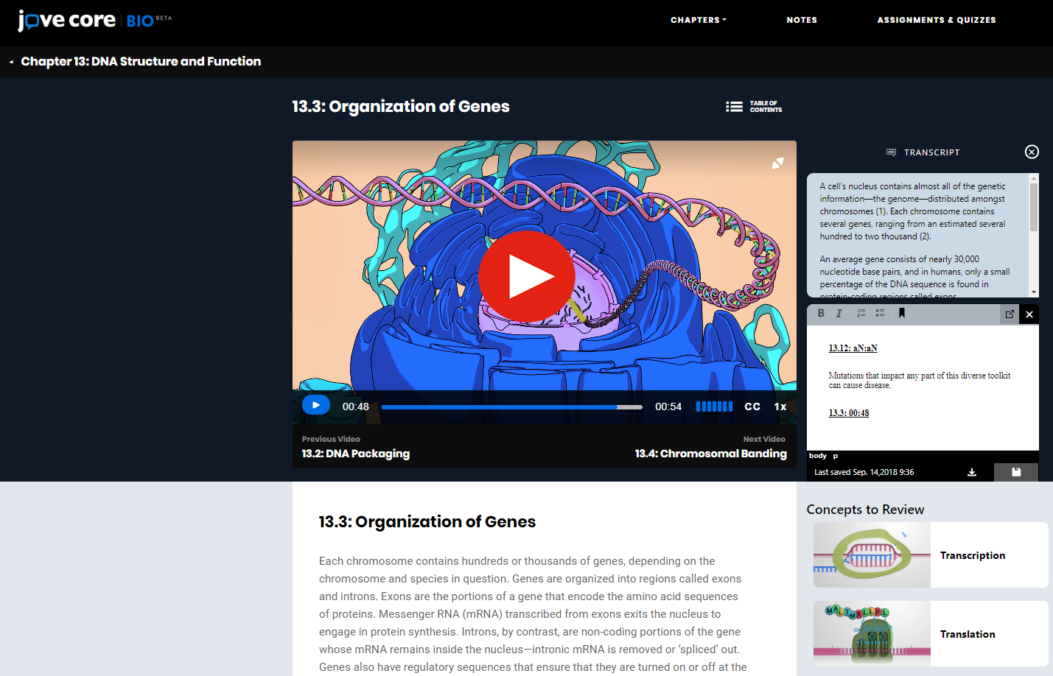

Slide 2
The Textbook Model is Broken!
Features that Matter
Interactive and Immersive Design
300+ Key Concepts Animations
100+ JoVE Video Journal Articles
40+ Related Research Techniques Videos
End of Video Self-Assessments
Customizable Quizzes

Slide 3
Video Courseware to Replace the Textbook
JoVE Core Helps
Students come to class prepared
Professors spend time on what matters
Integrate primary sources into class
Better understand student comprehension
Aid in flipped learning

Slide 4

A Better Way To Learn
Visit www.jovecore.com to request for a free trial!

