Slide 1
Required sized of light box advertisement:3035mmx1450mm
The yellow area is can be seen
The area can be seen:3010mmx1425mm
Notes:
Title: 30pt, bold, dark grey

Slide 2
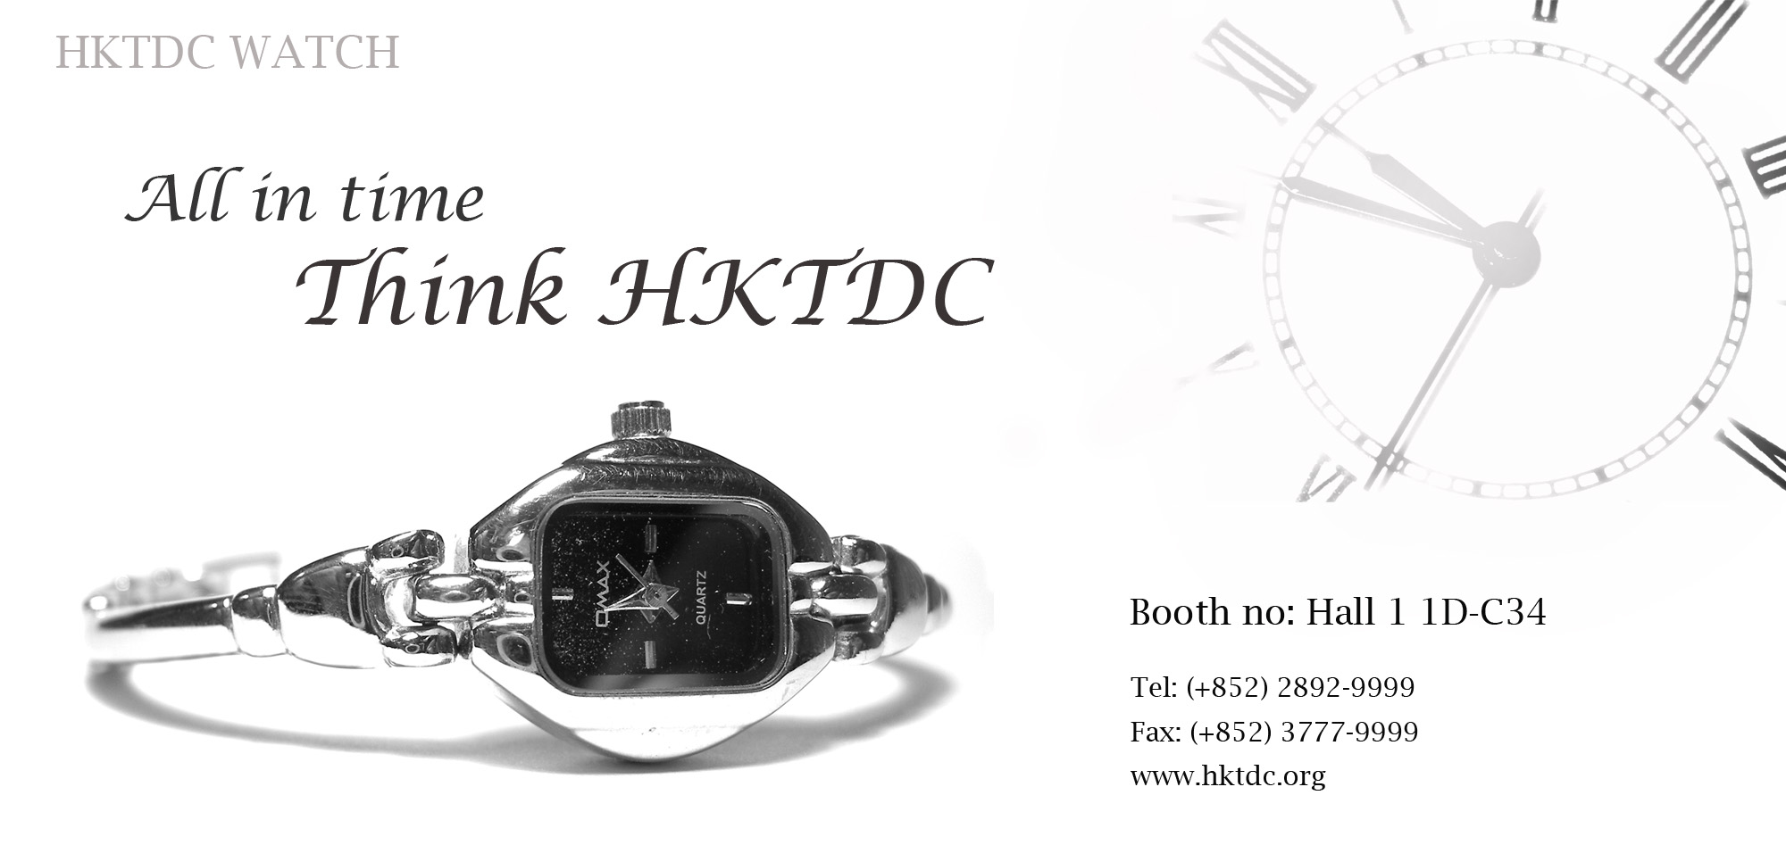
Example
The size of whole advertisement is 3035m x1450mm
The area can be seen 3010mmx1425mm
Notes:
Title: 30pt, bold, dark grey
Subtitle: 18pt, bold, orange

Slide 3
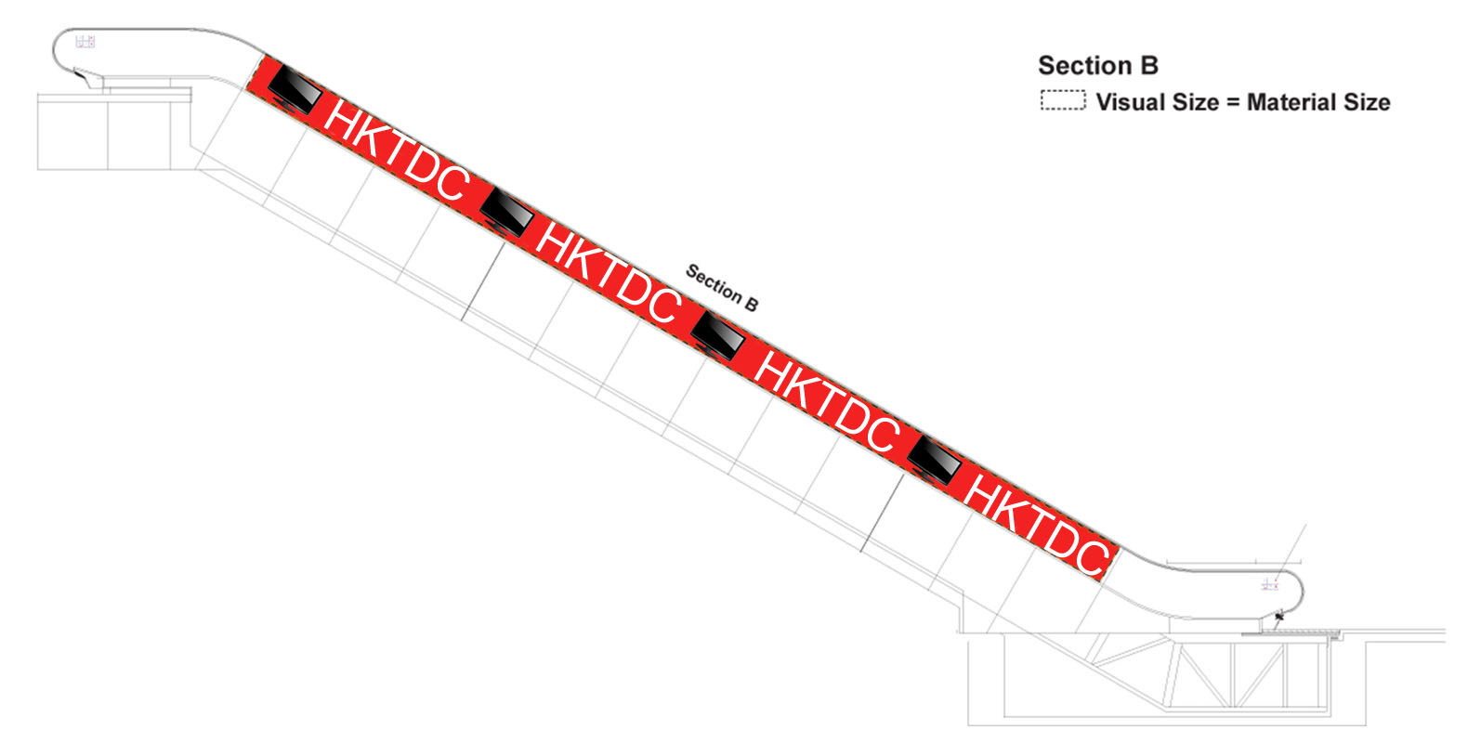
Escalator advertisement
Size:13,600mm x 640mm
Notes:
Title: 30pt, bold, dark grey

Slide 4
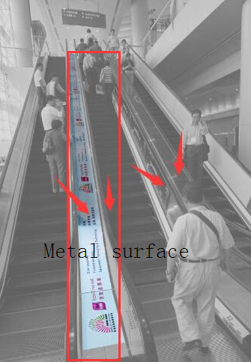
Escalator metal surface advertisement
Size:18,360mm x 410mm

Slide 5
Requirements of contents
✓Clear pictures
✓Clear company name
✓Simple informations
✓Contacts（可放
Booth No.
Website

