Slide 1
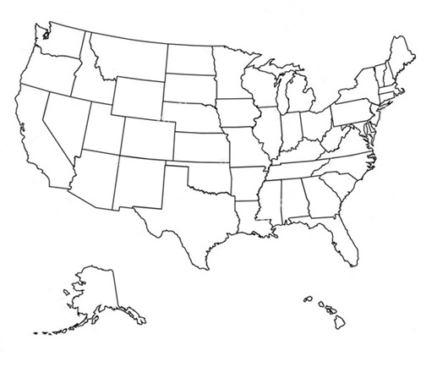


Advanced Polymer, Inc. - Our Presence
API Headquarters R&D/Manufacturing/Sales
400 Paterson Plank Rd
Carlstadt, NJ 07072
IL – Technical Sales
MI – Technical Sales
NC – Technical Sales
GA – Technical Sales

Slide 2
About Us
Innovative specialty chemicals for almost 40 years. We combine a wealth of experience, with R&D resources and the responsiveness of our technical and customer service team to support our customers.
Industries including:
Architectural
Textiles & Leather
Inks, Paints & Coatings
Adhesives/Adhesion Promoters

Slide 3
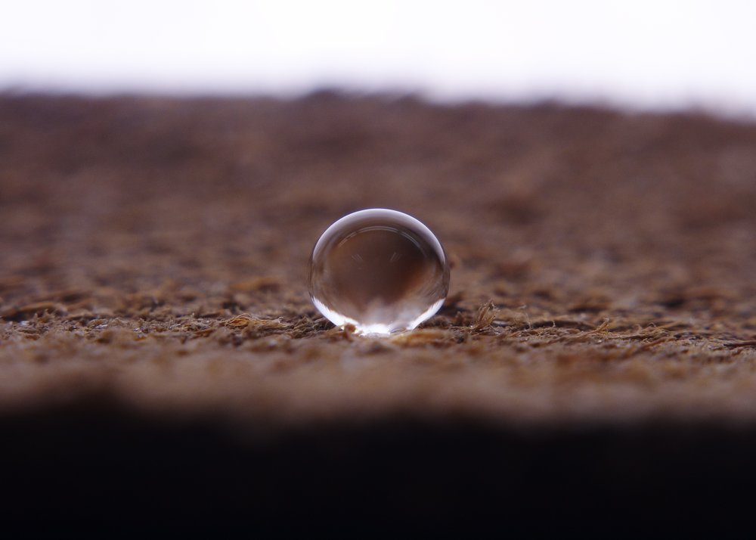
Architectural Applications
WATER, OIL AND STAIN REPELLENTS
Advanced Polymer, Inc. offers a variety of materials used to impart barrier properties to surfaces such as concrete, grout natural stone, pavers, wood and others. These sealers shield against water, oil, stains as well as corrosion and freeze-thaw damage.

Slide 4
Water, Oil & Stain Repellents - Waterborne
Product | Actives (%) | VOC (g/L) | Description
APS-254 Emulsion | 36.0 |  | General purpose water repellent for various porous hard surfaces. Rapid water beading effect. Non-surface changing.
AdvaPel® 724 | 25.0 |  | Short chain fluoropolymer for penetrating water, oil and stain repellency sealers. Exceptional performance on tile, stone and cementitious surfaces. Non-surface changing.
AdvaPel® 729 | 13.0 | 0 | Short chain fluoro phosphate ester for penetrating water, oil and stain repellency sealers. Exceptional performance on tile, stone and cementitious surfaces. For brush and roll applications only. Non-surface changing.
API-WP66 | 30.0 |  | Silicone/fluoro copolymer for penetrating sealers. Exceptional performance on tile, stone and cementitious surfaces. Non-surface changing.

Slide 5
Water, Oil & Stain Repellents - Solventborne
Product | Actives (%) | Carrier | VOC (g/L) | Description
APS-232HCA | 50.0 | Octamethylcyclo-tetrasiloxane |  | Silicone based super-hydrophobic treatment for various hard surfaces including stone, tile, concrete and pavers.
AdvaPel® 805 | 18.5 | n-butyl acetate/odorless mineral spirits (OMS) |  | Short chain fluoropolymer. Water, oil and stain repellent for a various hard surfaces including stone, tile, concrete and pavers.
AdvaPel® 816 | 18.5 | n-butyl acetate/ethyl acetate/odorless mineral spirits (OMS) |  | Short chain fluoropolymer. Exceptional water, oil and stain repellent for a various hard surfaces including stone, tile, concrete and pavers.

Slide 6

Textiles & Leather
FABRIC & LEATHER PROTECTANTS
Advanced Polymer, Inc. provides a full line of products to impart barrier properties to various fabrics in the textile finishing industry. These materials are designed to achieve superior water, oil, stain resistance and release.

Slide 7
Fabric & Leather Protectants- Waterborne
Product | Actives (%) | pH | Ionic character | Description
API-BI795 | 20.0 | 3.0 – 5.0 | Non-ionic | Blocked isocyanate reaction product. Stable at room temperature but dissociates to regenerate isocyanate functionality under the influence of heat.
API-NSF101 | 25.0 | 3.0 – 5.0 | Cationic | Silicone and fluorine free water repellent finish for a variety of fabrics. Built in durability.
AdvaPel® 732 | 19.0 | 3.0 – 5.0 | Cationic | Short chain fluoropolymer with exceptional soil release properties for various fabrics.
AdvaPel® 775 | 20.0 | 3.0 – 5.0 | Cationic | Short chain fluoropolymer designed to impart excellent water and oil repellency to all types of fabric substrates. Durable through extended home launderings.
AdvaPel® 734 | 30.0 | 3.0 – 5.0 | Cationic | Short chain fluoropolymer that will impart water, oil and soil repellency to textiles, upholstery and carpeting. For aftermarket applications

Slide 8
Fabric & Leather Protectants- Solventborne
Product | Actives (%) | Carrier | VOCs (g/L) | Description
APS-232HCA | 50.0 | Octamethylcyclo-tetrasiloxane |  | Silicone based super-hydrophobic treatment for various fabrics and leather. For aftermarket applications.
AdvaPel® 805 | 18.5 | n-butyl acetate/odorless mineral spirits (OMS) |  | Short chain fluoropolymer. Water, oil and stain repellent finish for a variety of fabrics. For aftermarket applications.
AdvaPel® 816 | 18.5 | n-butyl acetate/ethyl acetate/odorless mineral spirits (OMS) | 700 | Short chain fluoropolymer. Exceptional water, oil and stain repellent finish for a variety of fabrics. For aftermarket applications.

Slide 9

Inks, Paints & Coatings
VARIOUS ADDITIVES
Advanced Polymer, Inc. provides various additives to enhance performance by improving strength and durability; impart water, stain and chemical resistance; enhance color, increase gloss, reduce dust and dirt pick-up, promote adhesion and more.

Slide 10
Water Repellents
Product | Actives (%) | Ionic Character | Description
AP-0280 | 78.0 | Nonionic | Silicone based self-curable reactive copolymer emulsion that imparts water repellency on architectural substrates. Excellent choice for exterior deck stains and paints.
API-WP30C | 40.0 | Anionic | Copolymer emulsion for various waterborne systems. Excellent choice for rapid water beading effect on interior/exterior paints and coatings formulations. Can be used as a stand alone sealer.
API-WP35 | 36.0 | Anionic | Hydrocarbon based emulsion for various waterborne systems. Excellent choice for rapid water beading effect on interior/exterior paints and coatings formulations.
APS-232HCA | 50.0 | Solventborne | Silicone based additive for various solventborne systems. Designed to provide excellent water repellency and holdout for various surfaces. Will improve cleanability and dirt pick up resistance performance.

Slide 11
Oil/Stain Repellents
Product | Actives (%) | Ionic Character | Description
AdvaPel® 724 | 25.0 | Anionic | Short chain fluoropolymer for waterborne systems. Provides water, oil and stain resistance and holdout. Can be used in penetrating or film-forming sealers, paints, inks & coatings.
AdvaPel® 787 | 28.0 | Anionic | Short chain fluorophosphate ester for waterborne systems. Provides water, oil and stain resistance and holdout for brush and roll applications. Can be used in penetrating or film forming sealers, paints, inks & coatings. Helps with flow and leveling properties.
AdvaPel® 805 | 18.5 | Solventborne | Short chain fluoropolymer for solventborne systems. Provides water, oil and stain resistance and holdout. Can be used in penetrating or film forming sealers, paints, inks & coatings.
AdvaPel® 816 | 18.5 | Solventborne | Short chain fluoropolymer for solventborne systems. Provides excellent water, oil and stain resistance and holdout. Can be used in penetrating or film forming sealers, paints, inks & coatings.

Slide 12
Wetting/Leveling Agents - Fluorosurfactants
Product | Actives (%) | Ionic Character | Description
APFS-14 | 27.0 | Amphoteric | Short-chain fluorosurfactant with compatibility in waterborne and solventborne system. Exceptional wetting/leveling properties.
APFS-70S | 50.0 | Nonionic | Short-chain fluorosurfactant for various waterborne systems. Excellent choice for wetting low surface energy substrates such as plastics, oily substrates, waxy surfaces, and silicone and fluoropolymer treated fabrics.
APFS-75S | 20.0 | Anionic | Short-chain fluorosurfactant for anionic waterborne systems. Excellent choice for wetting low surface energy substrates such as plastics, oily substrates, waxy surfaces, and silicone and fluoropolymer treated fabrics. Excellent block resistance.
APFS-76S | 30.0 | Nonionic | Short-chain fluorosurfactant for various waterborne systems. Designed to provide excellent cleanability and oil repellency when added to flat finish architectural paints and water-based coatings. Will improve the chemical resistance and dirt pick up resistance performance.

Slide 13
Slip/Mar & Abrasion
Product | Actives (%) | Description
API-188 | 35.0 | Nonionic emulsion of a high melt polyethylene resin that will increase abrasion resistance, strength and durability in a wide range of coatings and finishes.
APS-228 Emulsion | 50.0 | Nonionic silicone emulsion designed to be used as an additive for waterborne coatings. It provides durable silicone characteristics to polyurethane and acrylic plastic, leather and wood coatings. It can be used in conjunction with cationic, nonionic and anionic systems. Among other properties, APS-228 Emulsion imparts mar, slip and dust/dirt repellency to auto care products for rubber, plastic and vinyl.
APS-260 | 100.0 | Silicone resin powder that can be used as a coating or resin modifier to impart lubricity and abrasion resistance. Excellent candidate for use in BOPP film additives due to superior antiblock block and slip properties.

Slide 14
Silane Coupling Agents – Inorganic
Product | Chemical Name | Description
AP-Silane 30 | n-Propyltrimethoxysilane | Alkylalkoxysilane that can be used as a high performance coating agent that provides good hydrophobicity, low surface energy, and superior adhesion.
AP-Silane 90 | Methyltrimethoxysilane | Alkyltrialkoxysilane that can be used as a high performance coating agent that provides great hydrophobicity and superior adhesion . AP-Silane 90 is important in sol-gel applications for glass applications.
AP-Silane 98 | Octyltriethoxysilane | Excellent hydrophobic treatment for substrates such as concrete, glass, mineral fillers etc. Treated substrates will retain their original appearance

Slide 15
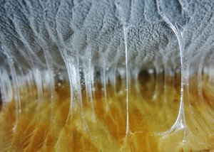
Adhesives/Adhesion Promoters
FOR LOW SURFACE ENERGY SUBSTRATES
Advanced Polymer, Inc. provides a line of specialty adhesion promoters used to help bond low surface energy substrates such as plastics, rubber and different composites without the need for surface pre-treatments. The specialty adhesion promoters, under the AdvaBond® product line, are typically used to alter the substrate’s functionality to make it easier to bond with other substrates or different coatings or adhesives.

Slide 16
Adhesion Promoters - Waterborne
Product | Actives (%) | VOC (g/L) | Description
AdvaBond® 7200 | 30.0 |  | Waterborne chlorinated maleic anhydride modified adhesion promoter for various polyolefinic substrates, especially polypropylene containing. Can be used as a primer or as an additive to a coating/adhesive formulation.
AdvaBond® 7302 | 30.0 |  | Waterborne adhesion promoter for various polyolefinic substrates, especially polyethylene containing. Can be used as a primer or as an additive to a coating/adhesive formulation.
AdvaBond® 7419 | 28.0 |  | Waterborne adhesion promoter for various low surface energy substrates. Ideal for heat seal coatings with low temperature applications. Can be used as a primer or as an additive to a coating/adhesive formulation.
AdvaBond® 7426 | 28.0 |  | Waterborne adhesion promoter for various low surface energy substrates. Ideal for heat seal coatings with higher temperature resistance. Can be used as a primer or as an additive to a coating/adhesive formulation.

Slide 17
Adhesion Promoters - Solventborne
Product | Actives (%) | Carrier | VOC (g/L) | Description
AdvaBond® 8100 | 30.0 | Xylene |  | General purpose adhesion promoter for solventborne systems. Can be used as a primer or additive to inks, paints, coatings and adhesives. Can also be supplied in VOC exempt solvents.
AdvaBond® 8117 | 30.0 | Cyclohexane |  | Solventborne adhesion promoter for polypropylene containing substrates. Ideal choice for automotive primer applications. Excellent fuel resistance.
AdvaBond® 8203 | 57.0 | Xylene |  | Chlorinated, maleic anhydride modified adhesion promoter for various low surface energy substrates. Ideal for roof coatings/adhesives applications.
AdvaBond® 8214 | 30.0 | Toluene |  | Chlorinated adhesion promoter for various low surface energy substrates. Ideal for roof coatings/adhesives applications.

Slide 18
Adhesion Promoters - Solventless
Product | VOC (g/L) | Description
AdvaBond® P35 |  | Amino functional silane oligomer used in coatings, adhesives, and sealants to improve the adhesion of various resins. Can also be utilized as a mineral filler treatment. Ideal for SPUR or MS Polymer Sealants.
AdvaBond® P48 |  | Epoxy functional silane oligomer used in coatings, adhesives, and sealants to improve the adhesion of various resins. Ideal for waterborne latex sealants

