Slide 1


1000+
/
50+
/
700+
/
~$250M in 2017
Customers
Countries
Employees
Annual Revenue
Headquartered in Oakland, CA (NASDAQ: DZSI)
www.dasanzhone.com
Notes:
<Next slide>

Slide 2
Safe Harbor Statement
This presentation contains forward-looking statements that are subject to the safe harbors created under the Securities Act of 1933 and the Securities Exchange Act of 1934. Words such as “anticipate,” “believe,” “continue,” “could,” “estimate,” “expect,” “goal,” “intend,” “may,” “plan,” “project,” “seek,” “should,” “target,” “will,” “would,” variations of such words, and similar expressions are intended to identify forward-looking statements. In addition, forward-looking statements include, among others, statements that refer to financial estimates; projections of revenue, margins, expenses or other financial items. Readers are cautioned that actual results could differ materially from those expressed in or contemplated by the forward-looking statements. Factors that could cause actual results to differ include, but are not limited to, commercial acceptance of the Company's products; intense competition in the communications equipment market; the Company's ability to execute on its strategy and operating plans; and economic conditions specific to the communications, networking, internet and related industries. In addition, please refer to the risk factors contained in the Company's SEC filings available at www.sec.gov, including without limitation, the Company's annual report on Form 10-K and quarterly reports on Forms 10-Q. Readers are cautioned not to place undue reliance on any forward-looking statements, which speak only as of the date on which they are made. The Company undertakes no obligation to update or revise any forward-looking statements for any reason.

Slide 3


Our Company History
Founded in 1999
  Raised $500M from:
    Kohlberg Kravis Roberts (KKR)
    Texas Pacific Group (TPG)
    New Enterprise Associates (NEA)
Nasdaq Listed Company
  Ticker Symbol: ZHNE
  Became a public company through a merger with Tellium in 2003
Founded in 1993
  Wholly-owned subsidiary of DASAN Networks, Inc. (DNI) – Holding Company:
    Network Solutions Business (DASAN Network Solutions)
    Automotive Parts
    Software
    Material Industries
    Engineering
KOSDAQ (Korean) Listed Company
  Ticker Symbol: 039560
  IPO in 2000
Merger in September 2016
  DASAN’s Network Solutions Subsidiary + ZHONE completed merger in Sept-2016:
    Global Reach
    1,000+ Customers
    700+ Employees (~260 headcount in US)
    ~$250M Revenue as of CY2017
NASDAQ Listed Company (DZSI)
  HQ: USA – Oakland CA
  Manufacturing: USA: Seminole, FL (in-house); Korea, China (OEM)

Slide 4
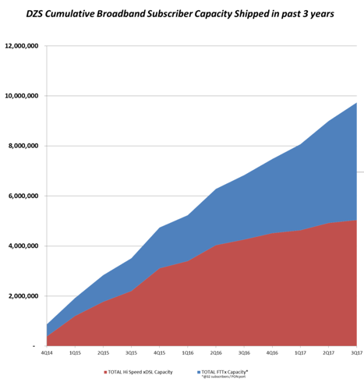
We are a Top 5 Global Network Solutions Provider
World Leader in Fiber and Copper Solutions for Quad Play Service Delivery:
    Internet
    Voice
    Video
    Wireless
Fully Managed Solutions from the Home and Enterprise Endpoints, Access and Transport Layers in the Network
Data Analytics on every Connection

Slide 5





Our Business Segments
Telco Carrier / Service Provider Segment
  Provide Fiber Access products to carriers and service providers worldwide
  Focus on Tier 1 carriers globally and Tier 2/3 & Alternative carriers in the U.S.
  Leading the Fiber Access market and sustaining leadership in each of our served markets
  Competition – Calix and ADTRAN (North America) / Huawei, Nokia, ZTE (Global)
Enterprise Segment
  Passive Optical LAN: an alternative to switched copper LAN
  Market verticals: Hospitality (hotels), Education (universities and college campuses), Sports Stadiums, Healthcare, and Corporates
  “Plug and Play” version of our FiberLAN product targeting Small and Midsized businesses (SMB) launching in 2H’2018
  Competition – Tellabs (private)
Broadband Access
Mobile Backhaul
Ethernet Switches
Software Defined Networks
Passive Optical LAN
  Fiber & copper
  Multi-gigabit
  Triple Play services
  5G ready
  Internet of Things
  Flexible & Scalable
  Cost Effective
  Redundant
  Carrier Class
  Simplify Operations
  Enable Innovation
  Centralize Mgmnt
  Future Proof
  Low Cost
  Integrated Mgmnt
Notes:
Broadband Access
Develop and support fiber and copper access technologies delivering multi-gigabit speed enabling today and tomorrow’s connected world
Mobile Backhaul
Provide backhaul solutions to mobile operators enabling a new level of manageability, flexibility, performance and cost
Ethernet Switching
Deliver carriers a cost effective and easy to use Ethernet switching platform for today’s networks enabling a migration to tomorrow’s network
Passive Optical LAN
Deploy enterprise networks with a new level of cost, power, space and cooling efficiencies enabling ultra high bandwidth to the desktop
Software Defined Network
Simplify carrier operations by enabling rapid deployment of new applications and services

Slide 6



















Our Global Footprint
Sales
Sales
Sales
Sales
Sales
Sales
Sales
R&D
R&D
R&D
Oakland, CA
Headquarters
Sales
Sales
Sales
(Customer Support in Alpharetta, GA)
Sales
R&D
(Oakland, CA)
Sales
Sales
Manufacturing
(Seminole, FL)
Sales
Sales
Sales
Sales
R&D
Manufacturing
Sales
Diversified Customers in over 50 Countries Flexible Production out of the U.S. (in-house) and Korea + China (OEM)

Slide 7
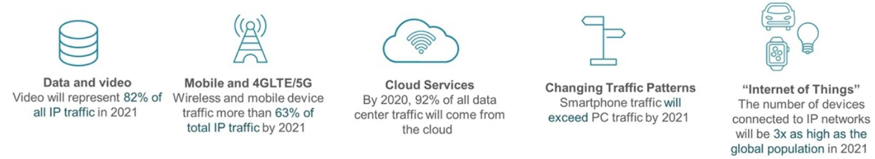
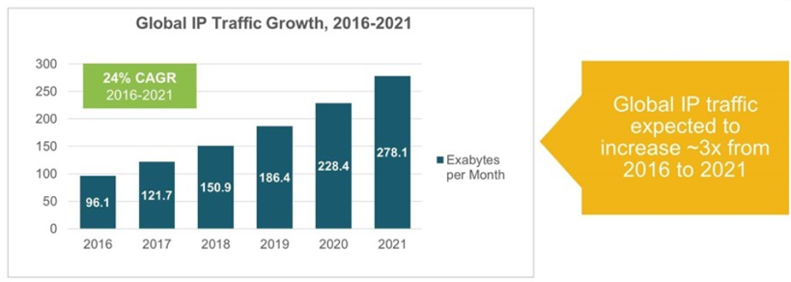
Accelerated Network Bandwidth Demands
Network Demands of High Bandwidth as below
Source : Cisco VNI 2017
Notes:
MACRO: we are seeing a rising tide of increased infrastructure investments by carriers away from legacy copper based products to fiber based products, particularly fiber to the home (“FTTH”)
Why is FTTH a growing and sustainable wave? Fiber to the home is becoming more relevant because:
more customers than ever have ultra-high definition televisions and displays
more carriers are providing IP TV
streaming services like Netflix are providing higher definition content
all factors are driving incentives for carriers to drive fiber to home to meet these broadband capacity demands
DASAN Zhone can take advantage of this because:
We are seeing a virtuous cycle with this copper to fiber transition within our product mix
We launched our MxK Fiber OLT product two years ago and now see the MxK OLT driving the sale of ZNID ONT products which then drive the sale of more MxK OLT products
It’s really a stepping ladder or a flywheel for additional purchases of our Fiber to the Home products since the more OLTs our customers buy, at some point they need to buy ONT products, which then leads to the purchase of more OLT products as broadband demand continues to grow
We are also excited about FiberLAN and see this offering taking more and more center stage at our company vs. legacy copper based products

Slide 8
What’s Driving the Global Demand for Fiber to the Home?
The global fiber to the home (FTTH) market is expected to grow from $9.5 billion in 2017 to $36.5 billion in 2027—a 14%+ CAGR
  Factors contributing to this strong growth include:
    Growing video and data usage needs
    Government initiatives in various regions
    Internet of Things (IoT)
    Rising construction in emerging economies
    Increasing telecom sector investments
These strong growth drivers, along with our global presence and industry-leading solutions, position us to grow solidly over the next several years
Source: Future Market Insights (FMI): “Fibre to the Home Market: Global Industry Analysis (2012-2016) and Opportunity Assessment (2017-2017)

Slide 9
Carrier Solutions

Slide 10












Strong Global Carrier Customer Base

Slide 11


















Broadband Access (Optical Solutions – GPON / EPON)
Premises
Access
Metro Area
Core
1GE or 10GE
40GE MPLS
DZS L2/L3 1GE Switches
V2224G, V5624G, V5648G
DZS L2/L3 10GE Switches
V6824XG, V6848XG
DZS Metro Area L2/L3 Switch
M3200
10GE L2 G.8032 (ERPS)
DZS Carrier Ethernet L2/L3 Switches
M2400
DZS FTTx High Density OLTs
V8106, MXK-819, MXK-F1421
DZS FTTx Medium Density OLTs
V8102, MXK-319, MXK-F219
DZS Management Systems
INAS, ZMS
10GE or Nx1GE
10GE or Nx1GE
10GE
DZS 1U MSANS
MXP Series
DZS 3U MSANs
MXK-319
DZS 8U MSANs
MXK-819, MXK-823
Nx10GE or 40GE
DZS 1U GPON OLTs
V5808, MXK-198
DZS 1U GigE Switches
V2224G-OP
DZS 1U xDSL DSLAMs
MX-1648 / MX-1696
DZS Cell Site Router
M1400
DZS Cell Site Switches
M1100, M1200
GPON
1GE
10GE
GPON
1GE
ADSL
VDSL
SHDSL
GPON
1GE
VDSL
GPON
1GE
ADSL
VDSL
SHDSL
POTS
DZS 1U G.FAST DPUs
V5916T
DZS G.FAST CPE
H370, H370W
DZS GPON ONTs
zNIDs, H66x, H68x
DZS GigE ONTs
zNIDs
DZS xDSL CPE

Slide 12
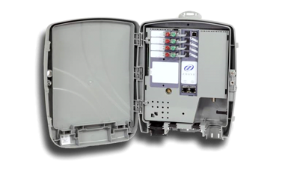


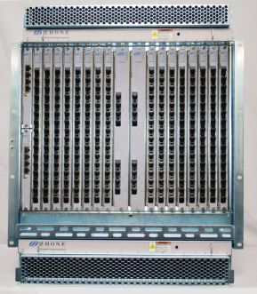


Industry Leading Density, Scalability and Switching Capacity
DZS MXK OLT
Highest GPON Density in the Industry
Multi-Service Copper and Fiber Support
  GPON / XG(S)PON / NGPON2
  1G / 10G Active Ethernet
Smallest Footprint in the Industry
(Central Office Equipment)
DZS ZNID ONT
  GPON / XG(S)PON / NGPON2
  1G / 10G Active Ethernet
  Wire Speed Throughput
  Indoor and Outdoor
(Customer Premise Equipment)

Slide 13

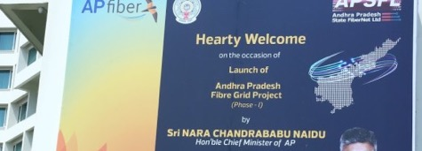

  Challenge Results
In 2016, the government of Andhra Pradesh announced a plan to provide triple-play services to at least 10 million subscribers by 2018 (The State has a population of ~60 million people)
APSFL, a PSU 100% owned by the Government of Andhra Pradesh, was established to undertake the works of AP Fibergrid
The APSFL continues to expand its network capabilities so that all households in Andhra Pradesh eventually have access to triple-play services.
DZS equipment is helping APSFL expand its infrastructure across all 13 districts of Andhra Pradesh
The H662GS ONT solution from DZS is a WiFi-enabled GPON-based set top box that can deliver streaming 4k video over a direct HDMI port, as well as basic internet data and voice to individual homes and businesses across the State
The value of the most recent order from APSFL is approximately $29 million
Products:
ONT: H662GS
“As the first state in the country to roll out these services for residents, DZS is helping us lead the way and grow APSFL’s market capabilities. This movement is influencing other states throughout India to design high-speed Internet infrastructures”
Hari Krishna, Commercial Executive Director, APSFL
Broadband Access

Slide 14

Enterprise Solutions, FiberLAN, & “Smart Cities”

Slide 15






















Strong Passive Optical LAN Customer Base

Slide 16
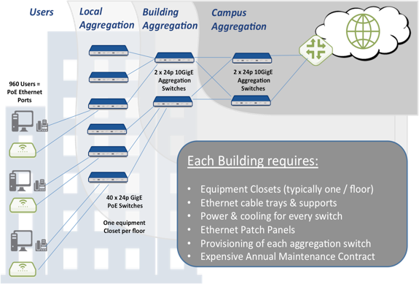
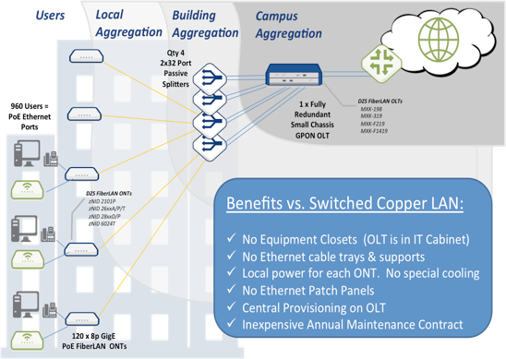
POL Architecture: Side by Side Comparison
Copper LAN Technology
Passive Optical LAN Technology
Side by Side Architecture Comparison

Slide 17
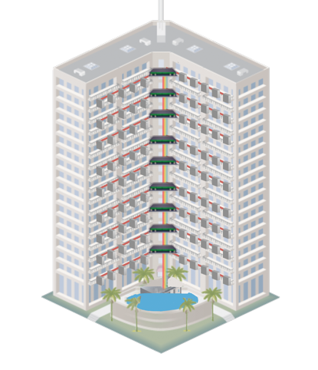
Before and the After of Copper LAN versus FiberLAN
Copper LAN
Before
FiberLAN
AFTER
Passive Optical Mux on each floor
Passive Optical Mux on each floor
Active components in the basement only
Notes:
LHS: Need building prepped – HVAC, power on each floor
RHS: on the right, active components down in the basement (MDU), don’t need active components on the floors so don’t need to condition the environment

Slide 18






























Select POL Customers
Hospitality | Education | Healthcare | Stadiums | Corporate Campus
Real Estate Development
New Vertical Strategy Targeting Emerging Markets (i.e., Russia / CIS / Middle East / Africa)

Slide 19


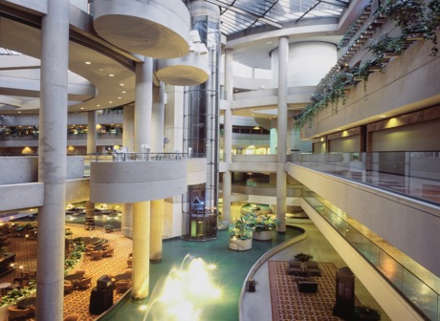
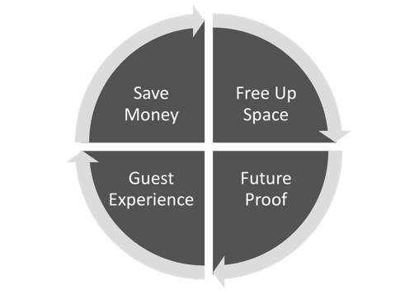







POL in Hospitality
Security Cameras
TV, Video
Hi Capacity Wi-Fi
Back Office
“We chose DZS POL because of its small footprint, high-bandwidth, low disruption to guests and its lifespan of more than 25 years – we need a solution that doesn’t have to be replace in the near future”
David Thompson, CIO, Pineapple Hospitality
Access Control / BMS

Slide 20
Passive Optical LAN (POL) Versus Legacy Copper LAN
POL Business case: Modernize a 30 year old Enterprise Copper Networking Architecture
POL CAPEX Advantage of 61% Savings versus Legacy LAN
      • New Cabling and Installs • Equipment Costs
POL OPEX Advantage of 54% Savings versus Legacy LAN
  • Power • Floor space • Service contracts • Fault management • Testing and certification • Capacity management • Network upgrades/patches • Preventive maintenance • Training. • Eco-Friendly - Green
POL TCO Advantage of 58% Savings versus Legacy LAN
  • Bandwidth Future Proof • SDN and NFV Ready

