Slide 1

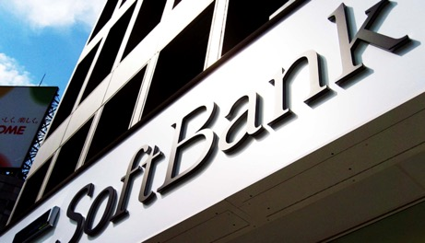

Challenge | Results
Upgrade mobile backhaul network prepared for 3G / LTE with existing ATM network Limited fiber availability due to leasing fibers from incumbent carriers | Softbank mobile business has grown dramatically becoming No. 3 to No. 1 in Japan. DZS’s mobile backhaul is one of the success factor of Softbank’s excellence FTTH based mobile backhaul architecture demonstrated it’s viability with this reference
Solution
DZS’ G-PON based mobile backhaul solution has provided excellent performance on cost, reliability, and future readiness Sole supplier for whole country coverage with thousands of OLTs
Products:
OLT : V5848G
ONT : M1100, H650 Series
Mobile Backhaul

Slide 2


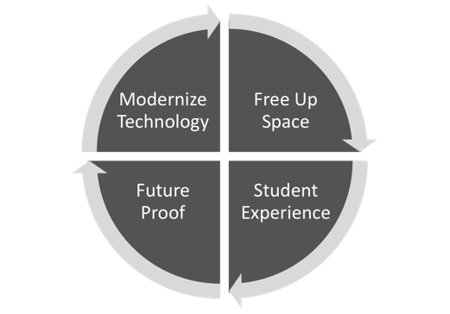
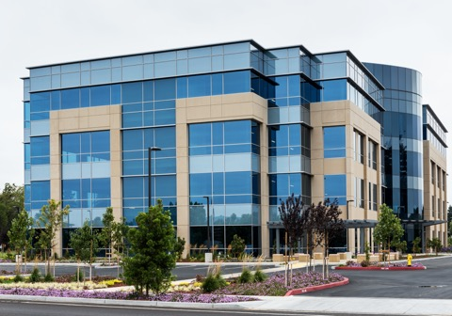







POL In Corporate Campuses
Security Cameras
Access Control / BMS
Hi Capacity Wi-Fi
Back Office
“We needed a broadband network with screaming speeds. DZS provided the key access solutions to make it happen.”
Cheri Beranek, CEO and President, Clearfield, Inc.
TV, Video

