Slide 1

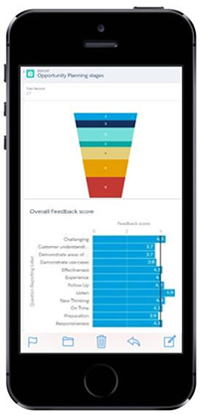

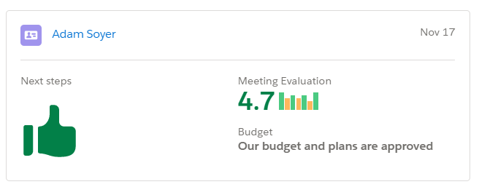

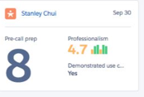

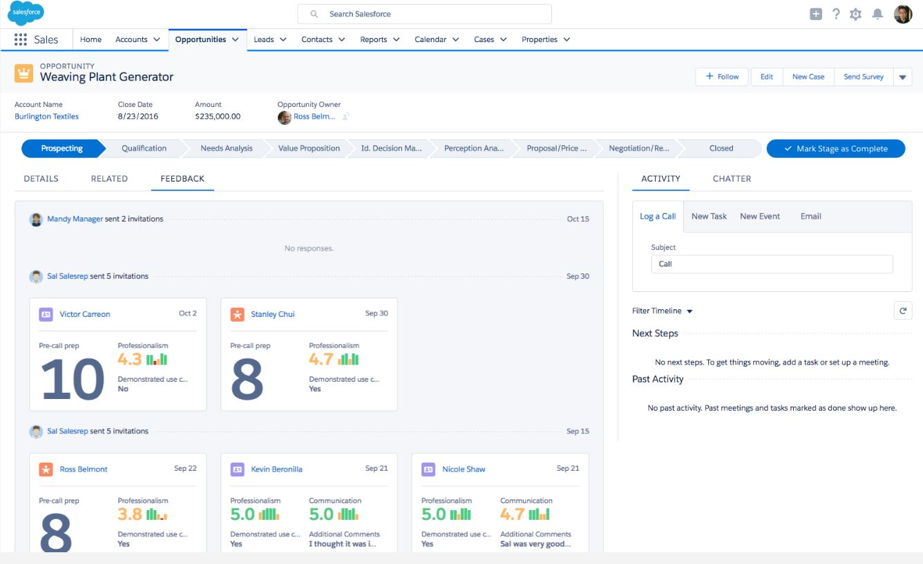
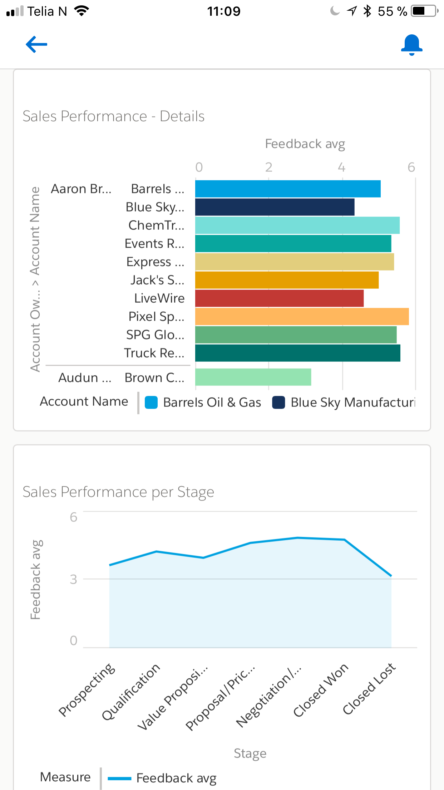
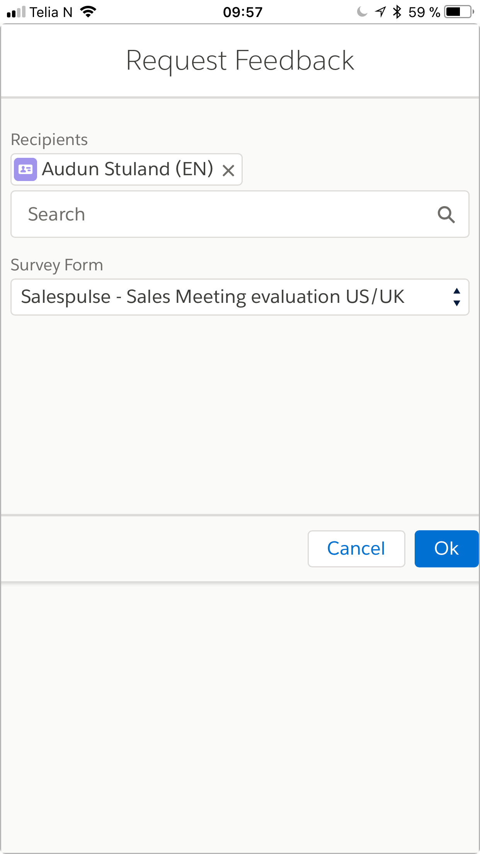
Get insight into every sales meeting in your organization
Sales Manager: How did the sales meeting go?
Sales Rep: Fantastic!
Sales Manager: That is not what the customer is saying. Look at the instant feedback in Salesforce. They don’t see the link between our solution and their industry
Sales Rep: Aha! I misread them in the meeting then…I will contact them again now!

Slide 2
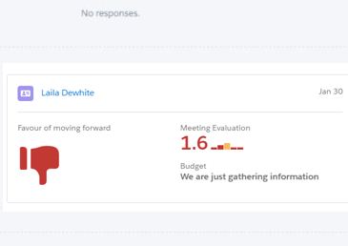

GET INSIGHT INTO EVERY SALES MEETING
1
Watch Demo
INCREASE HIT RATE
BOOST SALES COACHING
INCREASE TRANSPARENCY
INCREASE YOUR HIT RATE BY 10%

Slide 3



In today’s world, real-time feedback is key to differentiating and understanding your customers buying journey
SALES PROCESS
LEADS
TARGET VERIFICATION
QUALIFICATION
CUSTOMER INTERACTIONS
NEGOTIATION
CONTRACT
SIGNED
Discovery
Demonstrate Solution
COACHING - SALESPULSE
SELF REFLECTIONS - SALESPULSE
Sales manager: Are you spending your coaching time on the right people and on the right areas?
Am I really good at listening to the customer and understanding there needs?
Salespulse gathers the prospect’s and customer’s feedback during the sales process
?
PRIORITIZATION - SALESPULSE
?
?
?
?
Are you more or less in favor of buying after our meeting
VALUE - SALESPULSE
RELEVANCE - SALESPULSE
Sales manager: Is my sales team adding value to the customer in their dialogue?
Did the prospect see potential in his industry? Was there anything he was missing?

Slide 4
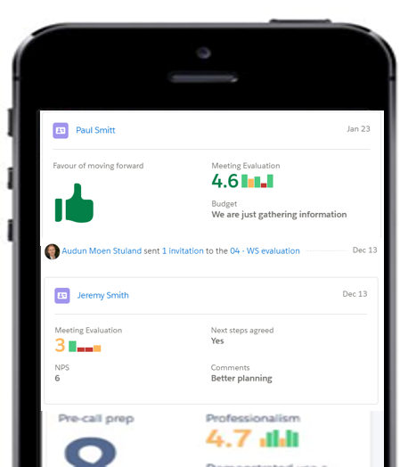
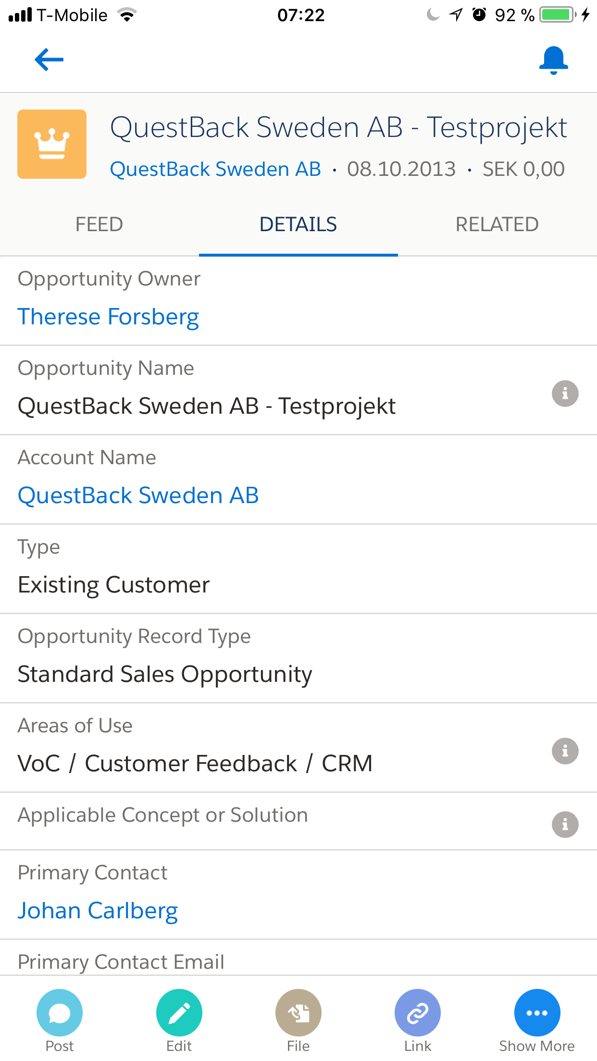
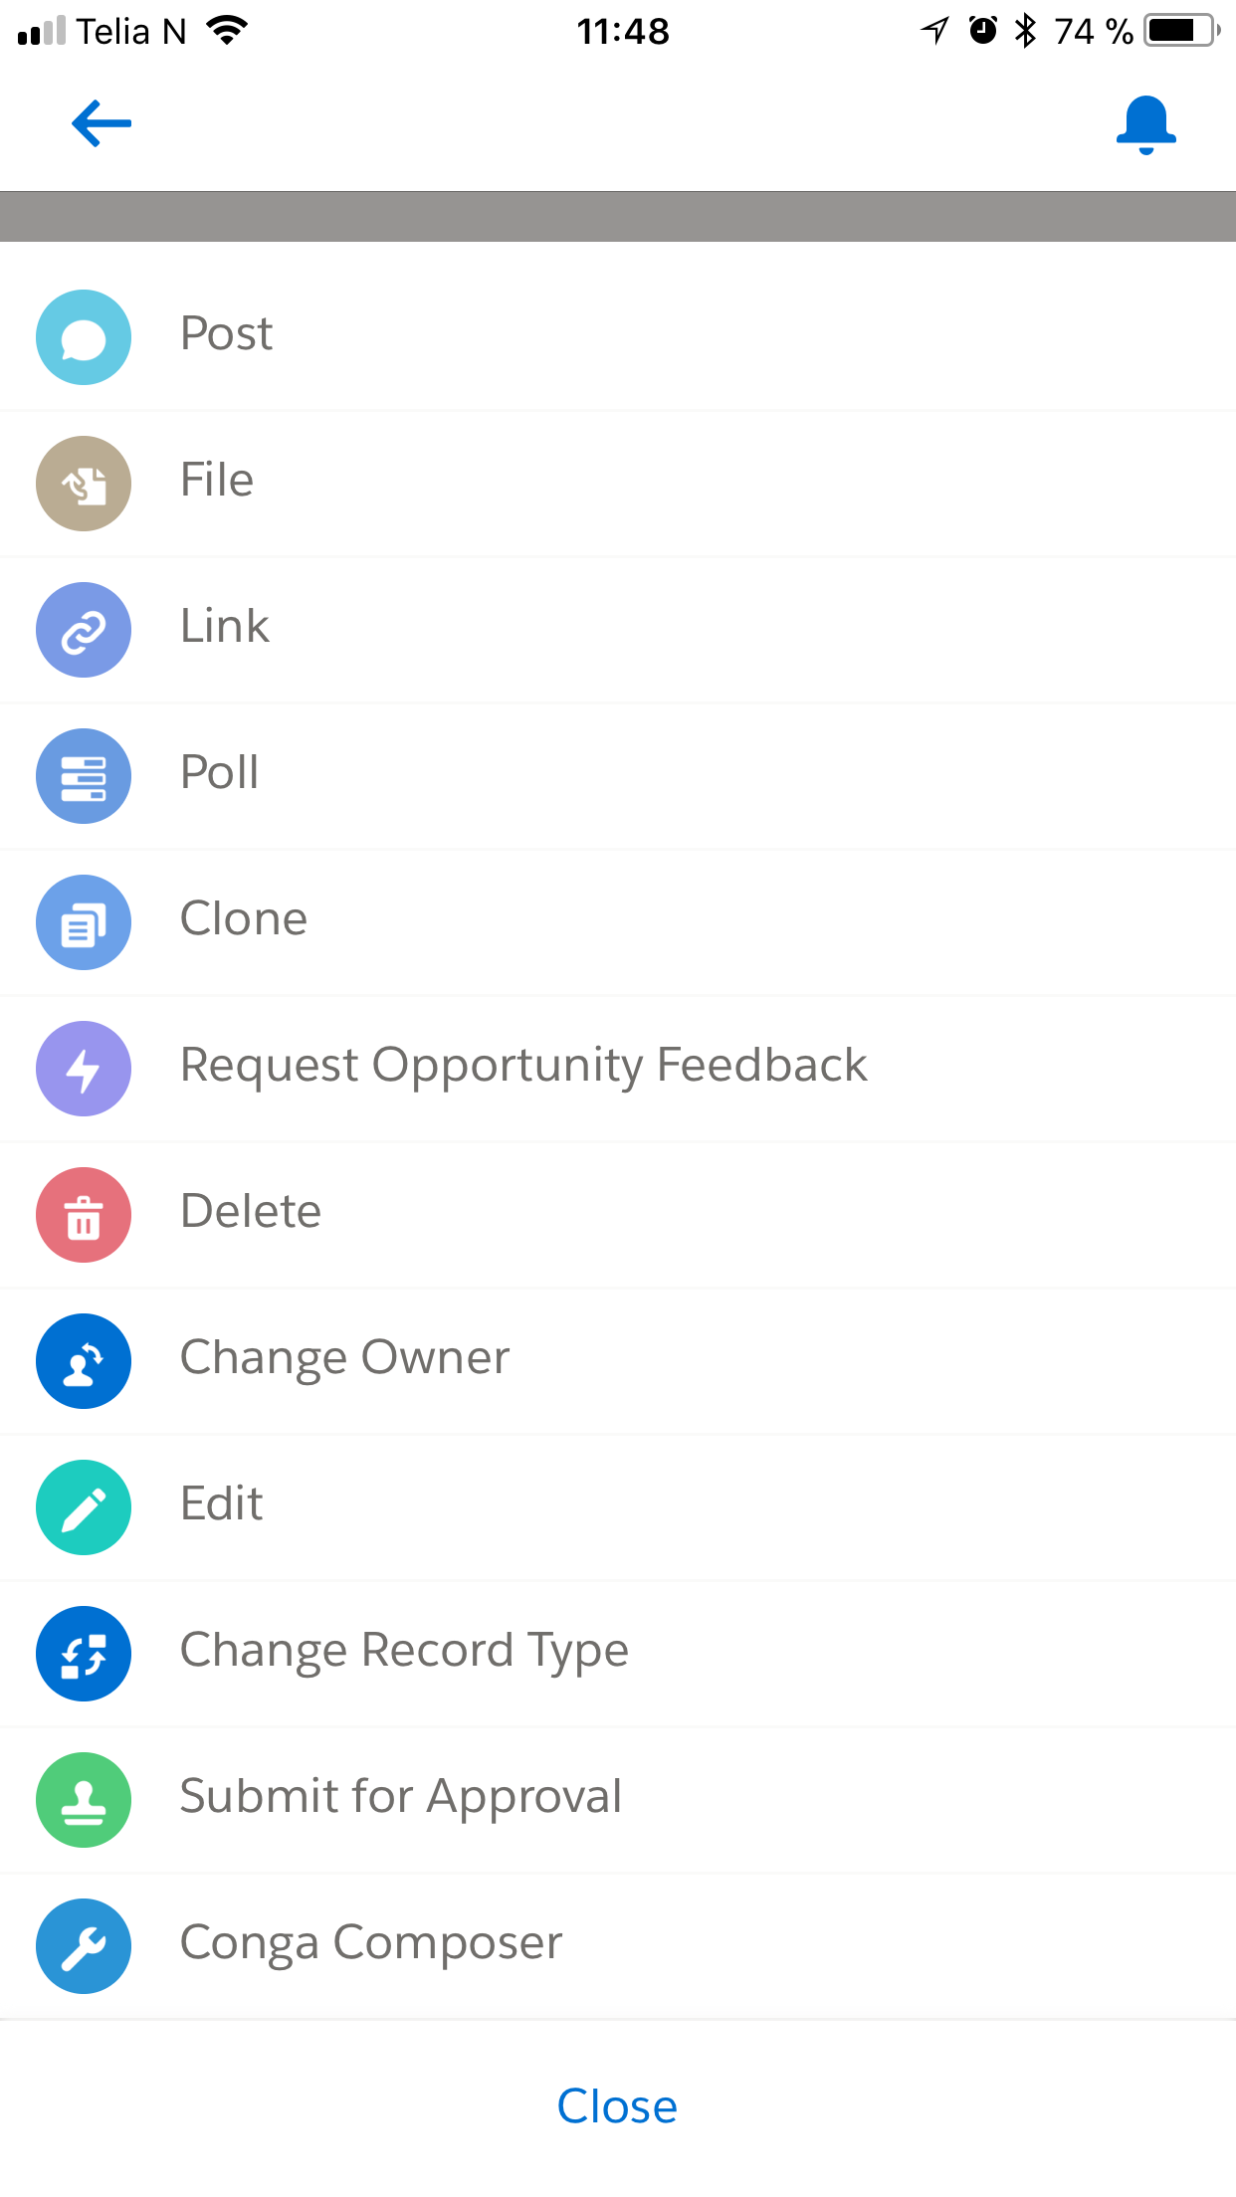

2
INCREASE SALES REPS ABILITY TO MAKE
THE RIGHT DECISIONS
?
?
?
?
?
Demonstrate Solution
REQUEST FEEDBACK AFTER A SALES MEETING IN A MATTER OF SECONDS
ACT IMMEDIATELY ON INSIGHTS FROM THE PROSPECT
COACH YOUR SALES REPS IN REAL TIME

Slide 5
Salespulse is a solution to increase sales reps ability to act on real time feedback after sales meetings
1
GET INSIGHT INTO EVERY SALES MEETING
?
?
?
?
?
Demonstrate Solution
REQUEST FEEDBACK AFTER A SALES MEETING IN A MATTER OF SECONDS
ACT IMMEDIATELY ON INSIGHTS FROM THE PROSPECT

Slide 6
SALES MEETING
Increased ability to understand prospects
Visability and understanding into pipeline forecasting
Self reflections and own development
SALES REP
PROSPECT
Demonstrate Solution
How did it go in the sales meeting?
Fantastic! Everyone was really positive. The see a clear need for our solution
That is not what the customer is saying. Look at the feedback in Salesforce. They don’t see the link between what we offer and their industry
Aha! I misread them in the meeting…I will get on the phone with them and correct this
SALES MANAGER
SALES REP
SALES MANAGER
SALES REP

Slide 7
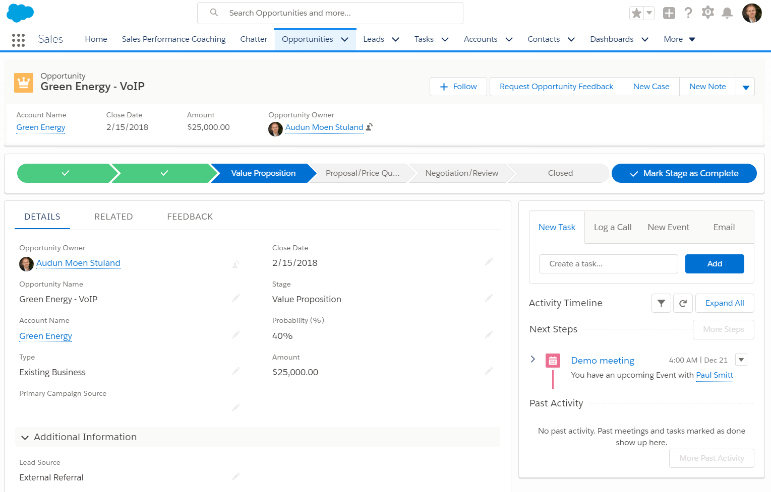
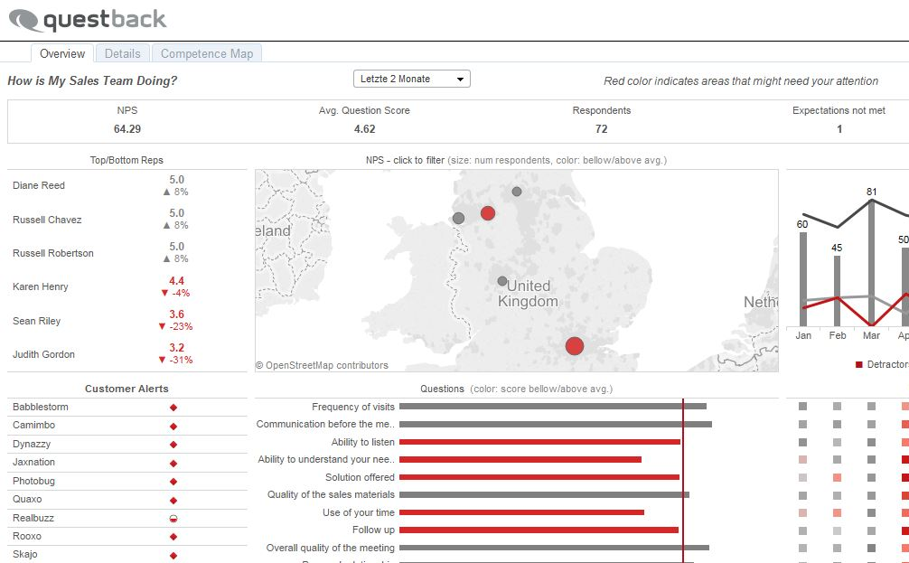
Fully automated directly in the sales process and opportunity journey in Salesforce
Automatically request feedback from the prospects at key changes in the opportunity journey or after sales meetings
Request feedback with the push of one button
...or...
Salespulse can trigger a survey automatically based on changes to any of these fields
ALL FUNCTIONALITY AVAILABLE IN CLASSIC AND LIGHTNING

Slide 8
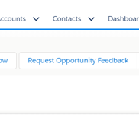

3
COLLECT FEEDBACK FROM PROSPECTS AT
KEY AREAS OF YOUR SALES PROCESS
Request feedback with the push of one button
...or...
trigger a survey automatically based on changes to any field in Salesforce
ALL FUNCTIONALITY AVAILABLE IN CLASSIC AND LIGHTNING
INCREASE TRANSPARENCY IN YOUR OPPORTUNITIES

Slide 9
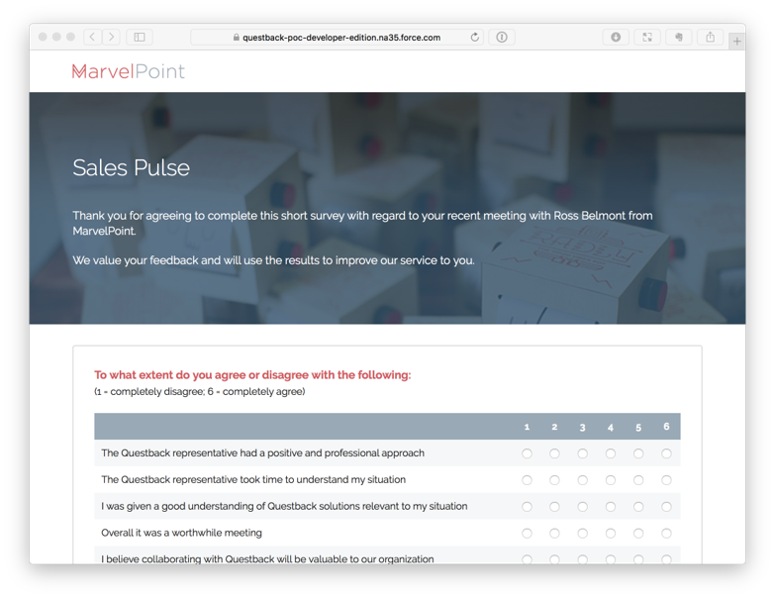
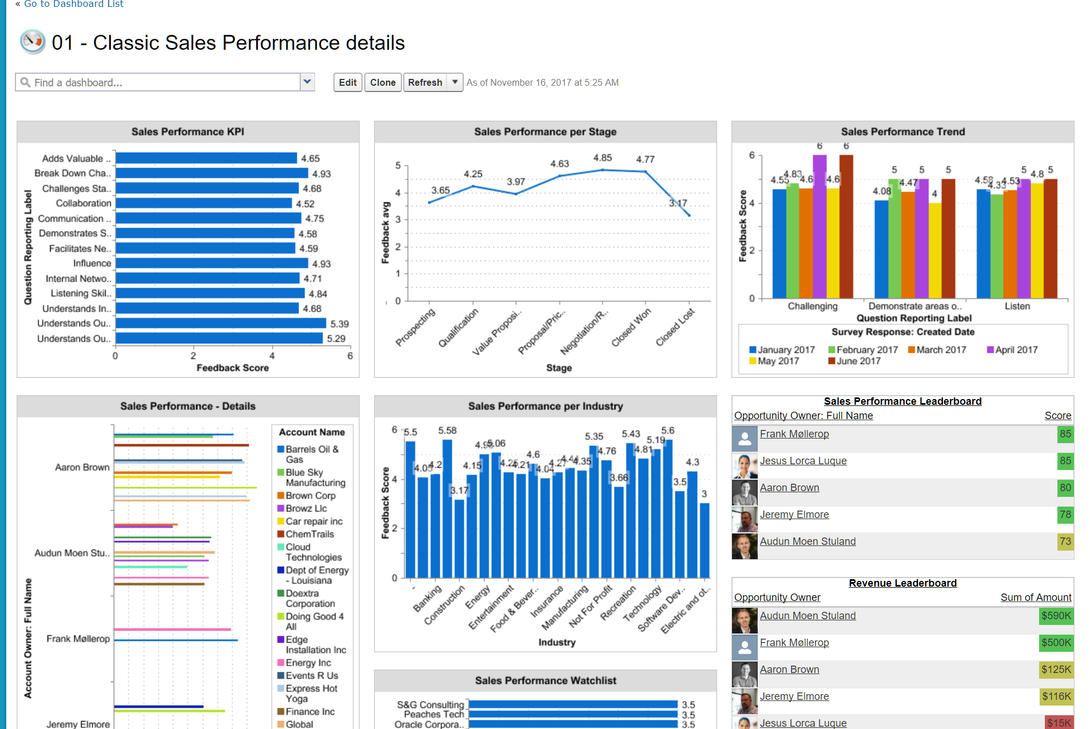
4
INSTALLATION AND CONFIGURATION IN
30 MINUTES
Salespulse is a managed package and includes
5 survey templates
10 prebuilt reports
2 prebuilt dashboards
IDENTIFY YOUR SALES REPS STRENGTHS AND WEAKNESSES

Slide 10
Fully automated directly in the sales process and opportunity journey in Salesforce
Automatically request feedback from the prospects at key changes in the opportunity journey or after sales meetings
Request feedback with the push of one button
...or...
Salespulse can trigger a survey automatically based on changes to any of these fields
ALL FUNCTIONALITY AVAILABLE IN CLASSIC AND LIGHTNING

Slide 11
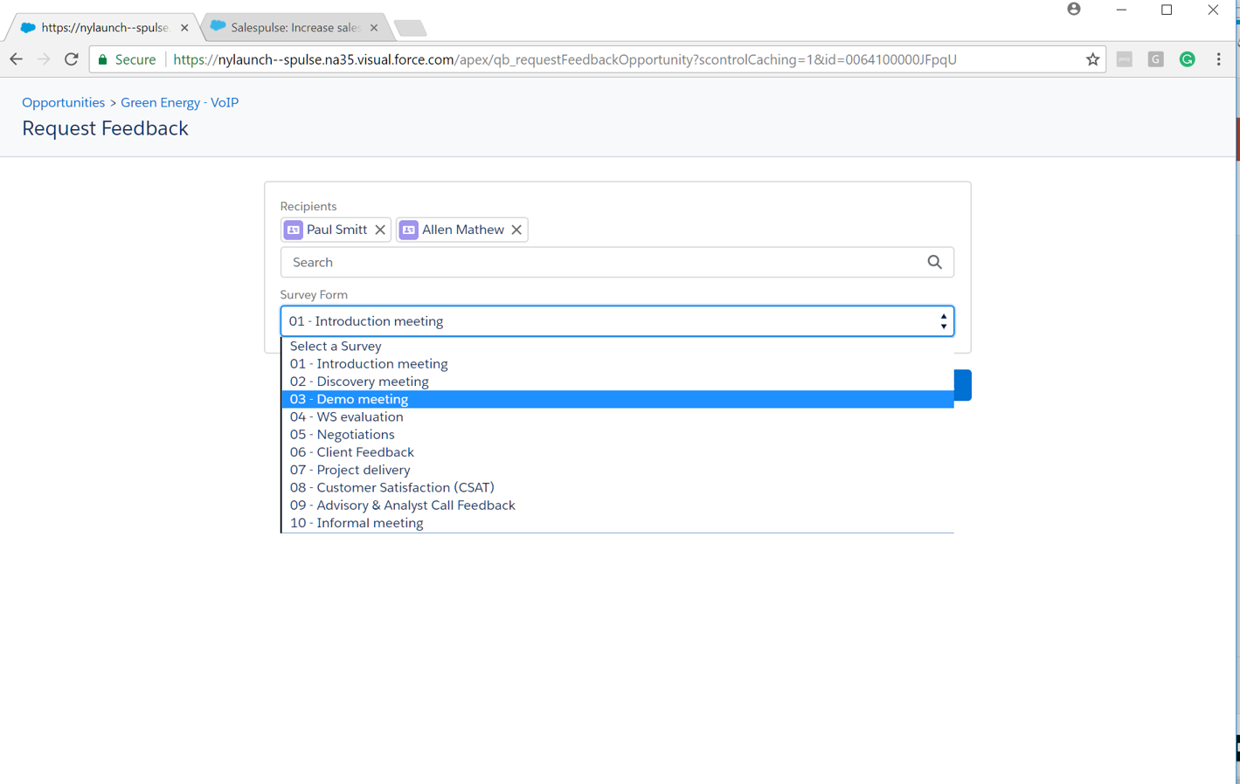
Request feedback from prospects immidatly after your meeting to get their reactions and sentiment
Request feedback based on what kind of meeting you had with the customer
Ask different questions at different stages of your sales cycle or depending on what kind of meeting it was

Slide 12
5
ANALYZE PROSPECTS REACTIONS AND
SENTIMENTS IMMEDIATELY AFTER YOUR MEETINGS
Request feedback based on what kind of meeting you had with the customer
Ask different questions at different stages of your sales cycle
DETECT MISSING INFORMATION AND MISUNDERSTANDINGS
AND ADRESS THEM IMMEDIATELY

Slide 13
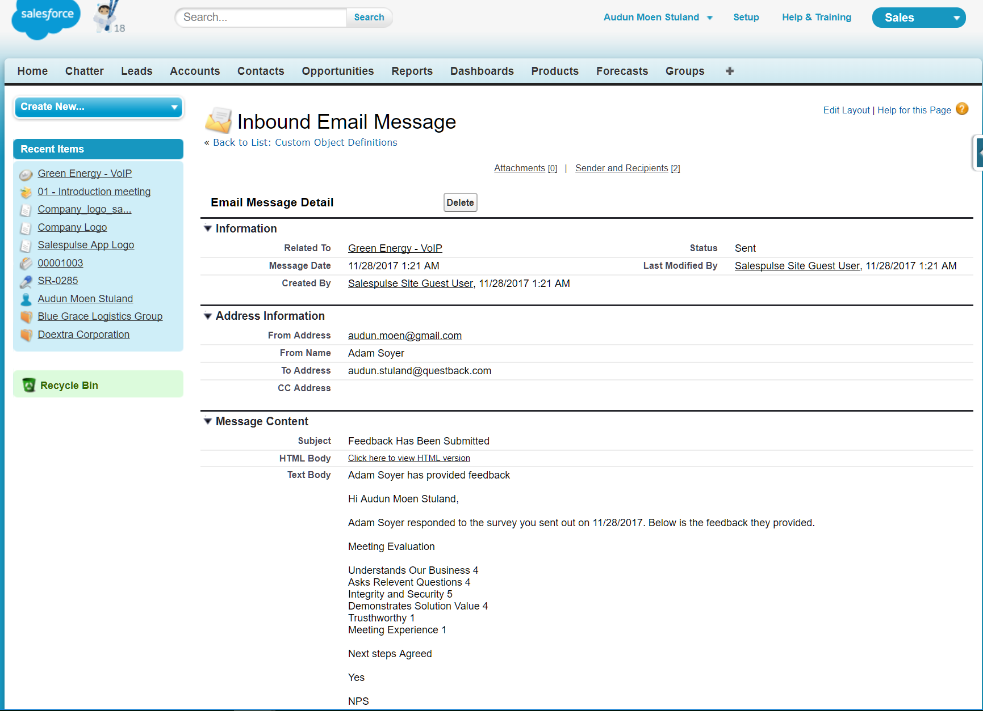
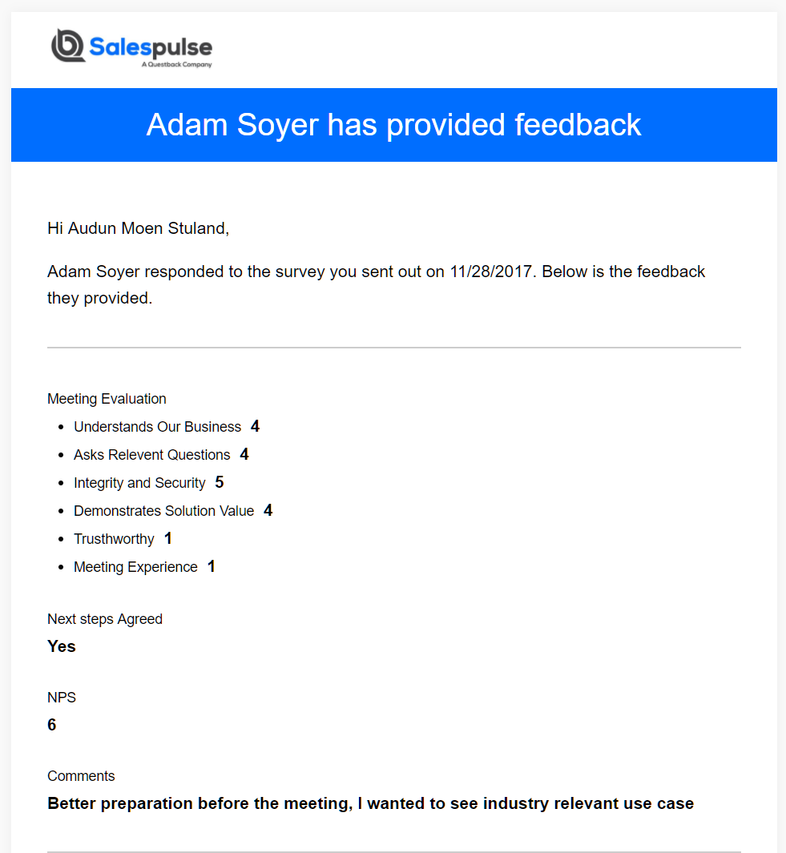
6
INCREASE THE CHANCE OF CLOSING BY
RECONNECTING BASED ON THE FEEDBACK
Detect shortcomings with the prospect immediately and reconnect
Sales reps can better understand their strengths and weaknesses as perceived by their prospects and customers
GIVE YOUR SALES TEAM A TOOL FOR SELF-DEVELOPMENT

Slide 14
Sales reps receives feedback instantly on their Opportunity in Salesforce – Great chance to reconnect
Detect shortcomings with the prospect immediately
Great reason to reconnect with the prospect discussing their feedback
Sales reps can understand their strengths and weaknesses as perceived by their prospects and customers

Slide 15
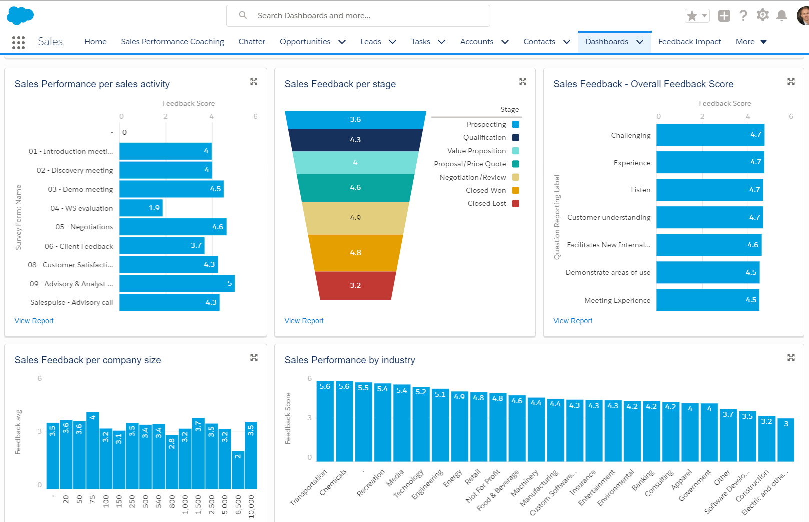
7
ANALYZE SALES PERFORMANCE AT
EVERY STAGE OF YOUR SALES CYCLE
Analyze sales feedback pr sales activity, company size or industry
Are your sales reps better working with a specific industry or during certain stages in the sales process?
Use this data to know what to coach on and increase the ability for self- reflections
DETECT WHERE TO FOCUS YOUR TEAM IMPROVEMENTS

Slide 16
Analyze sales performance at each stage of your sales process to understand where to focus your improvements
Analyze sales feedback pr sales activity, company size or industry
Are your sales reps better working with a specific industry or during certain stages in the sales process?
Use this data to know what to coach on and increase the ability for self- reflections

Slide 17
View historical feedback on accounts and contacts to better serve your customers and contacts in the future
Feedback cards to visualize each interaction with a customer
Increase customer loyalty and upsell potential by understanding how to treat the contact going forward

Slide 18
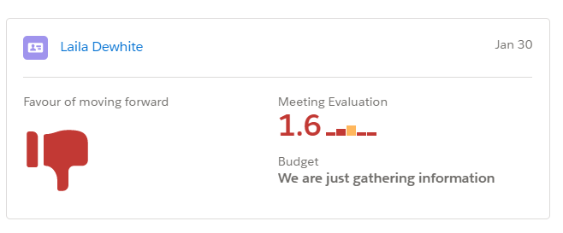
View historical feedback on accounts and contacts to better serve your customers and contacts in the future
Feedback cards to visualize each interaction with a customer
Increase customer loyalty and upsell potential by understanding how to treat the contact going forward

Slide 20
8
HISTORICAL FEEDBACK WILL HELP YOU
UNDERSTAND!
Feedback cards help visualize each interaction with a customer
Increase customer loyalty and upsell potential by understanding how to treat the contact at each stage of the sales process
TREAT CONTACTS INDIVIDUALLY BASED
ON YOUR HISTORY WITH THEM

Slide 21
View historical feedback on accounts and contacts to better serve your customers and contacts in the future
Feedback cards to visualize each interaction with a customer
Increase customer loyalty and upsell potential by understanding how to treat the contact at each stage of the sales process

Slide 22
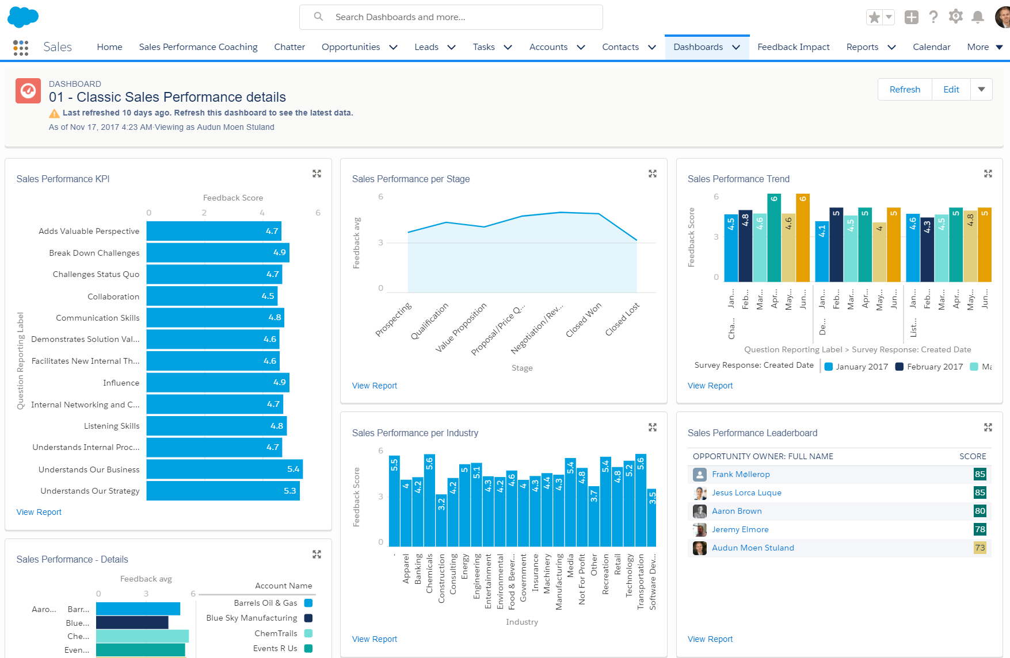
Analyze sales performance looking at your sales team from the customers point of view
Capture important trends in your sales reps performance and discover early signs for coaching
Sales feedback leaderboard to foster competition

Slide 23
9
ANALYZE YOUR SALES TEAM FROM
THE CUSTOMERS POINT OF VIEW
Capture important trends in your sales reps performance and discover early signs for coaching
TAILORED SALES TRAINING TO EACH SALES REP

Slide 24
10
ALL SALESPULSE FUNCTIONALITY AVAILABLE
IN SALESFORCE CLASSIC AND LIGHTNING
ENRICH YOUR STANDARD SALES DASHBOARDS
WITH SALES FEEDBACK DATA

Slide 25
All Salespulse functionality availabel in Classic and Lightning
10 Pre-built reports available as part of the managed package
2 Pre-built dashboards to start analyzing the feedback data instantly

Slide 26
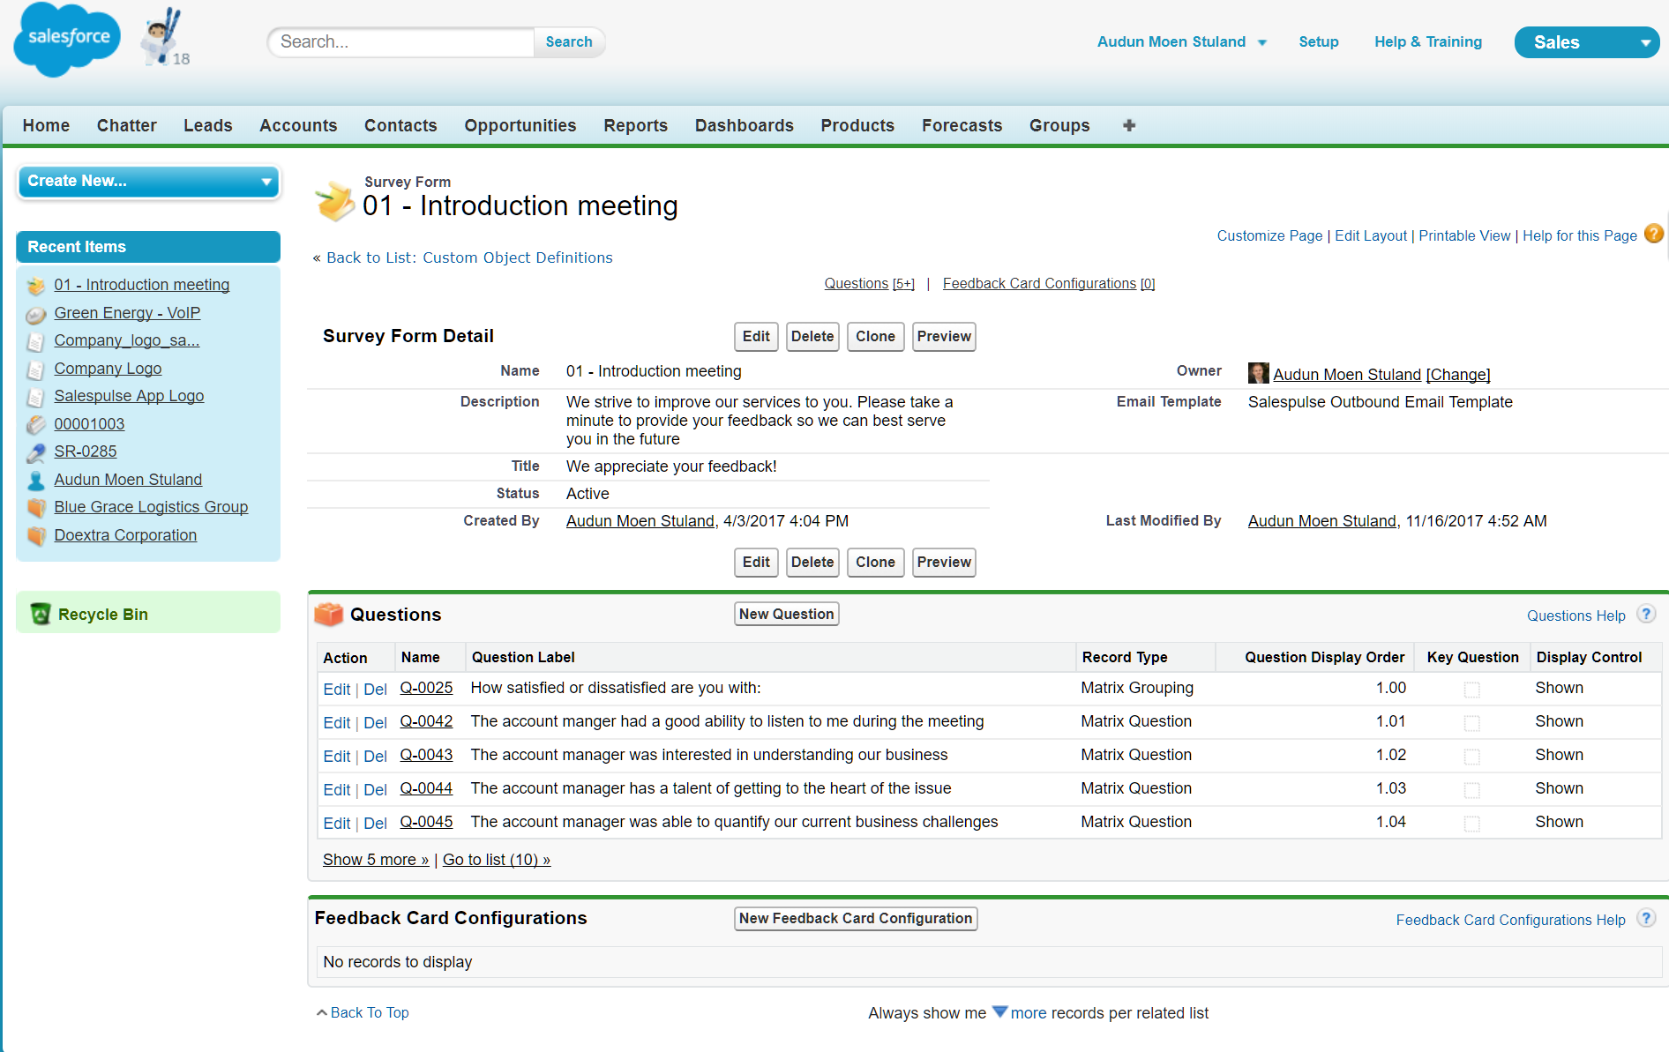
Configure and make changes easily to your surveys in your Salesforce user interface – lightning or classic
5 Pre-built survey templates for the following sales methodologies
Challenger
Customer centric
Target account selling
SPIN
Net Promoter Score

Slide 27
11
MAKE CHANGES EASILY TO YOUR SURVEYS IN
YOUR STANDARD USER INTERFACE
QUICLY ADAPT TO CHANGES IN YOUR SALES ORGANIZATION

Slide 28
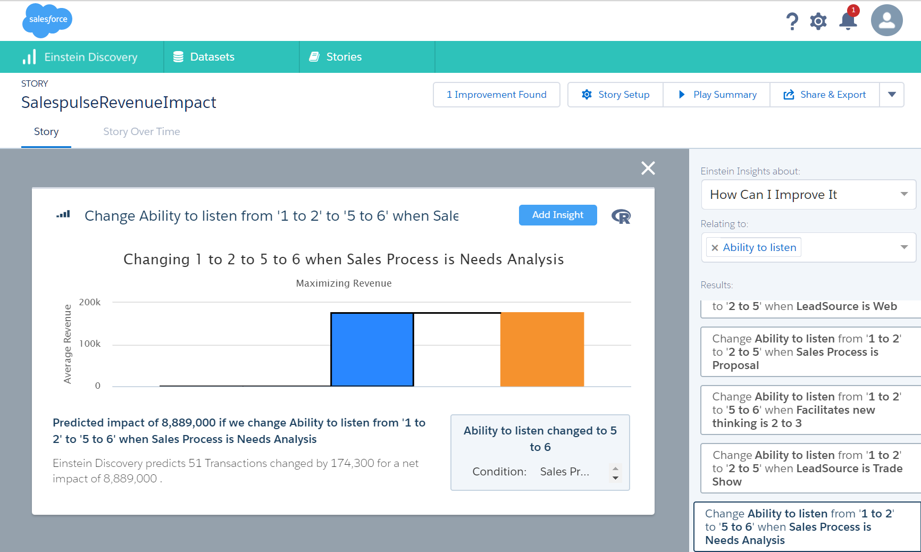
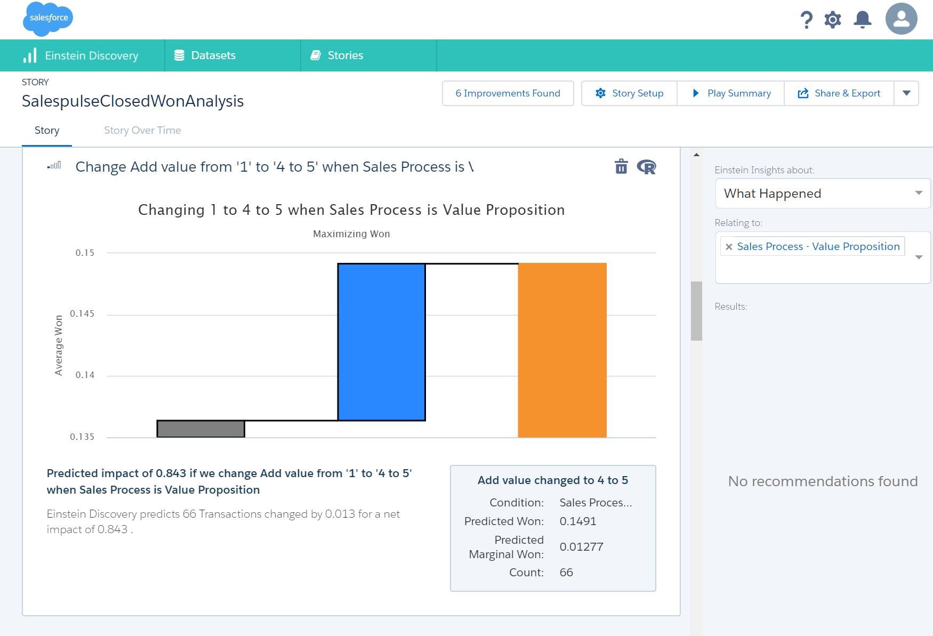
12
SALESFORCE EINSTEIN ANALYZES YOUR SALES
FEEDBACK AND TELLS YOU HOW TO IMPROVE
EINSTEIN SUGGESTION:
“Change Ability to listen from 1-2 to 5-6 when Sales process is Needs analysis will have an impact on 51 transactions for a net impact of USD 8,889 Millions”
WHAT ARE YOU WAITING FOR? DOWNLOAD NOW

Slide 29











Great customer feedback from initial customers
“I found the app was easy to install, set up and start collecting feedback. It has sharpened how we approach our sales cycles and become an integral learning tool that feeds our continual improvement approach to business. It’s a great app and I am glad we took the leap”
GEORGE KENNESEY, CEO, APPIPHONY
“Salespulse is a great addition to our coaching sessions. We now have the customers viewpoint on our Sales reps strengths and weaknesses and can coach our sales reps based on more than financial and activity data. Sales reps are also becoming more self-aware of their strengths and weaknesses and they get instant feedback on the effect of their sales training put in practice”
OLAFUR THORKELSON CEO, DATA DWELL
Looking for feedback? Salespulse is the best choice to start your business!
Thanks to the app's support team I learned about all the options that this app can offer you (more than you can see), so I'm very happy to have chosen Salespulse for my feedback needs. I highly recommend!
JAVIER BELAUNDE, DIRECTOR OF MARKETING,TRIPSUM

Slide 30
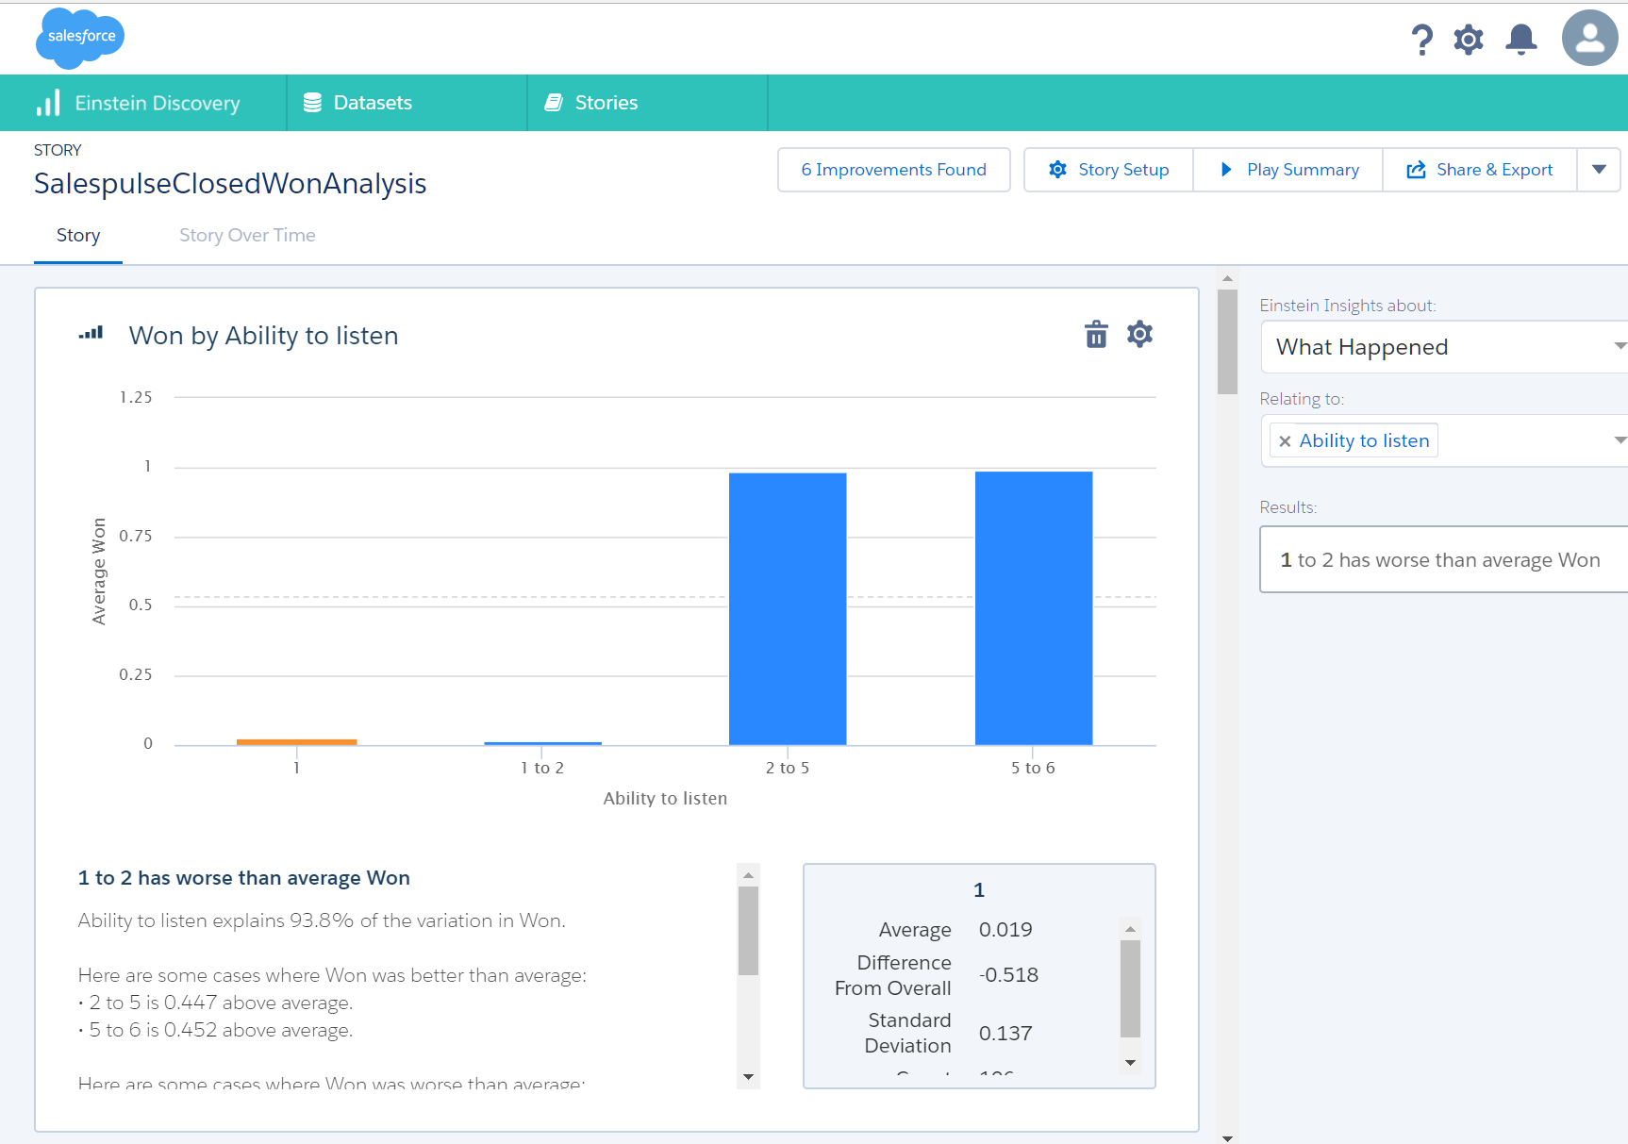
”Your ability to listen in customer meetings” explains 93.8% of the variation of closed won

Slide 31
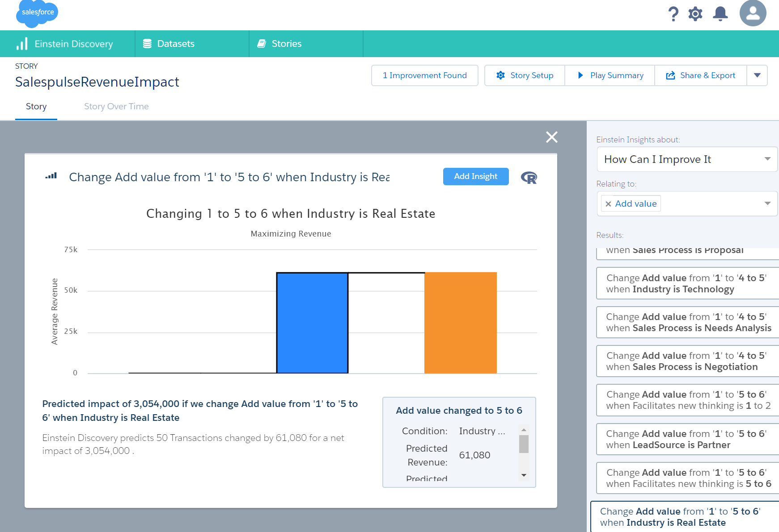
Increasing your ability to “add value” to your prospects in Real Estate will have an impact of 3mill USD

Slide 32
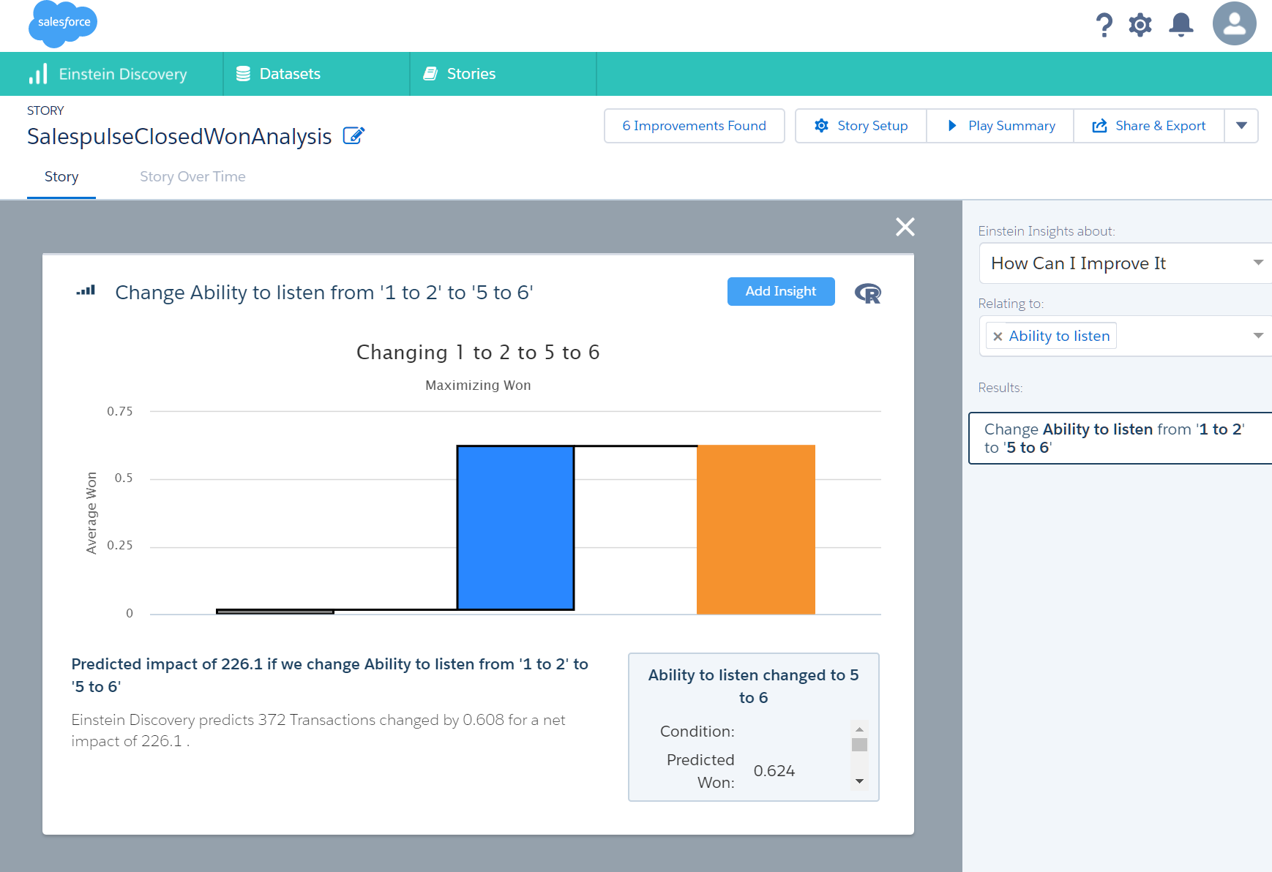
Compelling story with Qualitative (behaviour) data together with Salesforce Quantitative

Slide 33
Compelling story with Qualitative (behaviour) data together with Salesforce Quantitative

