Slide 1
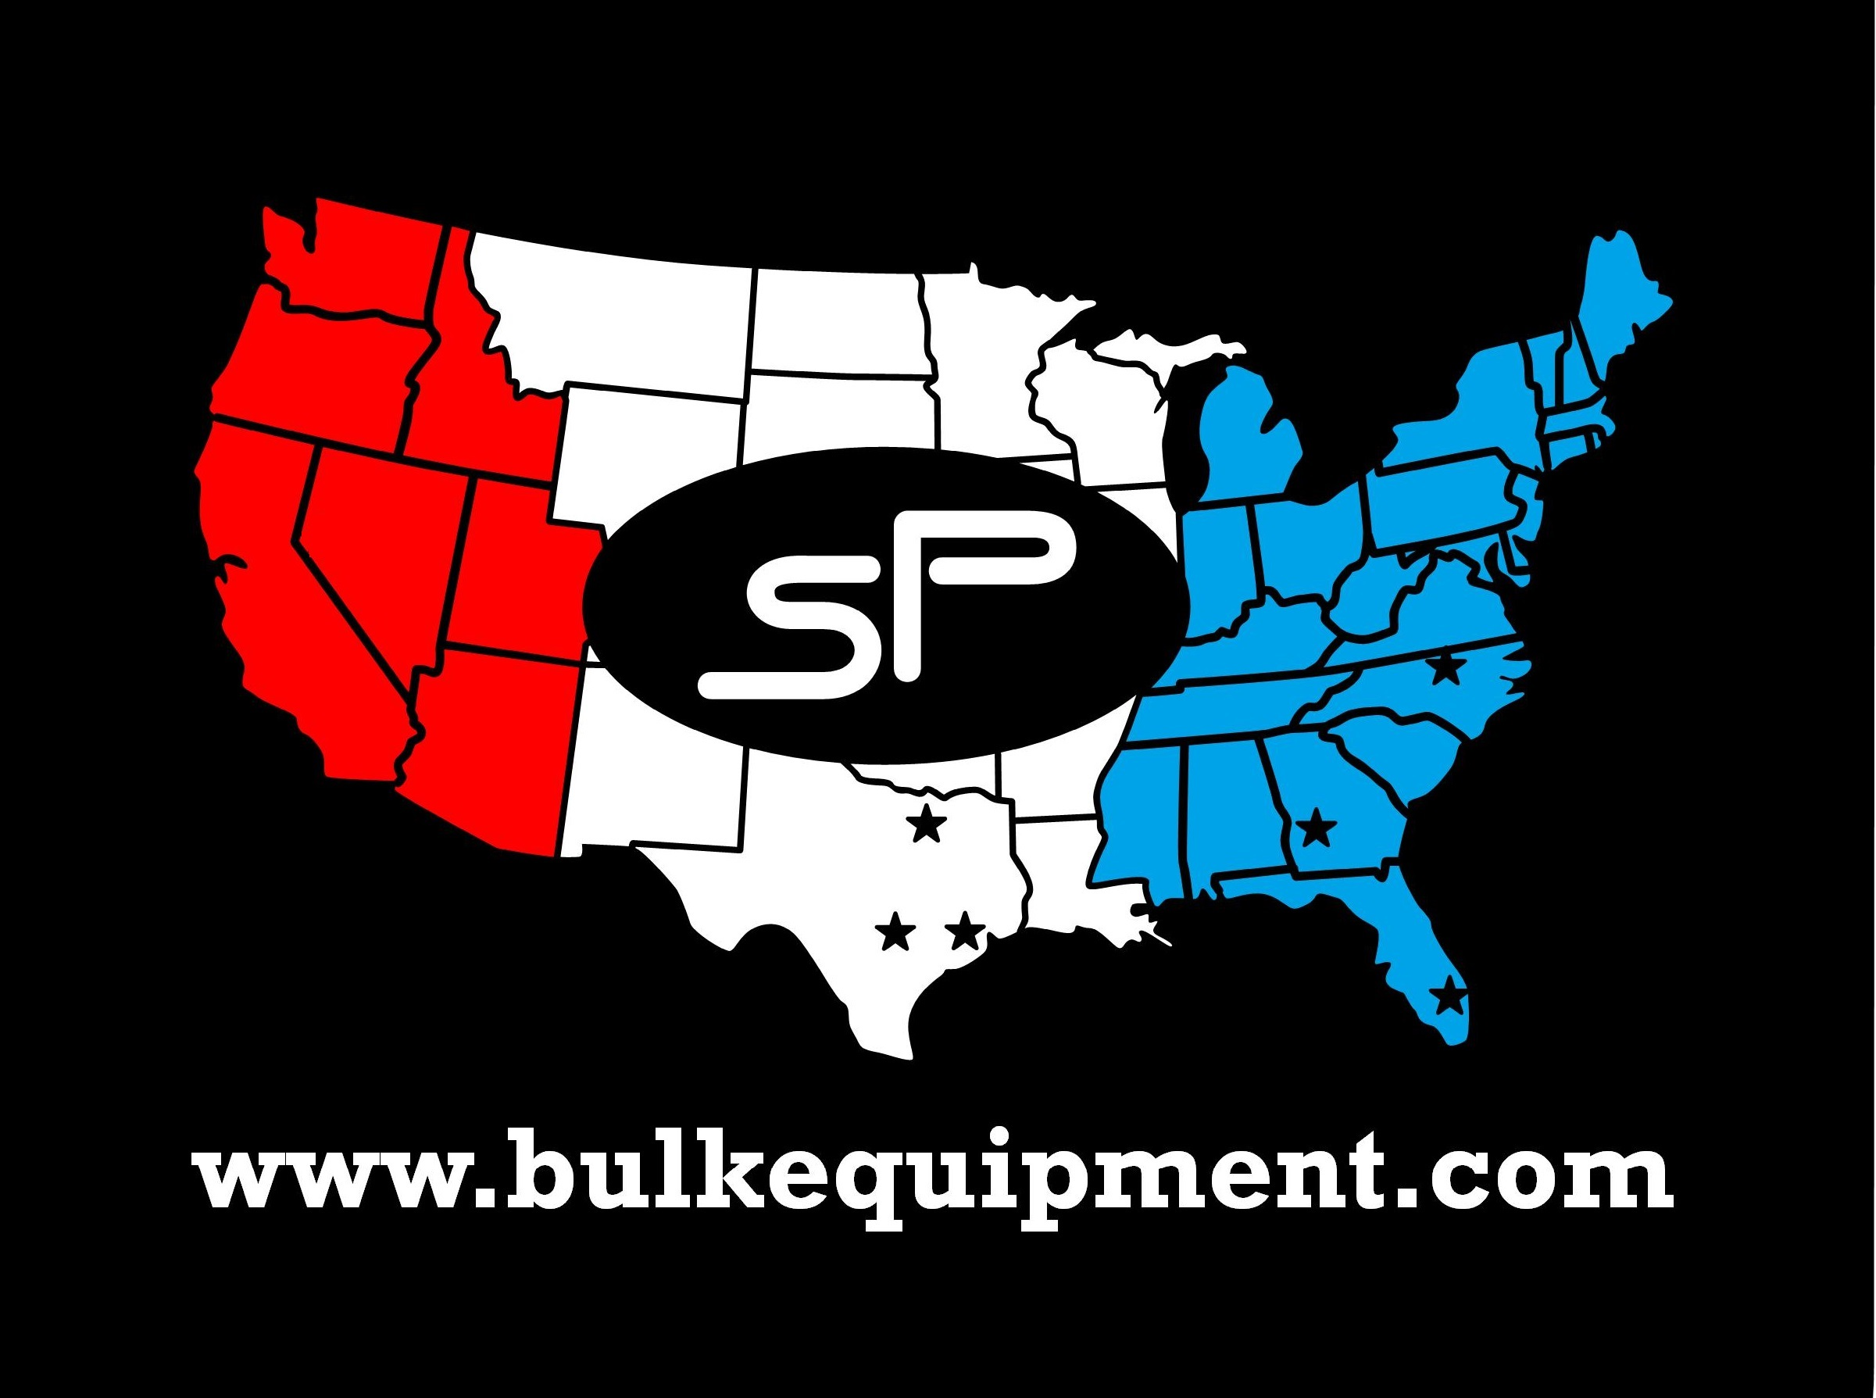

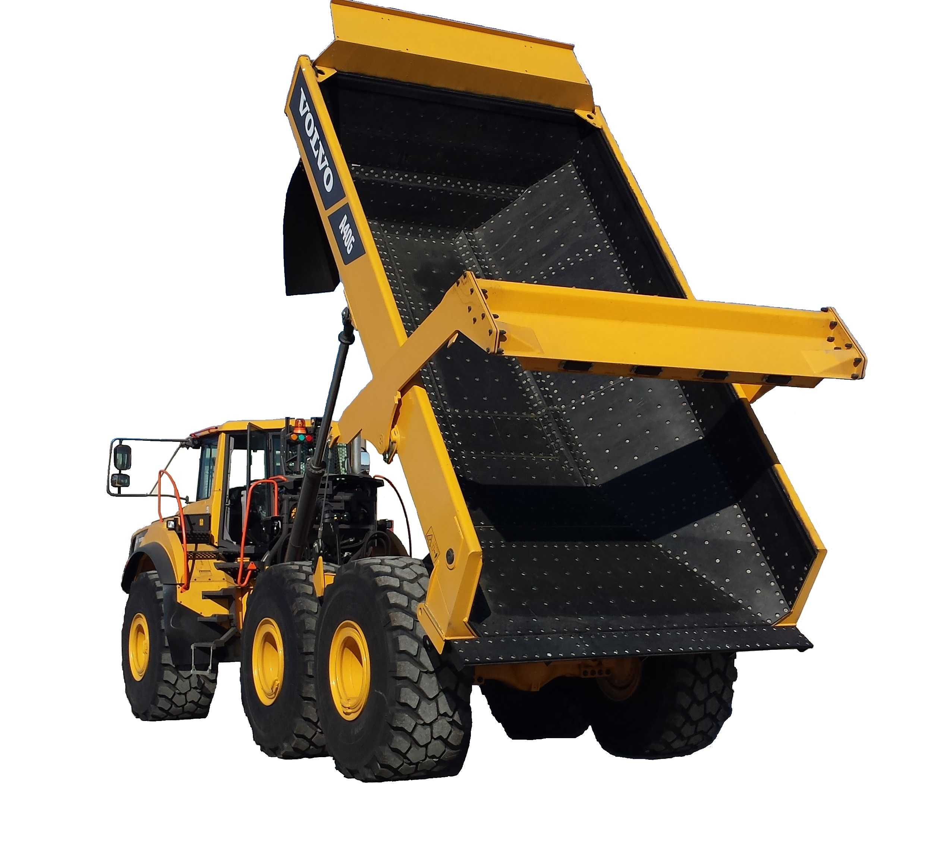

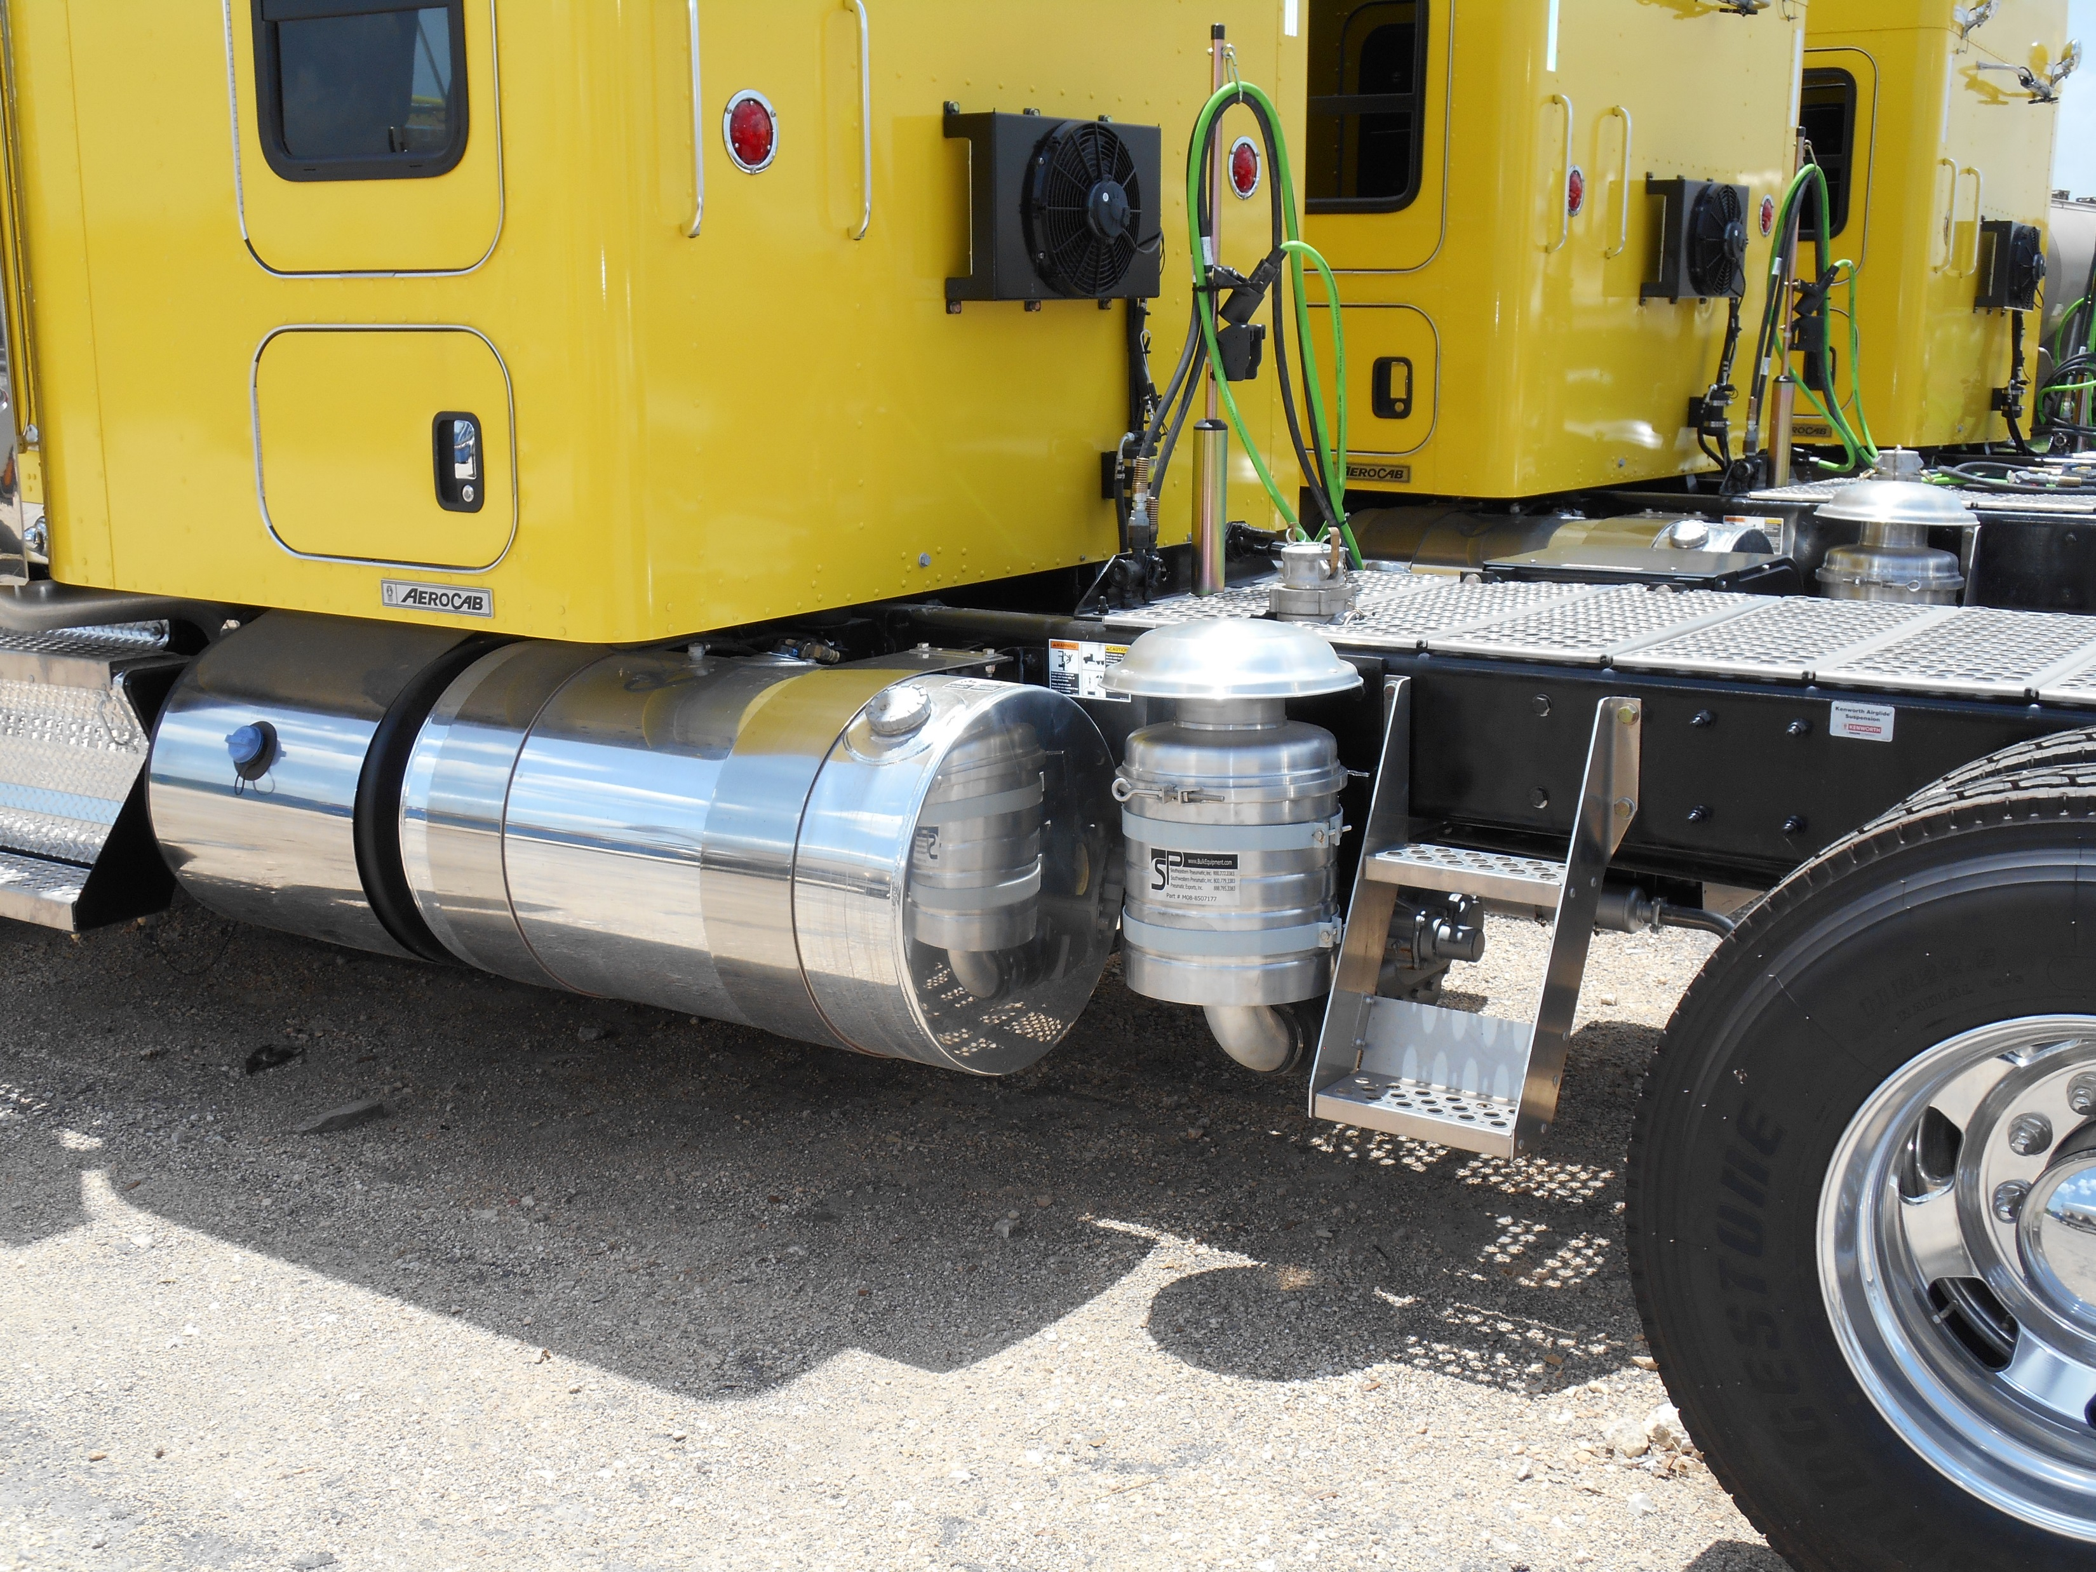
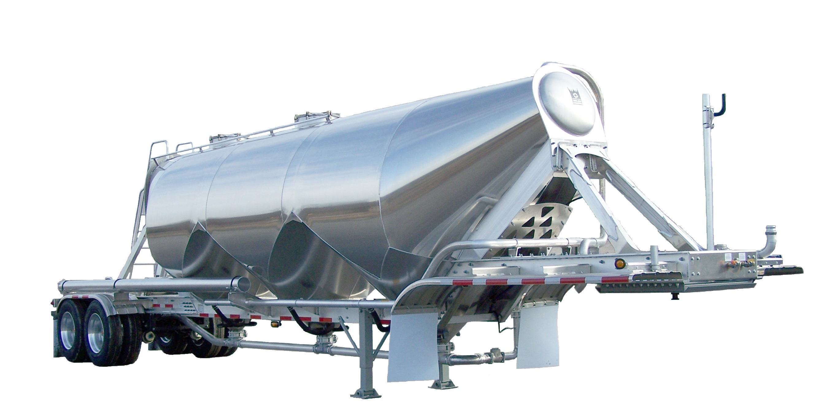
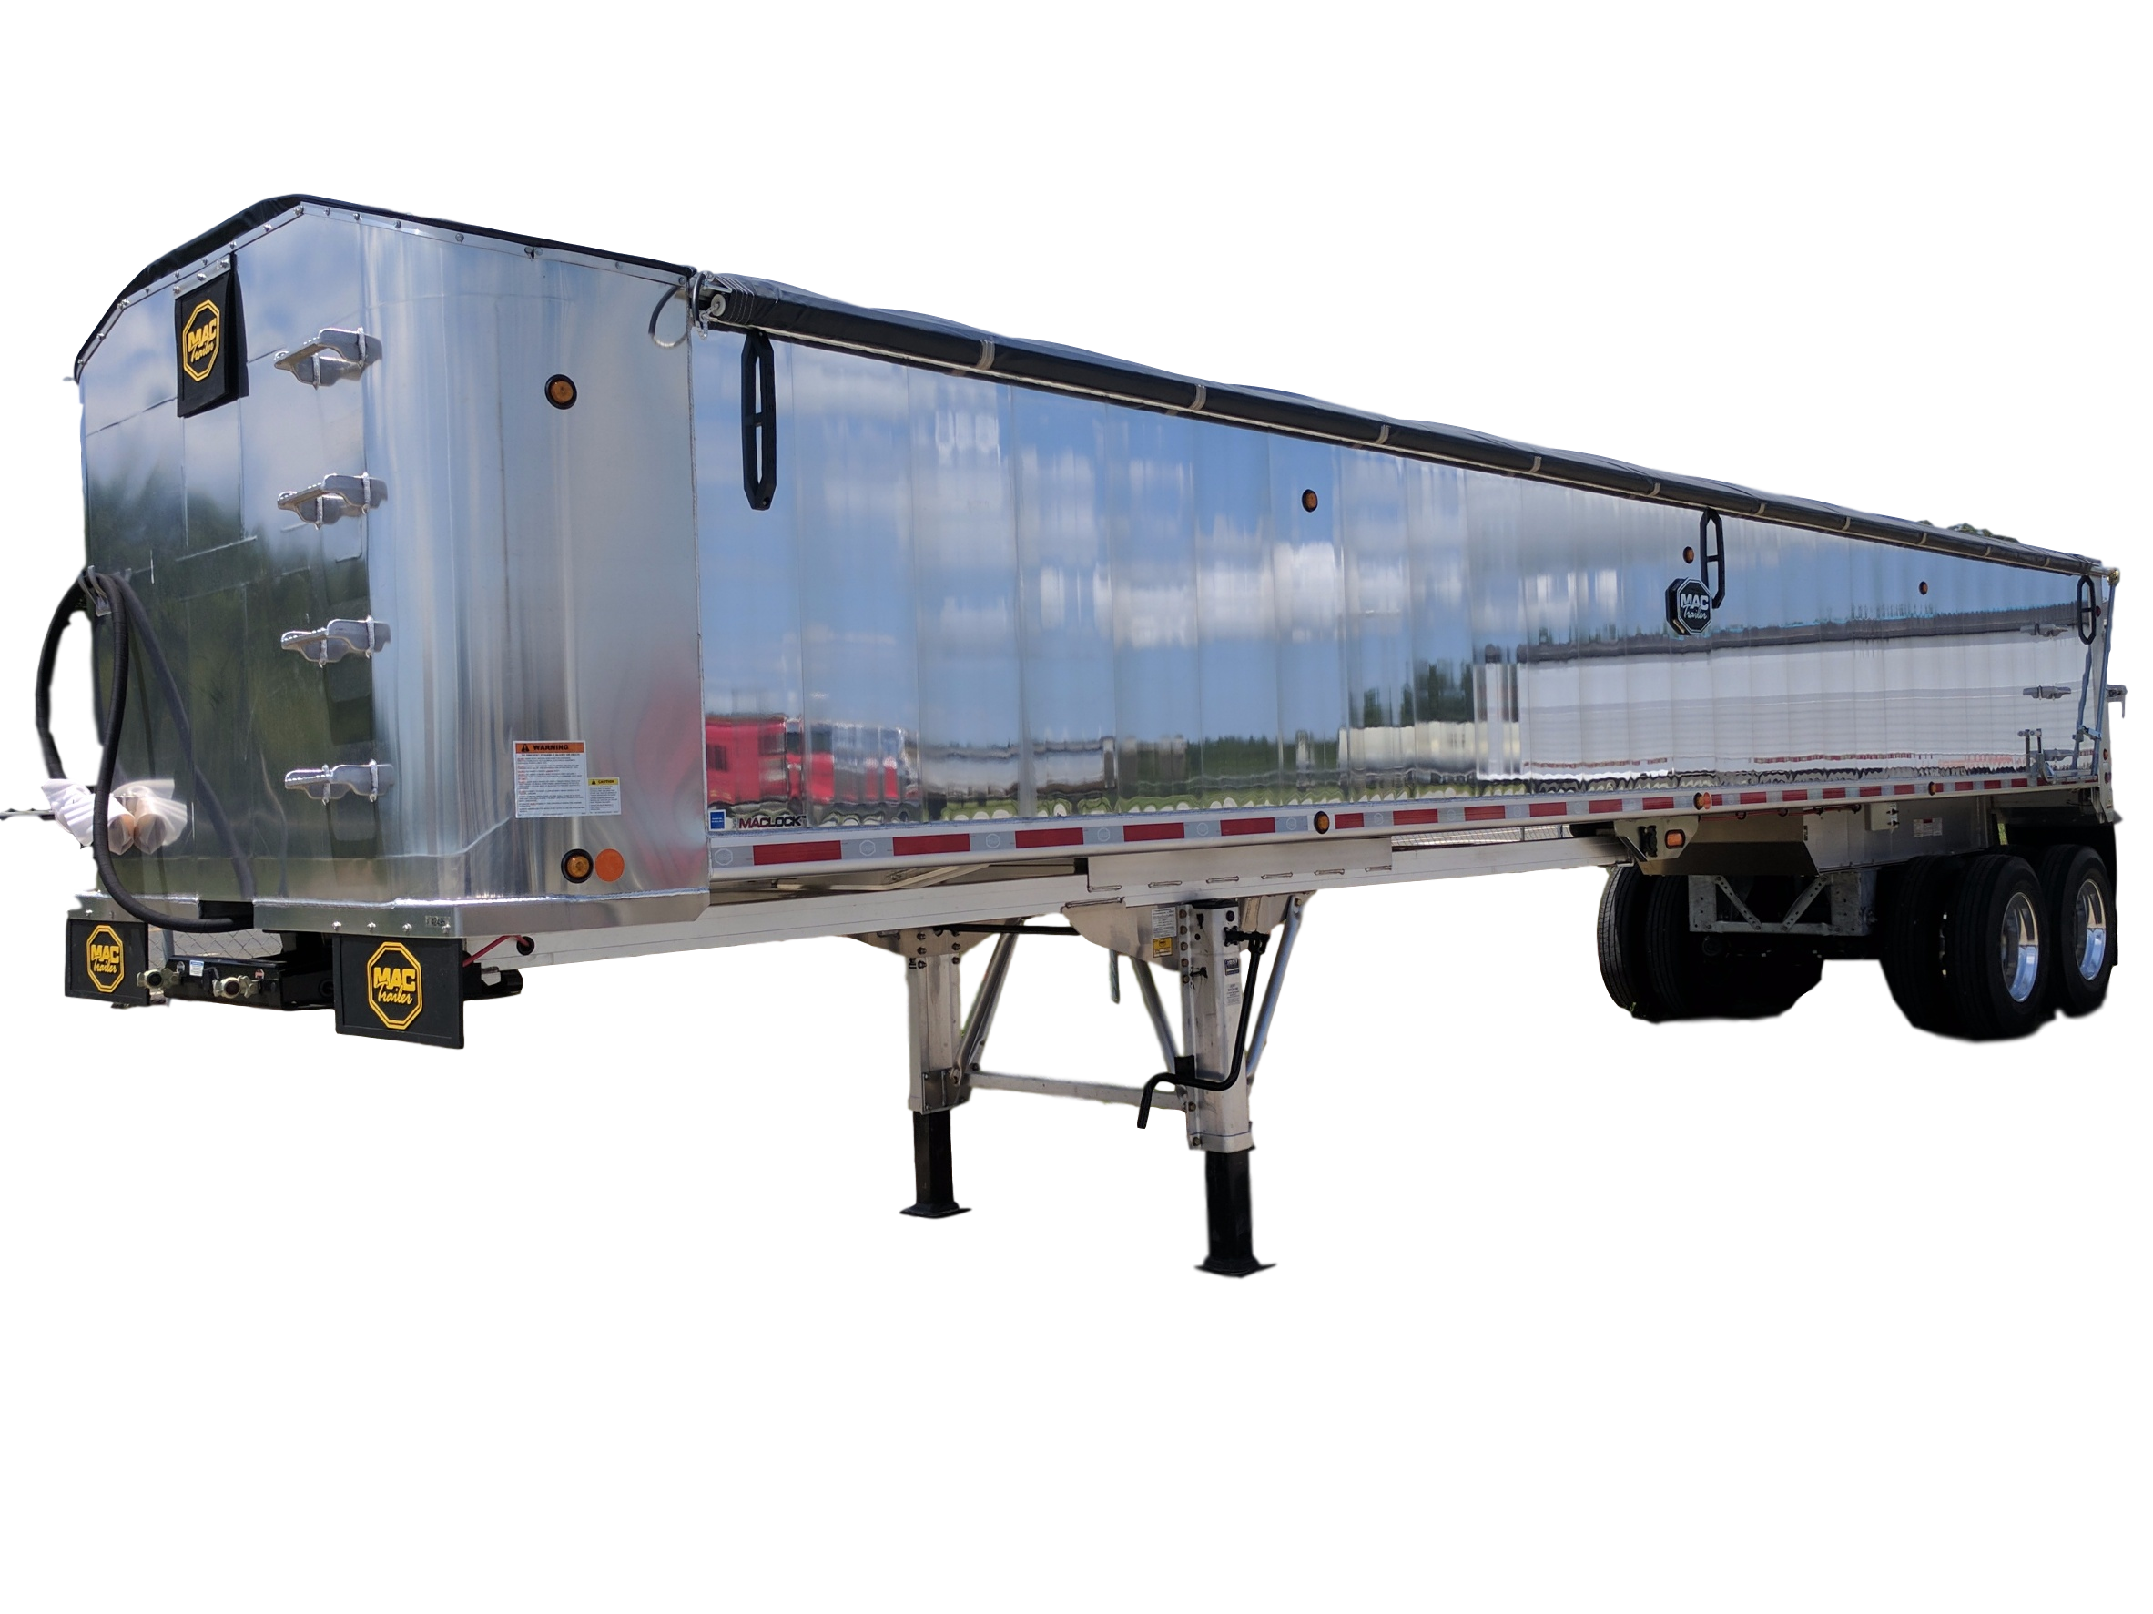
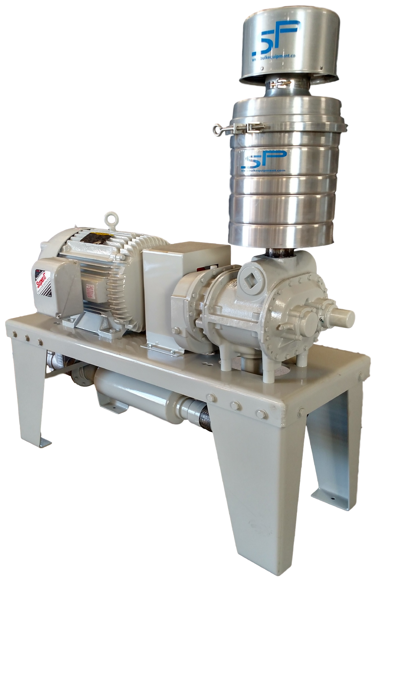
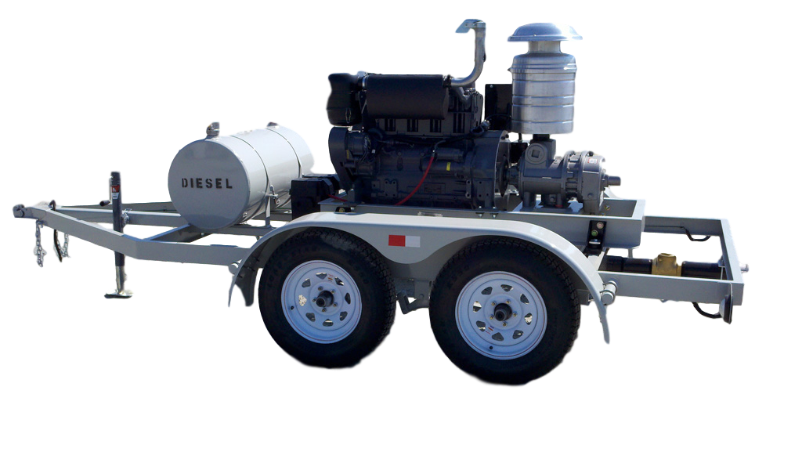
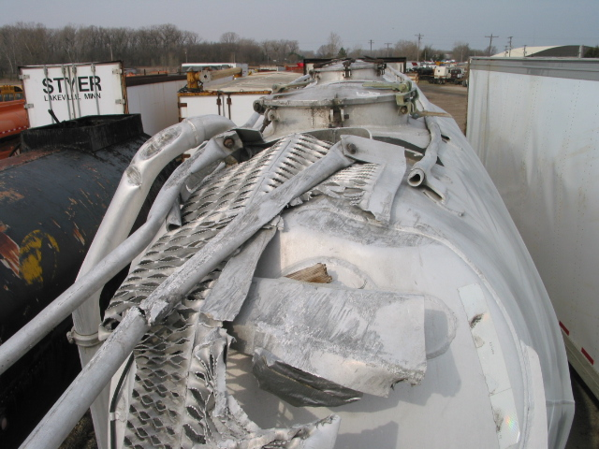
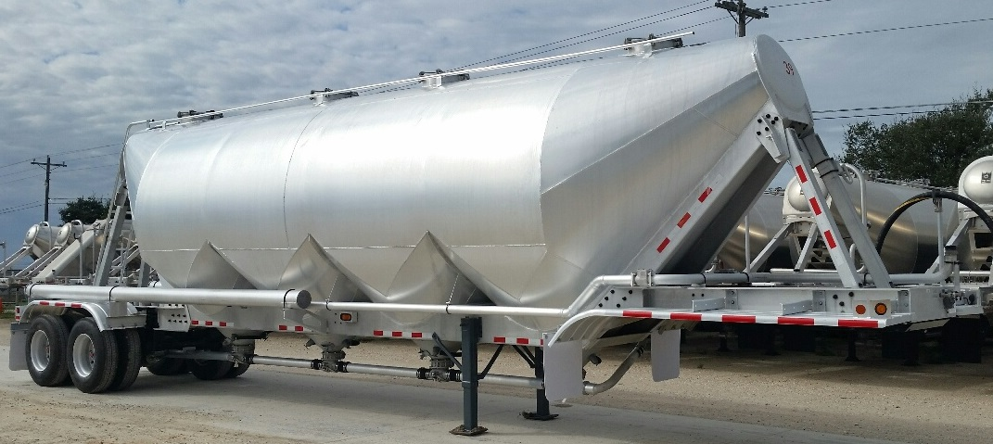


Southeastern Pneumatic
Southwestern Pneumatic
Pneumatic Exports
7 Locations to Serve You
Services
Warranty Service Center
All of our facilities (except Miami) offer full service installation and repair services
Liners
Experts in Dry Bulk Transportation Solutions
Facility Hours
Monday – Friday
8:00 AM – 5:00 PM
Including sandblasting, preventative maint, custom fabrication and DOT services
New | Used| Services | Parts
Southeastern Pneumatic 356 Dixon Dr: HQ, Blower Shop 787 E. Oglethorpe St: Trailer Shop, Sales Ellaville, GA 31806 800-777-3383 sales.sep@bulkequipment.com | Southwestern Pneumatic 23999 IH 35 Kyle, TX 78640 800-779-3383 sales.swp@bulkequipment.com
Southeastern Pneumatic 6915 US Hwy 220 Stoneville, NC 27048 866-427-3073 sales.sep.stoneville@bulkequipment.com | Southwestern Pneumatic 5733 Ransom St Houston, TX 77087 800-765-8265 sales.swp.houston@bulkequipment.com
Pneumatic Exports 3521 NW 115th Ave Miami, FL 33178 888-785-3383 sales.pei@bulkequipment.com | Southwestern Pneumatic 3251 VV Jones Rd Venus, TX 76084 866-772-3383 sales.swp.venus@bulkequipment.com
PTO Blowers
Blower service & oil change, vacuum pumps, liquid pumps, hydraulic systems, hydraulic coolers, wet line kits, tarps, liner, live floors, automated manways
Pneumatics
End Dump
Wreck Repair
Find us online
Electric
Diesel
www.bulkequipment.com
Southeastern Pneumatic, Inc.
800-777-3383
@bulkequipmentcompanies
Before
After

Slide 2
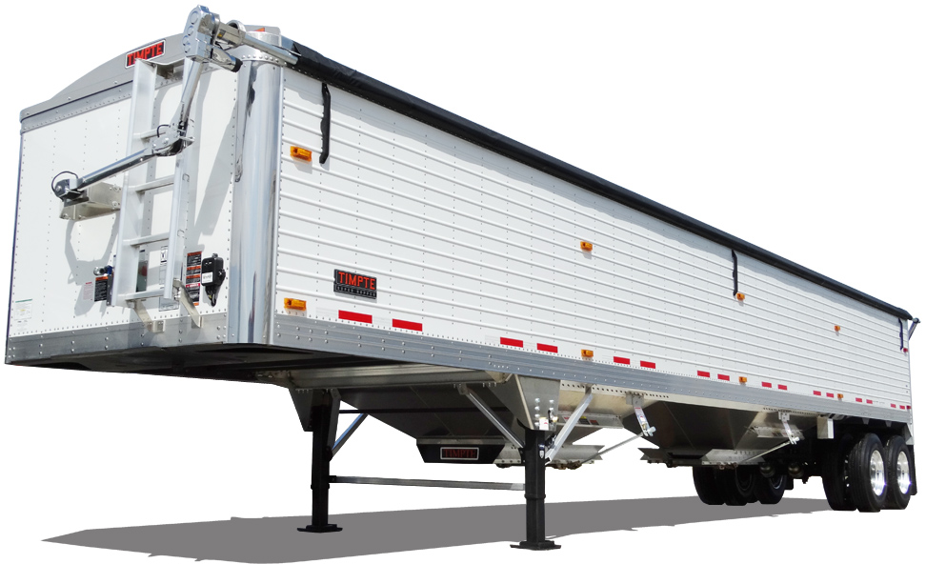

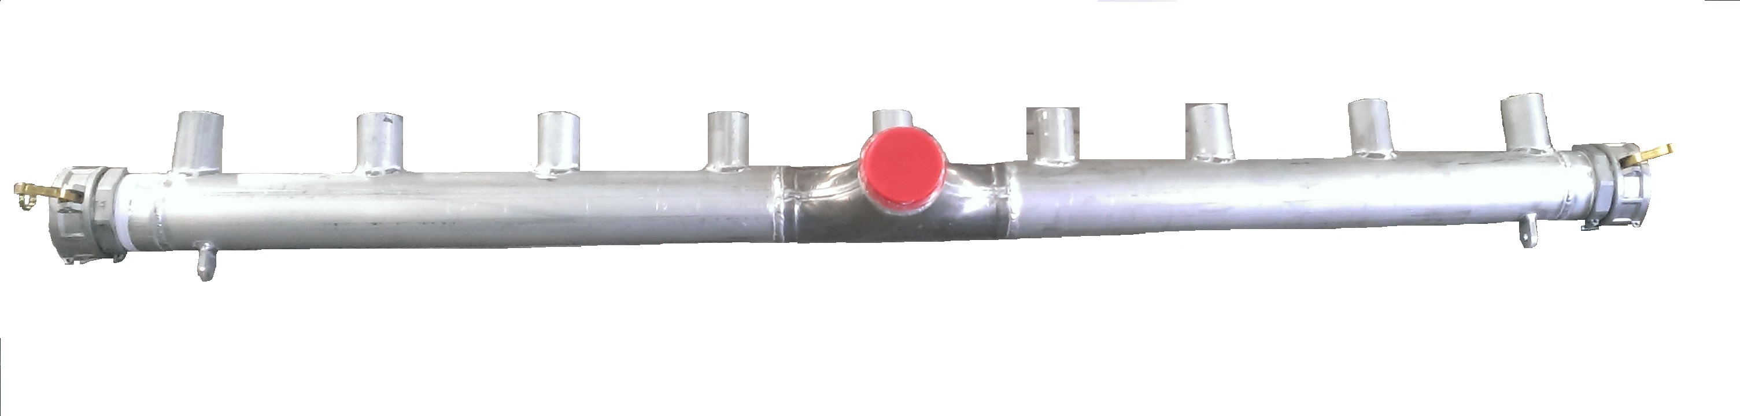
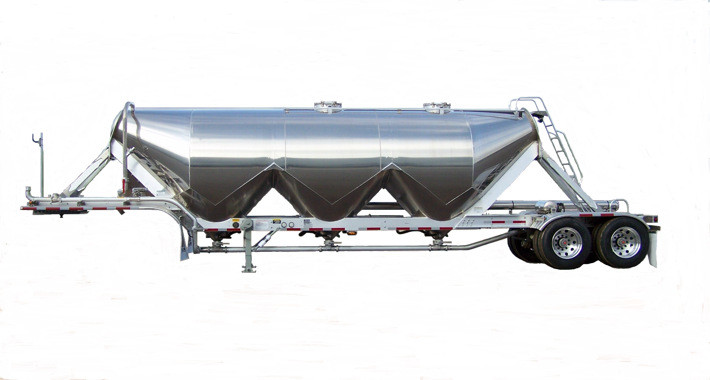
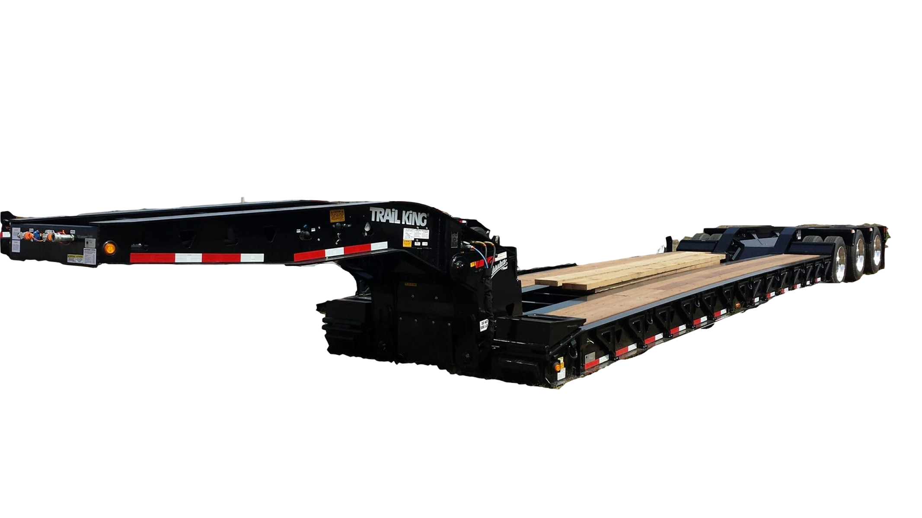
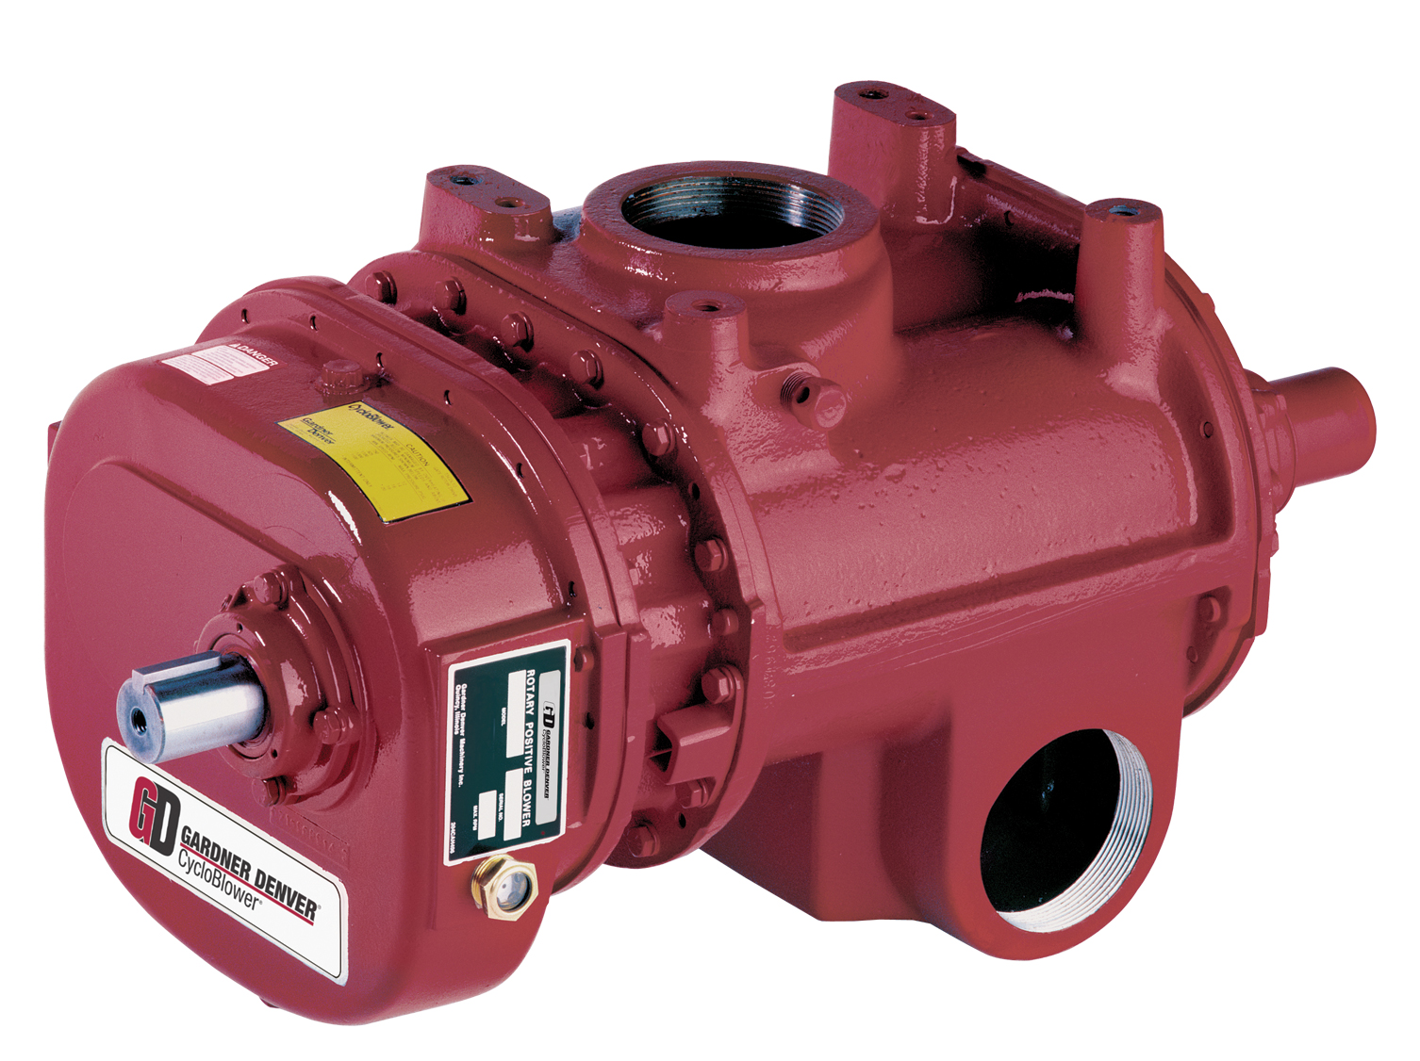
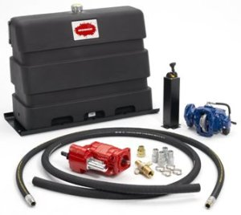
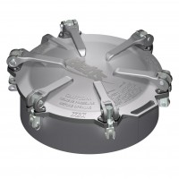
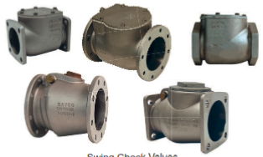
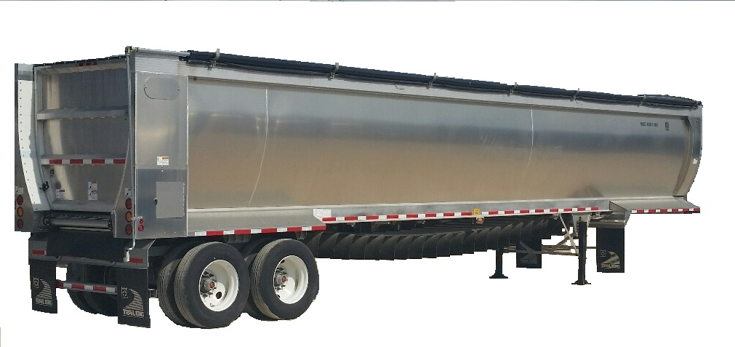
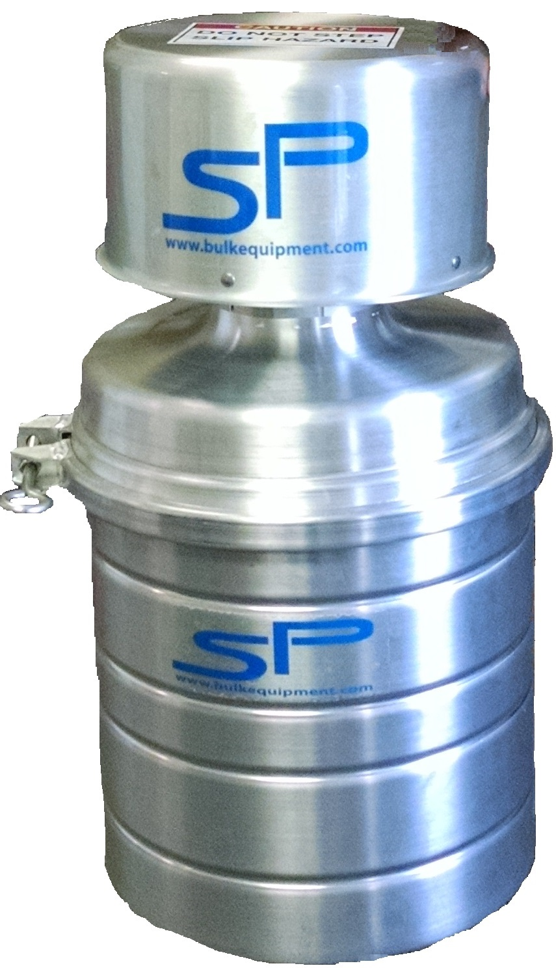
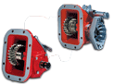
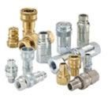
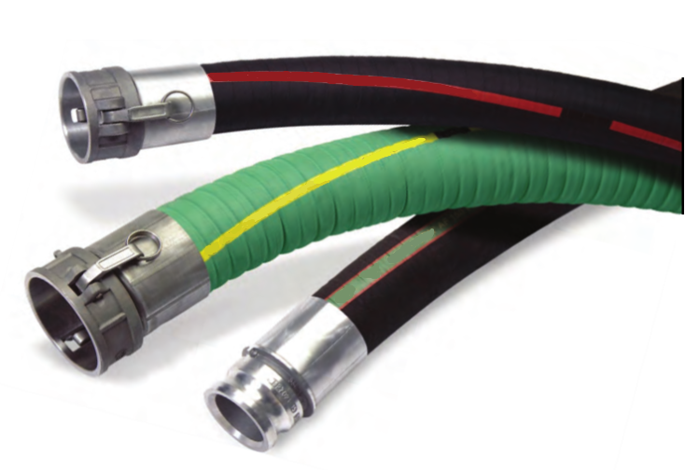
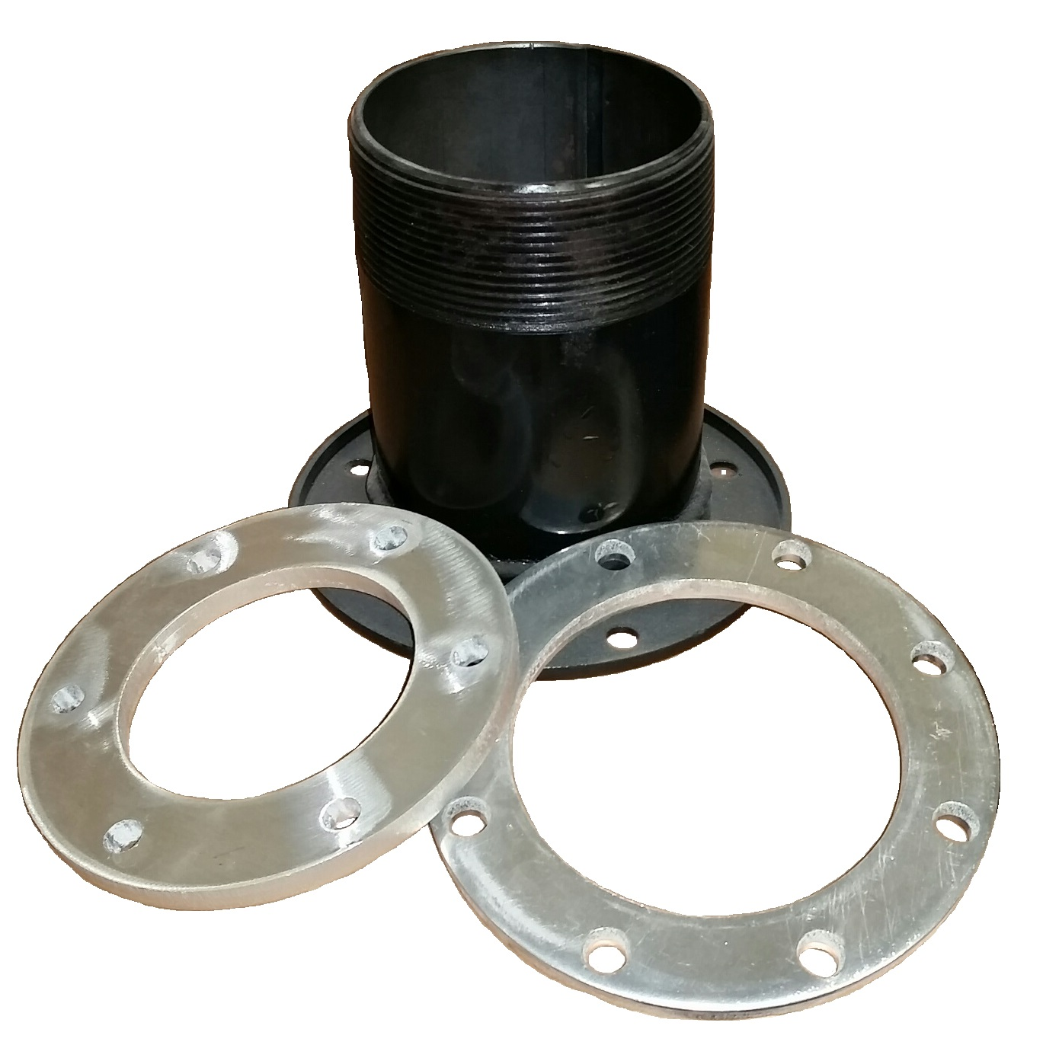
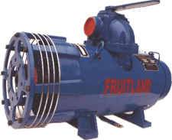
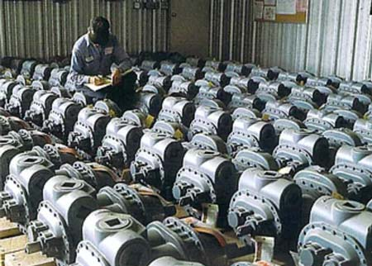
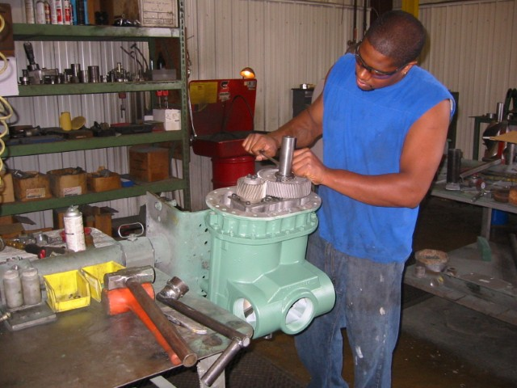
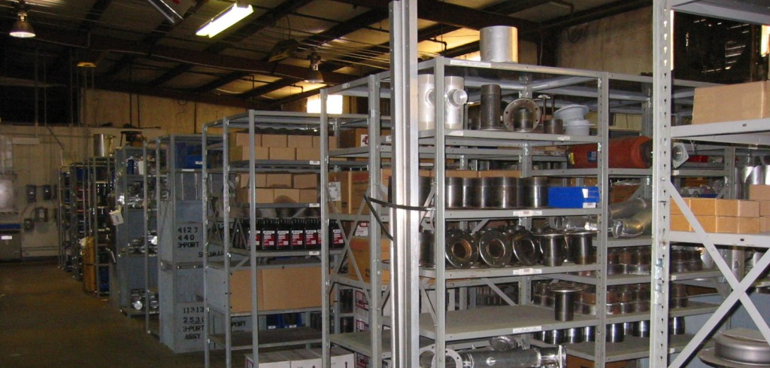
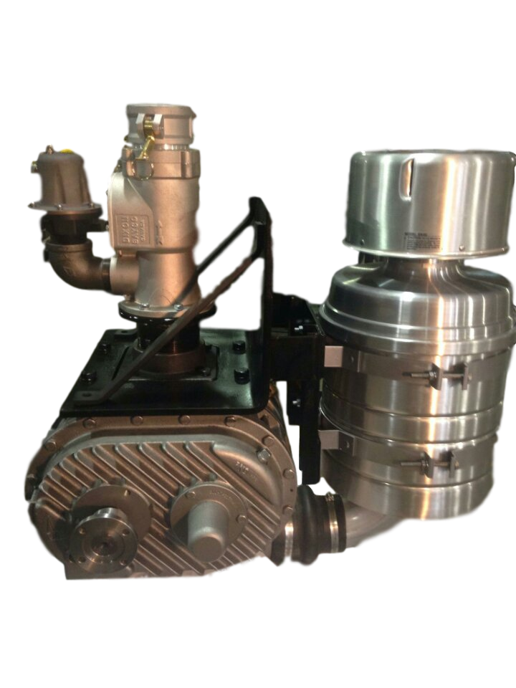


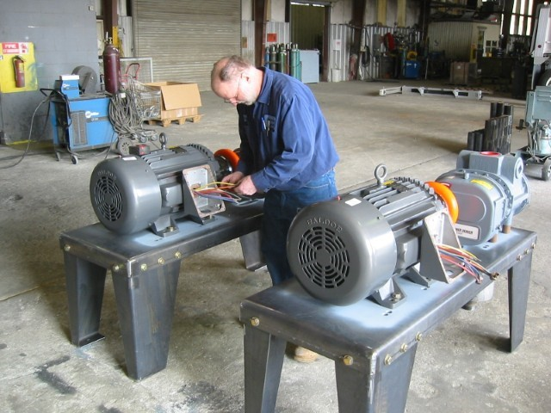
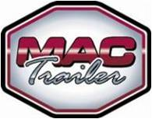


Blowers
Trailers
Parts
#1 USA mobile blower distributor
99% of parts in stock ship within 24 hours of receipt of order
Hydraulic & Wet Line Kits
2014
2015
2016
2017
Vacuum Pneumatic
Hopper
Trailer
Parts
Filter & Precleaner
Dry Bulk Pneumatic
Lowboys
www.preferredlowboys.com
We are proud to represent the Gardner Denver line of mobile products for use in dry bulk liquid and hydraulic applications. Gardner Denver blowers are the most efficient and productive blowers on the market. We specialize in blower installations for your trailer or truck. With our expertise and several model designs we can meet any mounting arrangement or need. We can integrate your system with hydraulics as well as power take off units (PTO).
PTO
Hose & Fittings
End Dump
Belt
Check out our current stock and inventory at:
www.bulkequipment.com/inventory
We can custom configure your trailer to meet your requirements
We have the ability to do after-factor modifications to your specs
Valves & Fittings
Vacuum Pump
Representing
Stock
Repair
PTO Kits
Package Units
+ MORE!

