Slide 1
Guidelines from Amazon
Choose images that are clear, information-rich and attractive.
Images must meet the following requirements:
Products must fill at least 85% of the image.
Should be square shape with a minimum of 1000 pixels by 1000 pixels
JPEG is the preferred image format,
You can find Images to use in the below dropbox folders
https://www.dropbox.com/sh/ocq6g2wyk527s25/AAB-EWZngtXfv0FR1BP-lQYTa?dl=0

Slide 2
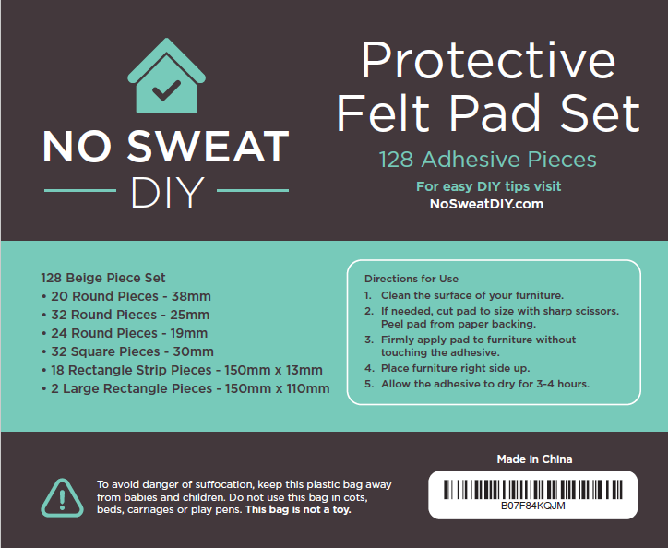
Example of Packaging

Slide 3
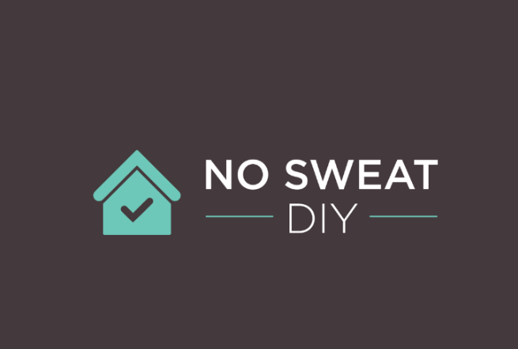

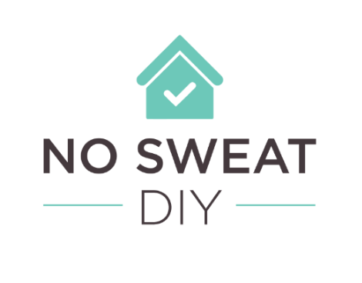
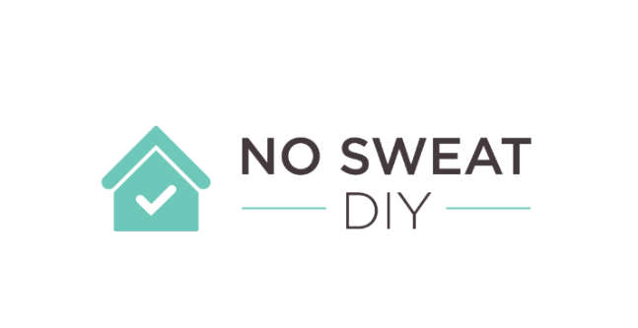
The Logo Treatment

Slide 4
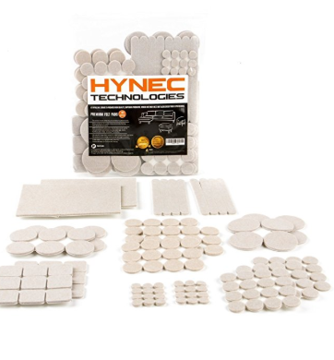
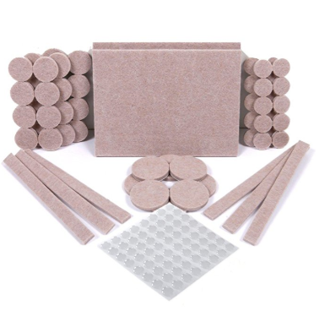
Image 1- MAIN IMAGE
Showing the full set – I will have to give you this images once I can get from my supplier. I still need to supply this image but am hoping I will have it available by the 5th of August. Examples of how competitors have done this is below.
This Images image must have a pure white background, must be a photo (not a drawing) and must not contain excluded accessories.
Images must be at least 1,000 pixels by 1000 pixels to be zoom-able.
Images must not exceed 10,000 pixels on the longest side.
Products must fill at least 85% of the image.
Images must show only the product that is for sale, with few or no props and with no logos, watermarks or inset images
Images may only contain text that is a part of the product.

Slide 5
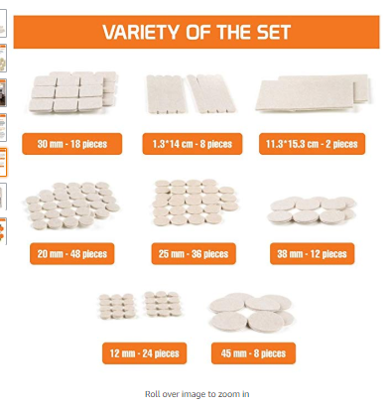
Image 2
Displaying Variety of the set --- I will need to give you images for this once I can get from my supplier. Examples of Competitor:
Text to Include (feel free to reduce text if images appears too wordy):
Large Variety of Shapes and Sizes to fit your Needs.
128 Beige Set includes:
20 Round Pieces - 38 mm
32 Round Pieces - 25 mm
24 Round Pieces -19 mm about .75 inch)
32 Square Pieces - 30mm
18 Rectangle Stripes - 150mm x 13mm
Rectangle Pieces - 150mm x 110mm

Slide 6
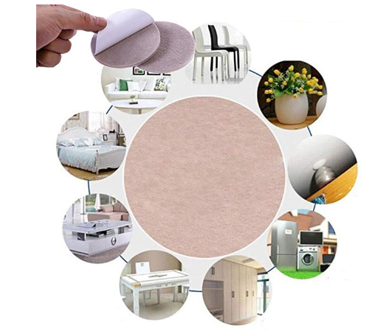
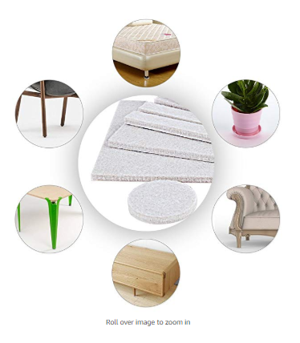
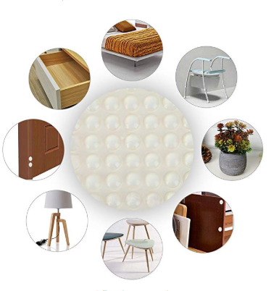
2-4 Images – How Images can be used
I will attach some images which I have taken showing how the felt pads can be used. I’m happy for you to use any stock photography if the images I have supplied do not work.
Should be square shape with a minimum of 1000 pixels by 1000 pixels
I have some images of a main room, the room is carpeted, so would like this to be 3D rendered so it appears at wood flooring. I can take additional pictures if needed

Slide 7
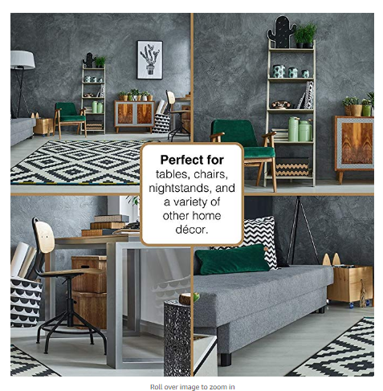
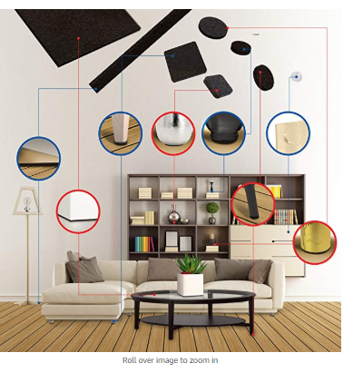
2-4 Images from previous slide
More examples - Representing all of the ways felt pads can be used and how images can be created.

Slide 8
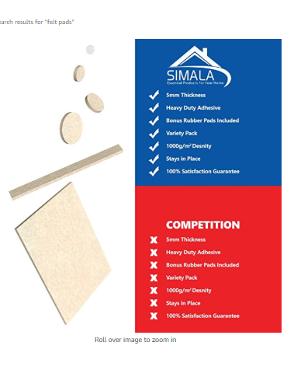
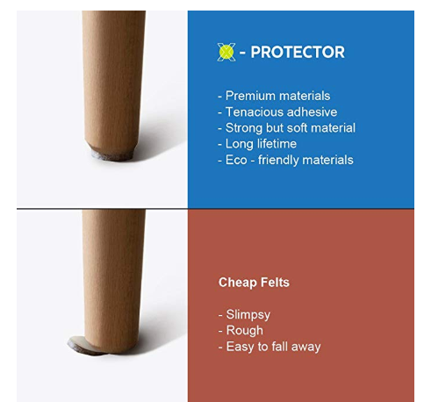
1 Images
Displaying Pros and Cons of my pads vs competitors

Slide 9
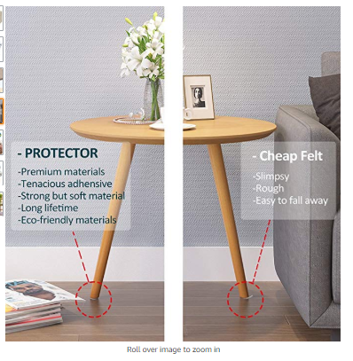
I Image (continued from previous slide)
Displaying Pros and Cons of my pads vs competitors
TEXT
No Sweat DIY Felt Pads
Super Sticky Grade A Adhesive which will stay in Place
Variety of Sizes to fit your furniture
Cheap Furniture Pads
Cheap Glue which will fall off
Little Variety which will not be flexible for all of your furniture needs

Slide 10
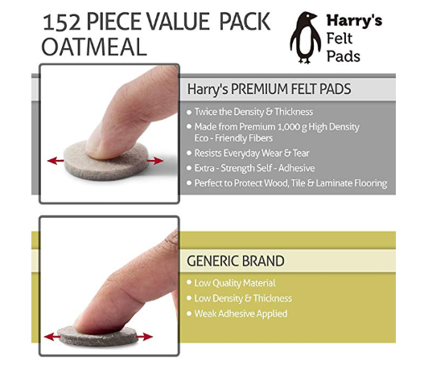
I Image
Displaying Thickness of my product compared to competitors
TEXT
No Sweat DIY
Made From 1000 g High Density Fibres which will stay in Place and will resist everyday wear and Tear.
5mm Thich Pads which will protect your surfaces
Cheap Furniture Pads
Uncompressed material which will fall apart
Thin Pads which will not protect your floor

Slide 11
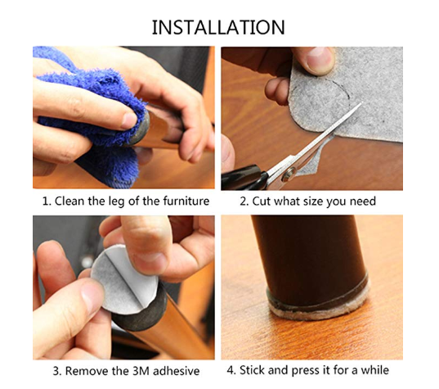
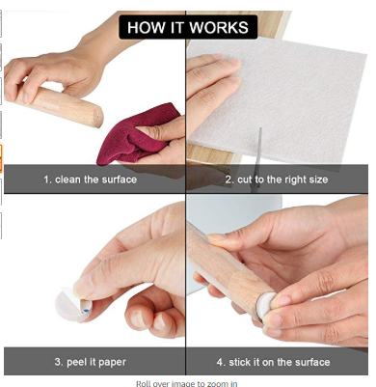
1 Images
Installation
TEXT
To Get The Best Out of your Felt Pads Follow These Directions
1. Clean the surface of your furniture.
2. If needed, cut pad to size with sharp scissors.
3. Peel pad from paper backing.
4.. Firmly apply pad to furniture without touching the adhesive.
5. Place furniture right side up and allow the adhesive to dry for 3-4 hours.

