Slide 1

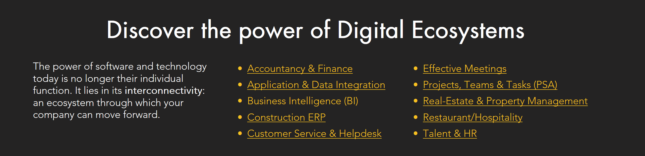

Digital Ecosystem Tech Mapping
Design Examples

Slide 2
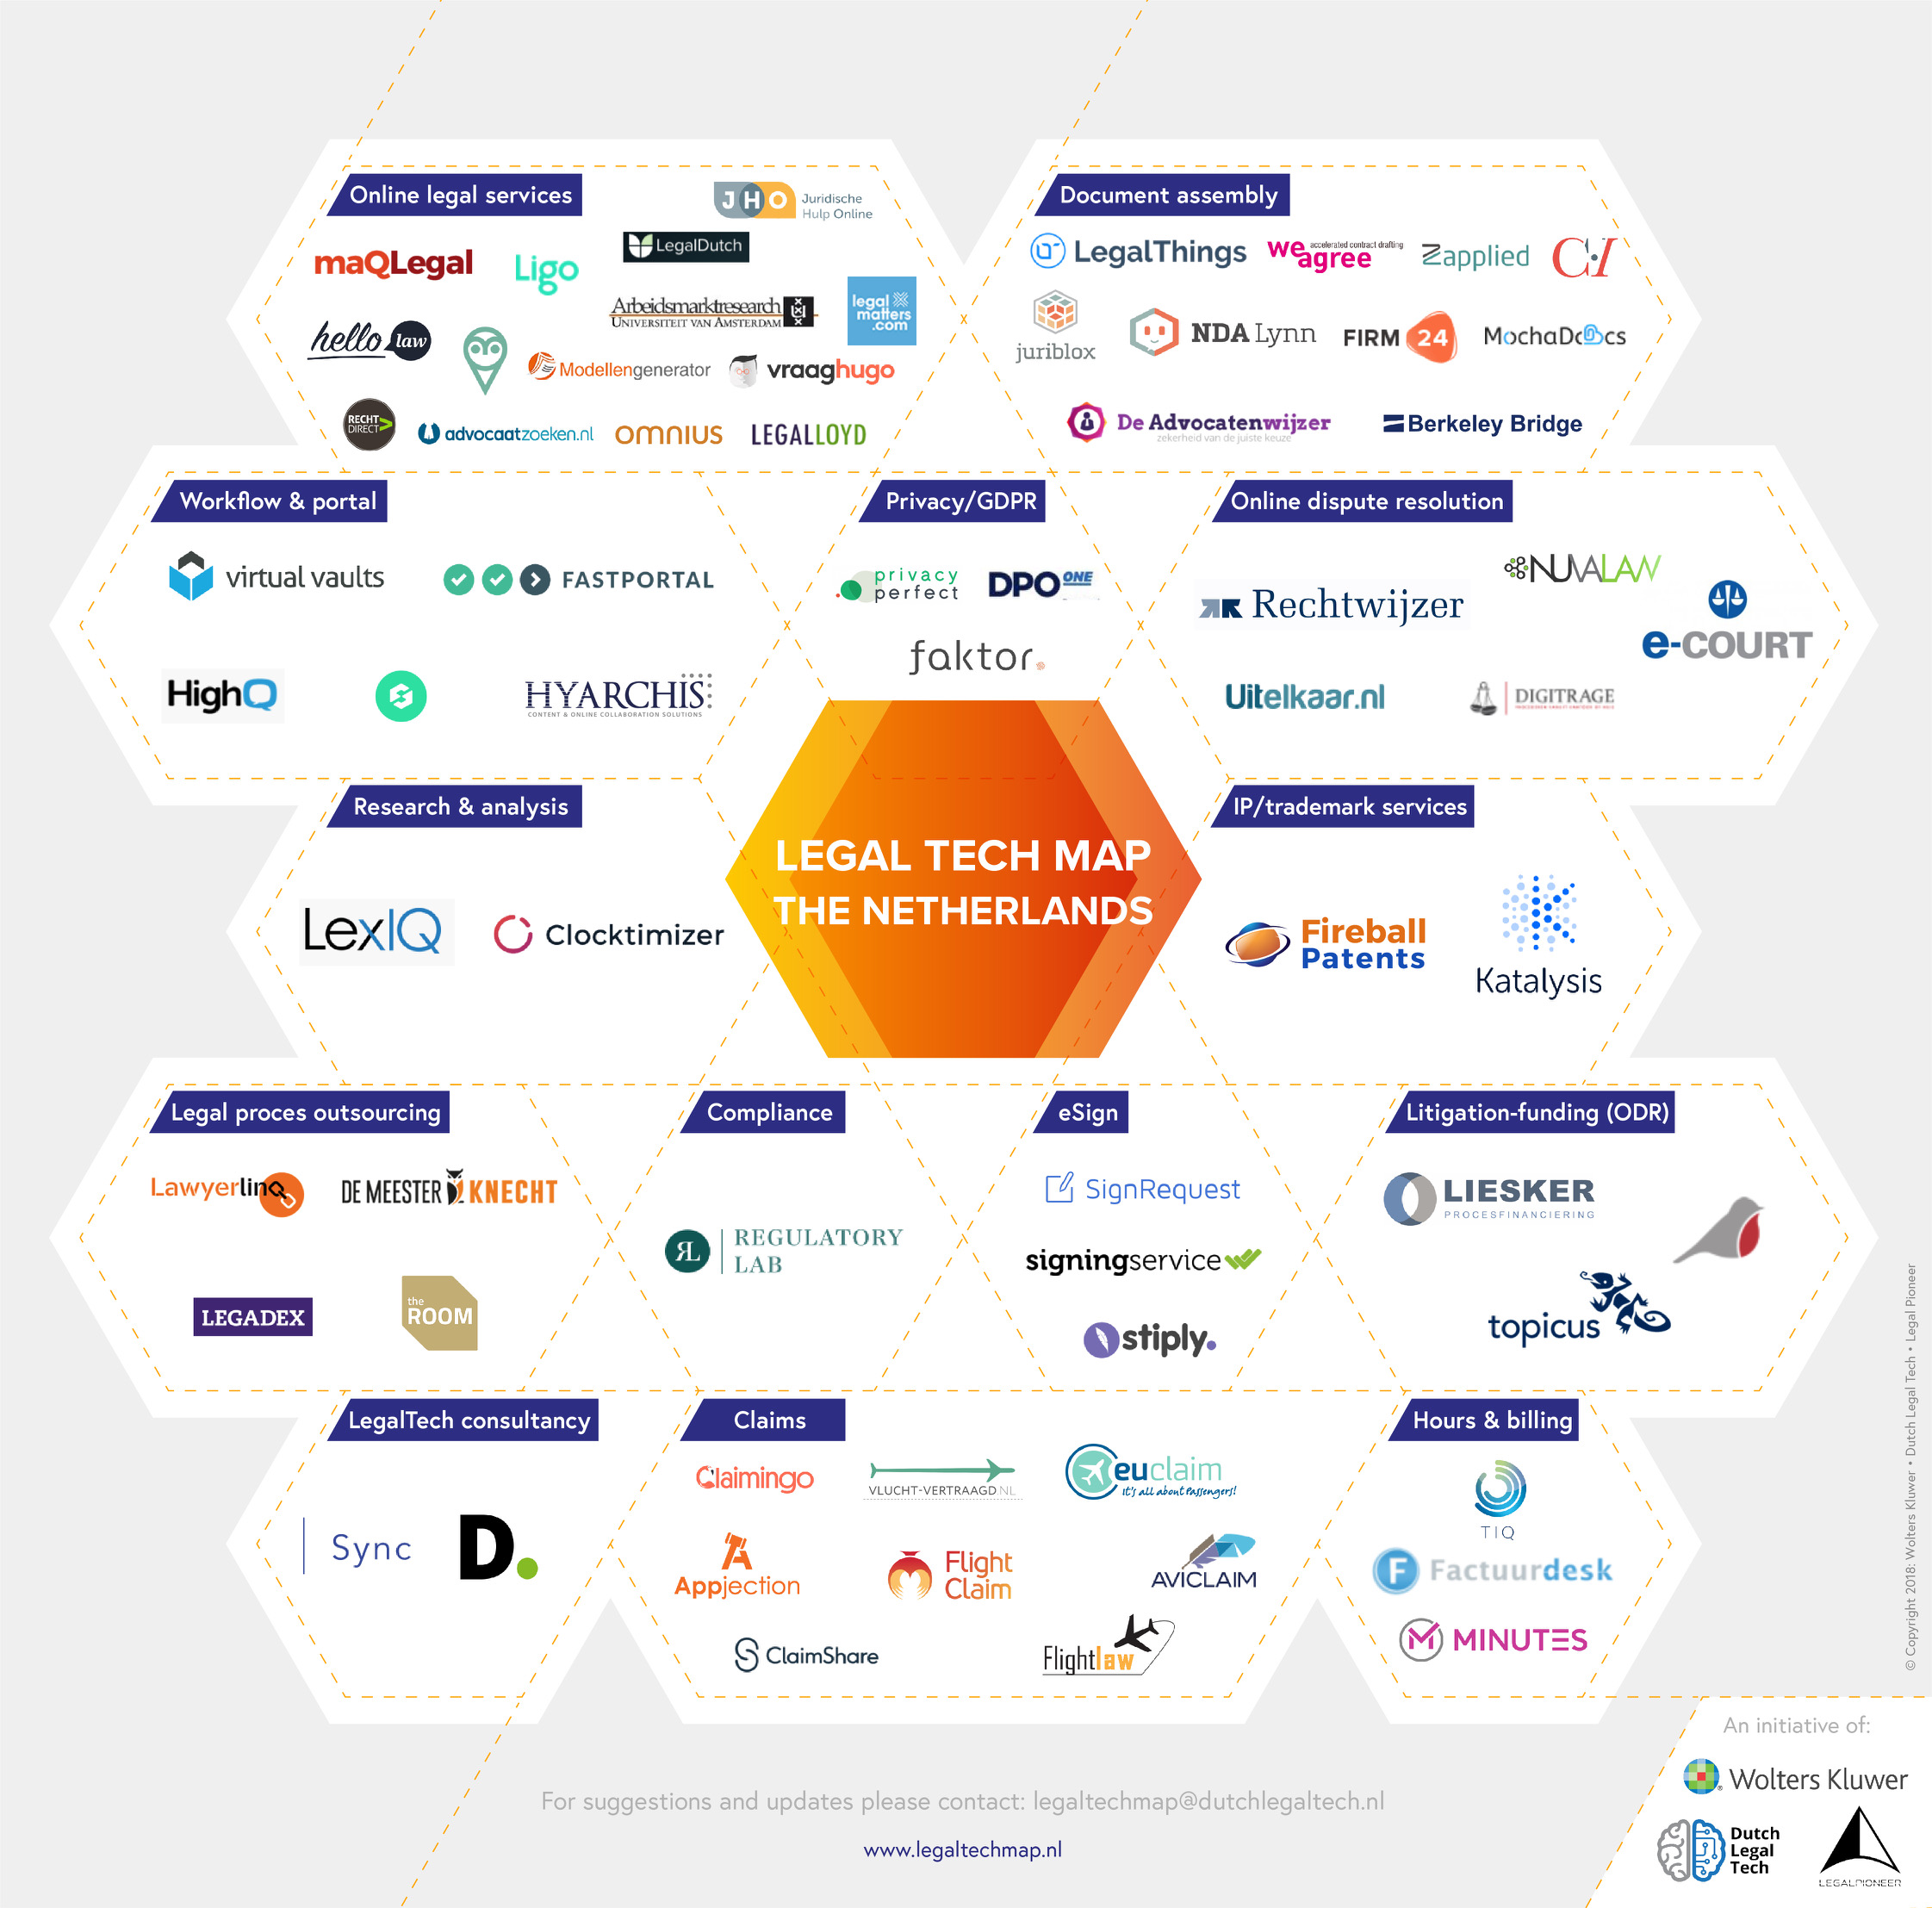

Slide 3
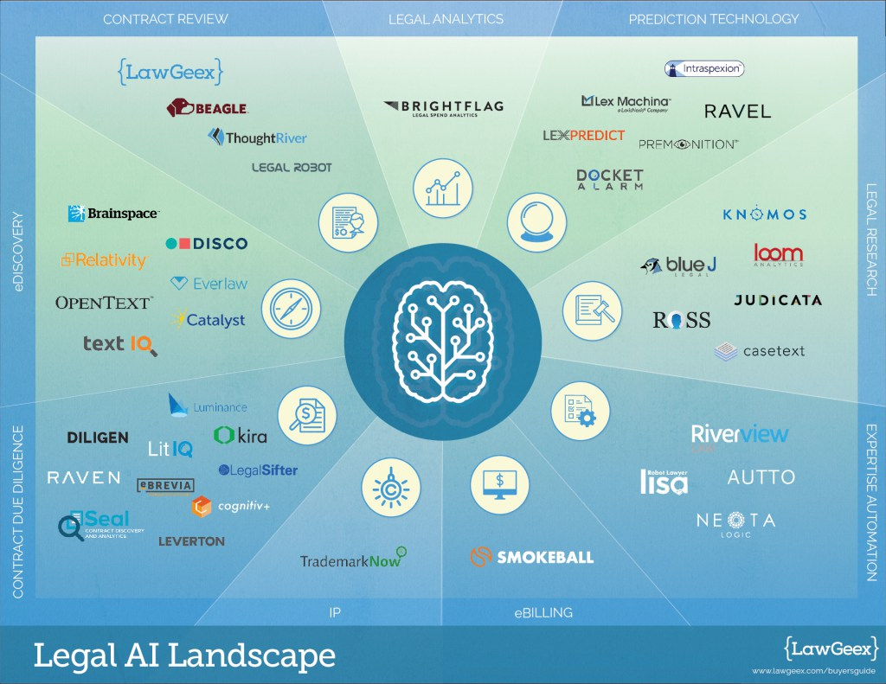

Slide 4
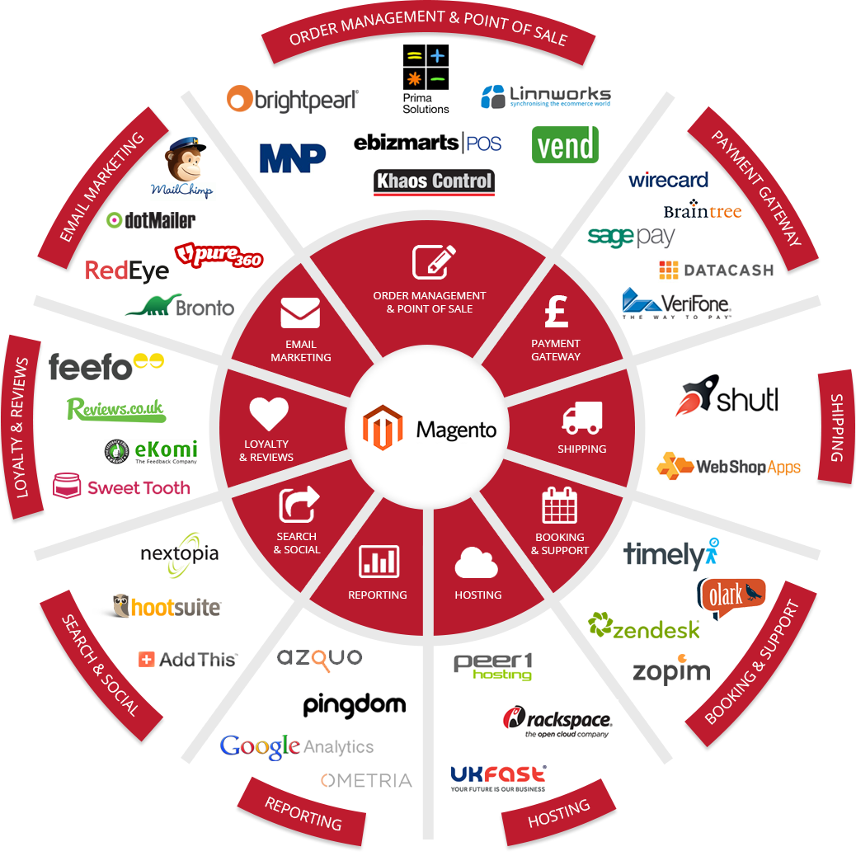

Slide 5
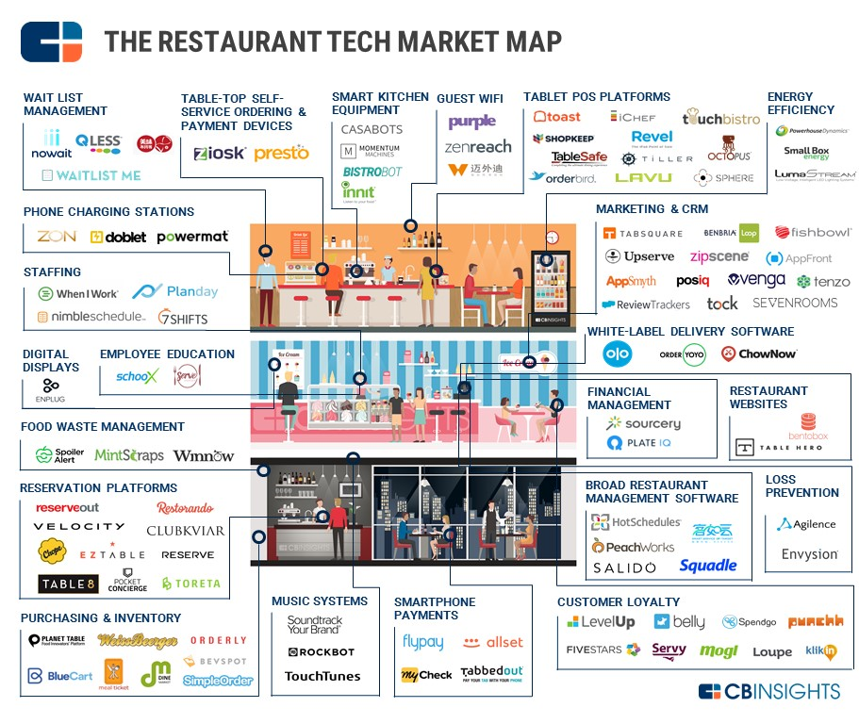

Slide 6
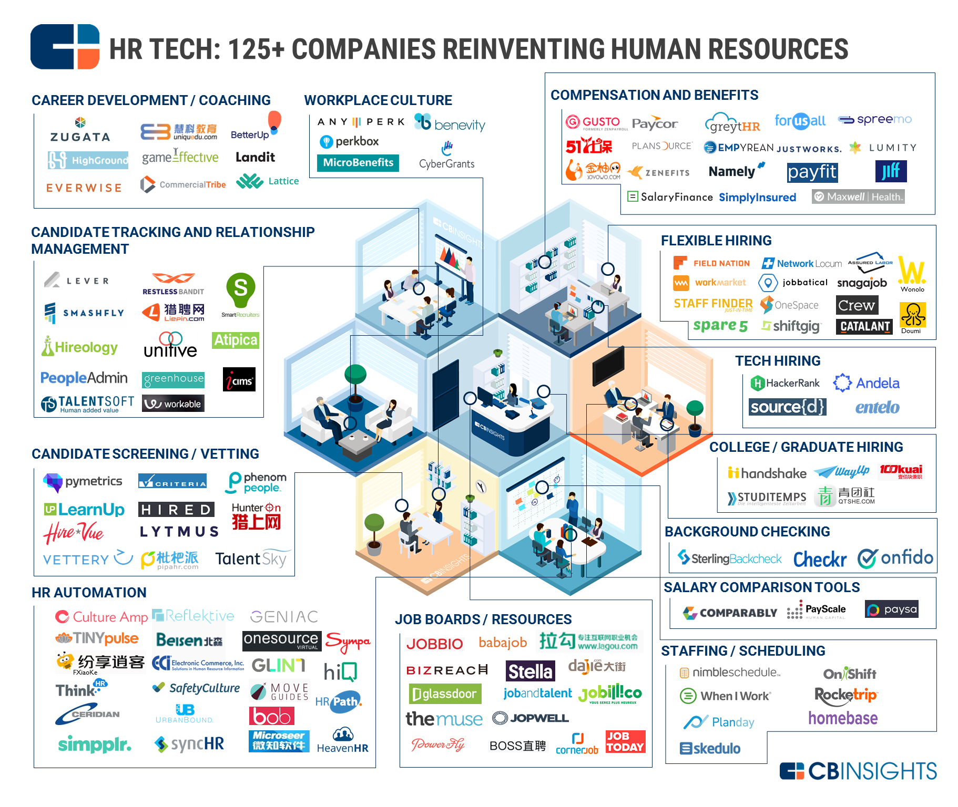

Slide 7
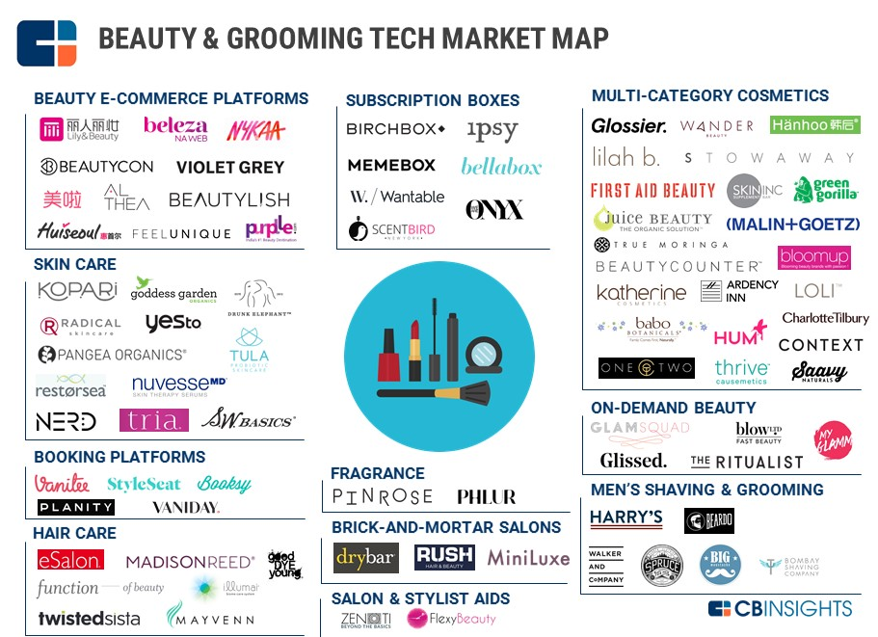

Slide 8































































Real Estate Digital ecosystem Focussed on Belgian market
CRM for real estate agents
Property Portals & Marketplaces
Tools for buyers & sellers
Rental inspections, location descriptions, building inspection
Schedule Visits & Open Homes
Property Development (projectontwikkeling)
Marketing
& callcenter
Property Management
(vastgoed beheer & syndic)
360° & 3D Virtual Tours
Transaction Management Offers & Contracts

Slide 9
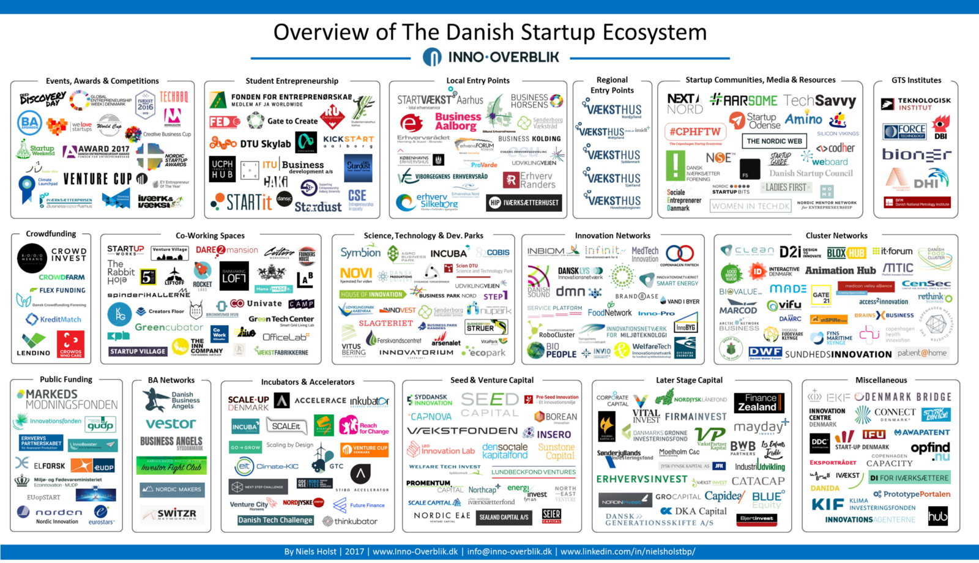

Slide 10
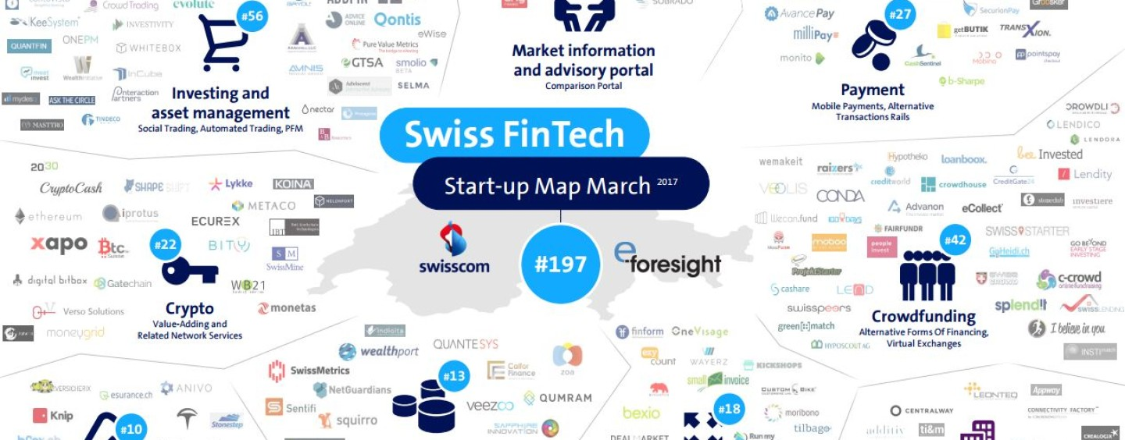

Slide 11
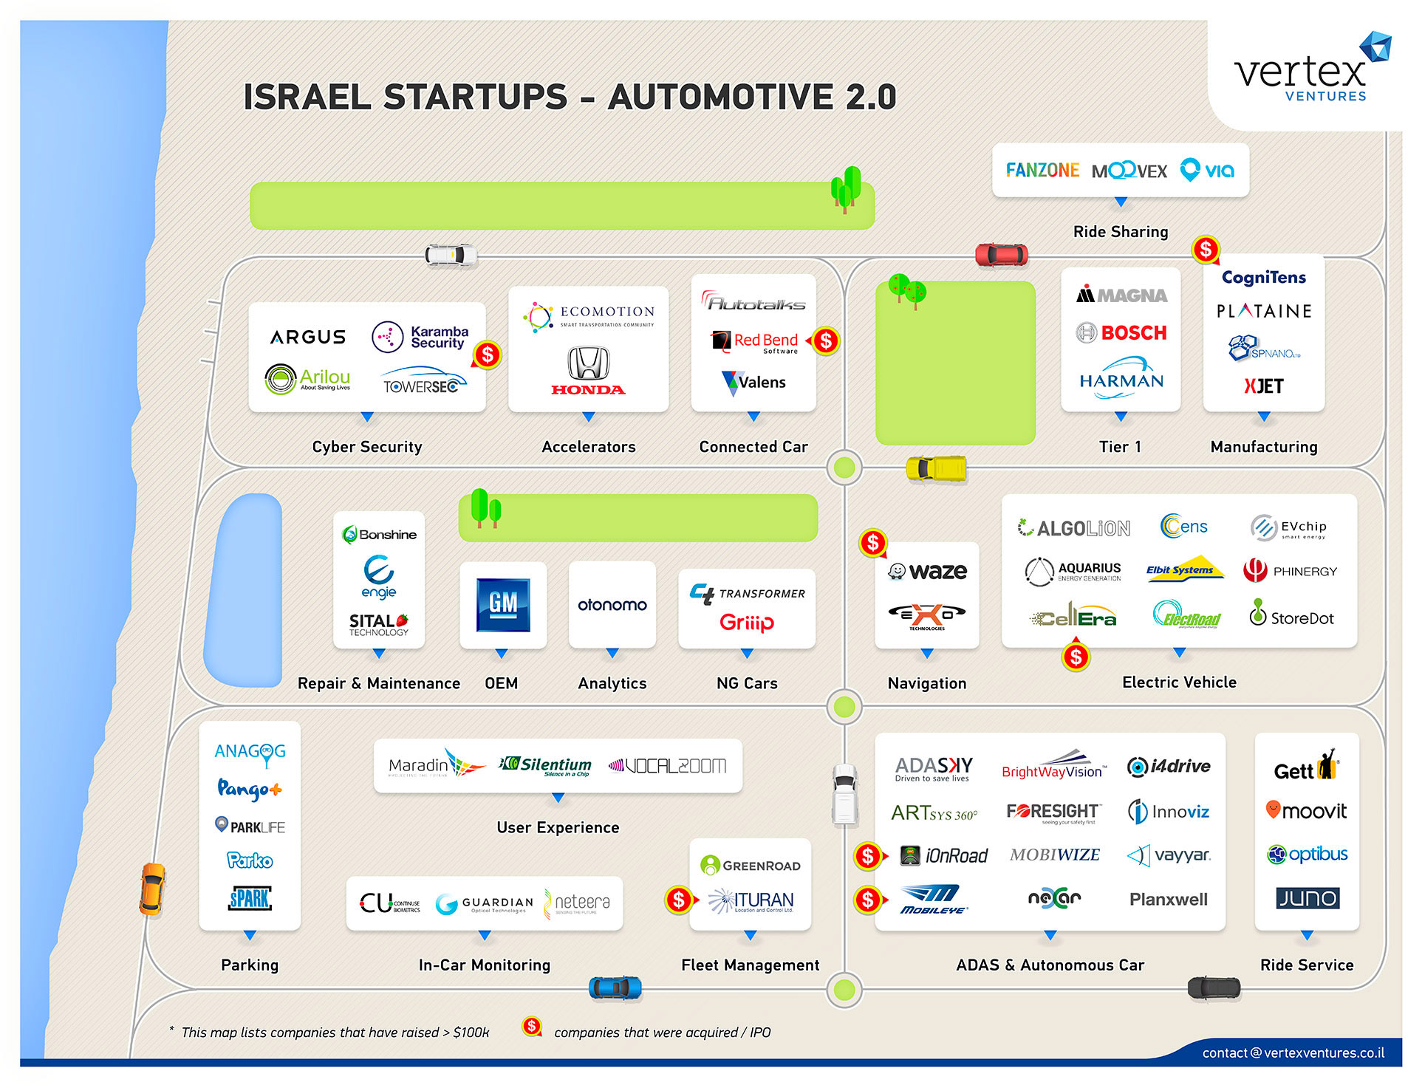

Slide 12
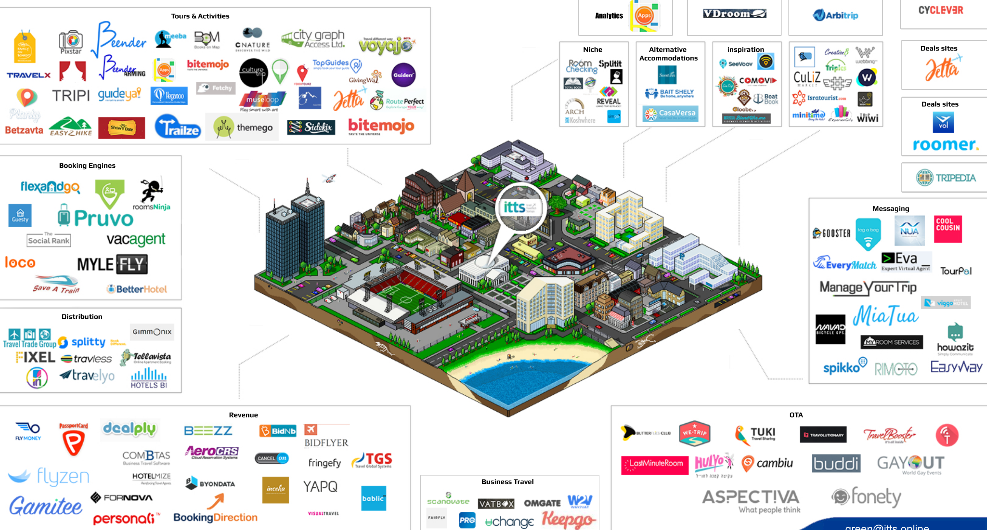

Slide 13
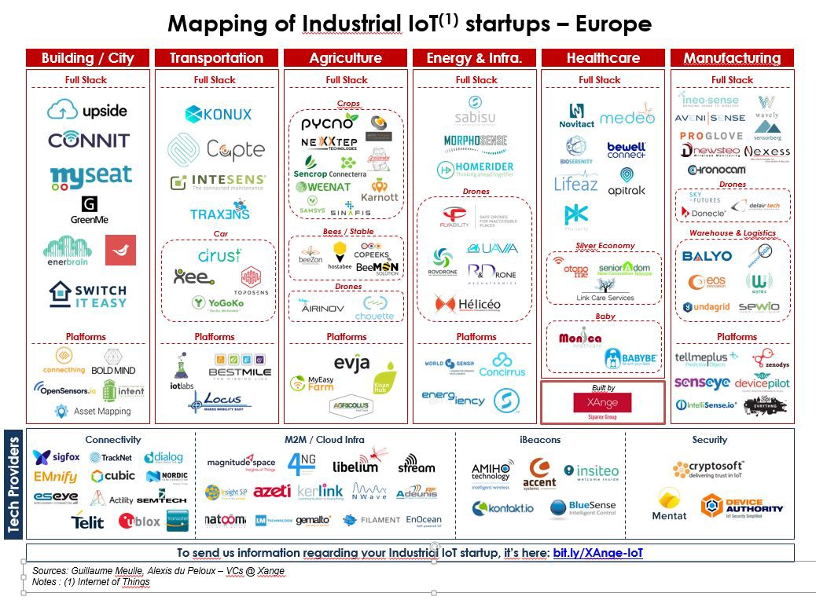

Slide 14
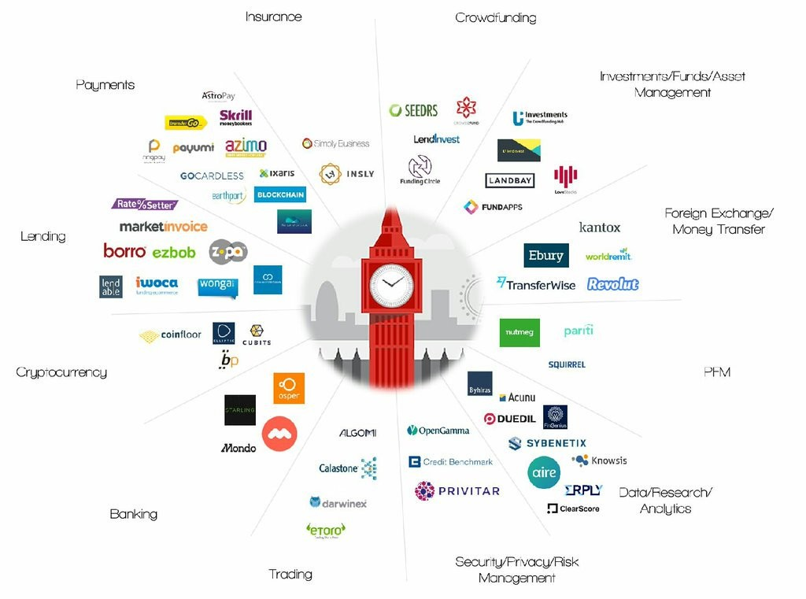

Slide 15
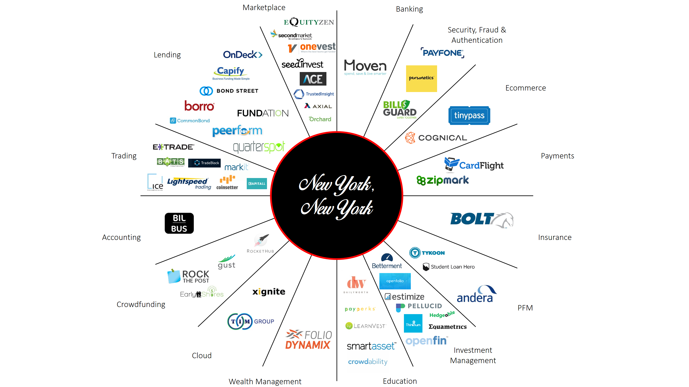

Slide 16
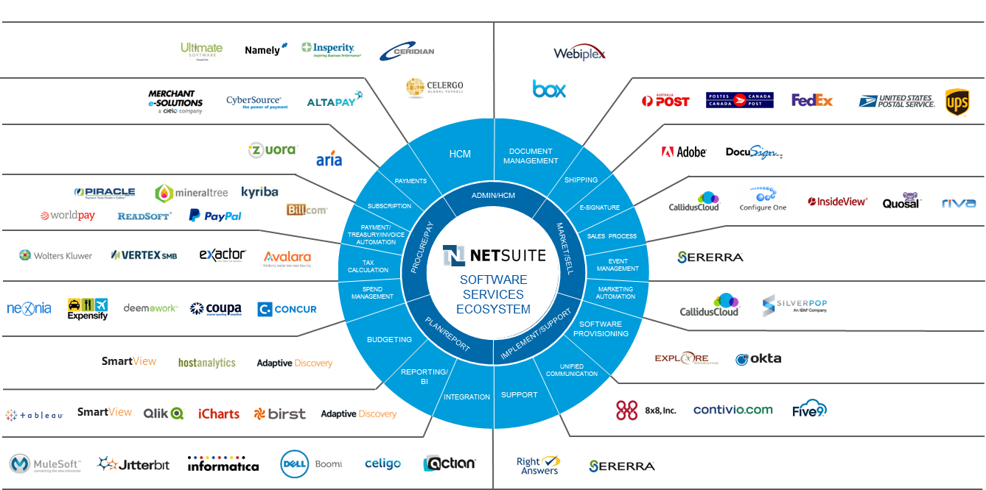

Slide 17
