Slide 1
Demographic Divides and
Satisfaction with Democracy

Slide 2
Introduction
Motivation of this study is to explain divisions in contemporary societies
Relevant to understanding Brexit, Trump, and similar electoral upsets
Opinions of educational and income groups diverge with socioeconomic development
Part of a larger comparative public opinion research project

Slide 3
Public Opinion vs Expert Assessments
Create indices to represent particular demographic groups
Compare these indices with expert indices measuring democratic quality
Aim to determine if experts match opinions of some demographic groups more than others
Pairwise correlations between these different indices as simple test

Slide 4
Comparative Public Opinion
Focus today: Satisfaction with Democracy
 | Individual Respondents | Country-Survey Observations
Social Trust | 2,107,958 | 1,509
Satisfaction with Democracy | 3,236,966 | 2,619
Support for Democracy | 1,333,078 | 1,030
Perceived Electoral Integrity | 967,005 | 776
Trust in Executive | 711,386 | 527
Trust in Executive | 2,902,614 | 2,341
Trust in Judiciary | 2,403,988 | 1,844
Trust in EMB | 471,522 | 320
Trust in Political Parties | 2,426,340 | 1,930
Trust in Police | 2,278,001 | 1,729
Trust in Military | 1,829,771 | 1,460
Trust in National Government | 1,955,004 | 1,715
Trust in Civil Service | 944,657 | 738

Slide 5
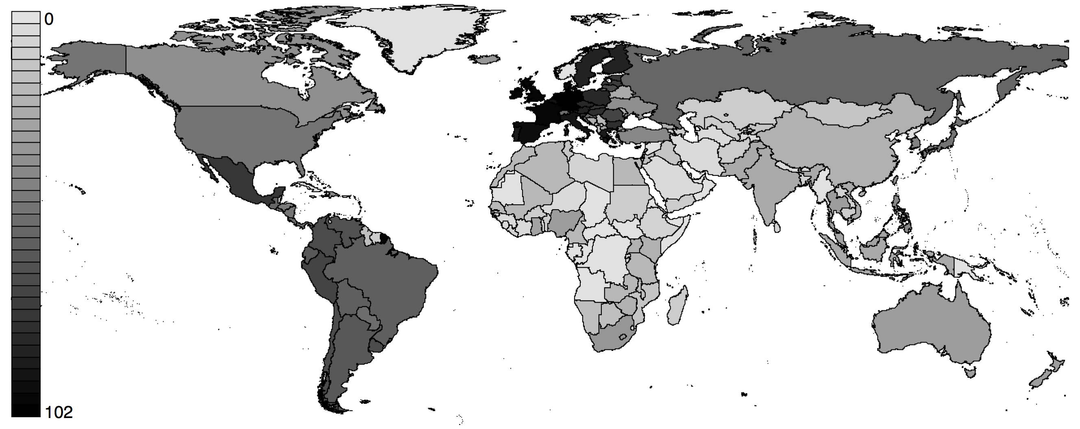
Surveys Per Country
Study includes 150 countries from 1973 to 2015

Slide 6
Typical Survey Question
Four-point response scale the most common
On the whole, how satisfied are you with the way democracy works in [country]?
Not at all satisfied
Not very satisfied
Fairly satisfied
Very satisfied
Different Response Scales

Slide 7
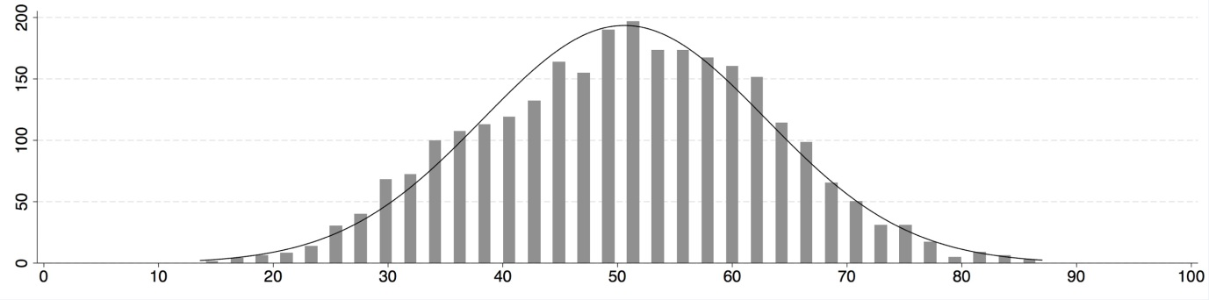
Dependent Variable
Satisfaction with Democracy
Values of different survey response scales converted to range from 0 to 100
Values then averaged within each country-survey to produce scores
Distribution of Scores
Frequency

Slide 8
Independent Variables
Demographic groups common across surveys
Education: primary school or less versus at least some tertiary education
Income: lowest 25% versus highest 25% within each country-survey observation
Age: people under 30 versus those over 50
Gender: male versus female

Slide 9
Demographic Divides
Groups diverge with rising socioeconomic development
Horizontal: HDI scores
Vertical: Satisfaction with Democracy scores
Median lines for different groups

Slide 10
Demographic Divides
Interactions with HDI scores
 | Odd Ratios | S.E. | Sig.
Primary Education | 1.19 | (0.05) | 0.000
Primary Education x HDI | 0.91 | (0.06) | 0.170
Tertiary Education | 0.82 | (0.04) | 0.000
Tertiary Education x HDI | 1.48 | (0.11) | 0.000
Lower Income | 1.02 | (0.04) | 0.635
Lower Income x HDI | 0.80 | (0.05) | 0.000
Higher Income | 0.74 | (0.04) | 0.000
Higher Income x HDI | 1.69 | (0.13) | 0.000
Age Under 30 | 1.00 | (0.01) | 0.842
Age Over 50 | 1.04 | (0.01) | 0.000
Female Gender | 0.95 | (0.01) | 0.000
Controls (Not Displayed)
Respondents |  | 302,327
Countries |  | 113
Wald Chi2 |  | 31430.4
Significance |  | 0.000
Pseudo R2 |  | 0.088

Slide 11
Control Variables
Socioeconomic Development (HDI)
Income Inequality (Gini)
Institutionalized Democracy (Polity)
Corruption (CPI)
GDP Growth (Annual %)
Proportional Representation
Independent EMB
Party Finances Reported
Compulsory Voter Registry

Slide 12
Demographic Group Indices
Satisfaction with democracy for different groups
Main index aggregates all respondents in each country-survey observation
Educational indices measure only the opinions of primary or tertiary educated
Income indices measure only the opinions of lower or higher income groups
These indices are then compared with expert indices of democratic quality

Slide 13
Democratic Quality Indices
Created by experts, institutions, and researchers
Democracy Barometer (DB): Democratic Quality Index
Economist Intelligence Unit (EIU): Democracy Index
Freedom House (FH): Freedom in the World Index
Polity IV (POL): Institutionalized Democracy
Varieties of Democracy (V-Dem): Egalitarian Democracy

Slide 14
Comparisons with Expert Indices
Pairwise correlations with public opinion indices
 | Main Index | Primary Educated | Tertiary Educated | Lower Income | Higher Income
DB: Democratic Quality | 0.495*** | 0.379*** | 0.543*** | 0.404*** | 0.467***
EIU: Democracy | 0.267*** | 0.153*** | 0.392*** | 0.197*** | 0.345***
POL: Institutionalized Democracy | 0.043** | -0.020 | 0.141*** | 0.039* | 0.129***
FH: Freedom in the World | 0.121*** | 0.015 | 0.262*** | 0.092** | 0.266***
V-Dem: Egalitarian Democracy | 0.195*** | 0.102*** | 0.315*** | 0.157*** | 0.272***
*** p < 000; ** p < .05; p < .1

Slide 15
Findings Summary
Results suggest general tendencies, exceptions possible
Tertiary educated less satisfied in countries with lower HDI scores, but more satisfied as HDI scores increase
Similar relationship for income groups, but not as strong
Democratic quality indices correlate more with tertiary educated and higher income groups

Slide 16
Collaboration Opportunities
Over 8 million individual survey respondents across 19 survey sources
Another 16 survey sources already identified for future inclusion
Setup for easily merging with other datasets
Education, income, age, and gender variables already recoded
Numerous other variables of interest partially recoded, can incorporate others

Slide 17
References (1)
Aarts, K., Thomassen, J., 2008. Satisfaction with democracy: Do institutions matter? Electoral Studies 27(1), 5-18.
Anderson, C.J., Guillory, C.A., 1997. Political Institutions and Satisfaction with Democracy: A Cross-National Analysis of Consensus and Majoritarian Systems. The American Political Science Review 91(1), 66-81.
Anderson, C.J., Tverdova, Y.V., 2003. Corruption, Political Allegiances, and Attitudes Toward Government in Contemporary Democracies. American Journal of Political Science 47(1), 91-109.
Atkeson, L.R., Saunders, K.L., 2007. The Effect of Election Administration on Voter Confidence: A Local Matter? PS: Political Science and Politics 40(4), 655-660.
Birch, S., 2008a. Electoral institutions and popular confidence in electoral processes: A cross-national analysis. Electoral Studies 27(2), 305-320.
Birch, S., 2008b. Index of Electoral Malpractice, 1995-2006. UK Data Service.
Bühlmann, M., Merkel, W., Müller, L., Weßels, B., 2012. The Democracy Barometer: A New Instrument to Measure the Quality of Democracy and its Potential for Comparative Research. European Political Science 11(4), 519-536.
Cingranelli, D.L., Richards, D.L., Clay, K.C., 2014. The CIRI Human Rights Dataset, Version 2014.04.14.
Claassen, R.L., Magleby, D.B., Monson, J.Q., Patterson, K.D., 2013. Voter Confidence and the Election-Day Voting Experience. Political Behavior 35(2), 215-235.
Coppedge, M., Gerring, J., Lindberg, S.I., Skaaning, S.-E., Teorell, J., Altman, D., Bernhard, M., Fish, M.S., Glynn, A., Hicken, A., Knutsen, C.H., Marquardt, K., McMann, K., Miri, F., Paxton, P., Pemstein, D., Staton, J., Tzelgov, E., Wang, Y.-t., Zimmerman, B., 2015. V-Dem Country-Year Dataset v5, in: Project, V.o.D.V.-D. (Ed.), Gothenburg, Sweden and South Bend, Indiana USA.
Dercon, S., Gutiérrez-Romero, R., 2012. Triggers and Characteristics of the 2007 Kenyan Electoral Violence. World Development 40(4), 731-744.

Slide 18
References (2)
Easton, D., 1965. A System Analysis of Political Life. Wiley, New York, NY.
Easton, D., 1975. A Re-assessment of the Concept of Political Support. British Journal of Political Science 5(04), 435-457.
EIU, 2016. Democracy Index 2015: Democracy in an age of anxiety. Economist Intelligence Unit, London, UK.
EIU, 2017. Democracy Index 2016: Revenge of the “deplorables”. The Economist Intelligence Unit, London, UK.
Farrell, D.M., McAllister, I., 2006. Voter satisfaction and electoral systems: Does preferential voting in candidate-centred systems make a difference? European Journal of Political Research 45(5), 723-749.
Foa, R.S., Mounk, Y., 2016. The Democratic Disconnect. Journal of Democracy 27(3), 5-17.
Freedom House, 2016. Freedom in the World 2016: Anxious Dictators, Wavering Democracies: Global Freedom under Pressure. Freedom House, Washington, DC.
Freedom House, 2017. Freedom in the World 2017: Populists and Autocrats: The Dual Threat to Global Democracy. Freedom House, Washington, DC.
Friedrichsen, J., Zahn, P., 2014. Political support in hard times: Do people care about national welfare? European Journal of Political Economy 35, 23-37.
Goodwin, M., Heath, O., 2016. Brexit vote explained: poverty, low skills and lack of opportunities, Solve UK poverty. Joseph Rowntree Foundation, York, UK.
Graham, C., Sukhtankar, S., 2004. Does Economic Crisis Reduce Support for Markets and Democracy in Latin America? Some Evidence from Surveys of Public Opinion and Well Being. Journal of Latin American Studies 36(2), 349-377.
Greenberg, A., Mattes, R., 2013. Does the Quality of Elections Affect the Consolidation of Democracy?, in: Bratton, M. (Ed.), Voting and Democratic Citizenship in Africa. Lynne Rienner Publishers, Boulder, CO, USA, pp. 239-252.

Slide 19
References (3)
Hacker, J.S., Rehm, P., Schlesinger, M., 2013. The Insecure American: Economic Experiences, Financial Worries, and Policy Attitudes. Perspectives on Politics 11(1), 23-49.
Han, S.M., Chang, E.C.C., 2016. Economic inequality, winner-loser gap, and satisfaction with democracy. Electoral Studies 44, 85-97.
Hyde, S.D., Marinov, N., 2012a. Codebook for the National Elections Across Democracy and Autocracy (NELDA) Dataset. Yale University.
Hyde, S.D., Marinov, N., 2012b. Which Elections Can Be Lost? Political Analysis 20(2), 191-210.
Jung, F., Sunde, U., 2014. Income, inequality, and the stability of democracy - Another look at the Lipset hypothesis. European Journal of Political Economy 35, 52-74.
Kelley, J.G., 2012. Monitoring democracy: When international election observation works, and why it often fails. Princeton University Press, Princeton, NJ.
Kerr, N.N., 2013. Popular evaluations of election quality in Africa: Evidence from Nigeria. Electoral Studies 32(4), 819-837.
Kerr, N.N., 2014. EMB Performance and Perceptions of Electoral Integrity in Africa, in: Norris, P., Frank, R.W., Coma, F.M.I. (Eds.), Advancing Electoral Integrity. Oxford University Press, New York, NY, pp. 189-210.
Kotzian, P., 2011. Public support for liberal democracy. International Political Science Review 32(1), 23-41.
Lewis-Beck, M.S., Stegmaier, M., 2000. Economic Determinants of Electoral Outcomes. Annual Review of Political Science 3(1), 183-219.
Maldonado, A., Seligson, M.A., 2014. Electoral Trust in Latin America, in: Norris, P., Frank, R.W., Coma, F.M.I. (Eds.), Advancing Electoral Integrity. Oxford University Press, New York, NY, pp. 229-245.
Marshall, M.G., Gurr, T.R., Jaggers, K., 2015. Polity IV Annual Time-Series, 1800-2015. Center for Systemic Peace, Vienna, VA, USA.

Slide 20
References (4)
Mattes, R., 2014. Electoral Integrity and Democratic Legitimacy in Africa, in: Norris, P., Frank, R.W., Coma, F.M.I. (Eds.), Advancing Electoral Integrity. Oxford University Press, New york, NY, pp. 211-229.
Mishler, W., Rose, R., 2001. What Are the Origins of Political Trust? Testing Institutional and Cultural Theories in Post-communist Societies. Comparative Political Studies 34(1), 30-62.
Moehler, D.C., 2009. Critical Citizens and Submissive Subjects: Election Losers and Winners in Africa. British Journal of Political Science 39(2), 345-366.
Nannestad, P., Paldam, M., 1994. The VP-Function: A Survey of the Literature on Vote and Popularity Functions After 25 Years. Public Choice 79(3), 213-245.
Norris, P., 2013a. Does the world agree about standards of electoral integrity? Evidence for the diffusion of global norms. Electoral Studies 32(4), 576-588.
Norris, P., 2013b. The new research agenda studying electoral integrity. Electoral Studies 32(4), 563-575.
Norris, P., 2014. Why Electoral Integrity Matters. Cambridge University Press, New York, NY.
Norris, P., 2015. Why Elections Fail. Cambridge University Press, New York, NY.
Norris, P., Frank, R.W., Coma, F.M.i., 2015. Contentious Elections: From Ballots to Barricades. Routledge, New York, NY.
Norris, P., Frank, R.W., Martinez i Coma, F., 2013. Assessing the Quality of Elections. Journal of Democracy 24(4), 124-135.
Norris, P., Frank, R.W., Martínez i Coma, F., 2014. Measuring Electoral Integrity around the World: A New Dataset. PS: Political Science & Politics 47(04), 789-798.
Norris, P., i Coma, F.M., Nai, A., Gromping, M., 2016. The Expert Survey of Perceptions of Electoral Integrity, Version 4.5, in: Project, E.I. (Ed.), Harvard Dataverse, V2.
OECD, 2015. In It Together: Why Less Inequality Benefits All. OECD Publishing, Paris, France.

Slide 21
References (5)
PELA, 1994-2012. Parliamentary Elites of Latin America. Interuniversity Institute for Latin America. Available at http://americo.usal.es/oir/Elites/, Salamanca, Spain.
Pew Research Center, 2016. Clinton, Trump Supporters Have Starkly Different Views of a Changing Nation. The Pew Research Center, Washington, DC, United Statres.
Quaranta, M., Martini, S., 2016. Does the economy really matter for satisfaction with democracy? Longitudinal and cross-country evidence from the European Union. Electoral Studies 42, 164-174.
Rosas, G., 2010. Trust in Elections and the Institutional Design of Electoral Authorities: Evidence from Latin America. Electoral Studies 29(1), 74-90.
Rose, R., Mishler, W., 2009. How Do Electors Respond to an "Unfair" Election? The Experience of Russians. Post-Soviet Affairs 25(2), 118-136.
Schäfer, A., 2012. Consequences of social inequality for democracy in Western Europe. Zeitschrift für Vergleichende Politikwissenschaft 6(2), 23-45.
Scheve, K., Slaughter, M.J., 2004. Economic Insecurity and the Globalization of Production. American Journal of Political Science 48(4), 662-674.
Seligson, M.A., 2002. The Impact of Corruption on Regime Legitimacy: A Comparative Study of Four Latin American Countries. Journal of Politics 64(2), 408-433.
Singh, S., Lago, I., Blais, A., 2011. Winning and Competitiveness as Determinants of Political Support. Social Science Quarterly 92(3), 695-709.
UNDP, 2015. Human Development Report 2015: Work for Human Development. United Nations Development Programme, New York, NY.
Wong, T.K.-y., Wan, P.-s., Hsiao, H.-H.M., 2011. The bases of political trust in six Asian societies: Institutional and cultural explanations compared. International Political Science Review 32(3), 263-281.

