Slide 1
Human Understanding Measured Across National Surveys: An Introduction

Slide 2
Why merge multiple survey sources?
Improve democracy in developing countries to decrease migration separating families
Inform healthcare policy to reduce infectious diseases and child mortality
Reduce inequality to build safer communities and lower violent crime rates
Broaden support for government and decrease deaths from conflict and civil war

Slide 3
What is the vision?
Merge all variables from all nationally representative surveys
Undertake systematic reviews and meta-analyses to advance human knowledge
Use findings to guide policy, design institutions, help disadvantaged, improve wellbeing, avoid social conflict

Slide 4
What is HUMAN Surveys?
“Human Understanding Measured Across National Surveys”
Formats and merges public opinion surveys
Hub for quality control and coordination
Distribution platform for merged datasets
Source of learning materials to get involved
Provides guidelines and instructions
Coordinates activities to avoid duplication
Continue indefinitely with minimal funding

Slide 5
Current Sources
Afrobarometer
AmericasBarometer (LAPOP)
Arab Barometer
Asia Barometer
Asian Barometer Survey
Australian Election Study
Comparative Study of Electoral Systems
Consolidation of Democracy in Central and Eastern Europe
Eurobarometer – Applicant and Candidate Countries
Eurobarometer – Standard and Special
Eurobarometer – Central and Eastern
European Social Survey
European Values Study
Latinobarómetro
International Social Survey Programme
New Europe Barometer
New Russia Barometer
Voice of the People Series
World Values Survey

Slide 6
How to merge so much data?
Online crowdsourced development
Coordinate those already doing the work
Develop shared guidelines
Provide clear instructions
Build upon existing frameworks and efforts
Learn from each other and improve processes
Establish online platform to organize efforts
Train trainers and provide free courses

Slide 7
Why should you get involved?
Division of tasks and specialization improves quality of publications
Save time and be the first to know something that pushes the boundaries of knowledge
International prestige, peer recognition, performance appraisals, and promotions
Collaborate on systematic-reviews and meta-analyses for greater impact
Learn new skills and answer new types of research questions

Slide 8
How can you get involved?
Co-author papers to help expand the resource
Download datasets for your own research
Write scripts to add sources or variables
Become theme leader or coordinating editor
Convert Stata scripts into R scripts
Organize training and orientation workshops
Contribute existing scripts or survey data
Help out with organization and admin tasks

Slide 9
What can we do with merged data?
Create public opinion indices
Track trends over time
Determine public opinion thresholds
Larger models controlling for more factors
Generate multiple parallel models
Machine learning and pattern recognition
Reduce effects of systematic bias
Compare results of different survey methods

Slide 10
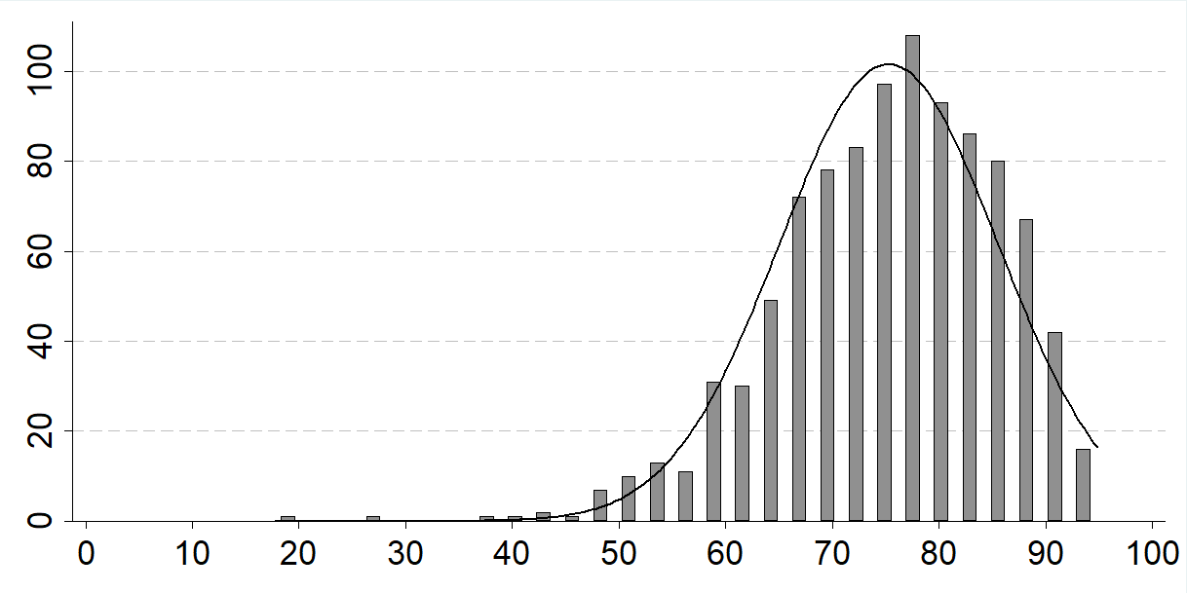
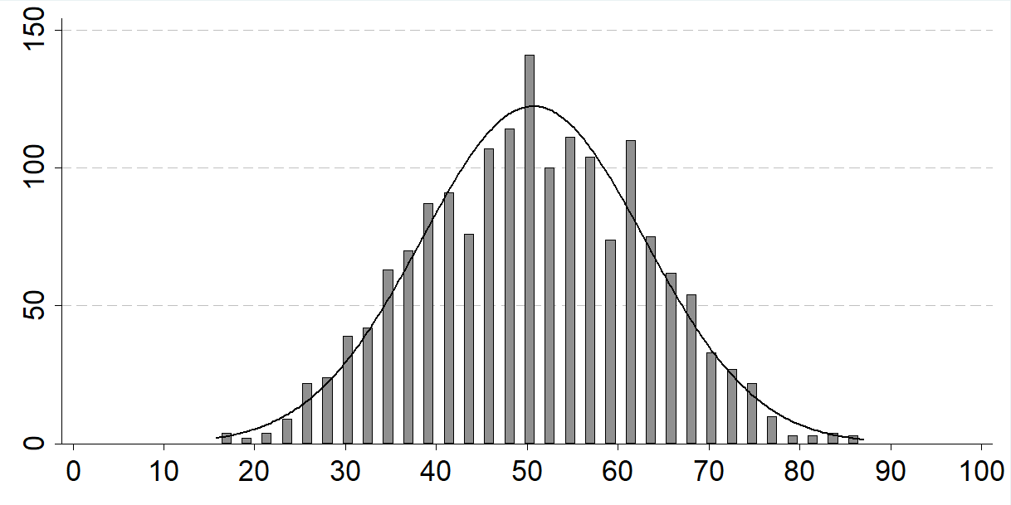
Example 1: Public Opinion Indices
Step 1: rename variables and reorder values
Step 2: rescale values to range from 0 to 100
Step 3: average values by country-survey
Step 4: average these scores by country-year
Support for Democracy
Satisfaction with Democracy

Slide 11
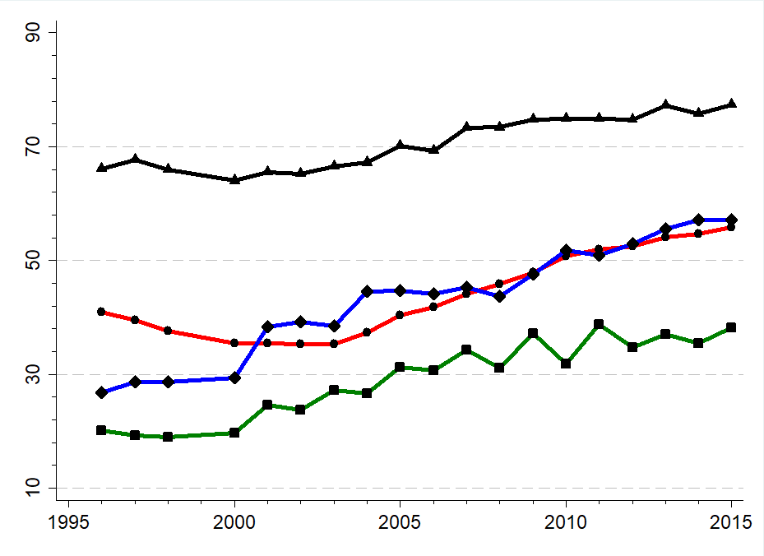
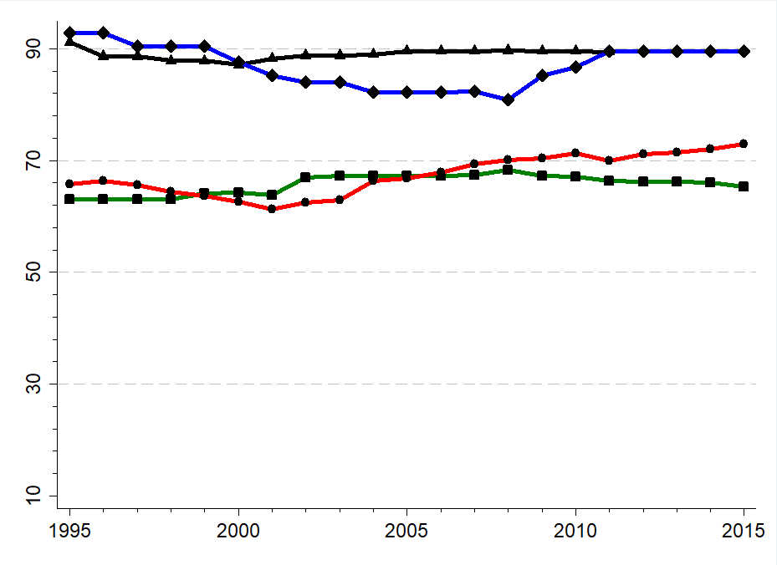
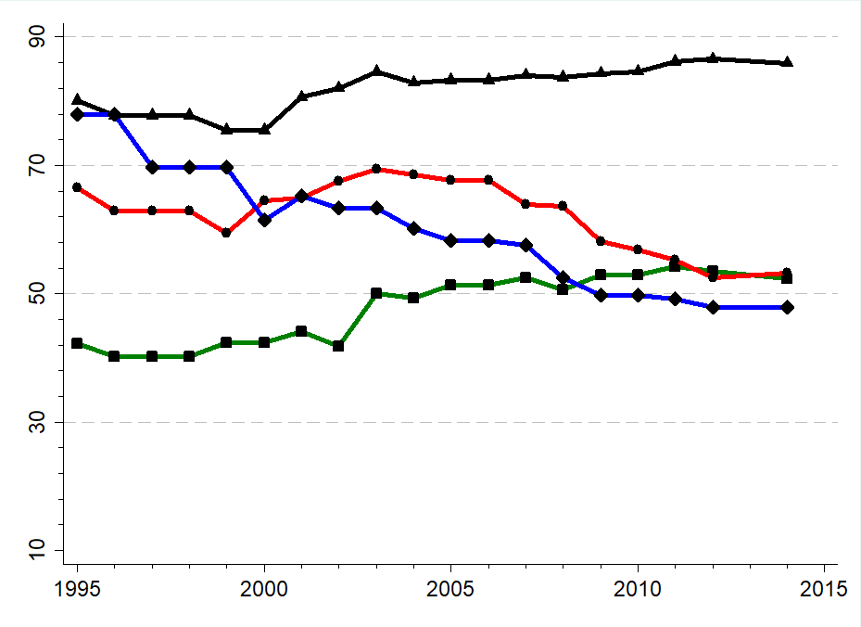
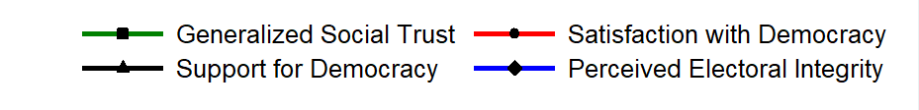
Example 2: National Indices
Six-year moving averages using country-year scores
Ecuador | Norway | United States

Slide 12
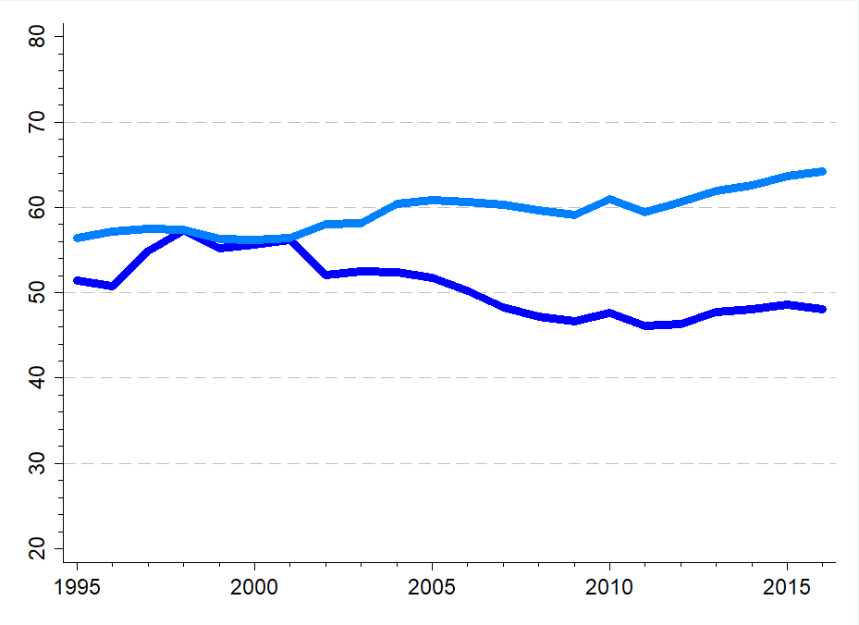
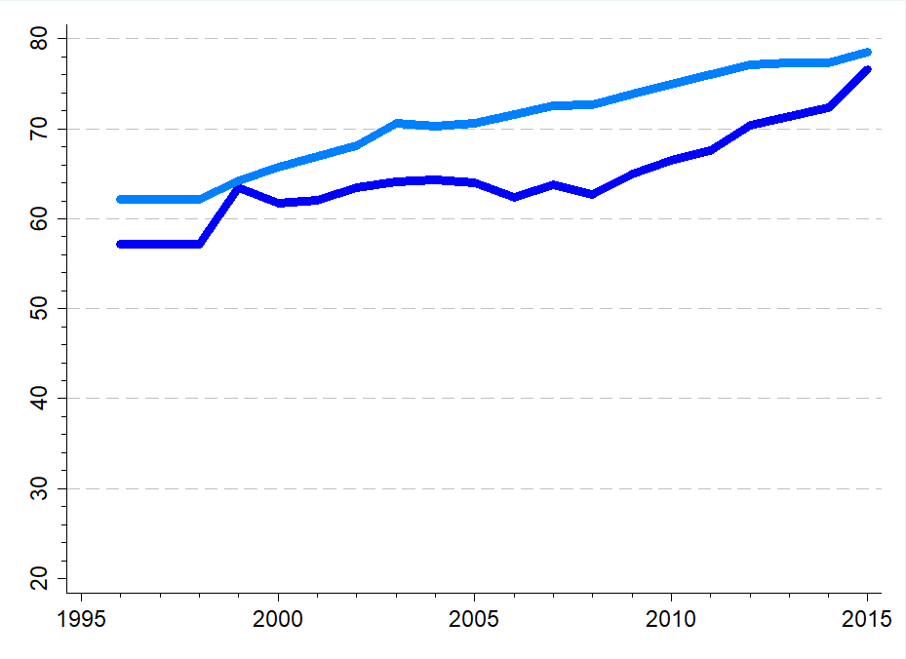
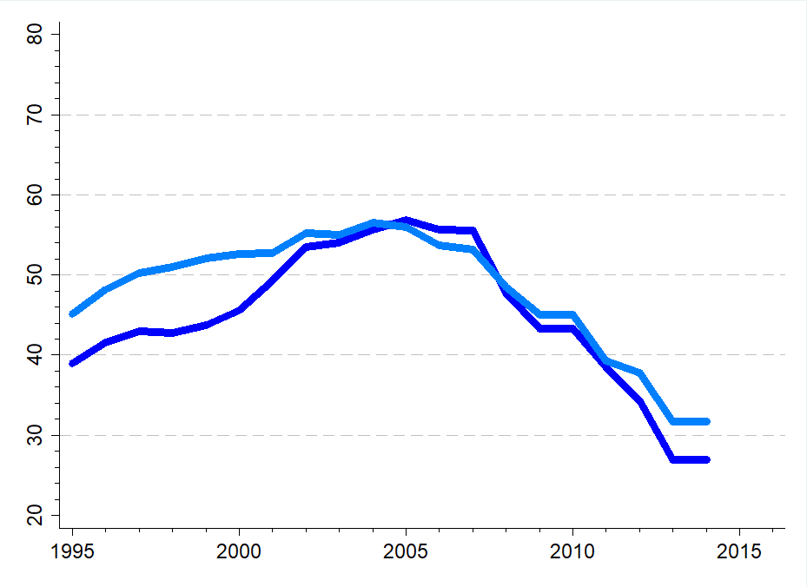
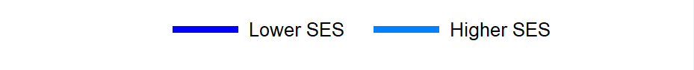
Example 3: Demographic Trends
Satisfaction with democracy of two demographic groups
United Kingdom | Switzerland | Greece

Slide 13
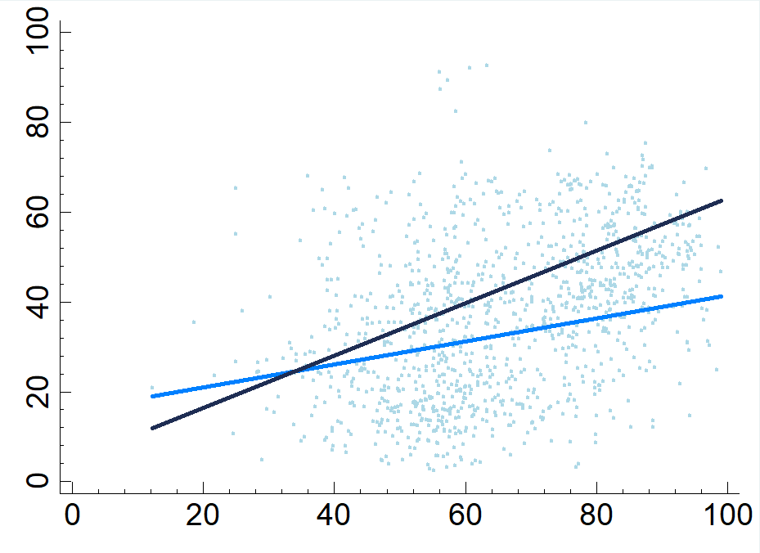
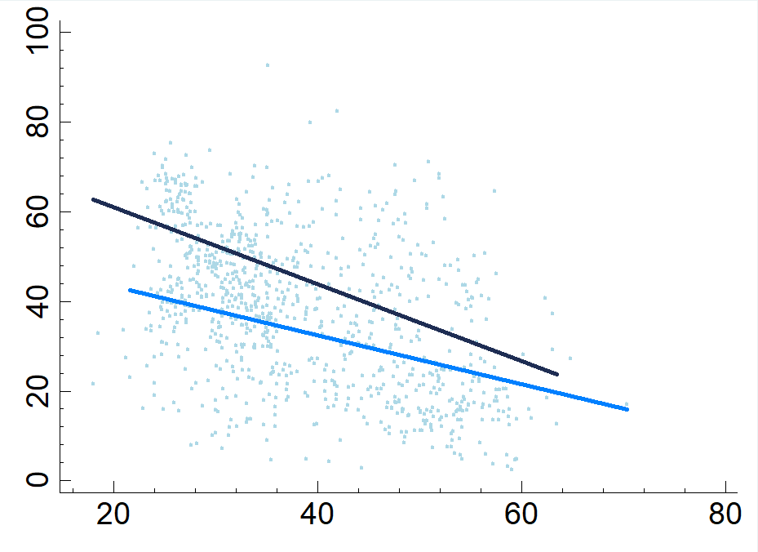
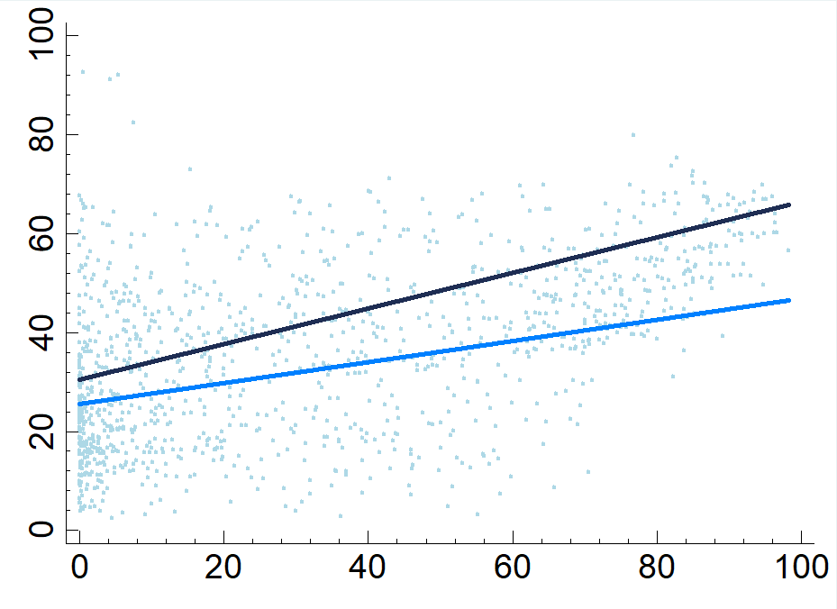
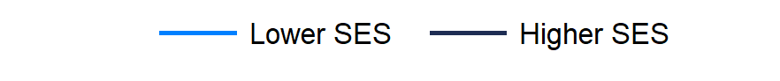
Example 4: Effects on Social Trust
Social trust of demographic groups contrast against globalization, inequality, and internet
Economic Globalization | Income Inequality (Gini) | Internet Users (%)

Slide 14
Example 5: Economic Indicators
Estimates of values with strongest effects on satisfaction with democracy
 | Positive Effects | Negative Effects
Government Debt (% of GDP) | below 42.5% | above 61.9%
Real Interest Rate (Annual %) | below 3.6% | above 4.9%
GDP Growth (Annual %) | above 2.7% | below 0.5%
Income Inequality (Gini) | 25.9 to 33.0 | above 47.5
Gov. Consumption (GDP per capita) | 0.09% to 0.14% | above 0.21%
Unemployment (% of workforce) | below 6% | above 8.4%
Inflation (Annual %) | 1.1% to 2.5% | above 4.9%
Budget Balance (% of GDP) | above -2.5% | below -3.5%
National Savings (% of GDP) | above 22.7% | below 15.7%
GDP Per Capita (current $US) | -unclear- | below $5,031

Slide 15
Considerations
Data cannot be used for commercial purposes
Using HUMAN Surveys requires also citing the data original sources
Some sources require registration, but all data is free to use
Cannot attempt to identify individual respondents
Analysis and modelling can be slow with respondent dataset

Slide 16
Conclusion
HUMAN Surveys a free resource for answering new research questions
Save time managing data and collaborate to broaden our research possibilities
Crowdsourced development model aims to operate indefinitely without funding
Existing programs could include under-surveyed countries where feasible

