Slide 1
Disadvantage and Democracy
Why Income and Education Matter for Attitudes Towards Democracy
Andrew James Klassen
andrew.Klassen@cdu.edu.au
Jeremiah Thomas Brown
jtb@unimelb.edu.au

Slide 2
crisis of citizen satisfaction
Scholars note declining citizen approval (Foa & Mounk 2016; Marsh 2014; Allan 2014; Armingeon & Guthmann 2014; Diamond 2016; Erdmann 2011; Tormey 2014; Kumlin 2010; Inglehart & Norris 2016; Bartels 2009; Achen & Bartels 2016; Dalton 2004).
Attitudes towards democracy one aspect (Webb 2013; Karp & Milazzo 2015; Loveless 2013; Foa & Mounk 2016)
Inequality a potential causal factor (Norris 2011; Inglehart & Norris 2016)

Slide 3
capability approach
Capability approach demonstrated shortcomings in other methods of assessing individual welfare (Sen 1980)
??? something on adaptive preferences ??? (_______ ____)
Inequality could explain differences in human welfare and attitudes (Burchardt 2009; Agee & Crocker 2013; Nussbaum 2001, 2011; Robeyns 2005; Sen 1980; Fuller 2011; Begon 2015)

Slide 4
??? ???
…
…
…

Slide 5
??? ???
…
…
…

Slide 6
??? ???
…
…
…

Slide 7

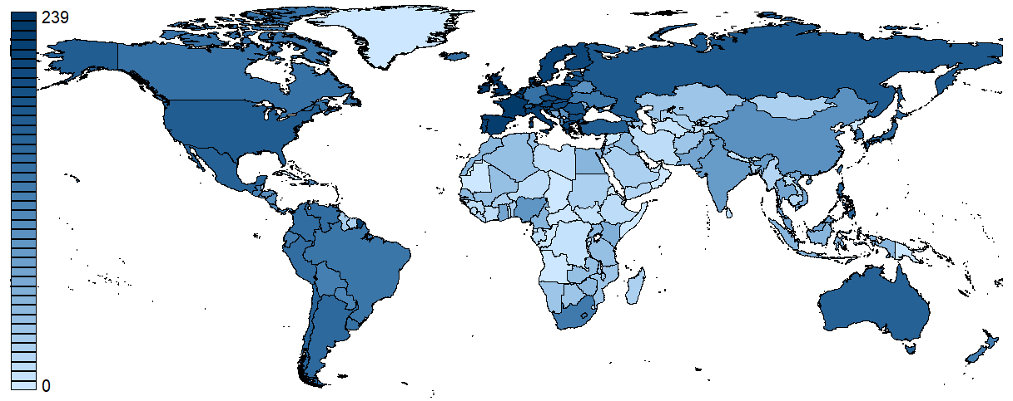

Human Understanding Measured Across Nations
https://dataverse.harvard.edu/dataverse/humansurveys

Slide 8
Afrobarometer
AmericasBarometer
Asia Barometer
Asian Barometer Survey
Consolidation of Democracy in Central and Eastern Europe
Comparative Study of Electoral Systems
Eurobarometer: Applicant and Candidate Countries
Eurobarometer: Central and Eastern
Eurobarometer: Standard and Special
European Social Survey
European Values Study
International Social Survey Programme
LatinoBarometer
New Europe Barometer
Voice of the People Series
World Values Survey

Slide 9
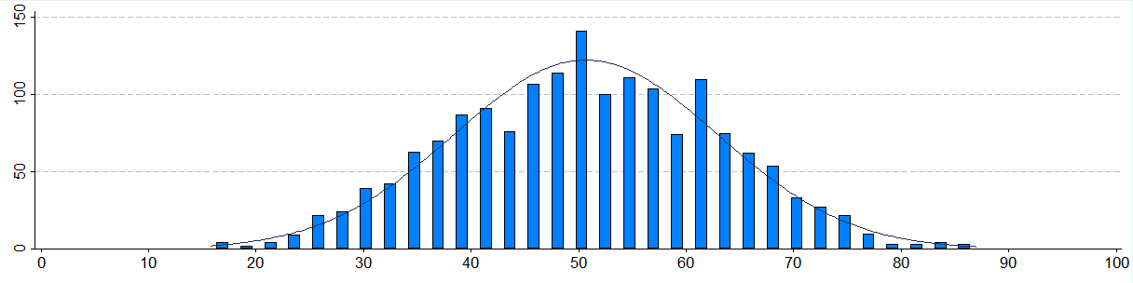
Dependent Variable
Public satisfaction with democracy
Four-point questions from respondent data
0 – 100 scale used with country-year data
Scale method: transform, double average

Slide 10
Independent Variables
Dummy variables representing respondent demographic groups
Income shares of quintiles from UNU-WIDER and World Bank
Economic indicators from International Monetary Fund and World Bank
Indices from Democracy Barometer, Economist Intelligence Unit, Freedom House, Polity IV, and Varieties of Democracy

Slide 11
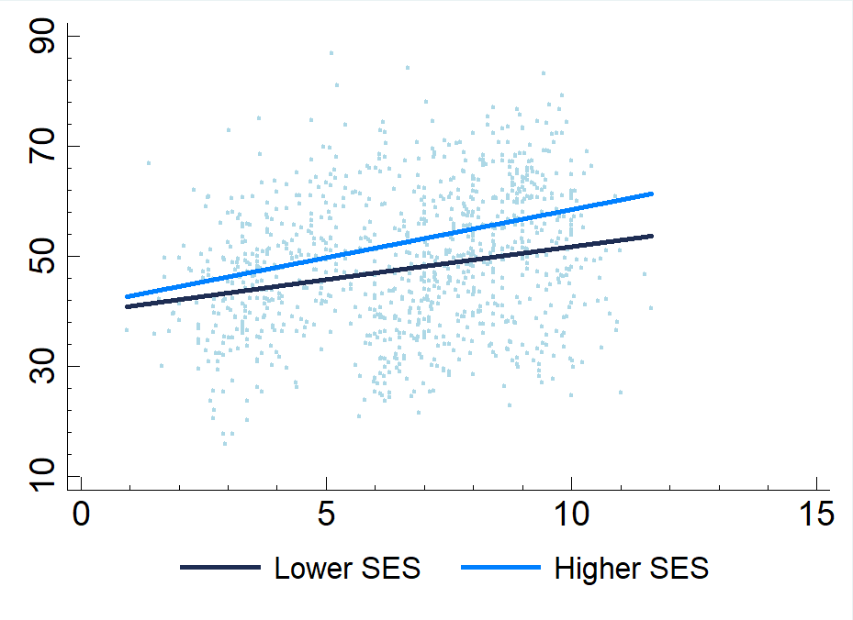
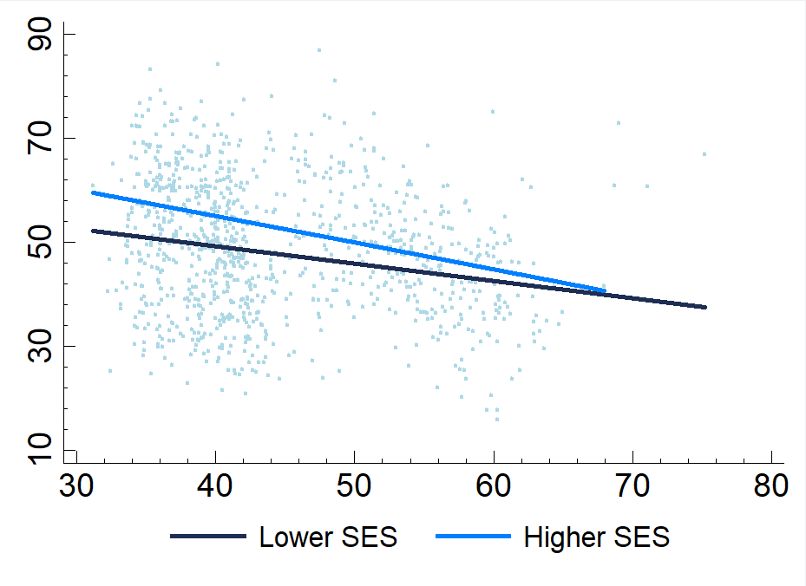
Group Differences
Satisfaction with democracy changes with income distribution
Satisfaction of different groups dependent upon relative distributions
Income Share of Lowest Quintile
Income Share of Highest Quintile

Slide 12
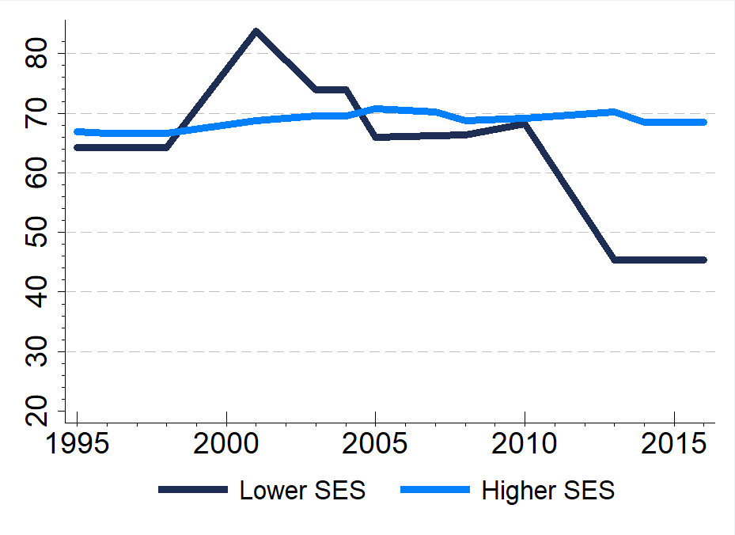
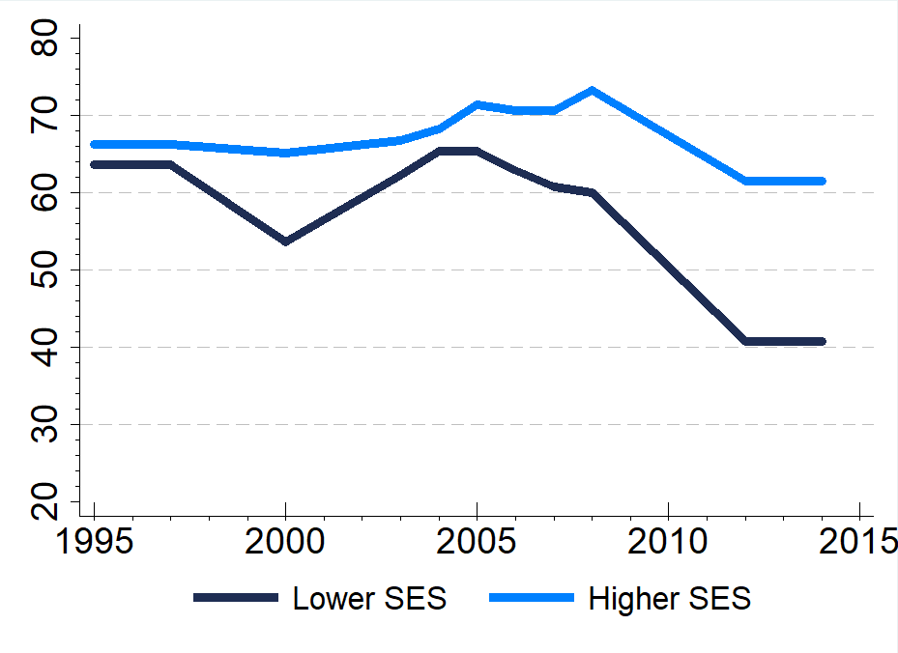
Diverging Trends
Democratic satisfaction of different groups diverging further apart in some countries
Similar trends across many developed nations around the world
Australia
Canada

Slide 13
Mixed-Effects
Model summary, excludes controls etc.
 | Lowest Quintile |  |  | Highest Quintile
 | C | SE | P | C | SE | P
Lowest Quintile x Primary Edu. | -0.010 | 0.001 | 0.000
Lowest Quintile x Tertiary Edu. | 0.013 | 0.001 | 0.000
Lowest Quintile x Lower Inc. | 0.005 | 0.001 | 0.001
Lowest Quintile x Higher Inc. | 0.001 | 0.002 | 0.377
Highest Quintile x Primary Edu. |  |  |  | 0.002 | 0.000 | 0.000
Highest Quintile x Tertiary Edu. |  |  |  | -0.004 | 0.000 | 0.000
Highest Quintile x Lower Inc. |  |  |  | -0.001 | 0.000 | 0.002
Highest Quintile x Higher Inc. |  |  |  | -0.000 | 0.000 | 0.317
Lowest Quintile Income Share | -0.006 | 0.006 | 0.350
Highest Quintile Income Share |  |  |  | 0.002 | 0.002 | 0.350
Primary Educated | 0.073 | 0.009 | 0.000 | -0.096 | 0.020 | 0.000
Tertiary Educated | -0.073 | 0.009 | 0.000 | 0.177 | 0.018 | 0.000
Lower Income | -0.108 | 0.010 | 0.000 | -0.022 | 0.018 | 0.217
Higher Income | 0.052 | 0.011 | 0.000 | 0.079 | 0.019 | 0.000

Slide 14
Index Comparisons
Higher SES produced strongest associates
Lower SES weaker and less often significant
 | Primary Educated | Tertiary Educated | Lower Income | Higher Income
DB: Democratic Quality | 0.431 | 0.560 | 0.448 | 0.480
 | 0.000 | 0.000 | 0.000 | 0.000
EIU: Democracy Index | 0.031 | 0.309 | 0.115 | 0.259
 | 0.452 | 0.000 | 0.008 | 0.000
FH: Freedom in the World | -0.028 | 0.234 | 0.047 | 0.212
 | 0.442 | 0.000 | 0.230 | 0.000
POL: Institutional Democracy | -0.049 | 0.110 | 0.003 | 0.094
 | 0.058 | 0.000 | 0.906 | 0.001
V-DEM: Egalitarian Democracy | 0.095 | 0.275 | 0.141 | 0.257
 | 0.000 | 0.000 | 0.000 | 0.000

Slide 15
???
??? few links back to capability approach ???
??? (Change this text back to white) ☺
???
???

Slide 16
IMPLICATIONS
Important for democracies to ensure relative disadvantages are not extreme
Some democratic measures disconnected from disadvantaged groups
…

Slide 17
Discussion
Societies with less relative disadvantage have higher satisfaction overall

Slide 18
Conclusion
Capability approach useful to critique inequalities beyond standard SES model
Future research can expand areas of inequality and attitudes considered

