Slide 1
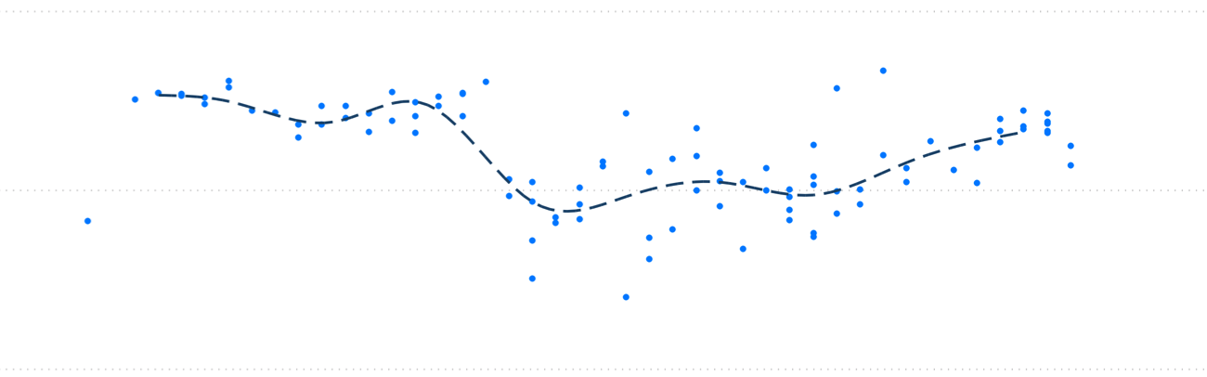
Public Opinions and Perceptions (POP)
Visualizing and Comparing Global Trends
Andrew James Klassen
andrew.klassen@cdu.edu.au

Slide 2
Overview
Data and Variables
Comparative National Trends
United Kingdom
United States
United Kingdom vs United States

Slide 3
Data and Variables

Slide 4
Data: Cross-National Surveys
AfroBarometer (AfB)
AmericasBarometer (AmB)
ArabBarometer (ArB)
AsiaBarometer (AsB)
AsianBarometer (AsnB)
EuroBarometer (EB)
Comparative Study of Electoral Systems (CSES)
Consolidation of Democracy in Central and Eastern Europe (CDCEE)
European Social Survey (ESS)
European Values Survey (EVS)
International Social Survey Program (ISSP)
LatinoBarometer (LB)
New Europe Barometer (NEB)
New Russia Barometer (NRB)
Voice of the People (VP)
World Values Survey (WVS)

Slide 5
Variable: Support for Democracy
With which one of these statements are you most in agreement?
0 | In some circumstances, a non-democratic government can be preferable to democratic government
50 | For someone like me, a democratic or non-democratic regime makes no difference
100 | Democracy is preferable to any other kind of government

Slide 6
Variable: Satisfaction with Democracy
In general, how satisfied are you with the way democracy works in this country?
0 | Very dissatisfied
25 | Dissatisfied
50 | Neither dissatisfied nor satisfied
75 | Satisfied
100 | Very satisfied

Slide 7
Variable: Perceived Electoral Integrity
On the whole, how would you rate the freeness and fairness of the last national election?
0 | Not free and fair
33.3 | Free and fair, but with several major problems
66.7 | Free and fair, with some minor problems
100 | Completely free and fair

Slide 8
Comparative National Trends

Slide 9
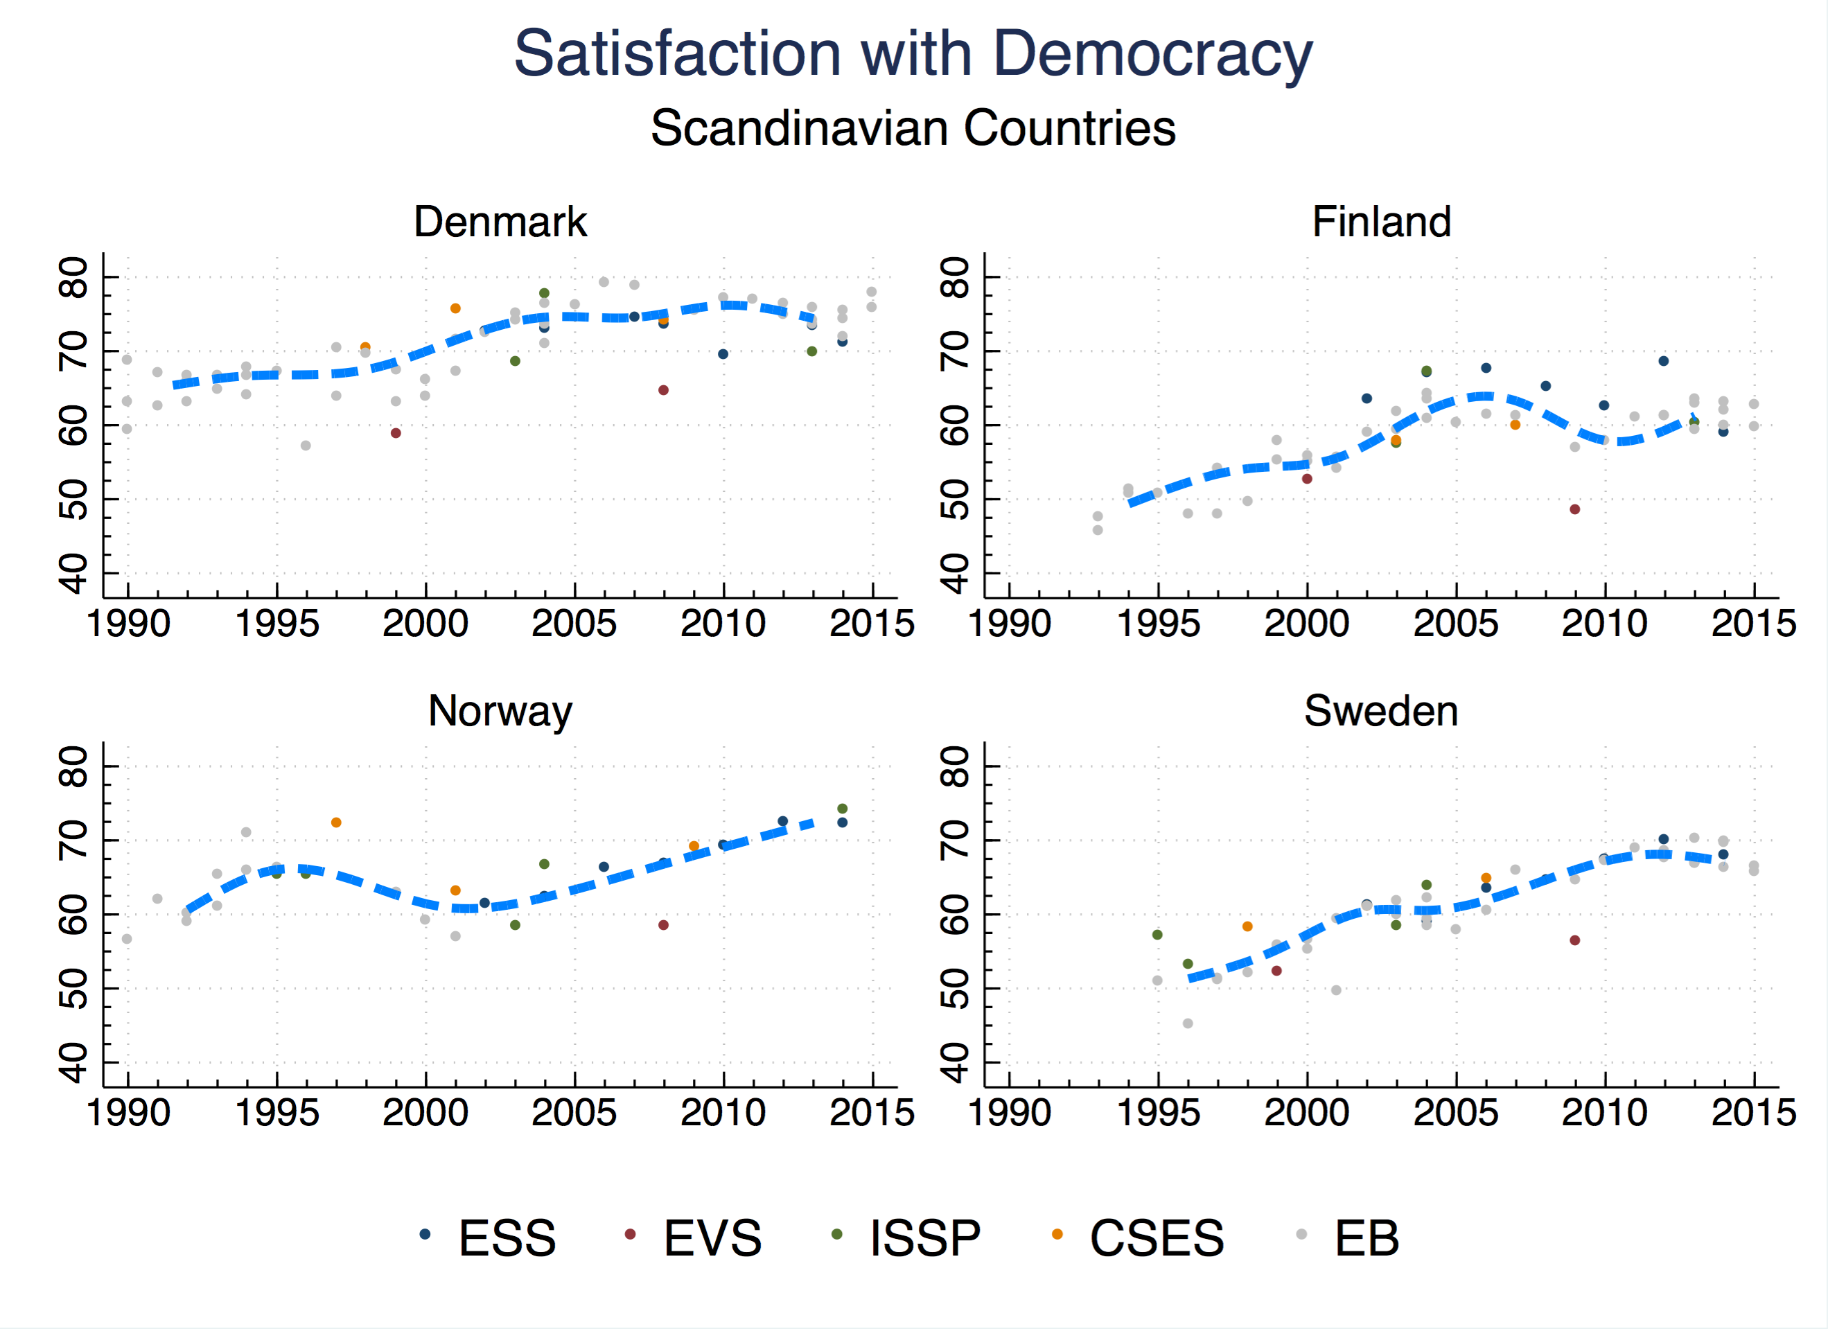

Slide 10
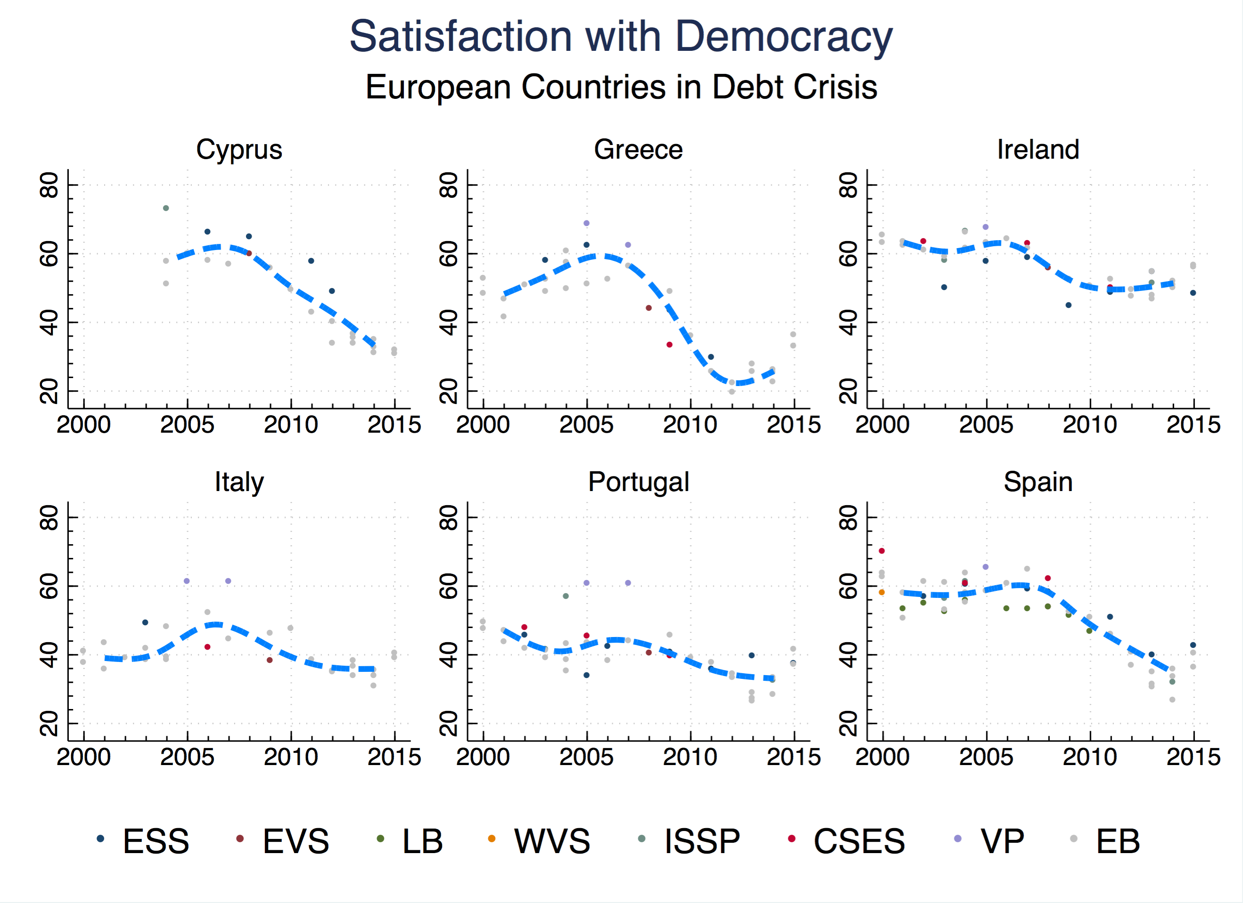

Slide 11
United Kingdom

Slide 12
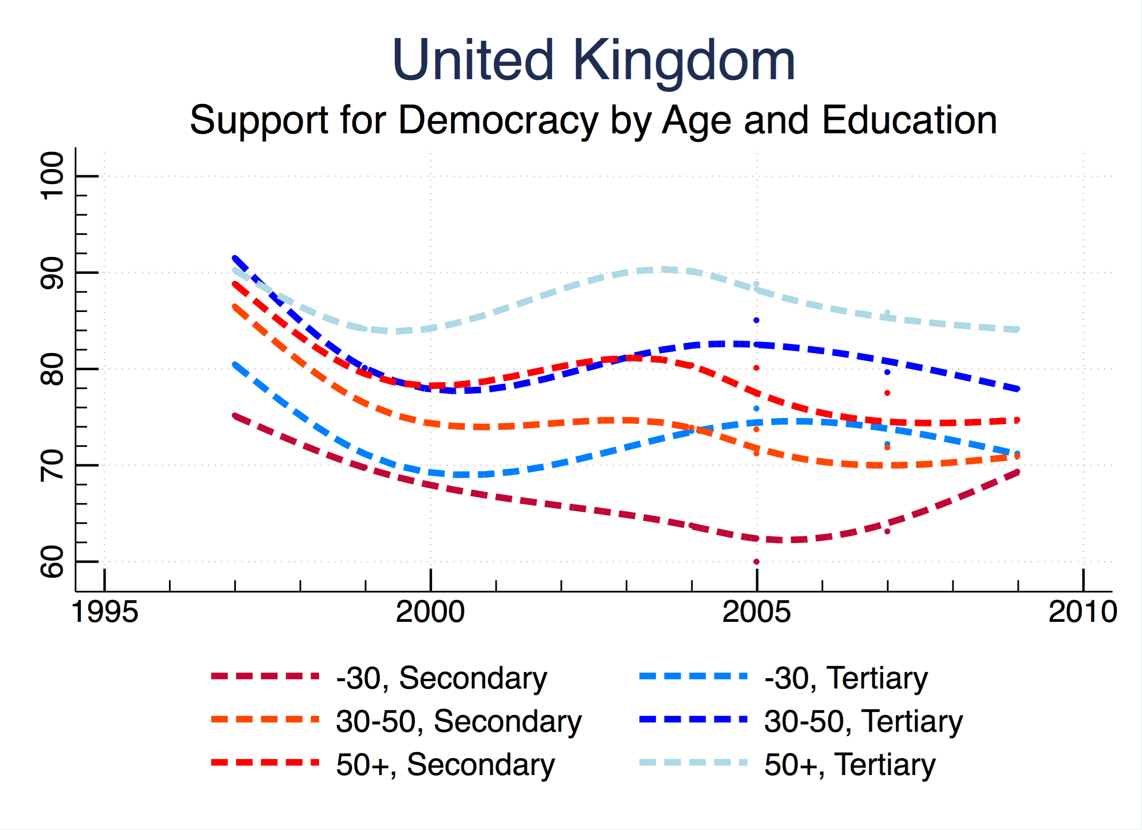

Slide 13
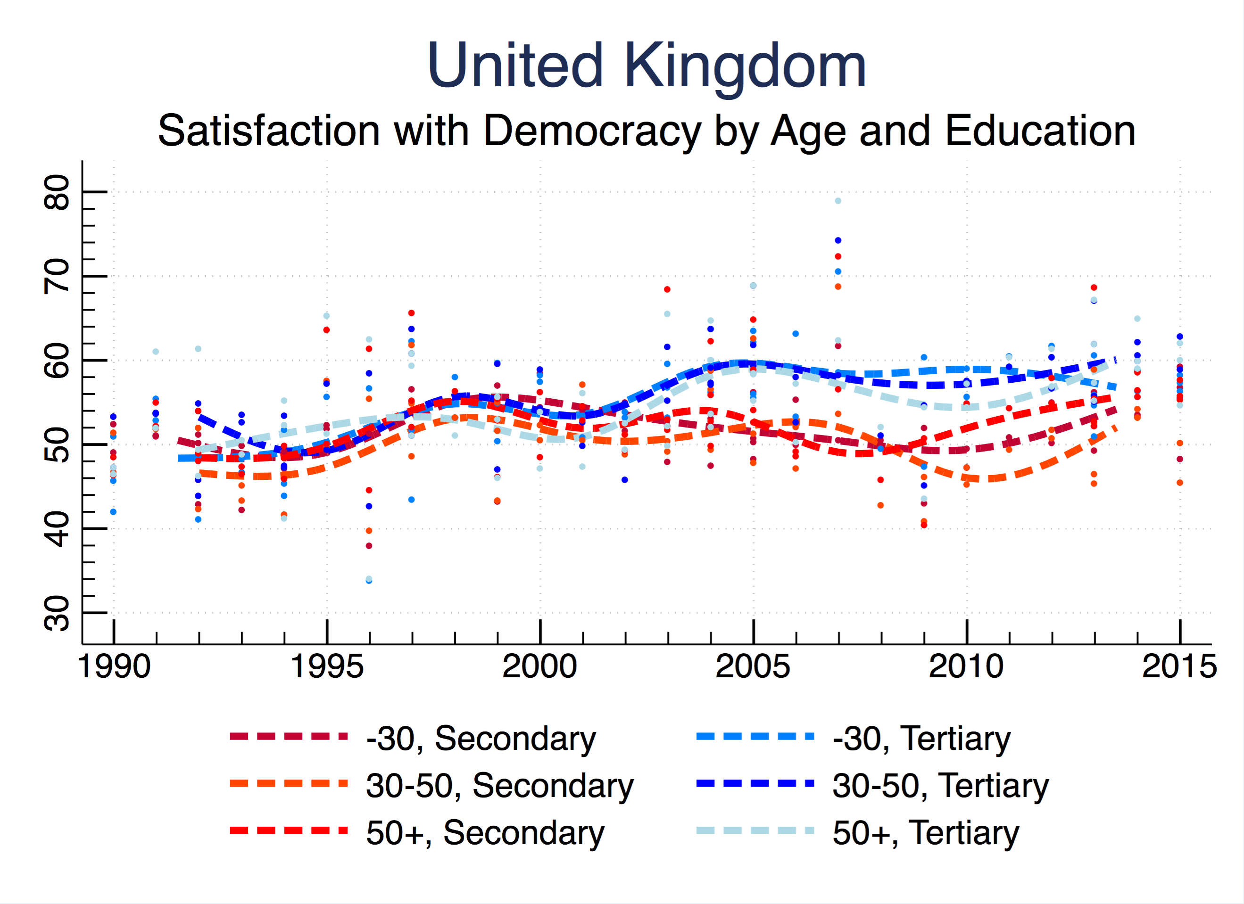

Slide 14
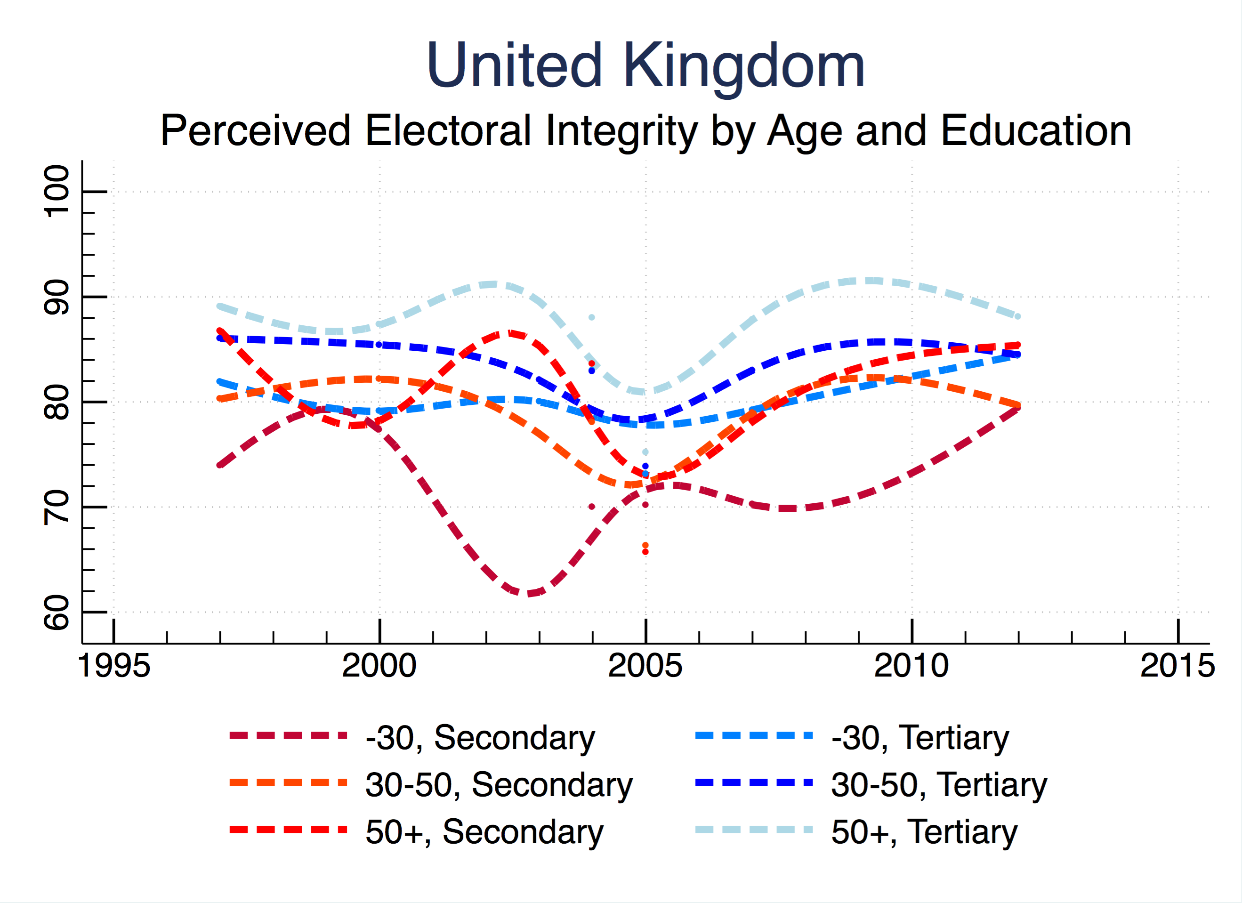

Slide 15
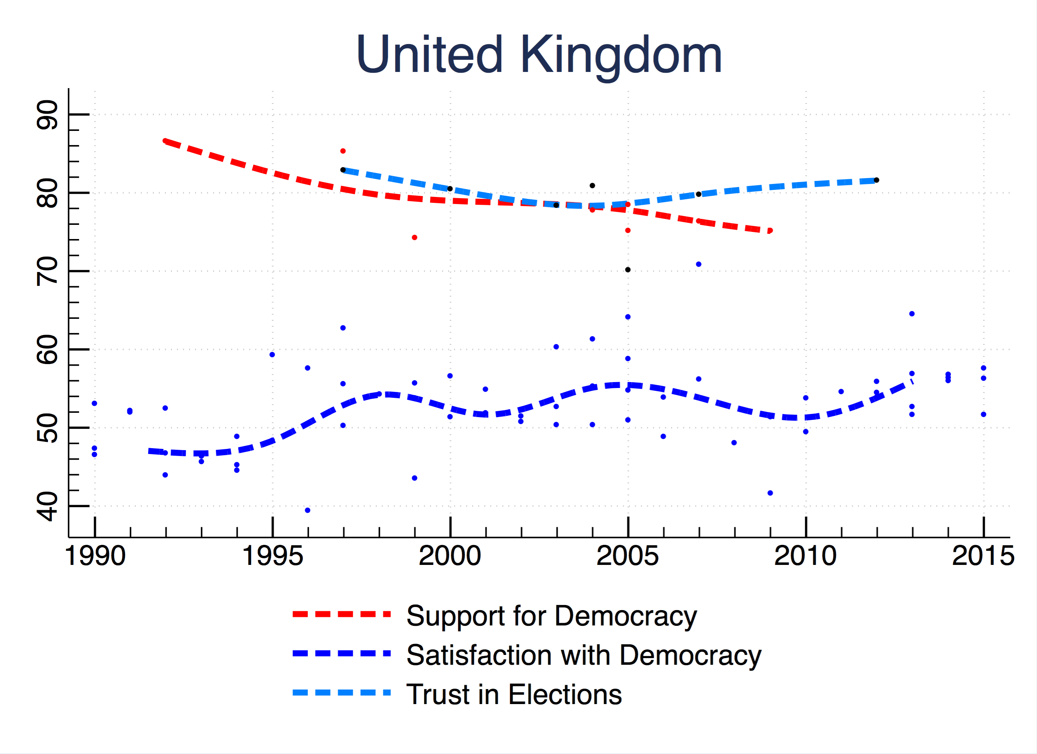

Slide 16
United States

Slide 17
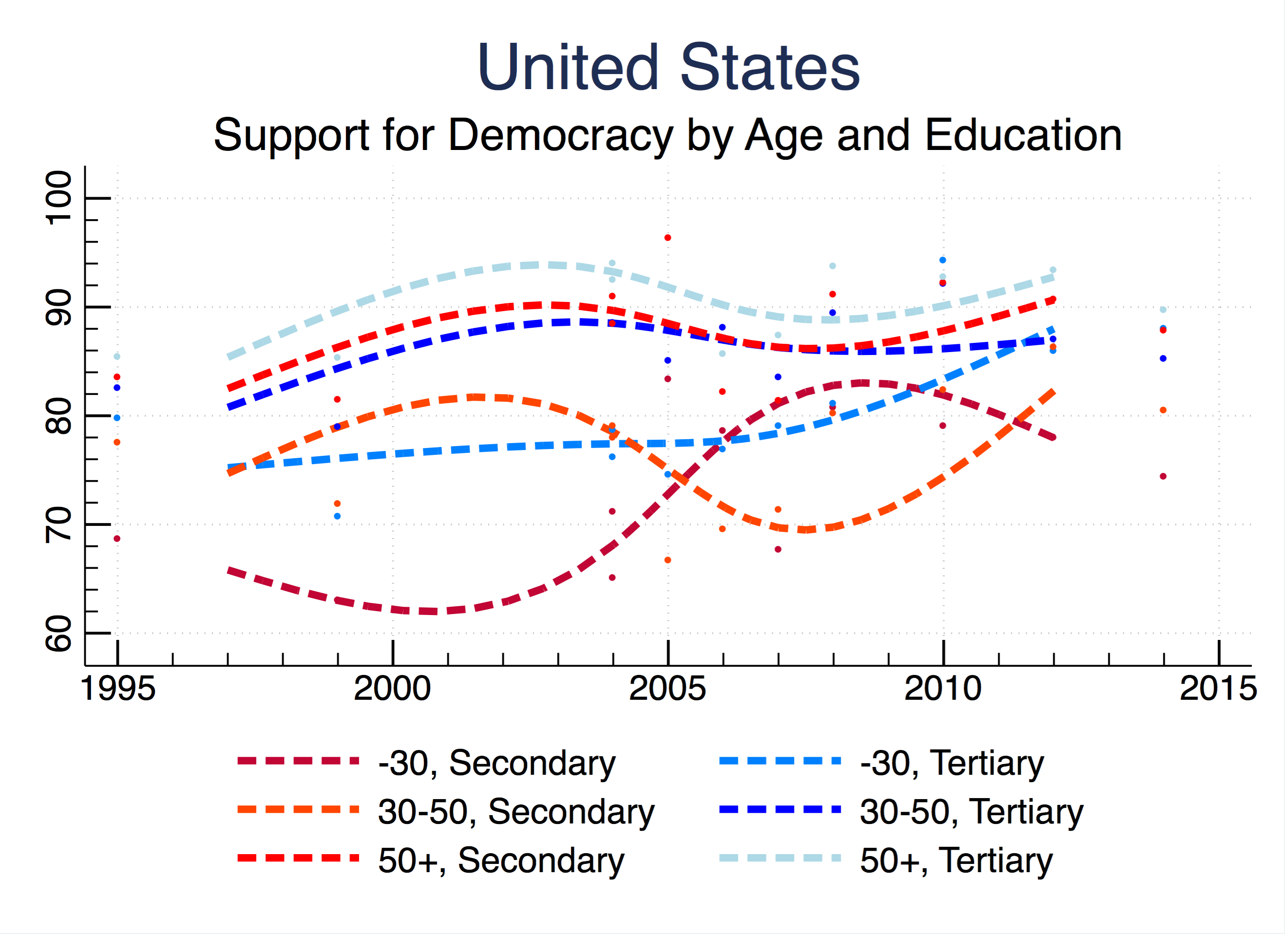

Slide 18
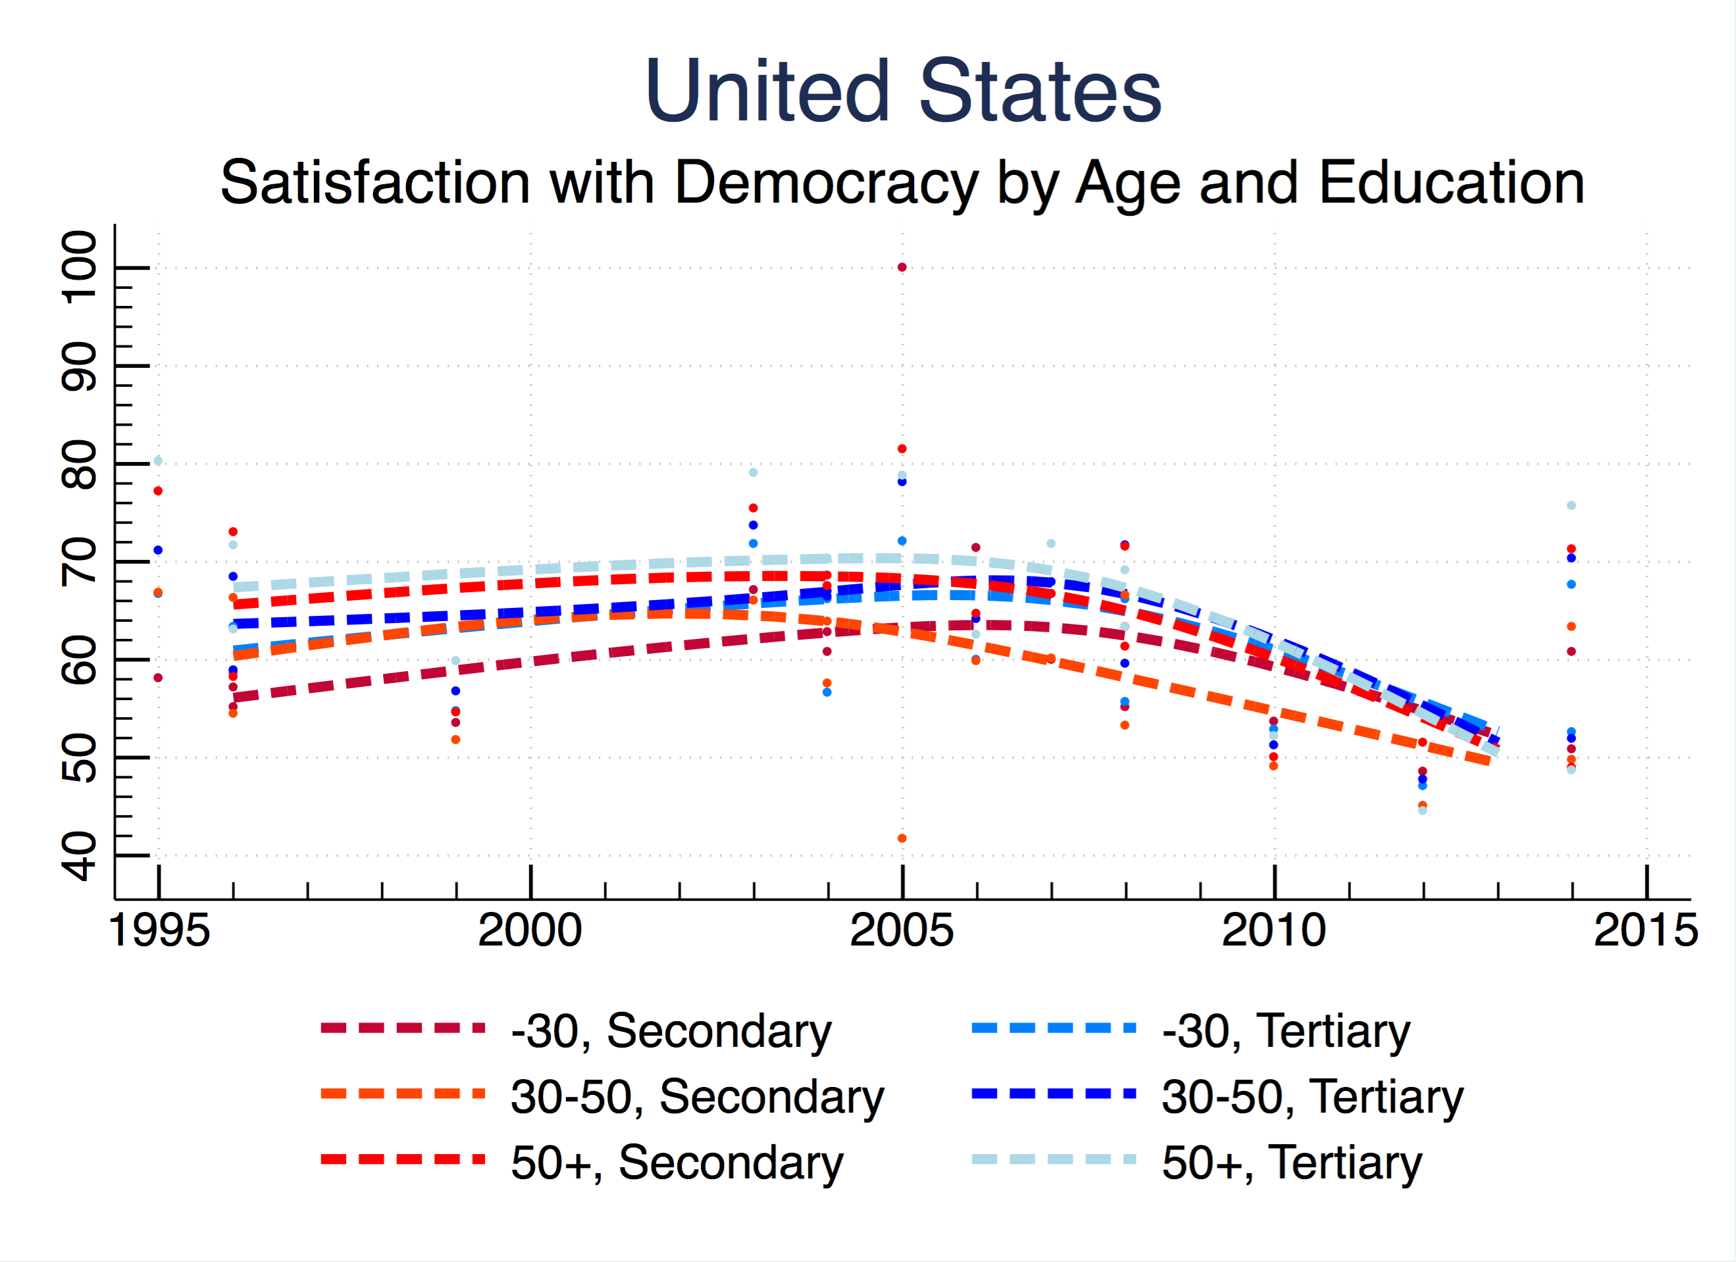

Slide 19
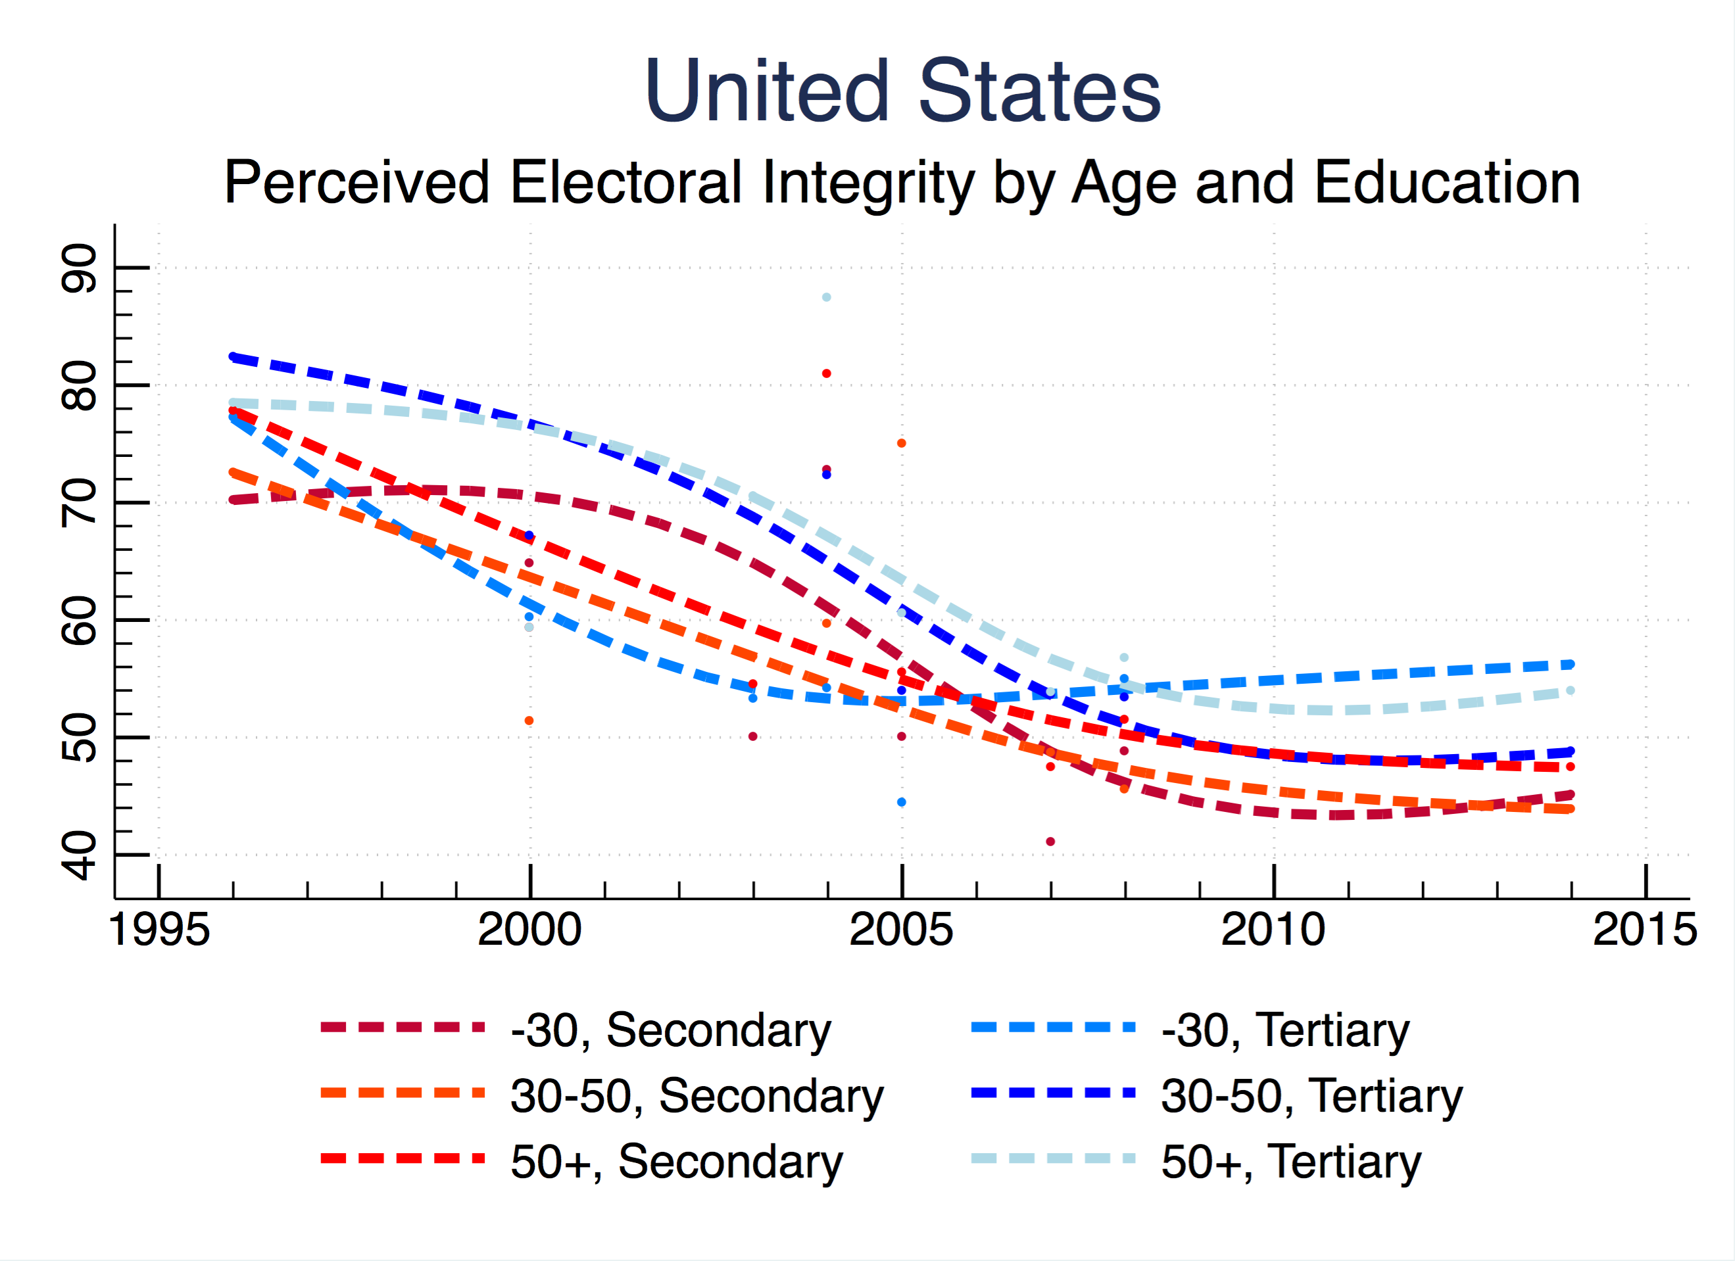

Slide 20
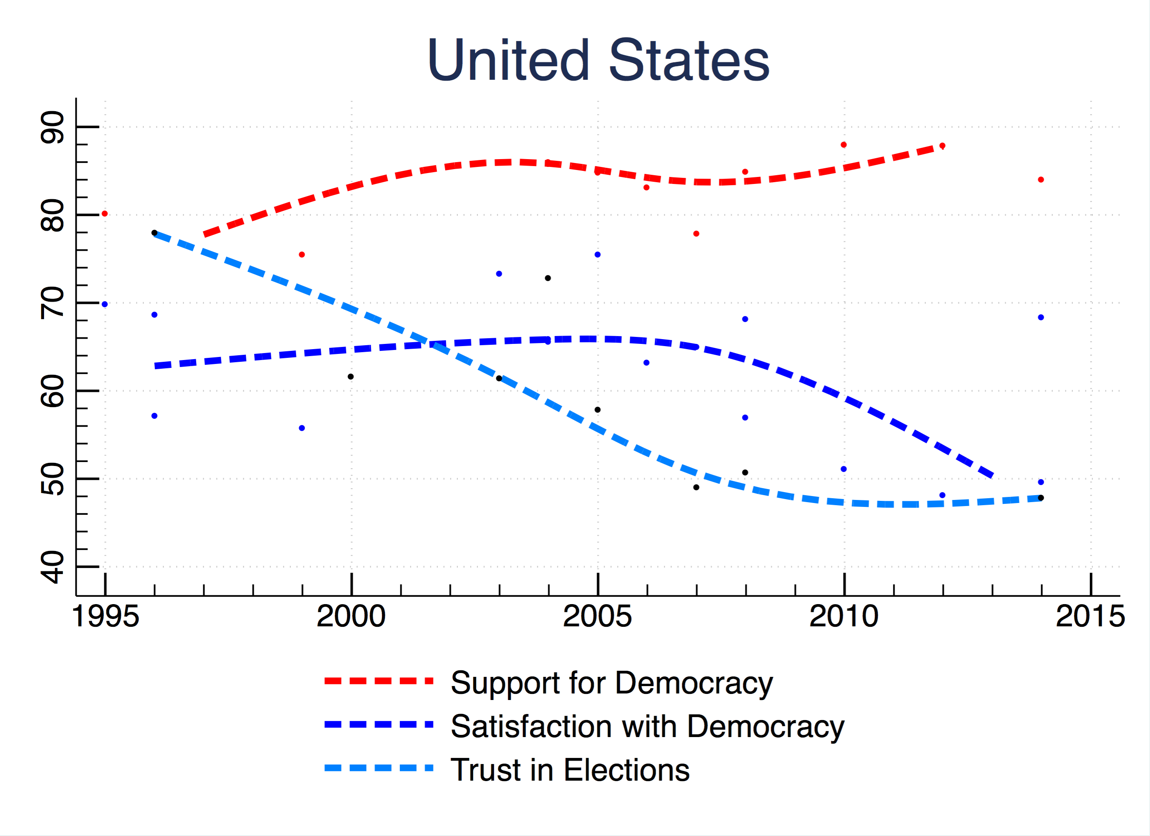

Slide 21
United Kingdom
Vs
United States

Slide 22
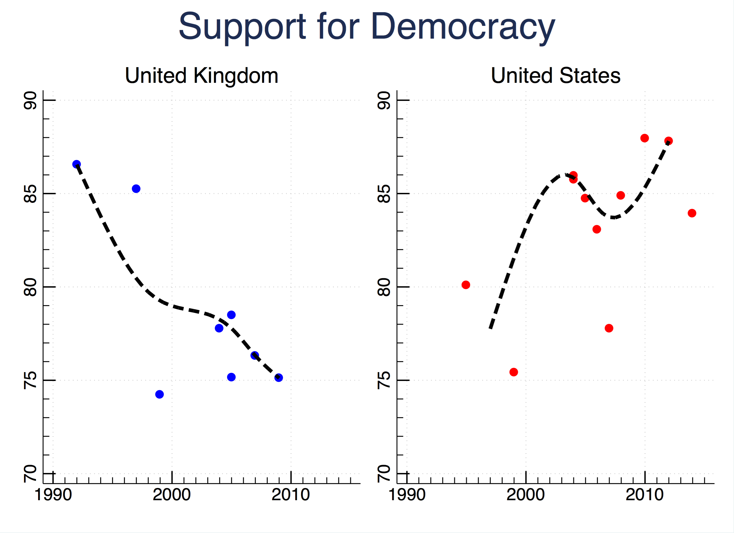

Slide 23
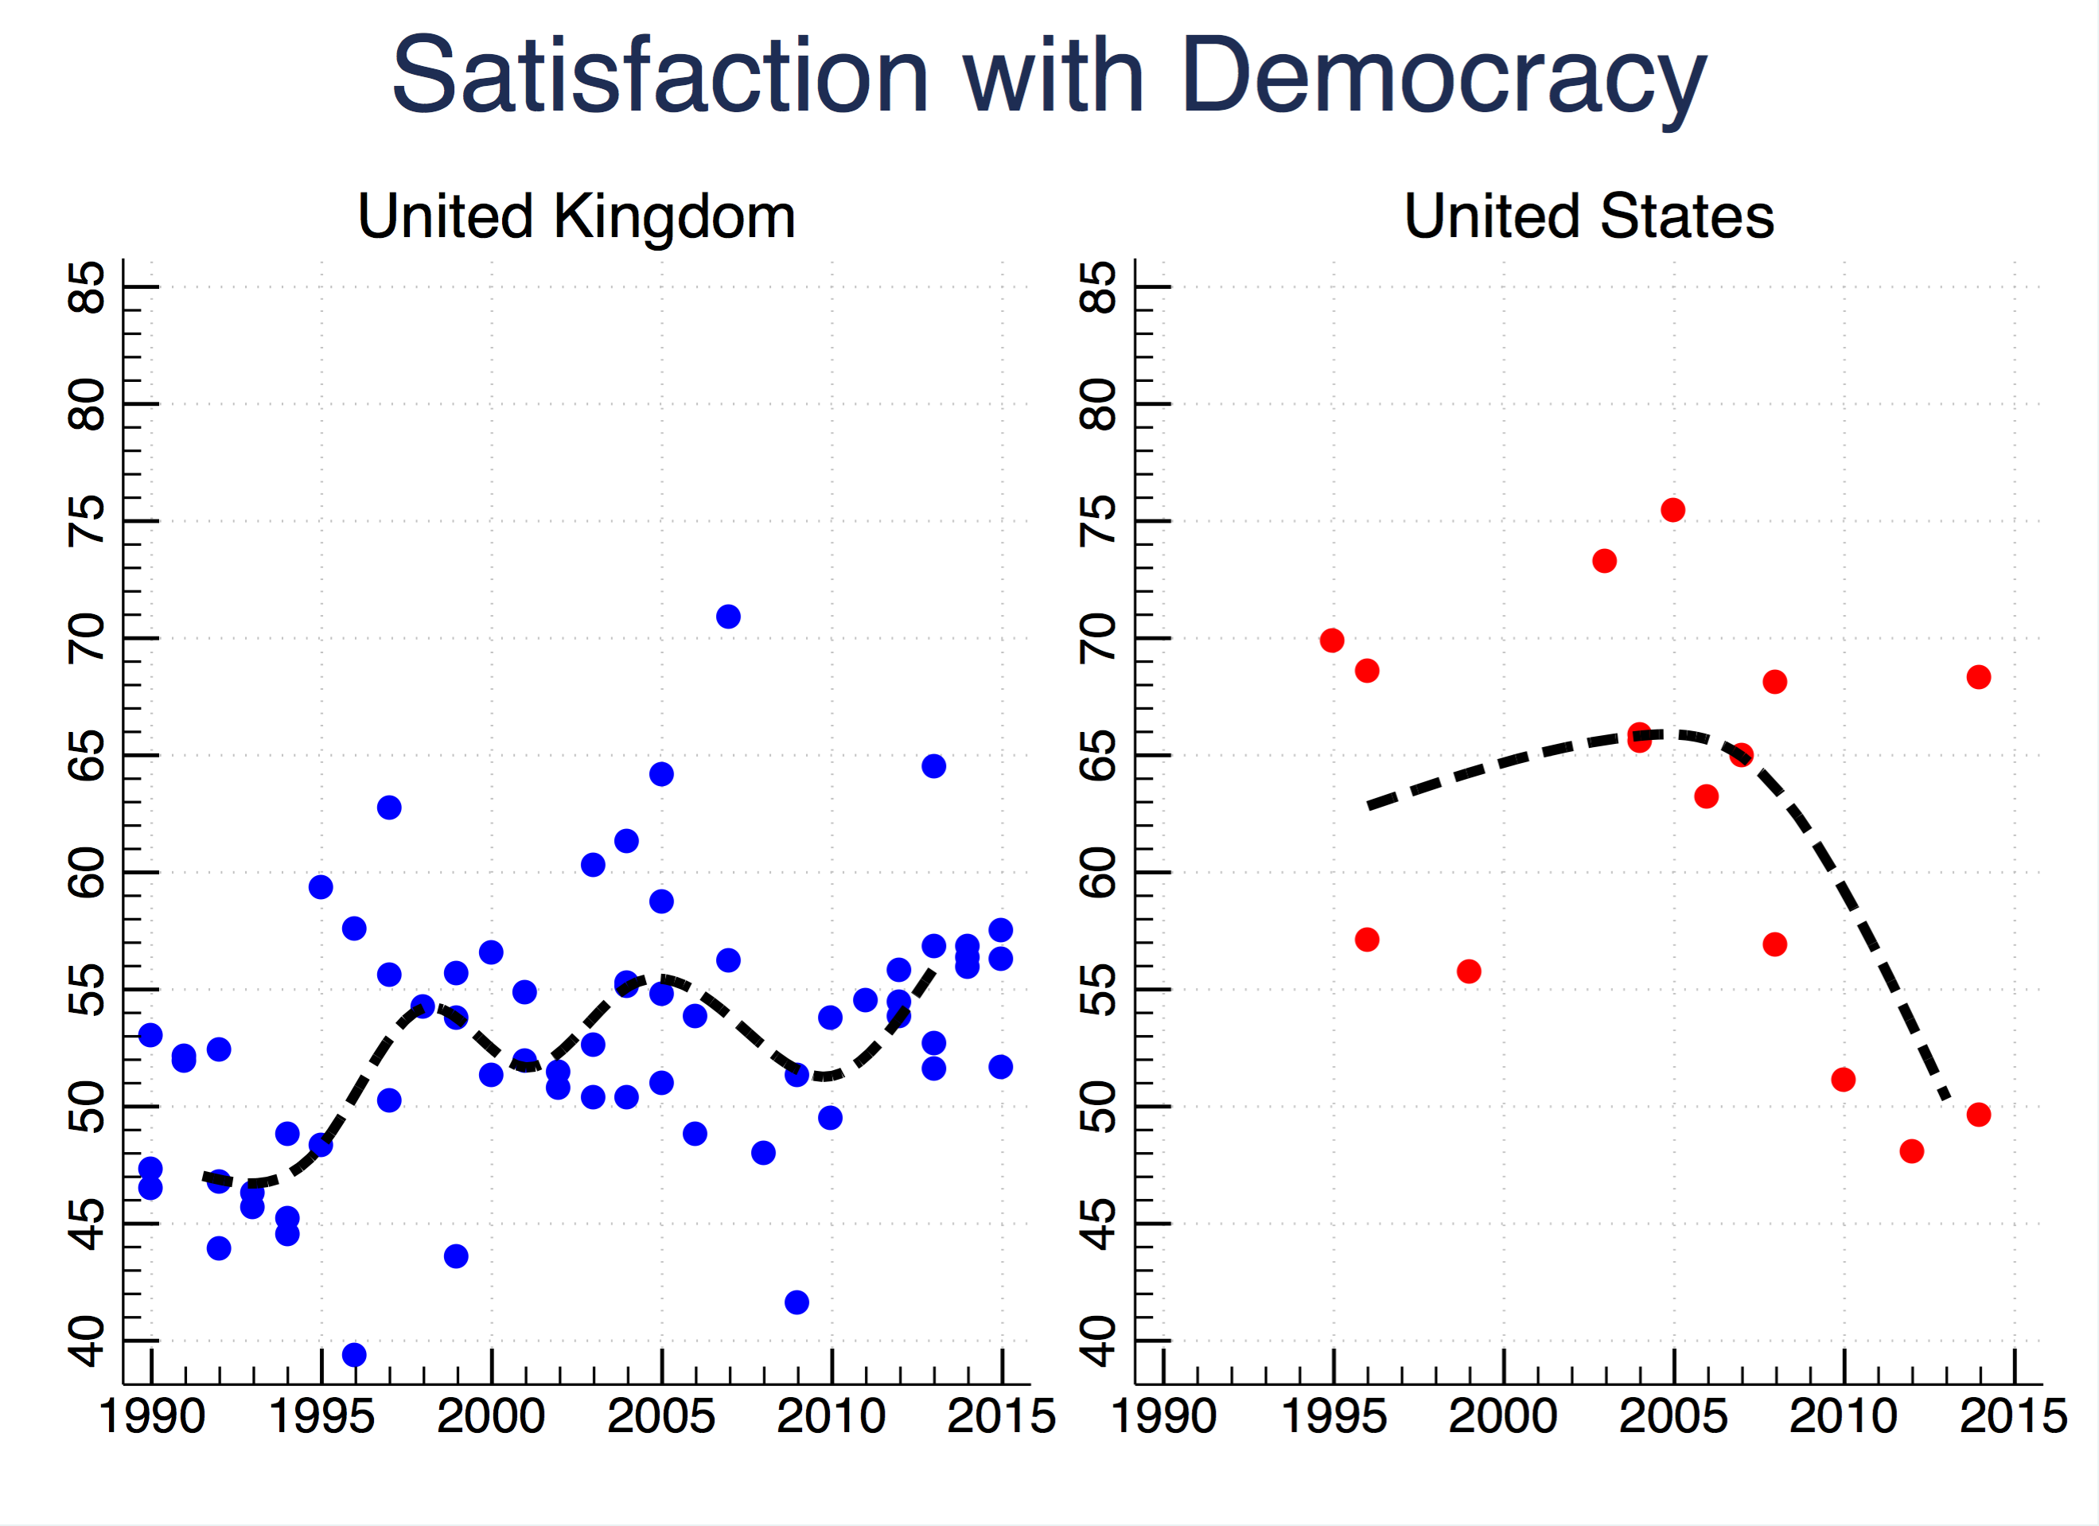

Slide 24
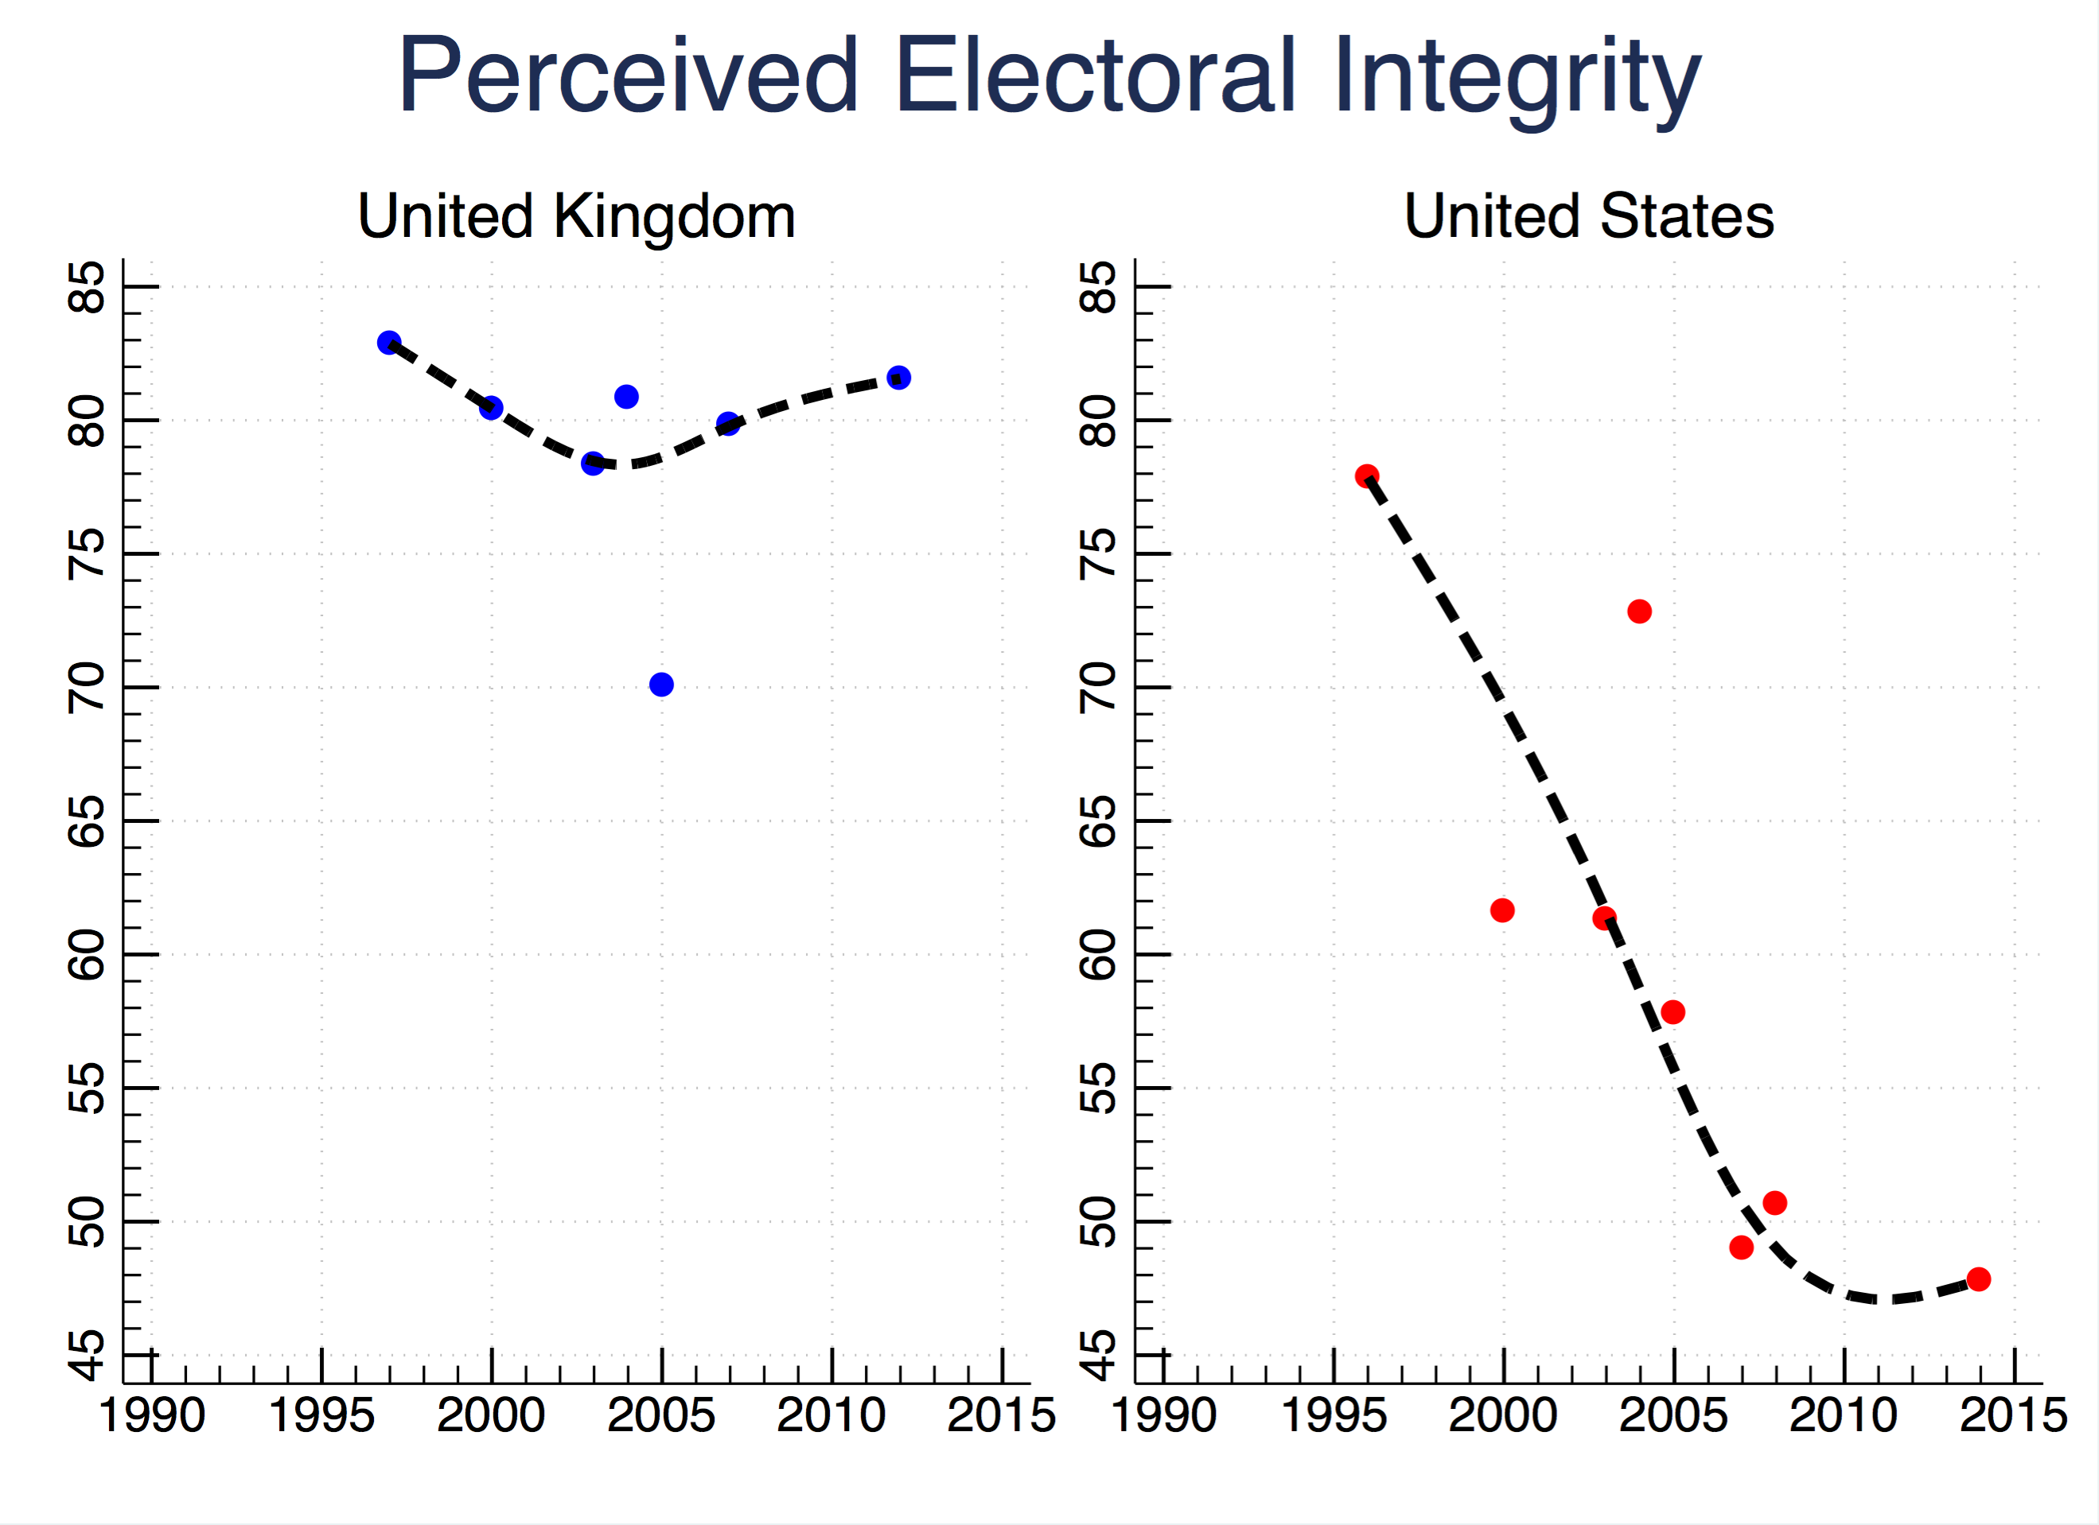

Slide 25
Thank You

