Slide 1
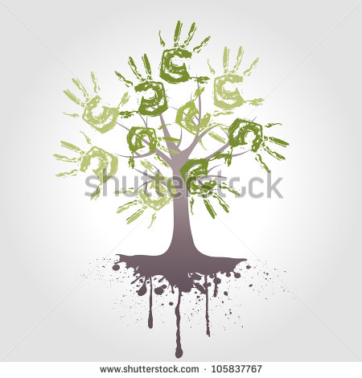
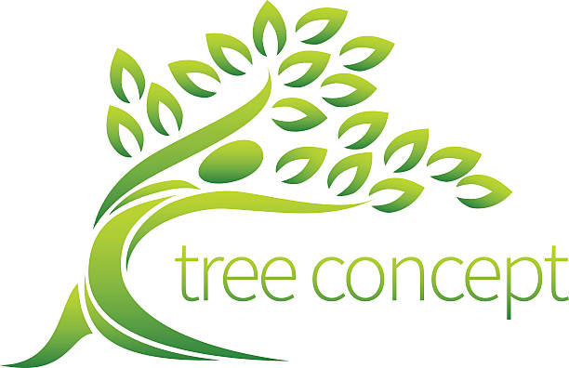
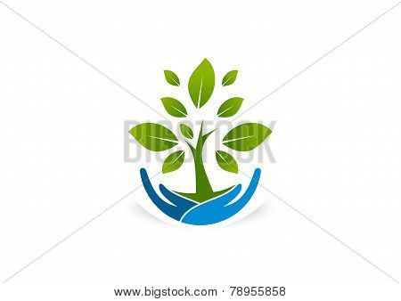
Roots too complicated but I like the hands representing human element. However, not clean look
This is a nice logo that encompass human and tree element.
Ideally, it should have a human as part of the tree logo which shows it cares for the tree/earth. Include brown, green and blue in the logo
This has human and tree element but is too common looking

Slide 2
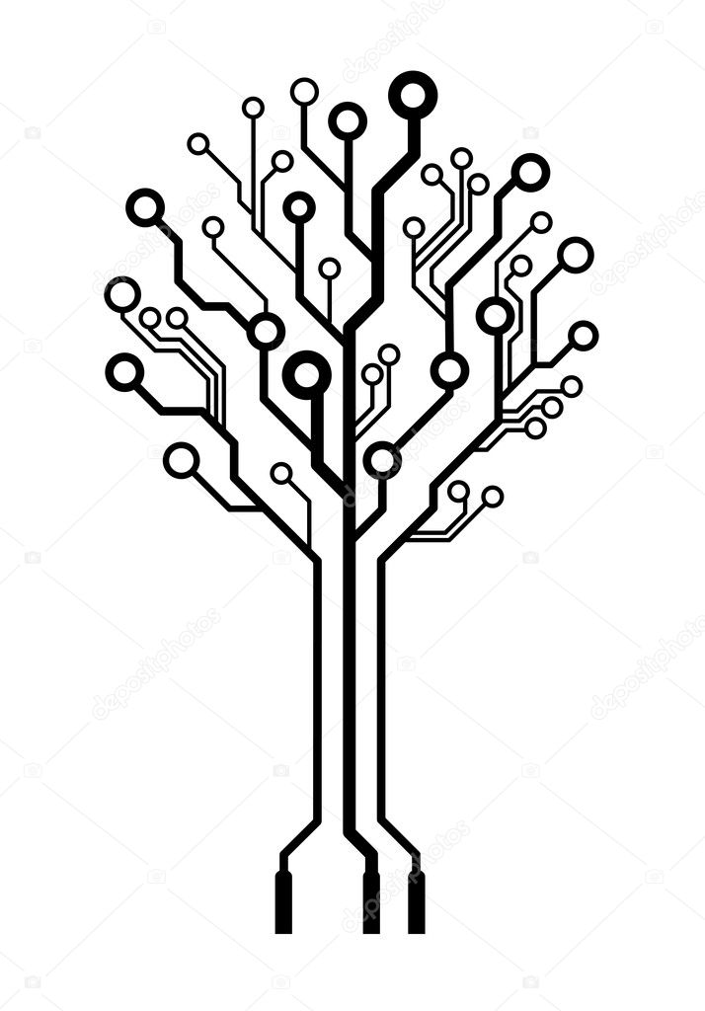
This concept is more techy.
add social element plus colour to this
Need to improve the look of this

