Slide 1
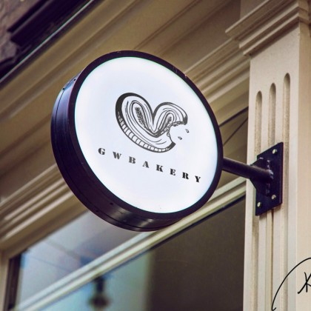
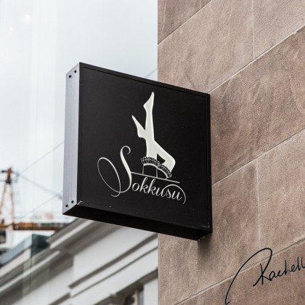
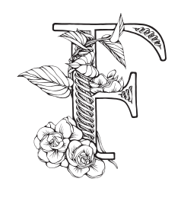
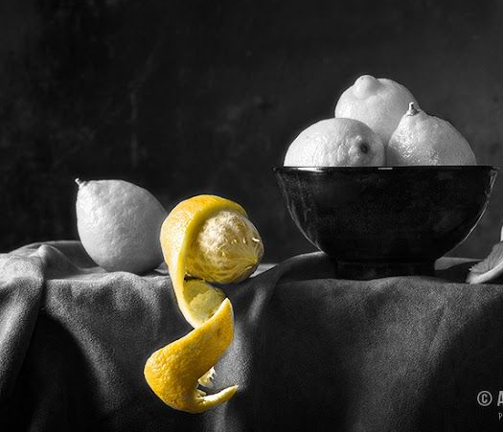
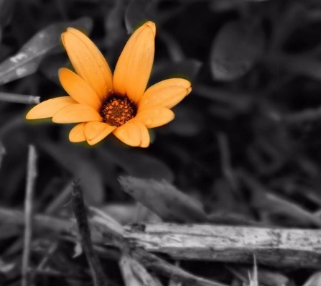
E
A logo design like the example, BUT what I am after is a design for the letter “E”.
I want the design to be the letter but with some sort of evolution of dining or food concept built into it. like the F example below
E
Evolve
Evolve
E
E
Evolve
Evolve
Only black and white as the main colours but a tiny splash of colour incorporated could be nice to, like the painting examples.
Using the letter F as an example maybe making one of the flowers bright yellow or a leaf green.

