Slide 1

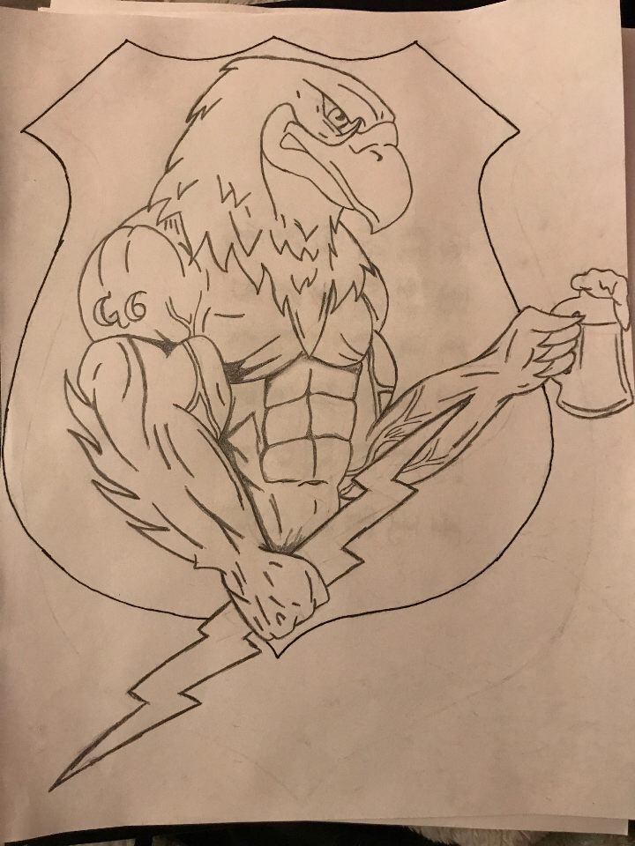
Went with a Fire Shield aka a Firewall look
G6 at the Center with Departments that help make up the shield of defense
Information Management
Information Support
Network OPS
NCNG – G6
Mission Command
01000111
00000110
Secure and Defend the Network
Service Support
Security Ops

