Slide 1


@VerbistEtienne
The New Art Economy
Auction Houses DISRUPTED

Slide 2


Slide 3


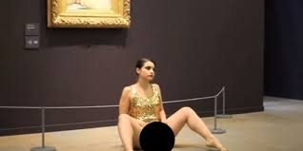
Notes:
all text blocks must be filled in red and the letters in white :
on every slide please
Background needs to be changed

Slide 4






The Auction Houses Disrupted
Notes:
I need 6 bullets
all title text blocks must be filled in red and the letters in white

Slide 5


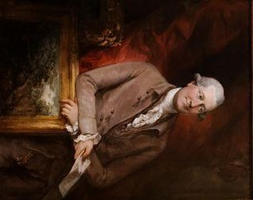










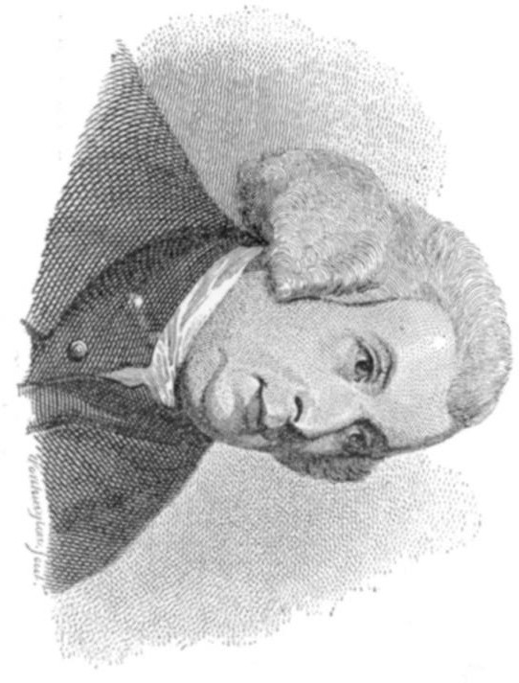










Notes:
Portrait -Horizontal please
all title text blocks must be filled in red and the letters in white

Slide 6



















































































Notes:
Horizontal –Portrait
Time line in RED/White letters
all text blocks must be filled in red and the letters in white

Slide 7










































































Notes:
Horizontal
Change in the timeline 2016 to 2018
all text blocks must be filled in red and the letters in white

Slide 8




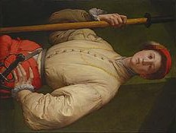
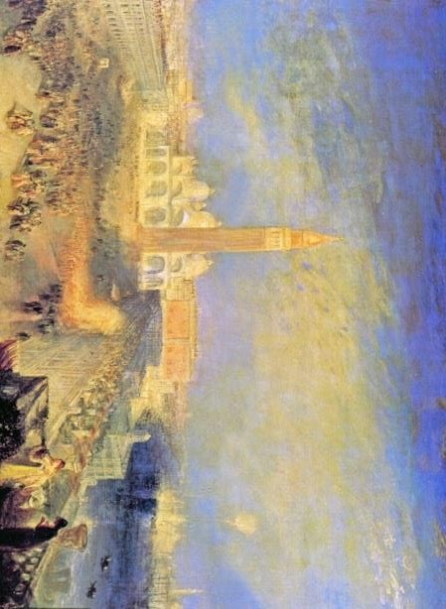





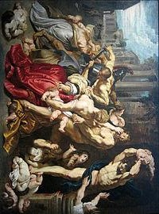










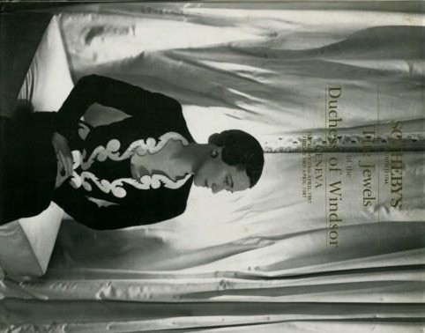













Notes:
all text blocks must be filled in red and the letters in white

Slide 9
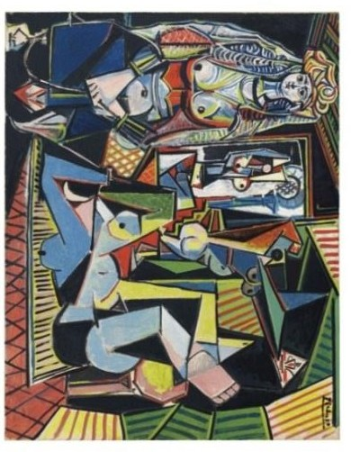


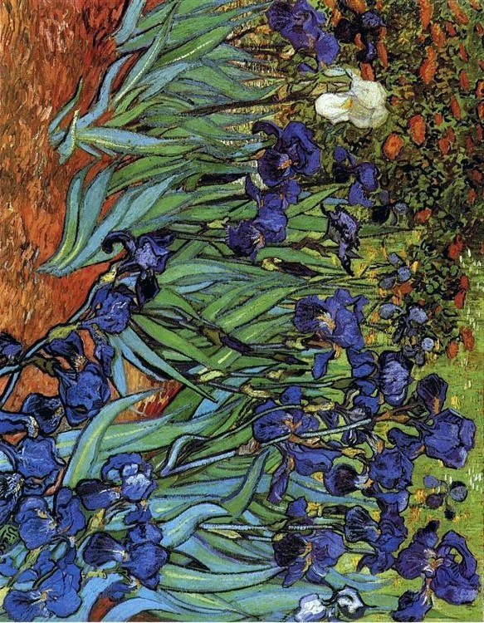







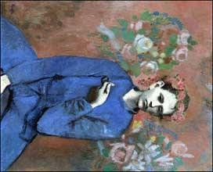

































Notes:
all text blocks must be filled in red and the letters in white

Slide 10
Title :The Auction Records 2017
Notes:
Title :The Auction Records 2017
Add all pictures & titles from the link bellow
https://www.artsy.net/article/artsy-editorial-expensive-artworks-sold-2017

Slide 11
























































































Notes:
Alltitle text blocks must be filled in red and the letters in white

Slide 12


The Disruptors

Slide 13




































Notes:
all text blocks must be filled in red and the letters in white
The date 2015 to be changed in 2018

Slide 14
Blockchain –Certification – for Trust
Verisart
Bronzechain
Ascribe
Magnus
Notes:
Verisart

Slide 15






















































•
•
•
•
•
•
•
•
•
Notes:
Alltitle text blocks must be filled in red and the letters in white

Slide 16







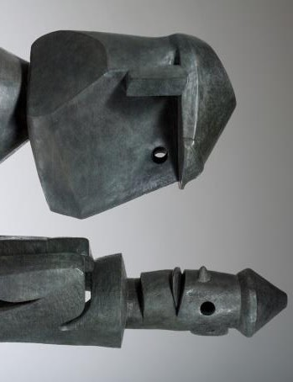



































Notes:
all text blocks must be filled in red and the letters in white
Ad : PRO …On the same line as Against

Slide 17


























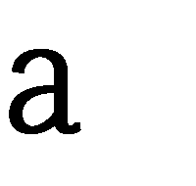










































▌
▌
▌
▌
Notes:
all text blocks must be filled in red and the letters in white

Slide 18


Notes:
all text blocks must be filled in red and the letters in white

Slide 19

Etienne Verbist

