Slide 1




Slide 2

About Us
Privately held business established in 2011
Innovators in technology
Specialists in Corporate Transfers
Extensive Network across all major cities in Australia
Coverage in selected cities internationally
Trusted by some of the largest TMCs in the country
www.gpu.travel

Slide 3

Our Drivers
Discreet and Professional
GPU partners with Industry Established, Authorised, and Insured Drivers
Extensive pre screening checks
Driver service commitment
“Driven” by Continuous Improvement.
GPS tracking on on time performance monitoring

Slide 4
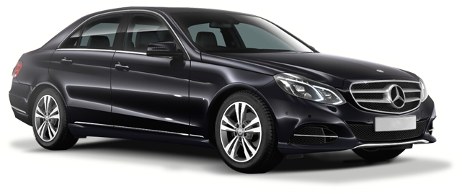
Our Vehicles
Late model vehicles ranging from Holden Caprice to Mercedes & European Vehicles
Various vehicle types available - Sedans, People Movers and Buses
Smart Drive option with complementary Wi-Fi and water

Slide 5


The GPU Difference
Technology driven business
On Time - Guarantee
Fixed, All Inclusive Pricing
360 Degree Feedback
Preferred Drivers by city by traveller
Driver Contact Information provided on booking
Reconfirmation 4 hours prior to all bookings
Pre Trip Driver Safety Declarations

Slide 6
The GPU Difference
Australian Based 24 hour Call Centre
Booking 24 hours a day with Easy to Use online booking portal
Client App for booking and job management
Account management with individual traveller preferences
Account Reporting

Slide 7
GPU Service Offering
Executive & Business Sedans
Airport Meet and Greet Services with signboard
Luxury Sedans
People Mover Vehicles
Larger Luxury Mercedes Viano Vehicles
GPU Premium
Luxury Sedans
GPU Ride
Standard Private Sedans
Cheaper alternative

