Slide 1

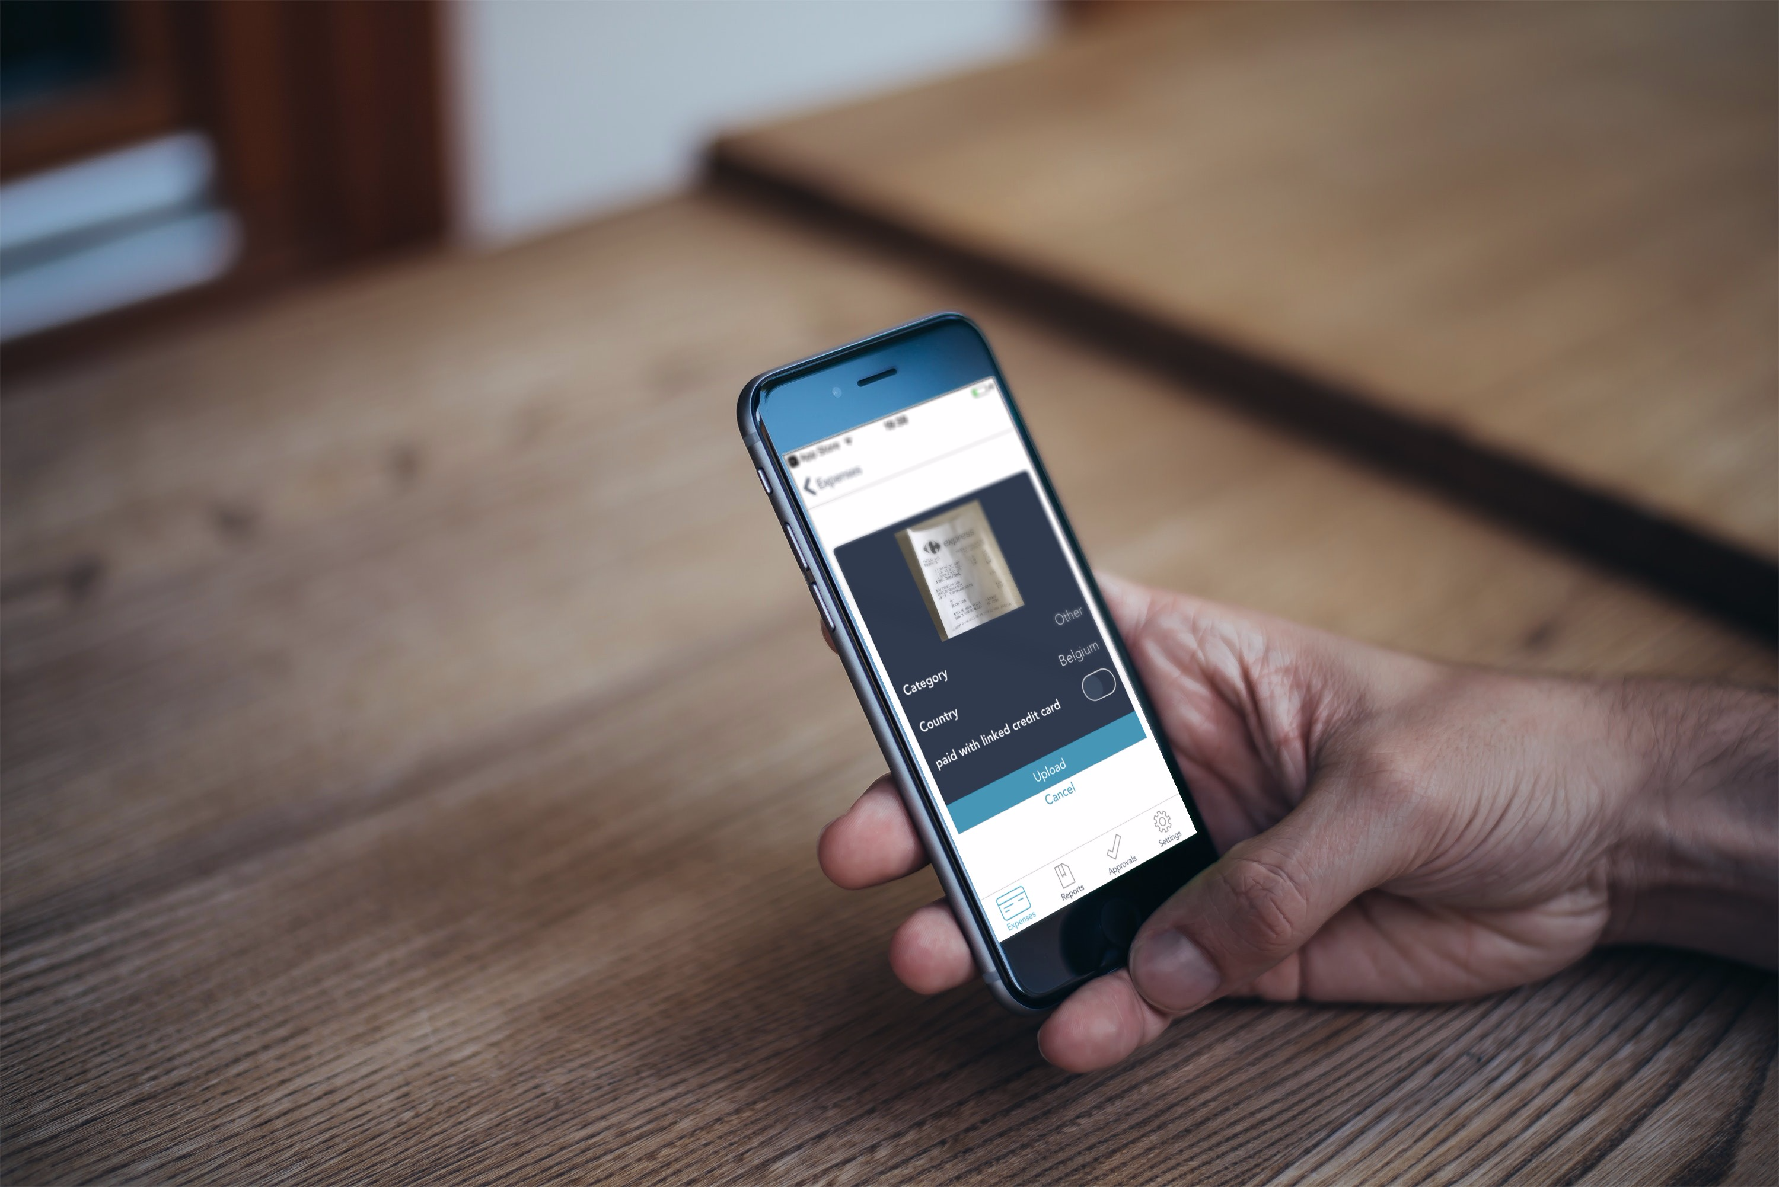
Travel & Expense Management The Next Generation
The New Experience

Slide 2
The New Experience
MobileXpense wants to reduce most of the interactions of the traveller with expense management
Our New system will guide the traveller and trigger when interaction is needed
A New Web interface and a new mobile App provide state of the art clarity and simplicity
Plan a business meeting in your Outlook or Google calendar and MobileXpense will take care of the travel booking for all the attendees
By giving total A-Z cost estimates before booking we help avoid unnecessary costs - allowing management to make more informed decisions in regards to remote group meetings.

Slide 3



The MobileXpense Experience
ADVANCE TOWARDS A SYSTEM DRIVEN AND USER ASSISTED EXPERIENCE
3 Interaction points for the Traveller
1
Choose Preferred Travel Option
2
Take
Picture of Receipts
3
Approve Report before Submission
At calendar entry we will trigger travel options to be sent to you and to invited team members
Receipt photos will get attached to an automatically generated expense report
We will send you the final report to check and approve before submitting

Slide 4












Please aline styles of slides 3,5,6,
Unify the small icons
It Starts with a Calendar Entry
Calendar Entry of Remote Meeting
Approval and reimbursement
triggers
New Travel Request
Automated Expense Report Creation (per date, week, or manual)
3 Action: Submit
triggers
Approval Email
With Travel Options
Allowances
1 Action: Chose Option
Mileage
triggers
Booking Code Sent
Expense Input via OCR
2 Action : Take photo of receipts
Action: take picture
Travel
Expense

Slide 5



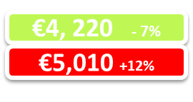



Increasing Efficiency of the Team Meeting
€5,010 +12%
Total €4,445
€4,220
-7%
Budget Checker
Calendar Entry for a Remote Team Meeting total cost calculation flagged
Budget Flagger
Understand the total
cost of a team meeting
Budget Checker show the gap between
budget and real costs
triggers
Approval and reimbursement
New Travel Request, for each team attendant
Automated Expense Report Creation (per date, week, manual)
triggers
Approval Email
for each attendant with travel options
Allowances - automated
Mileage - automated
Booking Code Sent
Approval Email
for each attendant
Expense Input via OCR
Action: take picture
Travel
Expense

Slide 6
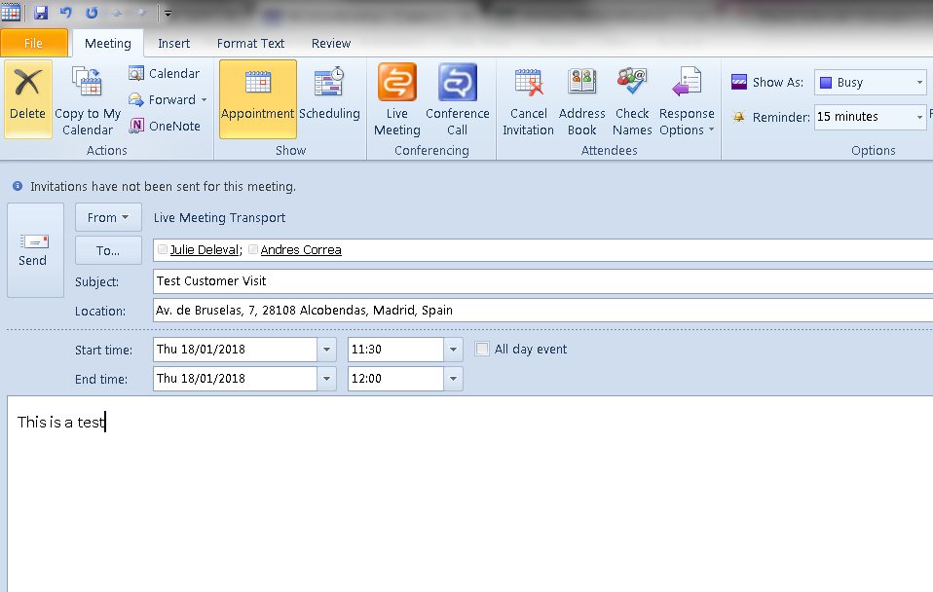


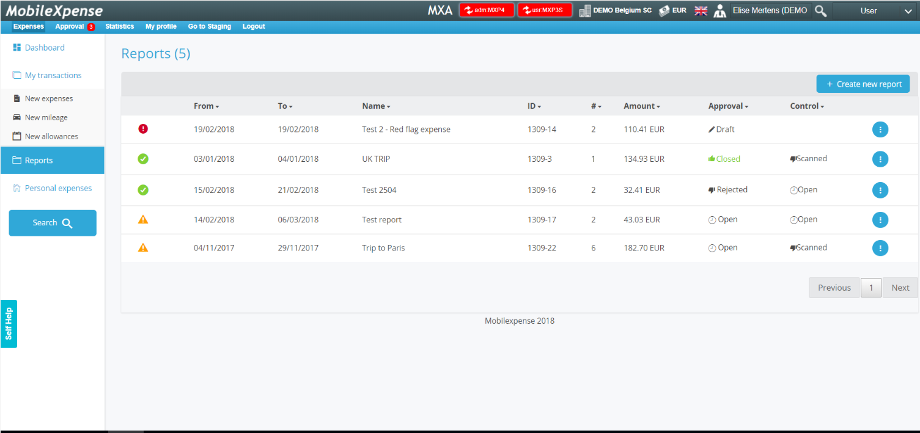
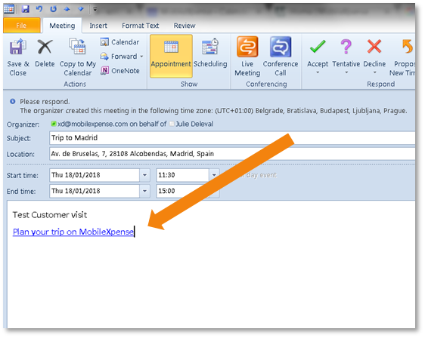

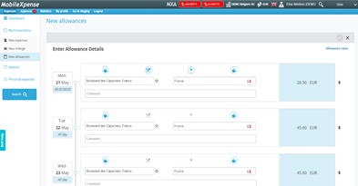

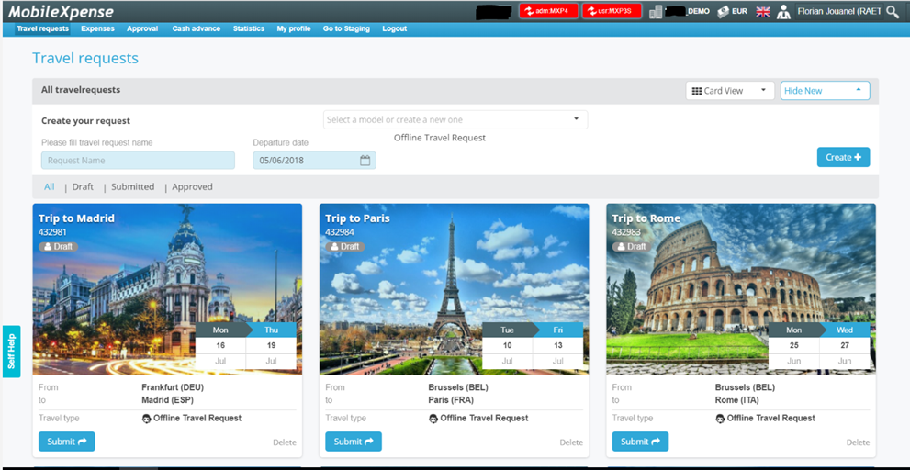

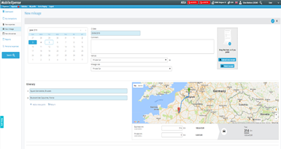
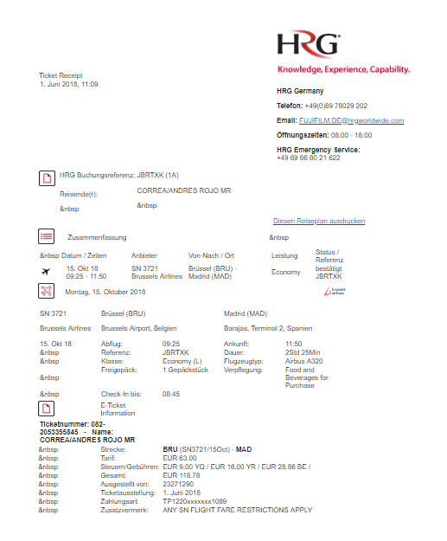


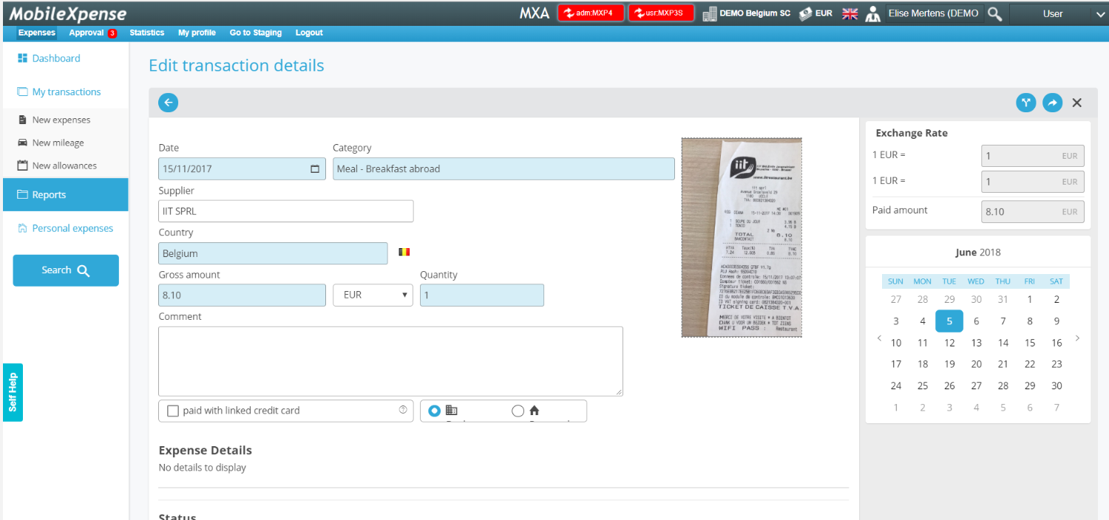
Please along styles of slides 3,5,6,
It Starts with a Calendar Entry
Calendar Entry
Expense Report Creation
Allowances
Travel Request
in MobileXpense
Mileage
Booking Reference sent
Expense Entry
Travel
Expense

Slide 7
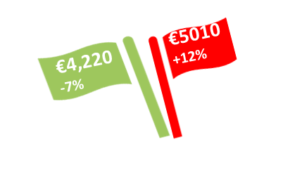
A
Budget Control for Corporate Meetings
Large Corporations depend on regular meetings between dispersed team members
MobileXpense helps to keep an eye on the travel costs and the budget
Budget Flagger
A calendar entry for a team meeting (set in a remote location involving travel for one or more attendees) will trigger a total trip cost estimate based on a preliminary search ` This visualization may help team leaders to make an informed decision for going ahead with the meeting
Budget Catcher
After the meeting we will catch all cost and show the gap between budgeted and actual cost
Total €4,445

Slide 8

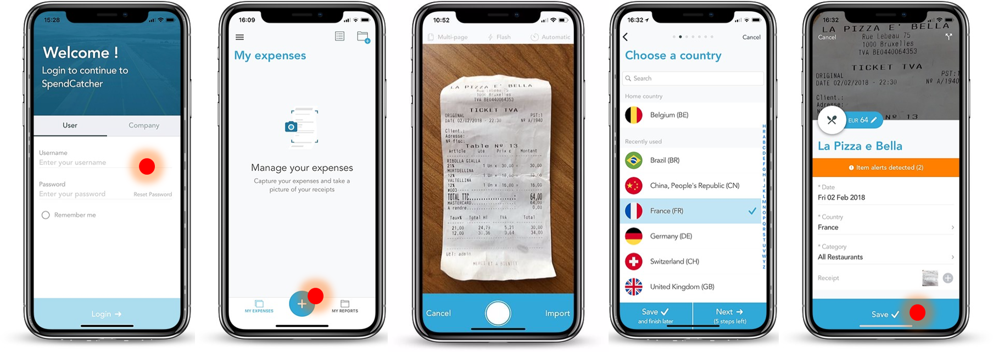
Spendcatcher – our new mobile App
SpendCatcher is the all new mobile App from MobileXpense combining the functional depth of Mobilexpense with Elegance and Ease-of-Use
Placeholder for a video w link

Slide 9
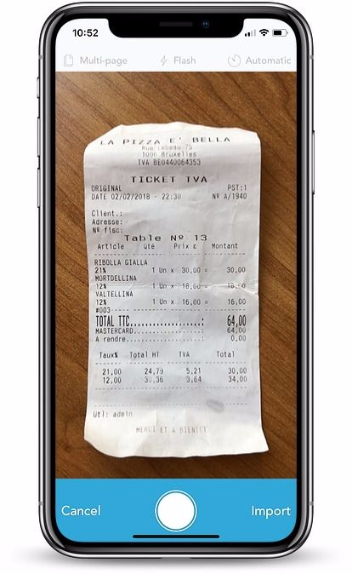
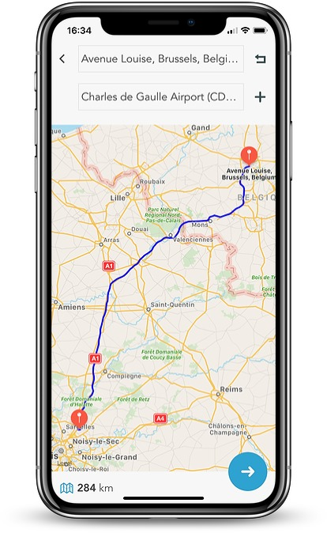
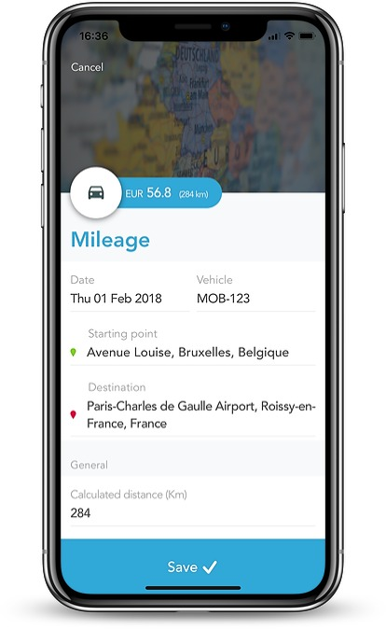
Spendcatcher – our new mobile App
1
2
3
Modern and easy
Interactive and Intuitive
The Fastest Expense Entry in the
Industry

Slide 10










The Roadmap
2019
We want to take the pain out of expense management by limiting the traveler’s interactions with the process – starting with the moment he/she plans a trip
Xxxxxx
Xxxxxx
Xxxxxxxxxxxxx
Xxxx
xxxxxxxxxxxxxxe
Q3, 2018
Q3, 2018
Q3, 2018
xxxxxxx
xxxxxxx
Solution 2
Xxxxxx
Xxxxxx
Xxxxxxxxxxxxx
Xxxx
xxxxxxxxxxxxxxe
Xxxxxx
Xxxxxx
Xxxxxxxxxxxxx
Xxxx
xxxxxxxxxxxxxxe
Xxxxxx
Xxxxxx
Xxxxxxxxxxxxx
Xxxx
xxxxxxxxxxxxxxe
Q2, 2018 Solution 1
Xxxxxx
Xxxxxx
Xxxxxxxxxxxxx
Xxxx
xxxxxxxxxxxxxxe
Q4, 2018
xxxxxxxxxxxxxxxx
Xxxxxx
Xxxxxx
Xxxxxxxxxxxxx
Xxxx
xxxxxxxxxxxxxxe
Q4, 2018
Q3, 2018
xxxxxxxxx
Xxxxxx
Xxxxxx
Xxxxxxxxxxxxx
Xxxx
xxxxxxxxxxxxxxe
Q3 2018 xxxxxxx
Xxxxxx
Xxxxxx
Xxxxxxxxxxxxx
Xxxx
xxxxxxxxxxxxxxe
xxxxxxxxxxx
Xxxxxx
Xxxxxx
Xxxxxxxxxxxxx
Xxxx
xxxxxxxxxxxxxxe

Slide 11
In Summary
MobileXpense launches the next generation of Travel&Expense management
With a true end-to-end process starting with the calendar entry ( 3 clicks???)
… and stopping after the trip/meeting to compare real cost worth budgeted costs
System-Proactivity requests far fewer interaction from the as the traveler action
New state of the art App “Spendcatcher” provides the easiest and fastest receipt capture in the industry ((xxx seconds???))
The new web interface is easy to use , fast and responsive.
“Budget Flagger” and “Budget Checker” help control budgets

