Slide 1
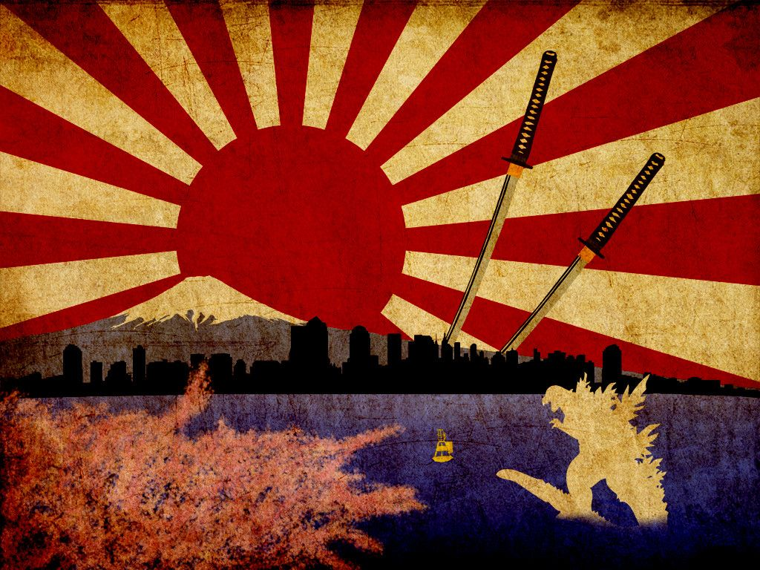
Option 1: Use this design as inspiration:

Slide 2
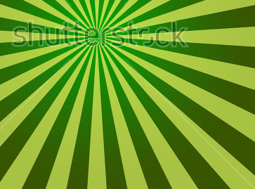
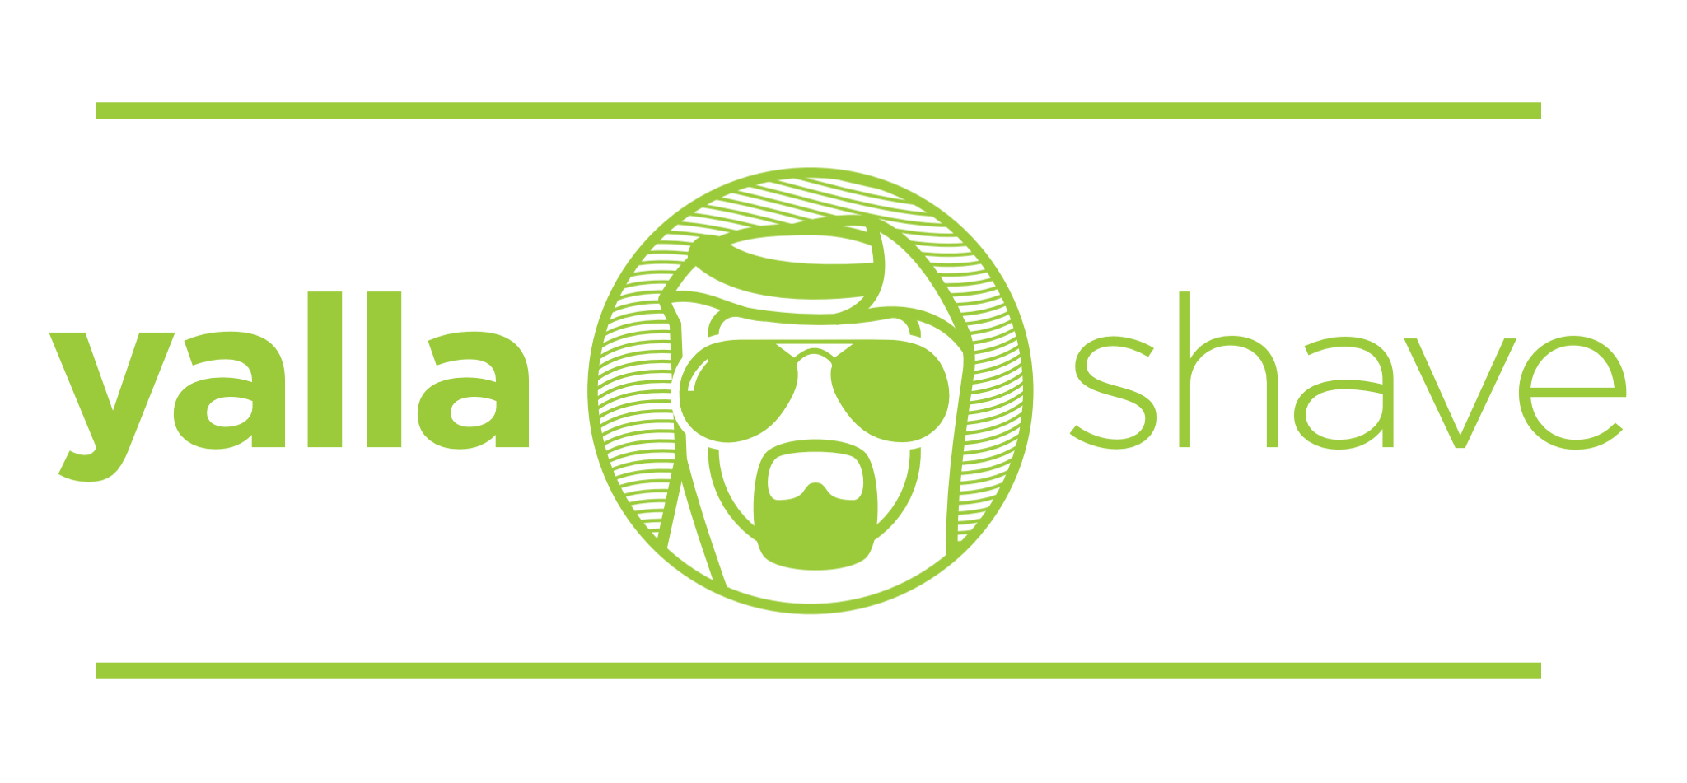
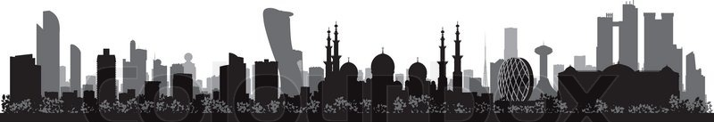
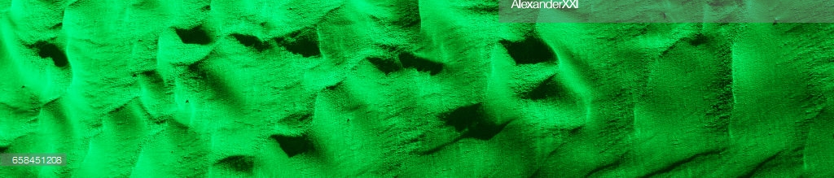
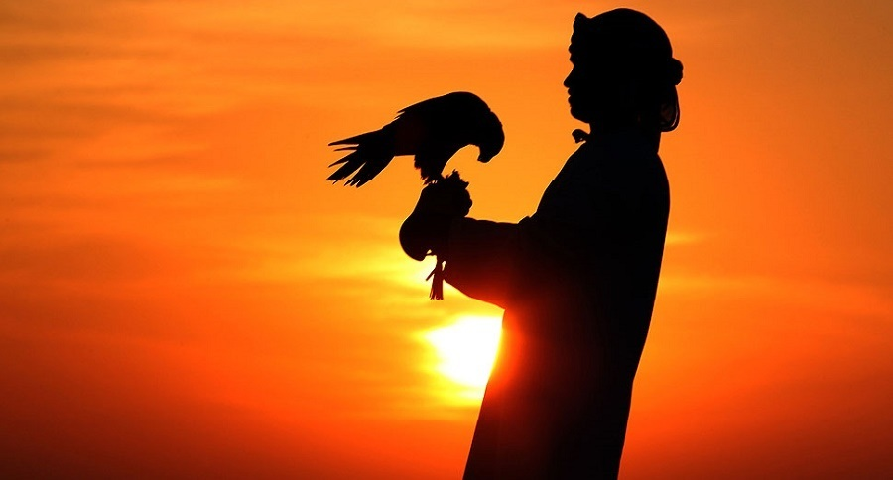
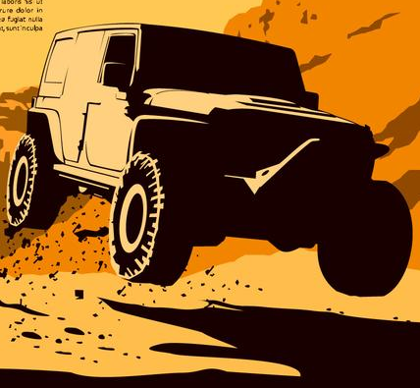
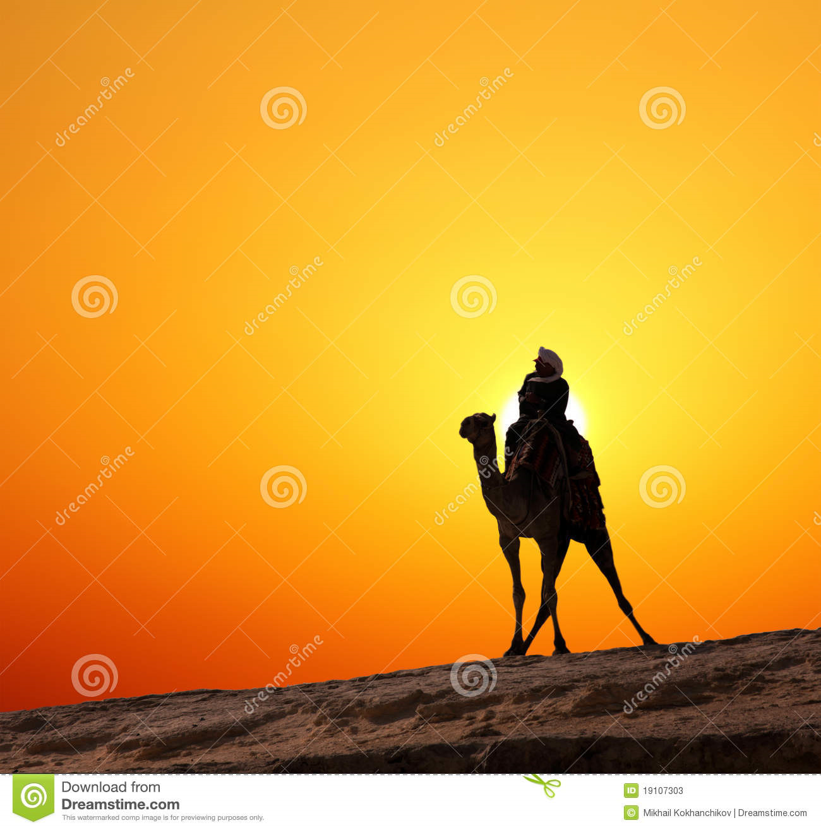
The ray color should be dark green and lime green
The logo should be in the form of a capsule
The skyline background should the continuing rays of green an lime green
The three pictures in the background should have green desert backgrounds so that it doesn’t like they are three separate pictures.
The final picture should have an antique feel (dark vignette around edges) and the look and feel of an old paper.

Slide 3
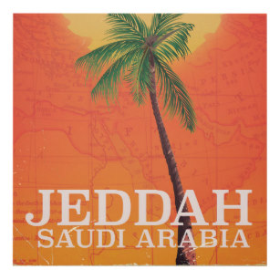
Option 2: Use this design as inspiration:
The important thing to note here is that this is a transparent picture where you can see the map of the middle east in the background

Slide 4
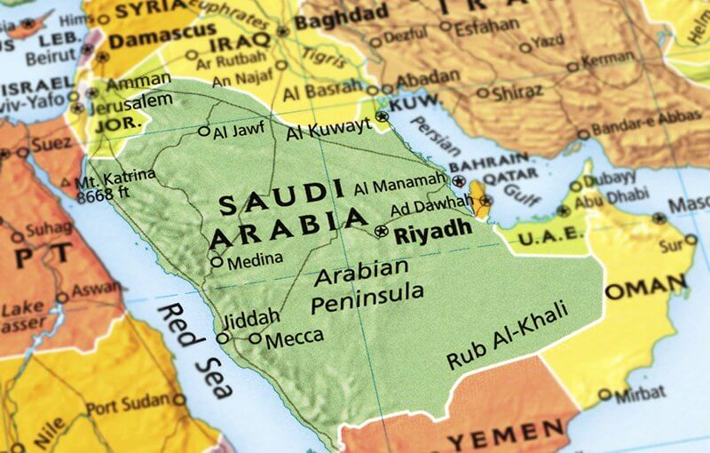
Option 2: create logo and rays as in option 1 but, but map in background and make foreground translucent so that the map is visible in the background.

