Slide 1
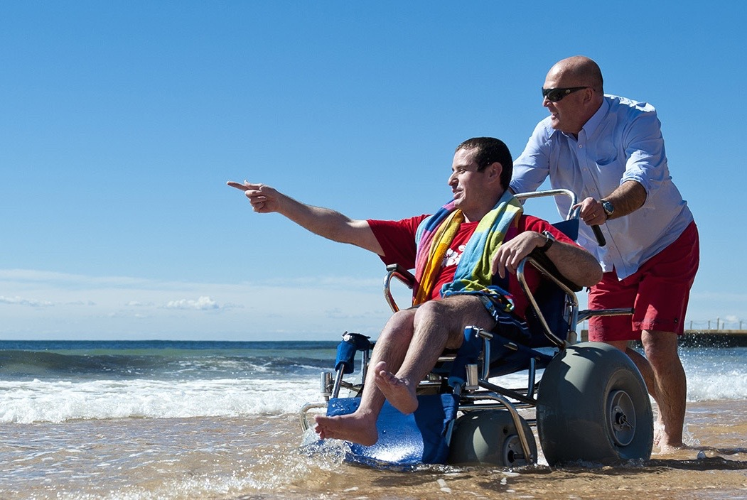
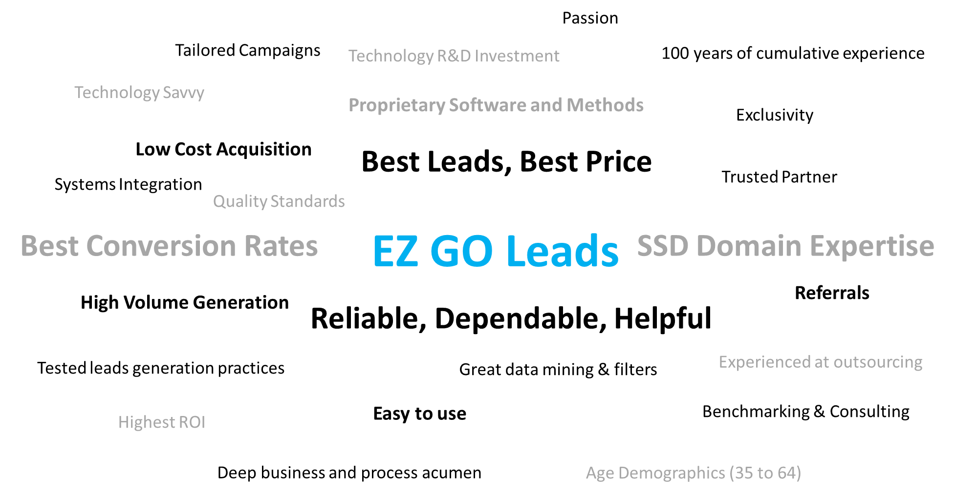

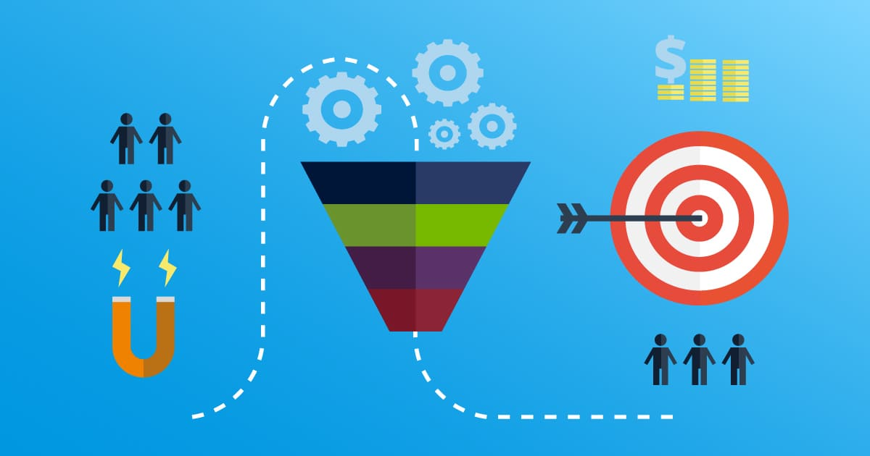

Context for the content of the mailer
Types of Images to Use … do not use these images
Themes that should be on the front page of mailer
Helping Disabled People
We understand the US Social
Security Legal Systems
We have a process to provide
You leads that meet your criteria
We have great technology
That connects people

Slide 2

Front Page of Mailer … concept, please do not feel constrained by this format
Best Leads, Best Price
Our high conversation rates lowers your client acquisition cost
Referrals available
High Volume, Quality Leads
50 years of SSD domain knowledge
Tested technology capabilities
Trusted Partner
Reliability, Dependable, Helpful
Deep business & process acumen
EZ to use
Integrate seamlessly into your IT systems
Tailored campaigns

Slide 3
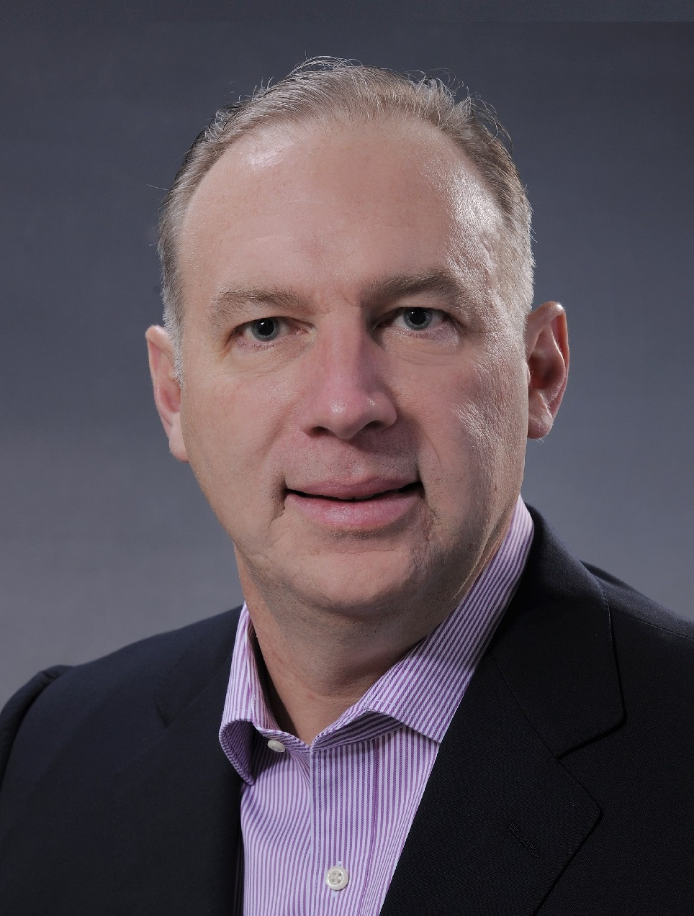
Second Page of Mailer
Logo
Best Leads … Best Price with High Volume & Quality capacity … Leads from a Trusted Partner that is EZ to use
Test our Leads
Start at 250 or 500 Leads.
Grow to 1,000 … 3,000 or even 10,000!
We give the right support to your growth.
Darren Huxol
President, EZ GO Leads
I want to personally introduce our company to you!
My team as > 50 years of cumulative SSD experience.
We have proven technology that delivers the best leads.
The timing is right for a new competitor in this industry.
I had to come out of retirement after 30 years with GE, the opportunity is just that great … I love building businesses and partnering with great customers!
Our business, industry, & technical acumen is unrivaled … and we can do it at a cost than no others can.
Let’s work together to bring Social Security Disability benefits to those in need and deserving!
To: Addressee
Barcode
Darren Huxol, President EZ GO Leads
8044 Montgomery Road, Suite 700
Cincinnati Ohio OH 45236
513-692-4494
Darren@EZgoLeads.com
Postage

