Slide 1
Ulmer Ventures Value
www.ulmerventures.com
202.596.2492
info@ulmerventures.com

Slide 2
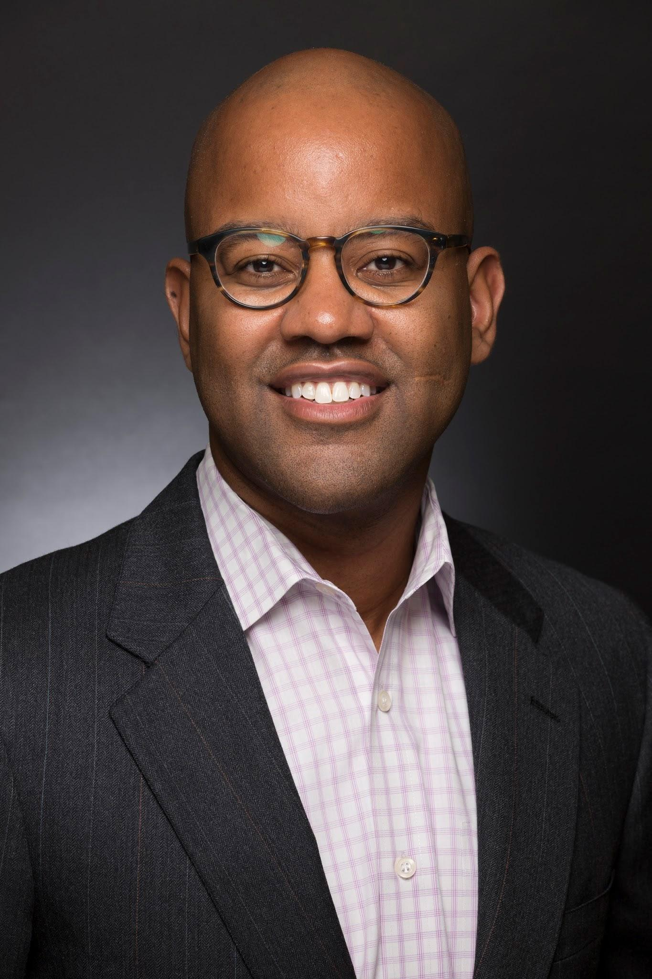
Experience
Over a decade @FDA (Former Deputy Division Director)
Expertise: Cardiovascular, Ophthalmology, General Hospital, Infection Control, Dental, Anesthesia, Respiratory
Vice President Regulatory Affairs / Quality Assurance @Danaher (Fortune 150 Company)
Initiated reorganization of department
Led major compliance effort
Successful FDA inspection (no observations)

Slide 3
Differentiators
Experience
Network
Leverage
Process

Slide 4


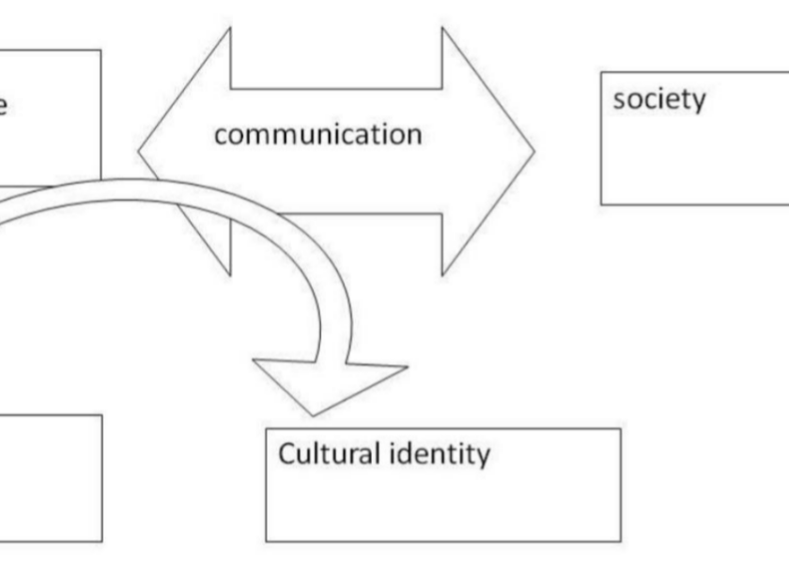

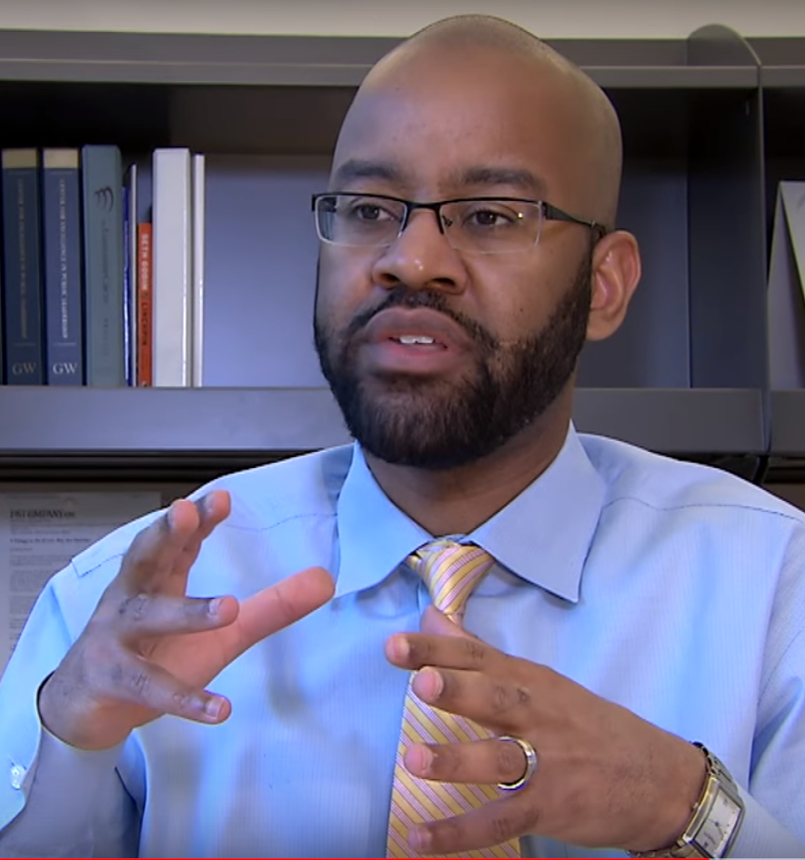


Services
Regulatory Strategy
FDA Communications
RAQA Organizational Structure
Regulatory Pathway
Deficiency Response
Application Review
Interim Executive Leadership
Training
FDA Communication
MDR Reporting
Compliance Remediation
Accelerated Product Registration
Notes:
Update Pictures to be more relevant
Picture of the process
Identify Model that enables sticky client

Slide 5
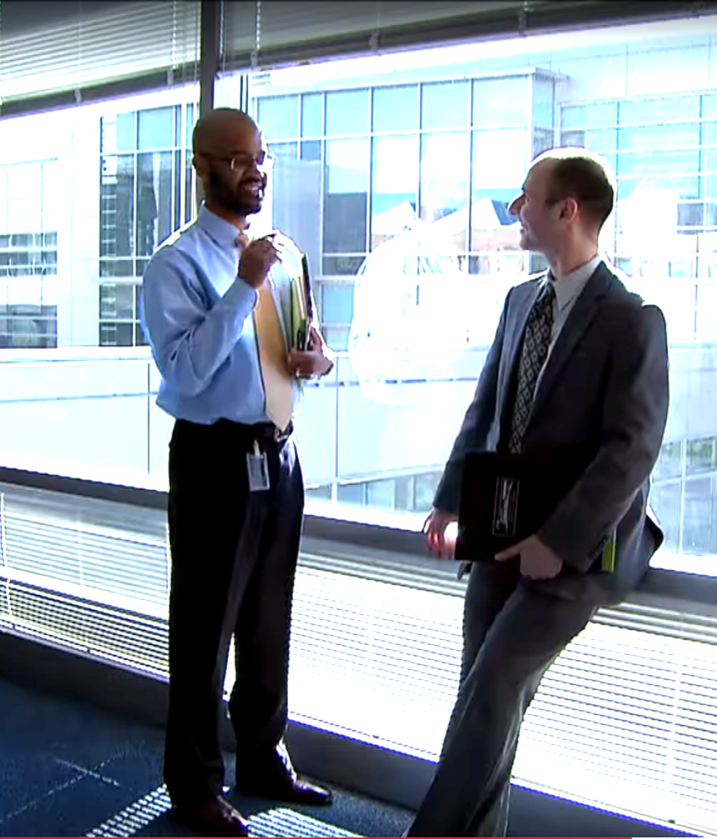
Experience to Provide...
Executive Application Review
Examples include: Presubmission, IDE, 510(k) , 513(g), PMA, Refuse to Accept, Hold letter
Troubleshooting
Strategic Advice & Diligence to Investors
Validate & Verify Founder Milestones
Diligence portfolio company Regulatory and Quality systems

Slide 6
Efficient Process
Exploratory Call
Regulatory Landscape
Problem Statement
Review & Align on Deliverables

Slide 7





Valued Partner Network
Notes:
Add Logos

Slide 8
Ulmer Ventures Value
Extensive Experience
Efficient Process
Valued Network
www.ulmerventures.com 202.596.2492 info@ulmerventures.com

