Slide 1
Koch Metals: https://www.kochmetals.com/
We like the continuous scroll down of this website with the fixed bar at the top
Very simple design with not too much information
We like the ability to click left and right for more summarized information
We want our website to be very similar to this

Slide 2
Concord Recourses https://www.concordltd.com/
- Very similar to the Koch website, regarding the continuous scroll layout
Like the front page which has scrolling pictures, and highlighted sentences
Like the font used throughout
Like the

Slide 3
CF Partners https://www.cf-partners.com/
- Like the location map and contact details

Slide 4
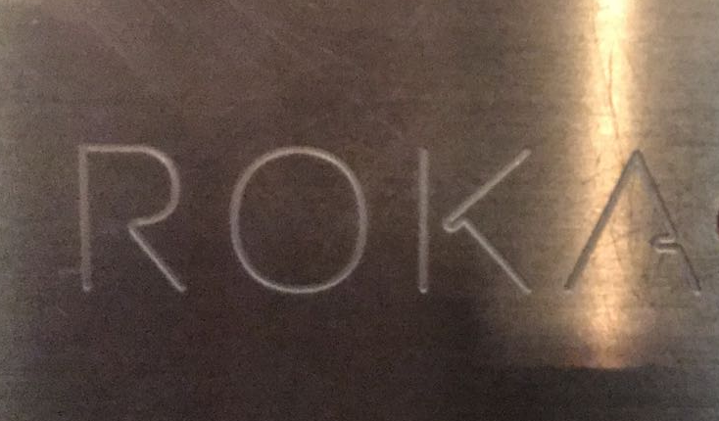


Logo Ideas:
Like the brand name written in large letters with the other words below i.e ROCA … and then Metals Group below. Simple and professional yet recognizable
Liked the type face, as it looks like it has been stamped into metal, we are in the metal industry
Like the idea of the logo being a simple shape, and not tied to a specific corporate color

Slide 5
Navigation bar above to stay static / users to scroll down to get to different pages or to click the top bar in which it will auto scroll the relevant page (non drop down menu’s)
Home Page – 4 x High resolution, high quality commodity focused images. Each picture is to have one sentence over played sumarising what Roca does
About– scroll down and users will get to the About page. There will be 2 clear paragraphs of text describing Roca. No picture background.
Commodities – scroll down and users will get to commodities section. They will be able to click left and right to see the commodities we trade and the specifics of each commodity in bullet points. We would like a static picture behind this – something metal / commodity related
Services – scroll down and users will get to the services page. Much like the About page it should be simple paragraphs
Contact – scroll down and users will get to the contact page. Simple google map, if you click on the specific office it shows the google map location for that office.
Log in – this is to be a ‘dummy’ Log in page, user name and password dropdown but doesn't’t allow anyone to actually go any where

Slide 6
ROCA
ABOUT
COMMODITIES
SERVICES
POLICIES
CONTACT
LOG IN
NOTES IN RED:
4 scrolling pictures, all have different wording on the pages, wording provided on next page.
We do not have acess to high quality pictures. We will need help sourcing these.
Roca Metals is a global commodities group with an established presence throughout the metal markets.

Slide 7
Roca Metals is a global commodities group with an established presence throughout the metal markets. Roca Metals has a strong focus on consolidating, processing, and trading a full range of physical metal commodities, having established both European processing facilities and trading offices. Our network of clients and partners range from international metal producers, sovereigns, independent operators and industrial consumers.
The ROCA team is entrepreneurial and builds solutions for relationships based on transparency and trust. ROCA strives to be a supplier, partner and market participant that delivers value-add services to producers and consumers of commodities by managing the market risk, operational risk and quality risk inherent in the global commodity markets.

Slide 8

NOTES IN RED:
Ability to click on the arrows to scroll though the different commodities. Potentially one static picture in the background
ALUMINIUM
99.7% – 99.85% primary aluminium
Master alloys
AlMn20/25
AlSi30/50
AlTi10
AlZr5/10
AlV5/10
AlBe5/10
AlSr10/15
P1020 (99.7%) Ingots, Sows and T-Bars
High Purity Aluminium Ingots, Sows and T-Bars (P0610, P0406, P0303 etc.)
Offgrade Aluminium Ingots, Sows and T-Bars
Billet
Rod
Aluminium

Slide 9
NOTES IN RED:
Here are additional tabs, which will be visible when users click left or right on the commodities page. There will be approximately 5-6 tabs, additional content still needs to be generated
COPPER
99.7% – 99.85% primary aluminium
Master alloys
Copper Phosphor 85/90 – waffle and shot form
Copper manganese
Copper iron
Copper nickel
Copper Granules
Various grades and sizes available
High grade copper alloy scrap
Copper nickel, nickel brass & silver, aluminium bronze.
FERRO ALLOYS
Ferro chrome
Ferro manganese
Ferro silicon
Ferro phosphorus
Ferro molybdenum
Ferro vanadium
Ferro tungsten
Ferro niobium
Ferro titanium
MAGNESIUM
99.7% – 99.85% primary aluminium
Master alloys
Copper Phosphor 85/90 – waffle and shot form
Copper manganese
Copper iron
Copper nickel
Copper Granules
Various grades and sizes available
High grade copper alloy scrap
Copper nickel, nickel brass & silver, aluminium bronze.
SILICON
Ferro chrome
Ferro manganese
Ferro silicon
Ferro phosphorus
Ferro molybdenum
Ferro vanadium
Ferro tungsten
Ferro niobium
Ferro titanium

Slide 10

TRADING & SOURCING
PROCESSING & CONSOLIDATING
ROCA’s experienced trading team has a wealth of knowledge throughout the global metal markets.
ROCA sources refined metals of various grades from smelters and the associated raw materials from mines and refineries. Our partnerships and relationships with suppliers allow ROCA to provide a reliable and flexible service to customers with short and long term supply agreements and just in time spot transactions.
The ROCA team is a reliable sourcing partner to secure the raw materials any industrial business needs on time, on specification and as needed. ROCA is able to access a global supplier base and optimise pricing for raw materials among its activities.
ROCA operates a physical processing and consolidation plant in the UK, responsible for processing and refining a wide variety of metallic scraps and alloys.
ROCA is a vertically integrated commodity group and……
More Text to be Added
Aluminium
99.7% – 99.85% primary aluminium
Master alloys
AlMn20/25
AlSi30/50
AlTi10
AlZr5/10
AlV5/10
AlBe5/10
AlSr10/15
P1020 (99.7%) Ingots, Sows and T-Bars
High Purity Aluminium Ingots, Sows and T-Bars (P0610, P0406, P0303 etc.)
Offgrade Aluminium Ingots, Sows and T-Bars
Billet
Rod
OPERATIONAL SECURITY
OUTSOURCED SOLUTIONS
ROCA’s senior leadership has experience across the commodity value chain including: risk management, marketing arrangements, commodity asset management, leadership of commodity production assets, lending to commodity producers and consumers and logistics management.
ROCA aims to add value to all its partners, suppliers and customers by providing services that enhance their business profitability, optimise commodity production or manage balance sheets.
Text to be Added

