Slide 1
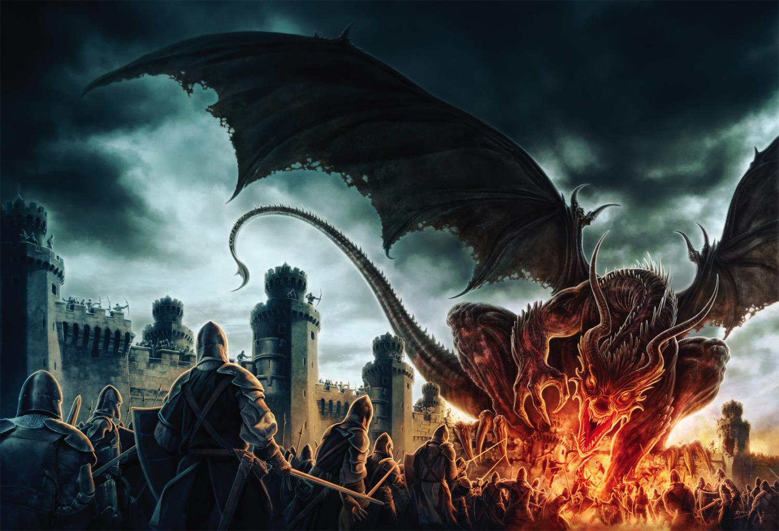


NOVELS
WORLD
AUTHOR
Notes:
Slider between multiple (3) images
Animated images (pan/zoom) with text moving and/or dissolving into view
Transparent overlay for the ability to add text/image hyperlinks per image

Slide 2
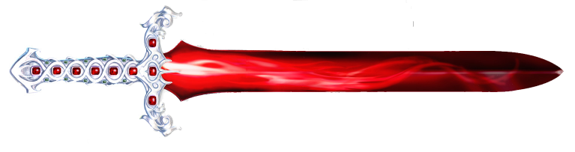
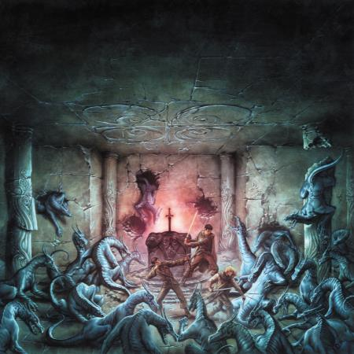
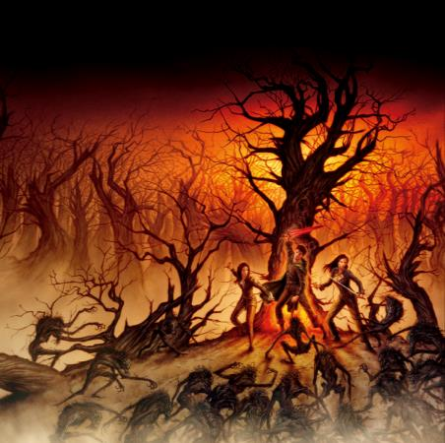
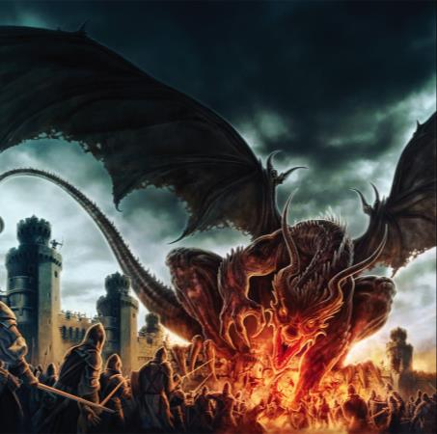

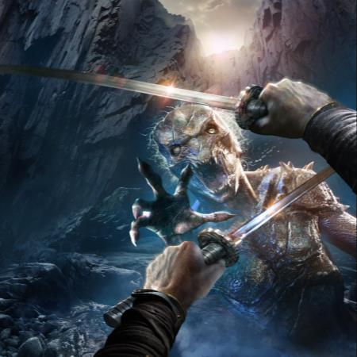
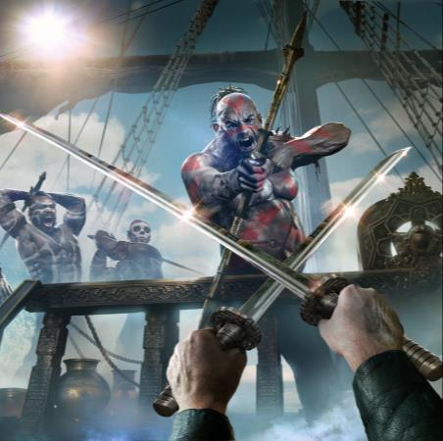
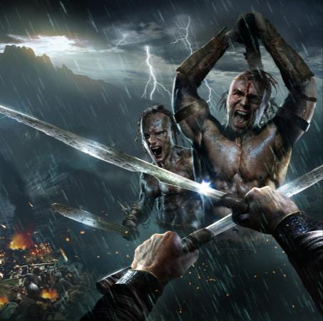
NOVELS
Summaries Excerpts Reviews Buy Online Signed Copies
Asahiel
Book One
The Crimson Sword
Book Two
The Obsidian Key
Book Three
The Divine Talisman
Kronus
WARDER I
The Ukinhan Wilds
WARDER II
The Blackmoon Shards
WARDER III
The Sundered Isle
Notes:
NOVELS Section Option #1: Modal Window for Content of Selected Book
Underline active menu item
On menu item hover: Display background image
On menu item click: Display page tiles
On tile hover: highlight or enlarge slightly
On tile click: open large modal window with individual artwork (image and details)

Slide 3

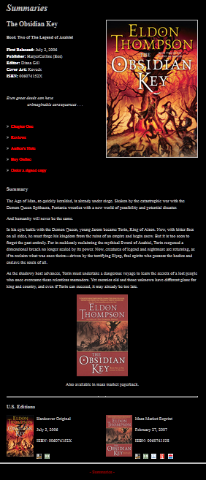

NOVELS
Summaries Excerpts Reviews Buy Online Signed Copies
The Crimson Sword
The Obsidian Key
The Divine Talisman
The Ukinhan Wilds
The Blackmoon Shards
The Sundered Isle
Notes:
NOVELS Section Option #1: Modal Window for Content of Selected Book
Underline active menu item
On menu item hover: Display background image
On menu item click: Display page tiles
On tile hover: highlight or enlarge slightly
On tile click: open large modal window with content from selected book (e.g. http://www.eldonthompson.com/Novels/Summaries/Summaries_OK.htm)
Side scroll controls to navigate to next book of selected content type (Summaries)

Slide 4
NOVELS
Summaries Excerpts Reviews Buy Online Signed Copies
The Obsidian Key
The winter storm tore across the land, ripping and snarling like a caged beast set free at last. Its howling breath wailed in his ears. Its frigid claws raked his skin. The darkness of its maw enveloped the earth, rendering deliberate progress a fool's dream. Grum looked again to his battered compass, scraping at the ice that shielded its surface. Its needle swung uselessly, drawn in random circles. He shook the instrument, cursing it to the smelter of Achthium's Forge. To the west were the Skullmars, the treacherous peaks from which they'd been blown off course. To the east, the tempest of the sea. Or so he assumed. The world around him had disappeared, its planes and edges forced together in a hazy smear. Head bowed, eyes squinting against frenzied gusts of windblown earth, he could scarcely spy the ground beneath his feet, let alone even the largest of markers that might guide him home. He risked a backwards glance to check on his companions. He could see but one, Raegak, tethered to him at the waist in their makeshift line. Beyond that, the rope stretched into the swirling void of pelting ice and strafing winds. He could only hope the others were still there, stumping after, knowing that to become separated now would mean dying alone in these frozen wastes. Not that remaining together afforded great consolation. Truth was, they were hopelessly lost, miles from the safety and comfort of their subterranean home. And even if home lay just around the bend, were they to stumble half a step to the left or right, they might pass right on by without ever knowing it. Raegak glanced up, eyes hollow, snow clinging to his beard. Grum looked quickly away, hiding his compass within a gnarled fist, determined to mask his dismay from those who looked to him for solace. He was toifeam, leader of this expedition, and by Achthium, he would see them through. To accentuate this silent oath, he crammed the worthless compass deep into a leather pouch. At that same moment, the earth fell away, and he found himself scrabbling against a clutching blackness. Chunks of ice and gravel skittered beneath his feet, while a shower of snow cascaded about him. Everything seemed to be sucking him down, down into some depthless— A sharp tug caught him about the waist, folding him violently forward and snatching the wind from his lungs. For a moment he slid downward again, before coming to a lurching halt. Curtains of snow slid past as his companions struggled with their footing above. He hung there, twisting in the abyss, before reaching up for the lip of the pit, where Raegak, stout legs braced against the earth, bent down and offered a leather-wrapped hand. Moments later, Grum huddled with his companions around the rim of the breach, peering into its depths. Should it prove to be the shelter that saved them, he would forgive himself his fright from the fall. Nevertheless, he had lived in these mountains long enough to know not to trust them. Such clefts in the earth's hide might become fissures descending hundreds, even thousands of feet—or if not, might open into the den of some surly creature in no mood to share its home. Even the most foolish of his kin knew better than to enter such an opening without knowing what lay within.
The Crimson Sword
The Obsidian Key
The Divine Talisman
The Ukinhan Wilds
The Blackmoon Shards
The Sundered Isle
Notes:
NOVELS Section Option #1: Modal Window for Content of Selected Book
Underline active menu item
On menu item hover: Display background image
On menu item click: Display page tiles
On tile hover: highlight or enlarge slightly
On tile click: open large modal window with content from selected book (e.g. http://www.eldonthompson.com/Novels/Excerpts/Excerpts_OK.htm)
Side scroll controls to navigate to next book of selected content type (Excerpts)

Slide 5
NOVELS
Summaries Excerpts Reviews Buy Online Signed Copies
The Obsidian Key
[+] Romance Junkies
[-] Sci-Fi Chick
July 2008
The Obsidian Key, by Eldon Thompson, is the sequel to The Crimson Sword.
King Torin must embark on a quest to find a long-forgotten race of people. While his friend Allion, Torin’s fiancé and her father join together on a journey of their own. With dangerous enemies around every corner, no one can be trusted. And Torin even has enemies within his own kingdom. For back at home, another seeks to usurp King Torin’s throne and claim it as his own.
This sequel is even better than the first. Torin’s journey is long, with many pitfalls, and gains several friends as well as enemies along the way. Meanwhile, Torin’s friend and betrothed have some unique experiences of their own, with foreseeable consequences. The Obsidian Key contains everything a great fantasy story should: magic, unique races as well as the well-known, danger, intrigue, quests, and relationships that grow and change. With plenty of suspense and surprises, this epic fantasy will leave you breathless after a climactic ending. And reaching for the 3rd in the series, The Divine Talisman, which releases today from Eos Books.
- Angela Schuch, SciFiChick.com
The Crimson Sword
The Obsidian Key
The Divine Talisman
The Ukinhan Wilds
The Blackmoon Shards
The Sundered Isle
Notes:
NOVELS Section Option #1: Modal Window for Content of Selected Book
Underline active menu item
On menu item hover: Display background image
On menu item click: Display page tiles
On tile hover: highlight or enlarge slightly
On tile click: open large modal window with content from selected book (e.g. http://www.eldonthompson.com/Novels/Reviews/Reviews_OK.htm)
Side scroll controls to navigate to next book of selected content type (Reviews)
Accordian-style expanding/collapsing menu for individual entries

Slide 6
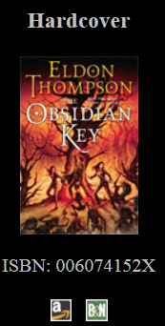
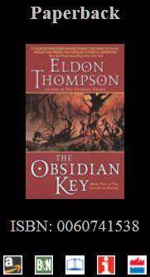
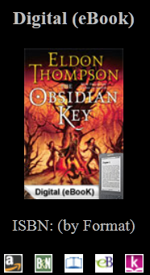
NOVELS
Summaries Excerpts Reviews Buy Online Signed Copies
The Obsidian Key
The Crimson Sword
The Obsidian Key
The Divine Talisman
The Ukinhan Wilds
The Blackmoon Shards
The Sundered Isle
Notes:
NOVELS Section Option #1: Modal Window for Content of Selected Book
Underline active menu item
On menu item hover: Display background image
On menu item click: Display page tiles
On tile hover: highlight or enlarge slightly
On tile click: open large modal window with content from selected book (e.g. http://www.eldonthompson.com/Novels/BuyOnline/Buy_OK.htm)
Side scroll controls to navigate to next book of selected content type (Buy)
Maybe accordian-style expanding/collapsing menu for individual entries? (book formats)

Slide 7
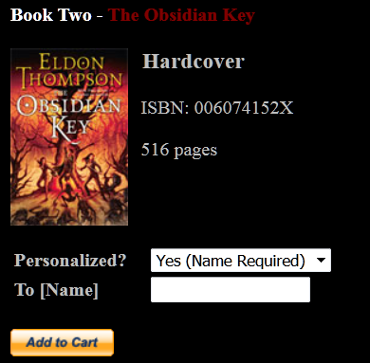
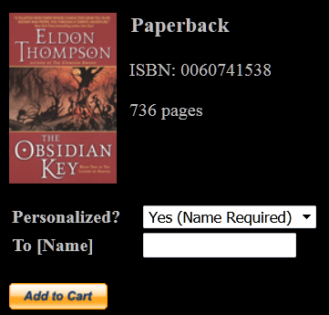
NOVELS
Summaries Excerpts Reviews Buy Online Signed Copies
The Obsidian Key
The Crimson Sword
The Obsidian Key
The Divine Talisman
The Ukinhan Wilds
The Blackmoon Shards
The Sundered Isle
Notes:
NOVELS Section Option #1: Modal Window for Content of Selected Book
Underline active menu item
On menu item hover: Display background image
On menu item click: Display page tiles
On tile hover: highlight or enlarge slightly
On tile click: open large modal window with content from selected book (e.g. http://www.eldonthompson.com/Novels/BuyOnline/Buy_OK.htm)
Side scroll controls to navigate to next book of selected content type (Signed Copies)
Maybe accordian-style expanding/collapsing menu for individual entries? (book formats)

Slide 8
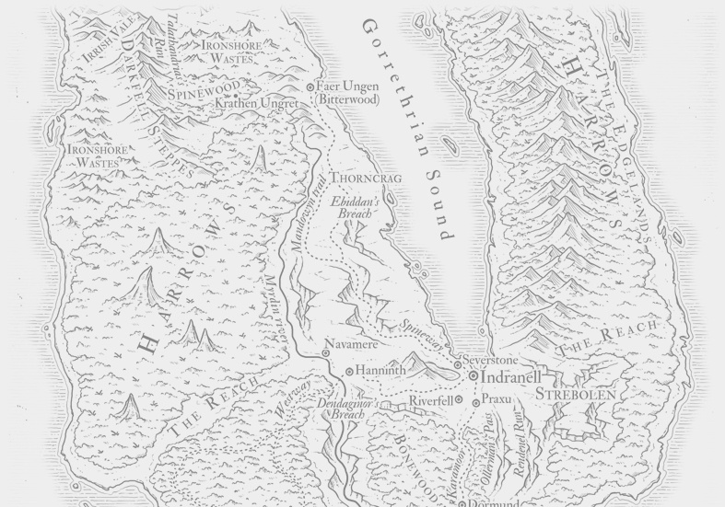
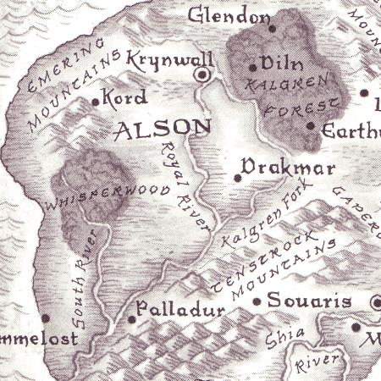
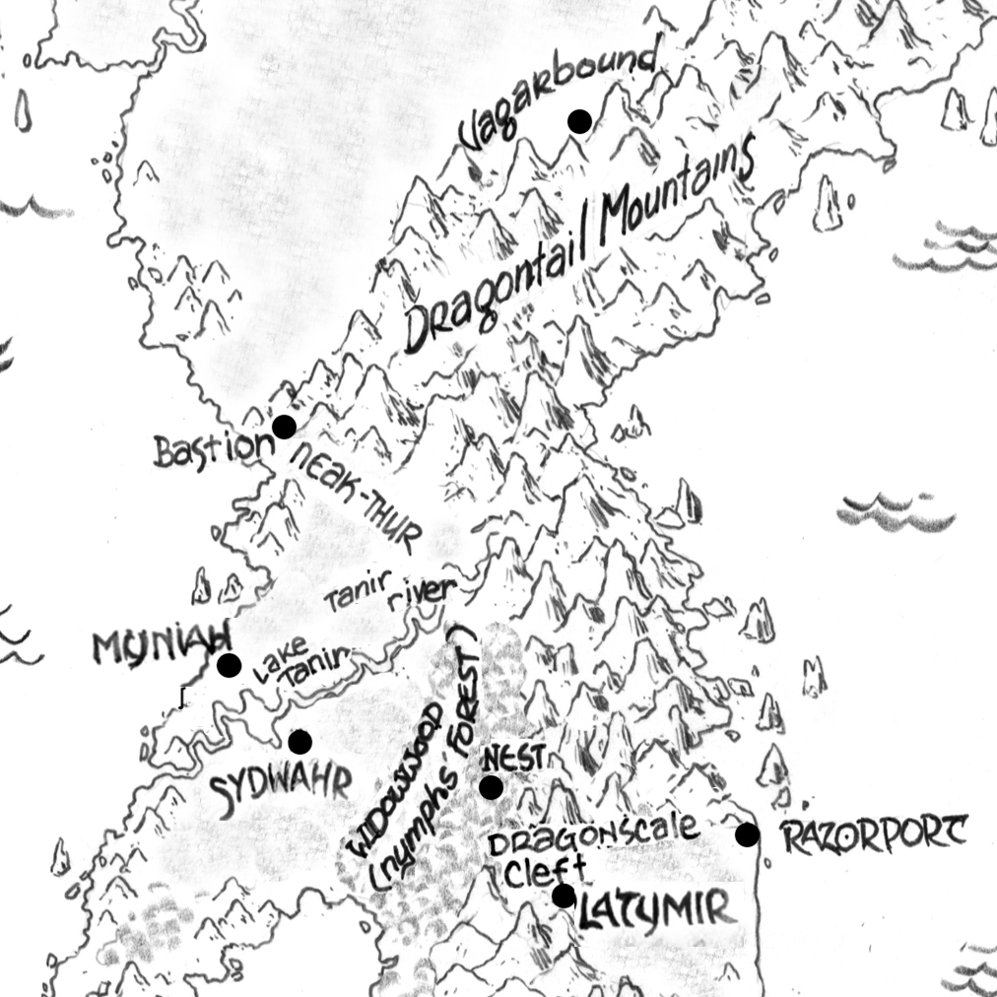
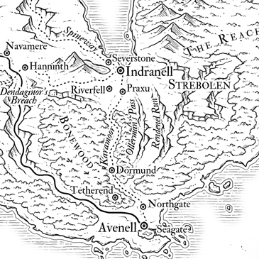
WORLD
Maps Characters Locations Artifacts Gallery
Pentania
Yawacor
Addaranth
Notes:
Underline active menu item
On menu item hover: Display background image
On menu item click: Display page tiles
On tile hover: highlight or enlarge slightly
On tile click: open large modal window with individual map page (image and details)

Slide 9
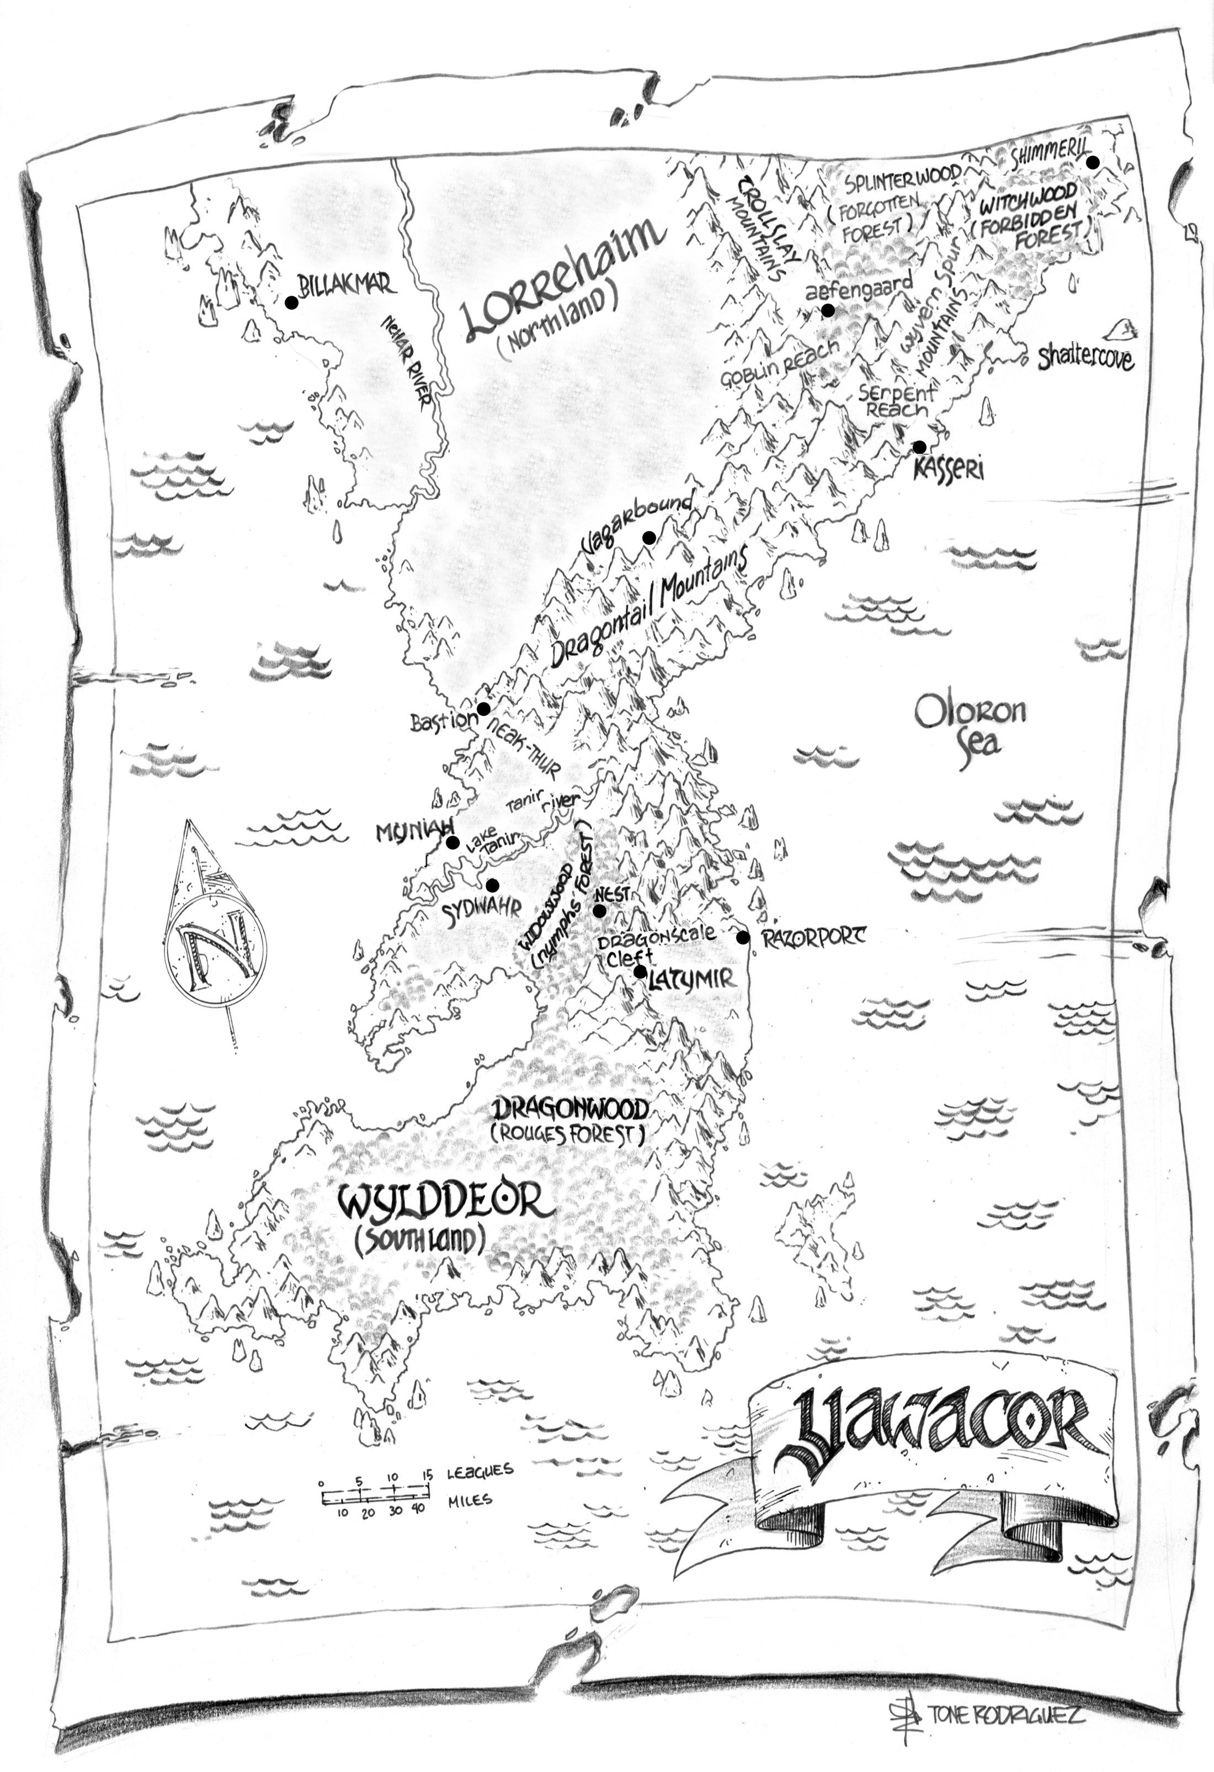
WORLD
Maps Characters Locations Artifacts Gallery
Pentania
Yawacor
Addaranth
Notes:
Underline active menu item
On menu item hover: Display background image
On menu item click: Display page tiles
On tile hover: highlight or enlarge slightly
On tile click: open large modal window with individual map page (image and details)
Content from map-specific page (e.g. http://www.eldonthompson.com/World/Maps/Yawacor.htm)
Side scroll controls to navigate to next map within large modal window

Slide 10
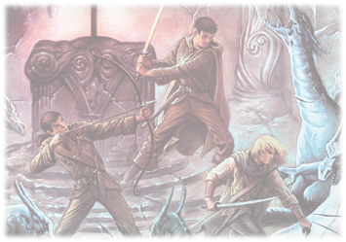
WORLD
Maps Characters Locations Artifacts Gallery
Below is a complete glossary of characters found throughout the "Asahiel" books. Click the button to hear an audio pronunciation provided by William Thompson (requires Adobe's free Flash Player plug-in).
Note: Spoiler material in black text. Highlight to read.
A'awari - Cannibalistic Mookla'ayan tribe at war with the Powaii.
Achthium - In Hrothgari mythology, the Great Smithy, creator of the earth and its inhabitants.
Adwan - A Hrothgari dwarf; father of Alfrigg.
Aethelred - Father of Htomah and a former Entient. Onetime friend to Vagorum, king of the Hrothgari.
Alfrigg - A Hrothgari dwarf; bairn of Adwan.
Alganov - An Entient of Whitlock.
Algorath - A renegade Entient; ancestor to Darinor.
Allion - A hunter and woodsman of the village Diln. [Highlight]: Later captain (Fason) of the City Shield of Krynwall; serves as regent in the absence of the king.
Amber - A Nymph jailor; kinmate to Mirren.
Annleia Solymir - Daughter of Laressa; granddaughter of Lord Lorre.
Arn - A mercenary from the land of Yawacor.
Ashwar - An Elder of the Circle of City Elders of Krynwall. Accomplice to Vorric Haze.
Ashwin - A soldier of the City Shield of Krynwall; member of an expedition to Yawacor.
Augelot - A lord of Palladur.
Autumn of the Rain - A castaway and later companion to the pirate captain Red Raven.
Bannok - King of Souaris who formed the League of Man; chief architect of the Proclamation of Man, which divided Tritos east and west into the lands of Partha and Kuuria and proclaimed the Age of Man (Year 0 AM).
Bannon - Lieutenant General, Sixth Division, unified Parthan Legion.
Banon - Eighth Elder of the village Diln.
Barak - A valor sergeant and cavalry squad commander of the Parthan Legion.
Bardik - A freedom fighter and West Wedge commander of the Southern Liberation Force of Wylddeor.
Barwn - An Entient of Whitlock.
"Black Spar" - Pirate and first mate of the Raven's Squall.
Bohwens - A lieutenant and master of scouts for the Southern Liberation Force of Wylddeor.
Boldin - A battalion commander (colonel) of the Parthan Legion.
"Brack" - A pirate and boatswain of the Raven's Squall.
[. . .]
Notes:
Underline active menu item
On menu item hover: Display background image
On menu item click: Open large modal window with individual character text (scrollable)

Slide 11
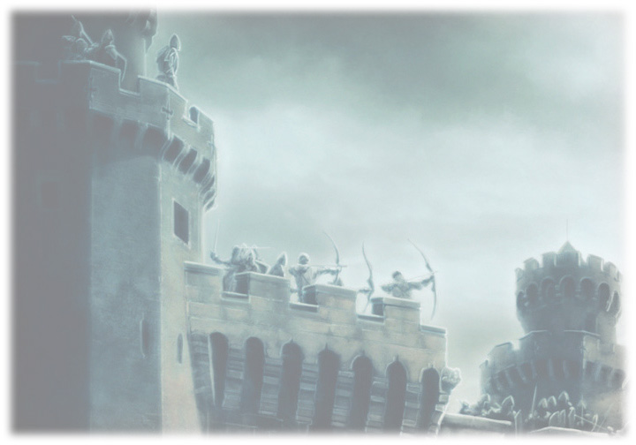
WORLD
Maps Characters Locations Artifacts Gallery
Below is a complete glossary of locations found throughout the "Asahiel" books. Click the button to hear an audio pronunciation provided by William Thompson (requires Adobe's free Flash Player plug-in).
Aefengaard - A valley located in the Splinterwood.
Alson - Western nation of Pentania. Rich and fertile land diminished by the exploits of a hedonistic king.
Aspandel Mountains - Range separating Kuuria from Partha and Vosges. Home to the Entients' stronghold of Whitlock.
Atharvan - Capital city of Partha, set in a region of broken hills and canyons. Dubbed "King of the East".
Bane Draw ("Iskin's Bane") - Draw south of Kraagen Keep, named for the defeat of King Iskin of Partha.
Bannok's Fist - A dam at the headwaters of the Shia River, on the western heights of the Aspandel Mountains in Kuuria.
Bastion - Giant battlement that serves as gateway between lands north (Lorrehaim) and south (Wylddeor) on the continent of Yawacor.
Battlemont - A military outpost located in southern Partha at the edge of the Kalmira Forest.
Billak Mar - A city of Lorrehaim on the western coast.
Conthur Keep - A city of Kuuria.
Crylag - A major city of Partha, located near the Fields of Ravacost on the Parthan-Menzo front.
Dagger Canyon - Canyon that wards Kraagen Keep, carved by an ancient tributary of the Llornel River, now run dry.
Diln - A forest village in Alson. Home of Jarom and Allion.
Dirrk - A city located in central Partha, south of Crylag.
Dragonscale Cleft - Pass that cuts through a southern stretch of the Dragontails.
Dragontail Mountains - Range that lines the eastern coast of Yawacor.
Dragonwood ("Rogues' Forest") - Forest of southern Wylddeor.
Drakmar - A barony of south-central Alson. Rival to Palladur.
Durthur Keep - A city of Kuuria.
Earthwyn - An unwalled city of Alson, set in the southern reaches of the Kalgren Forest.
Emerald River - A river running southwest from the Skullmar Mountains through the Kalmira Forest of southern Partha.
Emering Mountains - A small range of northwestern Alson.
Fahren Cleft - A mountain defile outside the Parthan city of Atharvan.
Fenwood - {See Widowwood}
Feverroot - A small community of healers, located in the Kalmira Forest of southern Partha.
Fields of Ravacost - A war-torn region that serves as the primary battlefront between the armies of Menzos and Partha.
Gaermont Ridge - A mountain ridge outside the Parthan city of Atharvan.
[. . .]
Notes:
Underline active menu item
On menu item hover: Display background image
On menu item click: Open large modal window with individual location text (scrollable)

Slide 12

WORLD
Maps Characters Locations Artifacts Gallery
Below is a complete glossary of magical artifacts found throughout the "Asahiel" books. Click the button to hear an audio pronunciation provided by William Thompson (requires Adobe's free Flash Player plug-in).
Carafix of Life - A representation of the universal energies by which all life is composed, used in the study of magic.
Dragon Orb - A mystical talisman of great power and origin, set to serve as the "lock" upon the Illysp seal.
Kronus Blades - A set of blades discovered by Kylac Kronus in a cove in the northern Skullmars. Of unknown origin, they are razor sharp, and virtually invincible.
Pendant of Asahiel - A secret artifact, said to be fashioned from one of the heartstones of a Sword of Asahiel.
Swords of Asahiel - Mythical blades said to have been used in the forging of the earth.
Wellstone - A crystal used as a conduit for absorbing, storing, and redirecting bursts of concentrated energy.
Notes:
Underline active menu item
On menu item hover: Display background image
On menu item click: Open large modal window with individual artifact text (scrollable if need be)

Slide 13
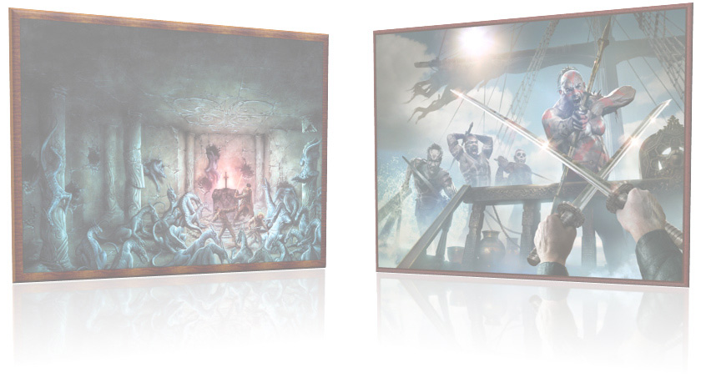
WORLD
Maps Characters Locations Artifacts Gallery
Book One
The Crimson Sword
Book Two
The Obsidian Key
Book Three
The Divine Talisman
WARDER I
The Ukinhan Wilds
WARDER II
The Blackmoon Shards
WARDER III
The Sundered Isle
Notes:
Underline active menu item
On menu item hover: Display background image
On menu item click: Display page tiles
On tile hover: highlight or enlarge slightly
On tile click: open large modal window with individual artwork (image and details)

Slide 14
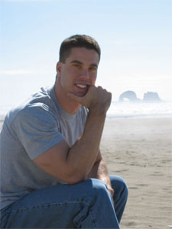
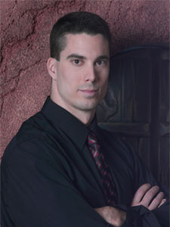
AUTHOR
Biography News Events Interviews Q & A
Weaned on the likes of The Lord of the Rings and Star Wars, Eldon took to writing fantasy adventure, it seems, almost as soon as he learned to read. By the time he hit grade school, he was writing 30-page stories in lieu of the two or three pages expected of all students on a monthly basis. When at age nine he read Terry Brooks's The Elfstones of Shannara, his goal of becoming a fantasy novelist went from child's ambition to hopeless obsession.
Yet writing was to be a hobby. Even his parents stressed the importance of a "safe" career path. So when the time came, Eldon accepted a scholarship and went off to college, where among his English, writing, and mythology courses, he studied computers, the health sciences, and worked hard to play football. What he really wanted to be was a quarterback. The NFL off-season, he thought, was long enough in which to write books.
However, after knee surgery, a dislocated throwing shoulder (literally dozens of times), and years of daily chiropractic care, he found himself on the outside looking in. Upon graduation from college, he finally accepted that his chances of entering dental school were far greater than those of ever being invited to an NFL combine.
Only, he didn't really want to do that, either. Other than play football, the only thing he'd ever really wanted to do was write—and he had several thousand pages of unpublished work to prove it. Still, it was unpublished for a reason. He hadn't tried, but he had no doubt as to what the result would have been if he had.
Employed as a technical writer, he spent the next few years composing and discarding works of dubious value. He had completed no fewer than six novels, as well as countless stories, premises, and unfinished works—but nothing of publishable quality. Eventually he decided that the fantasy genre was something to which he had nothing new to offer—at least, not in novel form. So he moved to Los Angeles to study screenwriting at UCLA, where he had hopes of bringing a worthy fantasy to the silver screen.
Three years later, Peter Jackson's The Lord of the Rings hit theaters—a project Eldon had absolutely nothing to do with, and which many have called an unmatchable achievement, the cinematic triumph of the new century.
So much for making a fresh mark.
It so happened, though, that during this time, Eldon began attending the Maui Writers Retreat and Conference, where, among bestselling novelists such as John Saul and Elizabeth George, he had a chance to study with his lifelong idol, Terry Brooks. Terry was most gracious in his encouragement. Rather than leave Eldon to the wolves, Terry allowed him to redo assignments until they were more or less on track. Though it might not have shown early on, Eldon was taking good notes and even learning a thing or two.

Slide 15
AUTHOR
Biography News Events Interviews Q & A
June 24, 2013
Unfettered anthology now available as digital ebook
[Date]
[News Headline]
[Date]
[News Headline]
[Date]
[News Headline]
[Date]
[News Headline]
[Date]
[News Headline]
Notes:
Underline active menu item
On menu item hover: Display background image
On menu item click: Display page tiles
On tile hover: highlight or enlarge slightly
On tile click: open large modal window with individual news (image and details)
Side scroll controls to navigate to next news story within large modal window

Slide 16
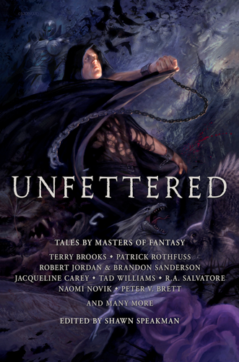
AUTHOR
Biography News Events Interviews Q & A
June 24, 2013
Unfettered anthology now available as digital ebook
[Date]
[Headline]
[Date]
[Headline]
Unfettered Digital Release
June 24, 2013
Today marks the official ebook release of Unfettered from Grim Oak Press, featuring Eldon's short story Unbowed. Direct links to various digital sellers can be found below. This is the anthology compiled and edited by Shawn Speakman, comprised of stories donated by a number of bestselling fantasy authors to help alleiviate medical bills resulting from Shawn's second bout with cancer.
Those who ordered hard copies of the exclusive anthology should receive them soon.
For more information, review the official announcement at:
http://grimoakpress.com/2013/06/ebook-published-unfettered
[Date]
[Headline]
[Date]
[Headline]
[Date]
[Headline]
Notes:
Underline active menu item
On menu item hover: Display background image
On menu item click: Display page tiles
On tile hover: highlight or enlarge slightly
On tile click: open large modal window with individual news (image and details)
Side scroll controls to navigate to next news story within large modal window

Slide 17
AUTHOR
Biography News Events Interviews Q & A
November 11-13, 2016
La Jolla Writers Conference
in San Diego, CA
[Date]
[Event Headline]
[Date]
[Event Headline]
[Date]
[Event Headline]
[Date]
[Event Headline]
[Date]
[Event Headline]
Notes:
Underline active menu item
On menu item hover: Display background image
On menu item click: Display page tiles
On tile hover: highlight or enlarge slightly
On tile click: open large modal window with individual event (image and details)
Side scroll controls to navigate to next event within large modal window

Slide 18
AUTHOR
Biography News Events Interviews Q & A
October 1, 2010
Warren Fitzpatrick
[Date]
[Interview Headline]
[Date]
[Interview Headline]
[Date]
[Interview Headline]
[Date]
[Interview Headline]
[Date]
[Interview Headline]
Notes:
Underline active menu item
On menu item hover: Display background image
On menu item click: Display page tiles
On tile hover: highlight or enlarge slightly
On tile click: open large modal window with individual interview (image and details)
Side scroll controls to navigate to next interview within large modal window

Slide 19
AUTHOR
Biography News Events Interviews Q & A
Story
Craft
Personal
Notes:
Underline active menu item
On menu item hover: Display background image
On menu item click: Display page tiles
On tile hover: highlight or enlarge slightly
On tile click: open large modal window with content from selected Q&A segment (e.g. Story)
Side scroll controls to navigate to next Q&A segment (e.g. Craft)
Accordian-style expanding/collapsing menu for individual answers to questions

Slide 20
AUTHOR
Biography News Events Interviews Q & A
Story
[+] Did you forget about "so-and-so"? Why doesn't he/she play a bigger role?
[+] Have we seen the last of "so-and-so", or will he/she reappear in later volumes?
[-] How do you pronounce "Asahiel"?
May 2007
I suppose it would depend on the speaker. (To-MAY-toe) / (To-MA-toe), right? One of my brothers pronounces it "OZ-eye-eel". Another insists that it's "AS-uh-heel". I usually go with the latter, when forced to speak it out loud. But mostly I try to avoid doing so. I'd rather listen to others try to pronounce it. Other variations I've heard include "ACE-uh-heel" and "A-zuhl" (like "Asia" and "Tool" smashed together). One of these days, I'll have to have my webmaster run a poll and see which readers prefer. But I don't think there will ever be a single correct answer.
Update - Jan 2010: My brother has kindly added "official" audio pronunciations to the World pages of this site (Artifacts, Characters, and Locations). So if you don't already have a preferred pronunciation of your own for one or more of these alien terms, you can check these pages for suggestions.
[+] Why did "so-and-so" behave in such a way? It seems strange.
[+] Why do so many characters in your books get captured?
[+] [CS] Jarom seems to lack any special skills or powers. What makes him the hero of this story?
[+] [CS] Why does Jarom "think" so much?
[+] [CS] How do you explain Killangrathor's unexpected frenzy at the end of The Crimson Sword?
[+] [CS] Why does Kylac have such a strange and unique accent?
[+] [CS] Can you tell me more about the origin and nature of Kylac's blades?
Story
Craft
Personal
Notes:
Underline active menu item
On menu item hover: Display background image
On menu item click: Display page tiles
On tile hover: highlight or enlarge slightly
On tile click: open large modal window with content from selected Q&A segment (e.g. Story)
Side scroll controls to navigate to next Q&A segment (e.g. Craft)
Accordian-style expanding/collapsing menu for individual answers to questions

Slide 21
CONTACT
{Social Media Icons}
{Copyright Notice}
+
{Additional Footer Elements}

