Slide 1



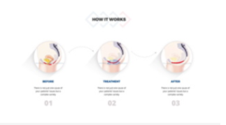
First to Dallas!
What is it? Why is it revolutionary?
Text + Video

Slide 2

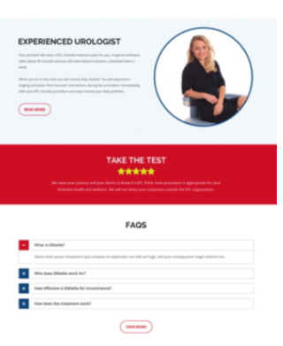
The Offer
Get it from us – the value proposition for Dr. Lee
Take a quiz / am I a good fit?

Slide 3

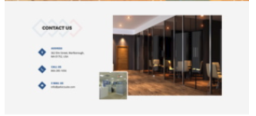
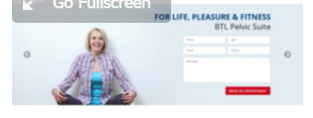
What to Expect and FAQ
Why our practice is investing and being the “first” and the center of excellence!”
End with contact info again

