Slide 1
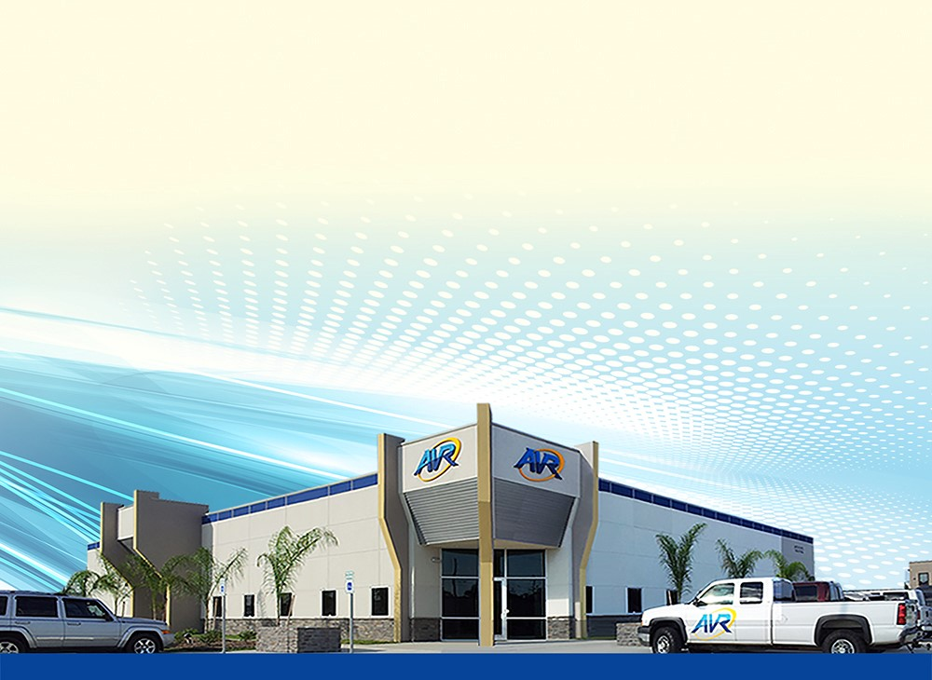
uManage Mobile Work Order System Demonstration
^{February 16th 2018}

Slide 2


AVR – A local partner who understands your challenges.
Expertise in dealing with MUDs and multi-contract environments
Local on-site support
Leverage existing relationships and infrastructure
Fully integrated solution
Reduced software admin overhead
Reduced interfaces
Simplified training
Simplified processes

Slide 3

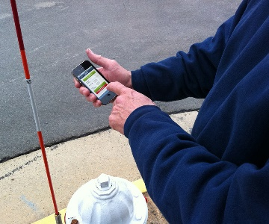
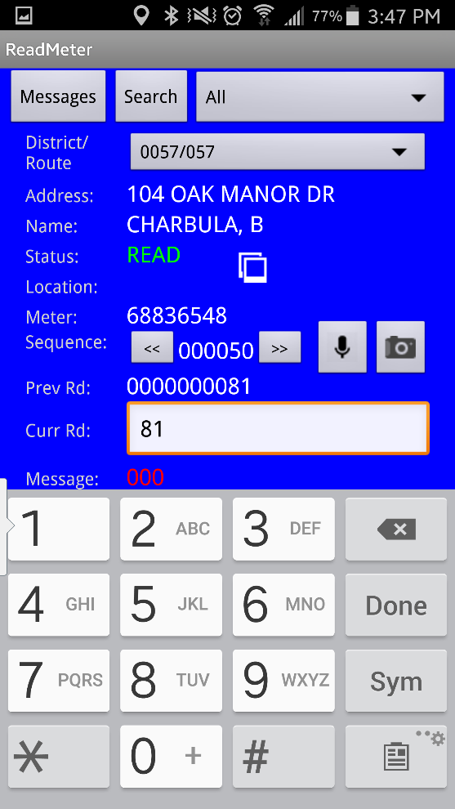


Benefits of Going Mobile
Paperless – reduce paper and printing costs
Increase productivity and billable revenue by reducing admin costs
Time to print and sort work orders for distribution to field
Drive time to pick up work orders
Office or truck time spent hand-writing work orders
Data entry time for re-entering work orders into the back office
Eliminate lost paper work orders, reduce incomplete work orders
Reduce work order mistakes / errors
Data captured at it’s source, drop down lists, real-time data validation
No more deciphering hand writing
Faster access to work order completion information for CSRs

Slide 4
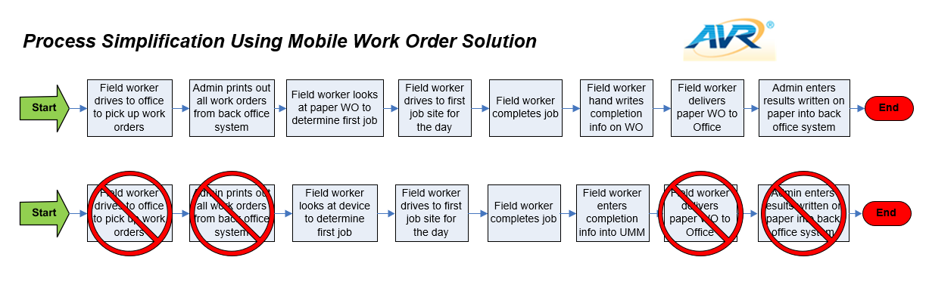
Benefits of Going Mobile

Slide 5
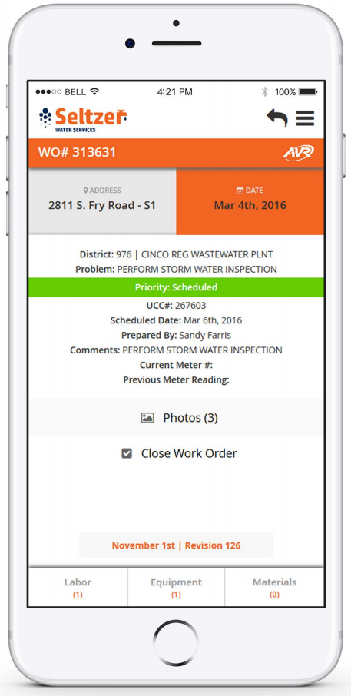
Main Product Features
See my work orders, sort, search, complete
Browser based solution, works on multiple devices
Dynamic screen formatting based on screen size
Use your own company logo and colors
Primary focus on ease-of-use and simplicity
No lost data, fields synchronized with AVR Cloud after entry
Stand-alone, can integrate with other back end work order solutions
Regular product updates / feature releases
Ability to implement on person-by-person or dept-by-dept basis

Slide 6



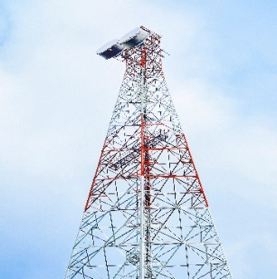
uManage Mobile – Product Development Roadmap
Target: July 2017 COMPLETE!
Target: April 2018
Target: Sept 2018
Target: Q1 2019
AND MORE!
Eliminate Paper Process
View and Complete My Work Orders
Enter Labor, Equipment, and Materials
Defaults and Dropdowns for Ease-of-Use
Custom Colors and Logos per Customer
Browser Based Solution (Device Flexibility)
Attach Photos from device
Add POs, Meter Number and Meter Readings
Client Configurations and User Permissions
Create new work orders from device
Add Skillset when entering labor
Attach Forms / Editable Mobile PDFs
View WO History for a Location
Alternate Time Keeping Options (Start/Stop Buttons)
Basic Asset Management**
GPS Coordinate Logging
Show my current / next WO on a map
Integrate with native app for driving directions
Route optimization
Dispatch / Desktop – View the last known location of mobile users**
**Requires modifications to back end/desktop solution

