Slide 1
Hashtag Sticker Project
I’d like to create a booklet of static-cling type stickers which are physical hashtags. The goal is to let people peel the stickers off, stick them to their wine glass and then post pictures of their glass to twitter and instagram with those hashtags.
The total project is:
1 front side cover with a very simple design
1 back side black and white text ad for email address
3 separate sticker sheets with hashtags with outlines
Canvas should be 8.4”x3.6” or 2520x1080 pixels at 300 dpi
Include a white space border of 1/16” around the outside and between any two sticker borders so that the sticker cutters have room to separate the stickers
The size of each of the panels should be sized to the hashtag with a little extra white space again for the cutters and should be on the order of 2 ½” x 1” but variable based on the word, e.g., #winewednesday should be thinner and longer than #wineo. The “REFERENCE” box and picture are to give an indication of the relative sizes of things that have worked well in the physical world
Use of various fonts and coloration of the letters including negative space where the hashtag has no color and the surrounding space has color is part of the design but they must be clearly readable (no script)
Small embellishments are encouraged, e.g., little cartoon hearts added to #winelover or frames, etc. but the embellishments shouldn’t impede reading
Arrangement is shown on the slides as an *indicative* approach I was using for design thoughts but the work is to optimize the size and placement of the hashtags on the canvas to have the most hashtags within the above constraints as possible
The dotted lines are recommendations for the cutter and should be included around each hashtag. Rounded corner rectangles are likely the best but some variation is OK.
Project output should be in Adobe Illustrator and .jpeg format both each time. Other formats possible but tell me in advance so I can check with the printer
All work needs to be original. No copywrited clip art or other copy/paste.
Examples of previous projects for ideas are here:
https://www.amazon.com/dp/B06XR3KHMV
https://www.amazon.com/dp/B01LM8BET4
https://www.amazon.com/dp/B01BJ5RJQM
I’ve tried to give some ideas for each of the three pages coming next. The content for the cover page and back page will come second but will be relatively simple
Finally, I’ve listed all the hashtags I can think of that would work *in order of importance*. Add from this list in order of importance.
I want to Divide the project into three steps:
First, one sticker page which will be offered to a couple different people
Second, pick one designer to finish the other two sticker pages
Third, do cover and email add text

Slide 2
Hashtag List
ORDERED LIST
#happy
#friends (include two times)
#yummy
#cheers (include two times)
#thirsty
#vino
#happyhour
#lifeisgood
#wineoclock
#winelover
#winewednesday
#drinkup
#vinho
#winetime
#drink #drank #drunk (all in one sticker)
#winenot
#lovewine
#winedown
#winegeek
#wineoftheday
#mywine

Slide 3

STICKER PAGE #1 – Design Thoughts
#winelover
reference
#winetime
#winegeek
#wineaddict
#winetasting
#drink #drank #drunk
#winewednesday
#wineoclock
#happyhour

Slide 4
STICKER PAGE #2 – Design Thoughts
#happy
reference
#friends
#friends
#lifeisgood
#lovewine
#winedown
#winewednesday
#winenot
#drinkup

Slide 5


STICKER PAGE #3 – Design Thoughts
#cheers
reference
#thirsty
#winewednesday
#cheers
#cheers
#vino
#mywine
#wineaddict

Slide 6
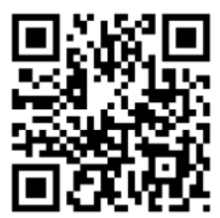
BACK OF COVER PAGE – Black and White Add
Title Title Title
Text to come later but this will be a black and white text call to action to ask for an email address with a giveaway
Call to action URL

Slide 7
Cover
Hashtag stickers cover art and information.
To come later
(Multi-colored but simple design)

Slide 8
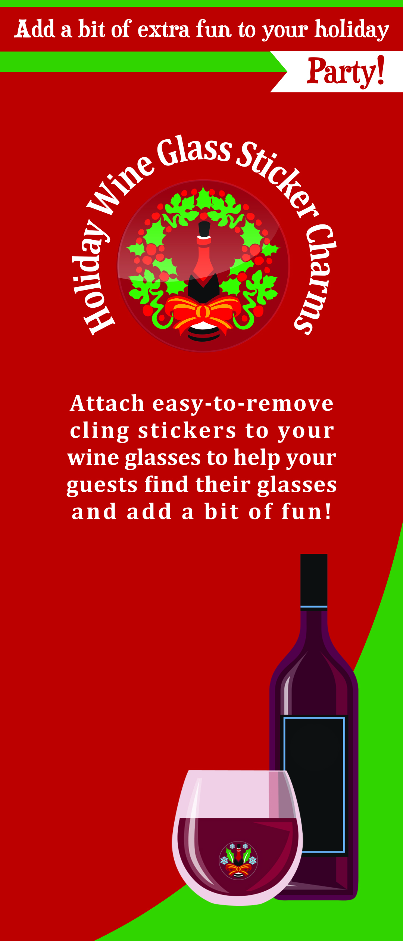
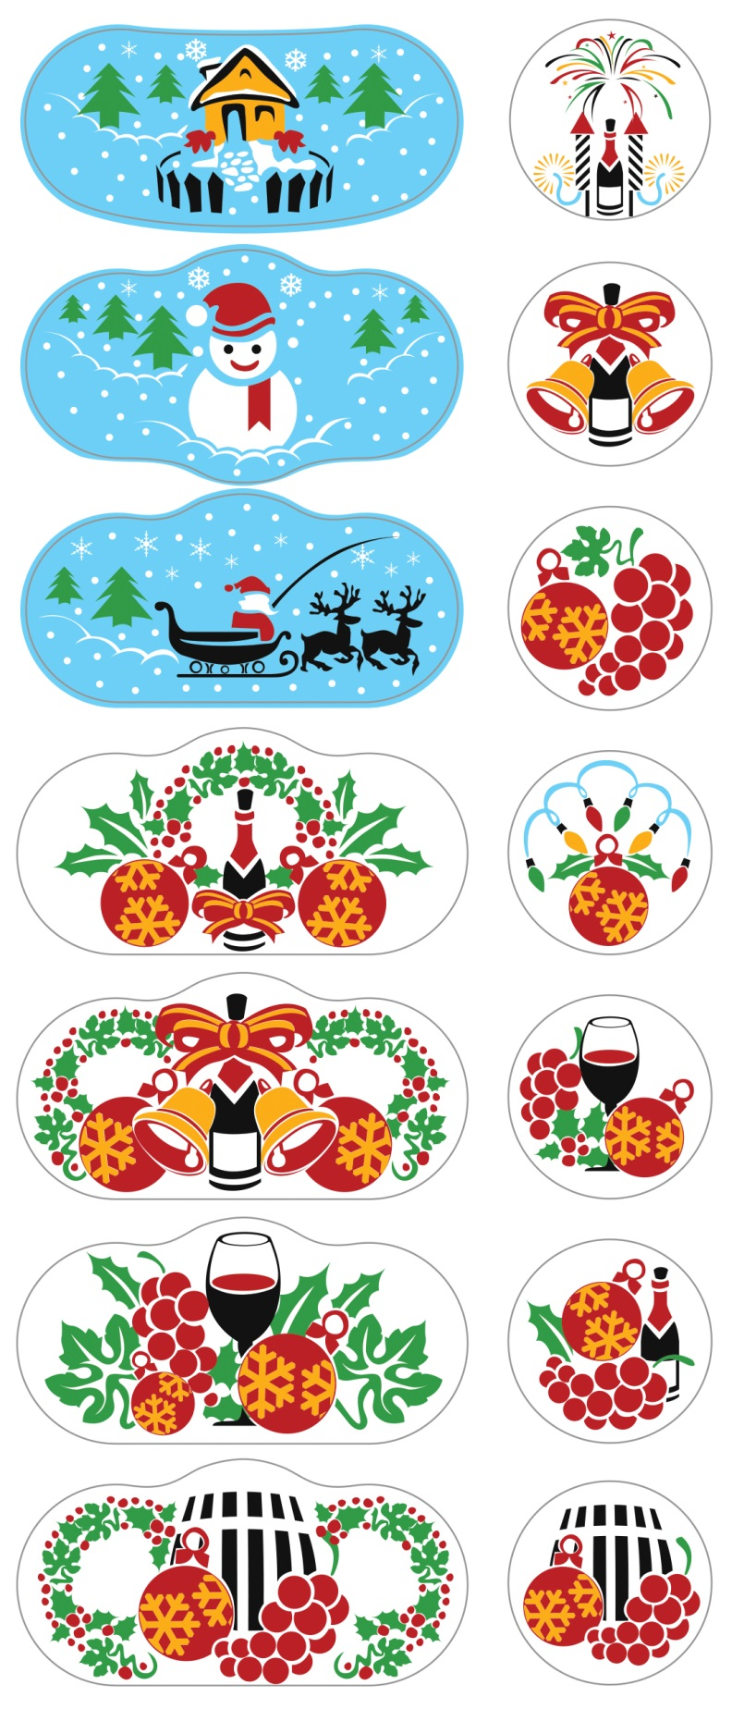
Example Layouts for cover and sticker page from previous project

