Slide 1



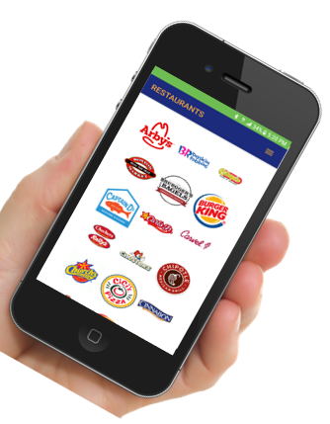








Some of the other Charities that we are proud to support:
Customer Satisfaction Representative
My
FUNDRAISER
10730 Potranco Rd, Suite 122, Box 139
San Antonio, Texas 78251
www.myeats.org

Slide 2
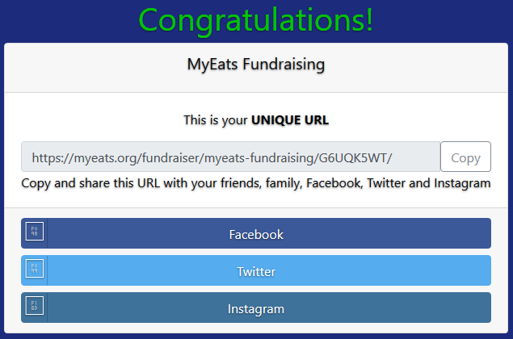
 |  | Are you tired of fundraisers where you, the parent, do all the work? Would you like a simplified process that doesn't require unsafe practices like door-to-door selling? Would you like to eliminate the hassle of collecting money and delivering items? Would you like a fundraising program that is 100% complete in one week? Would you agree that family, friends, and parents are tired of buying items that have no purpose or value? Do you agree that most family and friends would like to support a good cause?
My
My
LET’S PIN, POST, TAG, TEXT, OR TWEET
STEP 1
REGISTER TO PARTICIPATE
STEP 2
If you have been involved or around fundraising with schools for any lengths of time, then you are probably familiar with coupon books or discount cards. Even though millions have been sold throughout the years, we continue to hear the same complaints: the coupon is in the other car or purse, or, the coupon isn’t good in my area. While the product was great, it just wasn’t very user-friendly. Thank goodness for technology!
The MyEats® app includes more than 40 of your favorite national and fast food restaurant chains. Each of them is making generous offers to encourage consumers to support your school or group.
My
LET’S ASK FOR SOME HELP
STEP 3
Each participant must register. Simply type this Registration URL into your browser.
You just sent them a post. Let’s call and ask for some help to support your fundraiser.
Call 15 family members and friends
https://myeats.org/register/myeats-fundraising/

Slide 3

