Slide 1
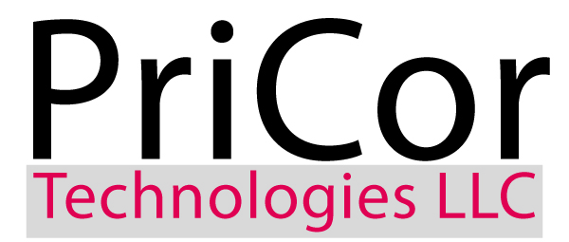
SIDE SEWER | EXCAVATION TRENCHLESS TECHNOLOGIES GROUP
Combining Capacity with Ability and Agility

Slide 2
What Do We Do?
PriCor Technologies is in business to enhance the service offering of the retail plumber.
At PriCor Technologies it is our goal to:
Increase your profitability
Provide the safest work environment in the industry
Maximize your marketing dollars
Help you retain your customers

Slide 3
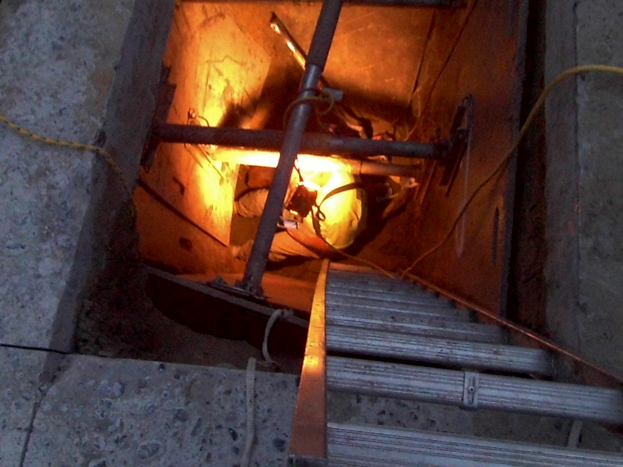
Our Service Offering
By utilizing our personnel and equipment you will see a significant increase in profitability. By partnering with PriCor you can use our equipment and personnel as if they are your equipment and personnel
8 Professionally Trained Excavation Crews
2 Cure in Place Pipe Installation Set Ups
Pipe Bursting Equipment
Sewer Camera and Locating Service
2 Hydro Jetters
Water Line Repair and Replacement
Concrete and Asphalt repair and replacement
Repairs in the Public Right-of-Way
Licensed Plumbers
Drain Cleaning and Maintenance
Backflow Certified
24/7/365 Emergency Service

Slide 4
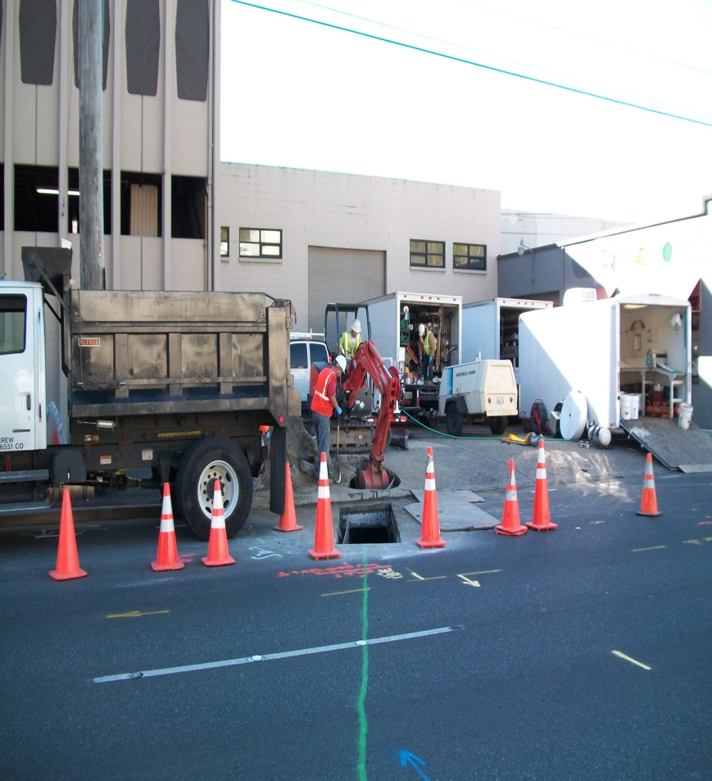
Partnership Types
PriCor Technologies offers several types of partnerships to help accommodate the needs of your business:
Wholesale Partnership
Referral Partnership
Full Service Partnership

Slide 5
Wholesale Partnership
Wholesale partners call us for pricing then sell the needed work directly to their customer after adding a discretionary mark up on our price.
Benefits:
Your mark up goes directly to your bottom line
You control how much profit comes out of each project
PriCor assumes all of the risk involved with each project we perform for you
PriCor handles all peripheral tasks involved with each job (pulling permits, covering inspections, etc.)

Slide 6
Referral Partnership
Referral partners essentially hand off a job to PriCor Technologies.
Benefits:
PriCor pays referral fees from $50 to $5000 depending on the scope of the work
We make sure the customer knows to call you again the next time they have a need for plumbing services
Enjoy the confidence in knowing you are turning your work over to a competent, professional organization

Slide 7
Full Service Partnership
As a full service partner PriCor Technologies acts as your sewer service and repair department.
Benefits:
Utilize all of our highly trained personnel to maximize every call
Your personnel is available to take on other projects
Customer retention is assured as we are on site as your direct representation
You are assured a prearranged percentage of each job we do for you. These unburdened profits go directly to your bottom line.

Slide 8
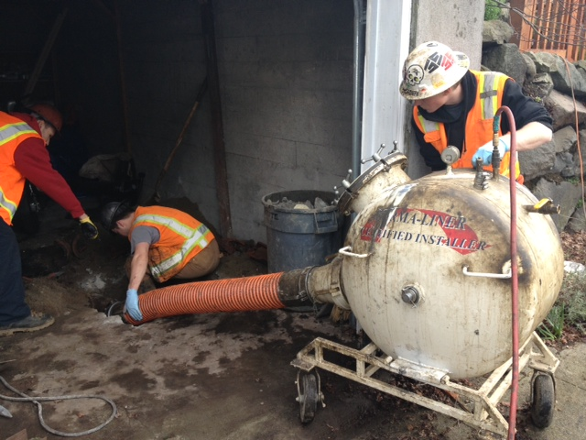
Overall Partnership Benefits
Safety First! All of our personnel is trained to perform each job with safety in mind
Our development of best sales practices has resulted in an 80% land rate with maximum customer satisfaction
PriCor Technologies is highly technical with unique problem solving capabilities
We are licensed, bonded and insured. We assume all risk for the work we do for you
Expand your service offering without purchasing and maintaining expensive equipment
No need to hire and train additional employees
Current employees are free to work on other money-making projects related to your core business
Create a profit center that captures jobs that would have been lost or you would not otherwise seek
No need to obtain additional licenses, bonding or insurance
Earn revenues that go straight to the bottom line as unburdened profits
Provide 24/7/365 emergency service to your customers without intruding on your own free time
Added capacity to ensure that you never lose a customer to your competition

