Slide 1


Idea to design –
(Ideo – Design Thinking)
Accelerating SAP S/4HANA projects
Social Technologies
Staff experts
on demand
Autonomy
of teams
Community
& crowd
SCALE IDEAS
for the creation of
exponential growth within your
organization
Ex-perimentation
Algorithm
Dashboards
Interface
processes
Engagement
Leveraged
assets
Illuminating the blind spots - making SAP S/4HANA projects challenging.
Zurich, March 2018 – Andreas L. Gross-Zerilli - Project Manager, Mind Trainer & Executive Coach

Slide 2
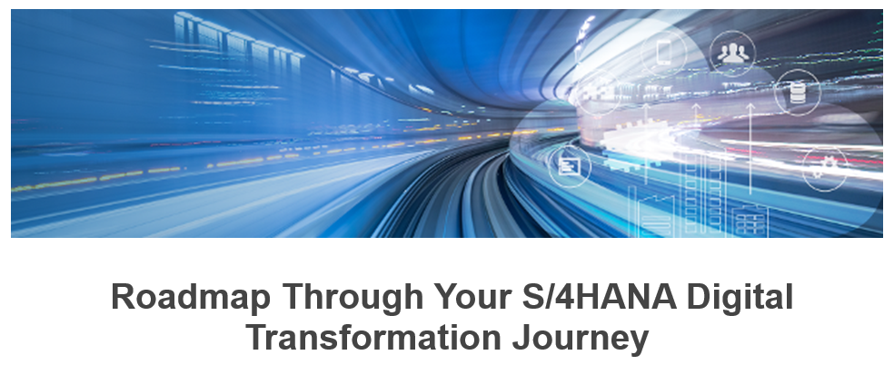
Where are we are coming from?
Why are we here, today?
What does SAP S/4HANA mean for our daily business- & project lives?
What makes the management of change so difficult – and how to solve the issue.
How we solve the occurring challenges during an SAP S/4HANA project
Digitalization is “real-timification” (or: zero latency) of all our businesses and collaborations.
“embedded Management of Change”
Preamble (providing the background of an SAP S/4Hana project)
SAP S/4HANA has not fallen out of the sky!
An introduction on the economical background, on the implementation concepts and the mind set of SAP S/4HANA projects – and how that affects an organization implementing.
Source: Original SAP© Advertisement

Slide 3
Preamble
Es ist echt irre, was unser Gehirn alles so schafft! - Viel Spaß beim Lesen !!!
Ehct ksras! Gmäeß eneir Sutide eneir Uvinisterät, ist es nchit witihcg, in wlecehr Rneflogheie die Bstachuebn in eneim Wort snid, das ezniige was wcthiig ist, das der estre und der leztte Bstabchue an der ritihcegn Pstoiin snid. Der Rset knan ein ttoaelr Bsinöldn sein, tedztorm knan man ihn onhe Pemoblre lseen. Das ist so, weil wir nicht jeedn Bstachuebn enzelin leesn, snderon das Wort als gzeans enkreenn. Ehct ksras! Das ghet wicklirh! Und dfüar ghneen wir jrhlaeng in die Slhcue!
Und als absolute Steigerung dieses hier:
D1353 M1TT31LUNG Z31GT D1R, ZU W3LCH3N GRO554RT1G3N L315TUNG3N UN53R G3H1RN F43H1G 15T! 4M 4NF4NG W4R 35 51CH3R NOCH 5CHW3R, D45 ZU L353N, 483R M1TTL3W31L3 K4NN5T DU D45 W4HR5CH31NL1ICH 5CHON G4NZ GUT L353N, OHN3 D455 35 D1CH W1RKL1CH 4N5TR3NGT. D45 L315T3T D31N G3H1RN M1T 531N3R 3NORM3N L3RNF43HIGKEIT. 8331NDRUCK3ND, OD3R? DU D4RF5T D45 G3RN3 KOP13R3N, W3NN DU 4UCH 4ND3R3 D4M1T 83G315T3RN W1LL5T

Slide 4





Preamble (providing the background of an SAP S/4Hana project)
Can you grasp, what “Disruptive Innovation” – expressed by the term “Digitalization” stands for?
The mobile service “Iridium” invented is used by all of us on a daily basis. Just on far lower and un-comparable scale of cost. The investment vs. the revenue subscribers leveraged generated unproportioned results.
01
Iridium, the global satellite phone company backed by Motorola (MOT), filed for bankruptcy in 1999, after the company had spent $5 billion to build and launch its infrastructure of satellites to provide worldwide wireless phone service. At the time, it was one of the 20 largest bankruptcies in US history. To work properly, the system needed 66 satellites. The creation of this enormous system forced the company to default on $1.5 billion of debt. The service had been such a failure that it only had 10,000 subscribers.
Cost
Iridium (MOT)
Disruption came from inside. The company’s management was not able to anticipate the related consequences of the invented “digital Cam”. The perception was to make money from photos printed on paper.
Technology
02
Kodak was a juggernaut of a company; but the tragedy of its collapse runs deeper. It is not that the company could not have saved itself by responding to change. The tragedy is that Kodak invented the change that eventually killed it. A Kodak engineer, Steven J. Sasson, invented the first digital camera in 1975. In an interview with the New York Times, Sasson describes how Kodak’s management reacted negatively to his camera because it was filmless photography, instructing him to tell no one about it.
Kodak
Lack of popular apps and an unpopular ecosystem means Microsoft holds less than 2 per cent of the global smartphone market, and sold just 2.3 million units during the first three months of the year.
03
Platform
When NOKIA’s top-brass realized that the iPhone and its App-Store were not going anywhere and that Android was on a steep rise, they panicked. It was only then that they realized that the rest of the world was breathing down their necks and their competitors were no longer local Italian, Korean or Japanese manufacturers (plus niche-happy BlackBerry) but multi-billion dollar Google and Apple. So, in their panic, they chose the coward’s solution: they sought out a strong ally. Only that ally turned out not to be their friend. (Remark: Nokia is on his way back to the business!)
Nokia
The three “Ls” killed Lehmann Broth: Not being capable to Leverage (the assets) due to that the Liquidity went down and the higher risk they had to take produced additional Losses! The community’s trust was “consumed”.
Community
04
In short, Lehman Brothers -- a company with a 158-year history, including 14 years as an NYSE-listed giant -- failed simply because it took on too much risk in a booming market. In the end, its move from the safety of corporate finance and M&A (mergers and acquisitions) income into the risky world of proprietary trading proved to be its downfall. The lesson here is that any firm, no matter how big and powerful, can be dashed to pieces on the rocks of leverage, liquidity and losses!
Lehmann Broth.
Lack of innovation and the belief in a business model being overdue. Resting on the laurels and not having the methodologies available to ignite a sustained process of innovation.
05
On April 30, 2009, President Obama forced Chrysler into federal bankruptcy protection and the company announced a plan for a partnership with Italian automaker Fiat. On June 1, Chrysler LLC stated they were selling some assets and operations to the newly formed company Chrysler Group LLC. Fiat will hold a 20% stake in the new company, with an option to increase to 35%, and eventually to 51% if it meets financial and developmental goals for the company.
Innovation
Chrysler
Polaroid
At its peak in 1978, Polaroid had $3 billion in revenue. But the advent of digital photography led to bankruptcy for the “instant film” company in 2008. The company reinvented itself, however, and today offers multiple digital products, including tablets, television sets, and digital cameras. The company’s “polarizer” technology enhances many LCD flat-screen televisions sold today.
Compaq Computers
Compaq was the first to re-engineer the IBM personal computers for the mass market. The company became the number one seller of IBM-compatible personal computers during the 1990s and held on to that status until Hewlett-Packard bought the company for $25 million in 2001. By that point, Compaq had lost sales to Dell Computer. It was also losing money on its acquisition of Digital Electronics Corporation. Hewlett-Packard discontinued the Compaq line in 2013.

Slide 5








In a world performing within a process of accelerating “Disruptive innovation” we all have to decide if we want to play the role of the “Disruptive” or the “Disrupted”.
Here and Now, each and every organization may decide either to disrupt itself – or to allow others, to do it for them.
All Exponential Organizations (ExOs) share the major connectional idea: The owning of assets will hinder us to innovate and in consequence will slow down the continuation of our exponential growth. This fact is a crucial thread to the future existence of our business.
Preamble (providing the background of an SAP S/4Hana project)
Adoption curve over 160 years of progressing industrialization
SCALE IDEAS (implement 4 out of 10!)
Staffing of (expert) resources on demand
Community & Crowd must contribute to your business model
Algorithms
Leveraged Assets
Engagement
Interface Processes connecting you to the external world
Dashboards (KPIs & OKRs) – as well as the concept around it
Experimentation
Autonomy
Social Technologies
Social Technologies
Staff experts
on demand
Autonomy
of teams
Community
& crowd
SCALE IDEAS
for the creation of
exponential growth within your
organization
Ex-perimentation
Algorithm
Dashboards
Interface
processes
Engagement
Leveraged
assets
A few Disrupters
In action

Slide 6
Preamble (providing the background of an SAP S/4Hana project)
Digitalization represents a Massive Transformation Purpose (MTP)
Having the right Staff (experts) engaged on demand is definitely crucial for an ExO. In most of the cases exceptionally performing organizations maintain a relatively small group of specialized people. The workforce is expanded and enriched by excellent, creative and flexible contractors whenever needed. AMP (Austria's greatest insurance company) uses contractors for nearly 50 percent of their IT-department.
Social Technologies guarantee that communication channels will stay open. More communication allows greater transparency, and importantly, keeps the organization always connected to its massive transformative purpose (MTP).
Social Technologies
Staff experts
on demand
Maintaining a Community and a crowd, both lower the risk as well as the effort to be invested to operate the business. Your community is your core team, your user, your customers, your company’s alumni as well as your company’s vendors, your partners and your fans. The crowd is everyone outside your on-demand staff, or people you engage for validation purposes – crowdsourcing or even crowdfunding.
Autonomy represents the key of the belief system of an ideal ExO employee. ExOs need autonomous, multidisciplinary and decentralized teams with the intention to satisfy the growing demands of customers. The technology company “High Fidelity” for instance, implemented a quite extreme form of autonomy in their organizational charter – the employees vote every quarter if they want to keep their CEO.
Autonomy
of teams
Community
& crowd
Internal - Factors
External - Factors
SCALE IDEAS
for the creation of
exponential growth within your
organization
Experimentation is key to every ExO. Where traditional Organizations sought to reduce every risk (for various purposes) – they overlook the biggest risk. The biggest risk is in fact taking no risk. If anyone wants to succeeds – to experiment is a must. Mondelez International, a multinational confectionary company, employs “Garages” to support the employees to anticipate innovative ideas. Disconnected from outside contact, participants can focus on the problem at hand rising with the new solutions.
Ex-perimentation
Algorithm
Algorithms sound far more complex than they really are. This term stands just for a more or less complex sequence of defined process steps within a predicable workflow. In business we call them “End-2-End processes” – in Excel “Macros” and in Mathematics “f(x)”. Search algorithms (a defined set of automated operations) made google the world’s leading search engine, some HR-departments use algorithms to prevent biases in filling open positions.
Dashboards
Interface
processes
Engagement
Leveraged
assets
Leverage assets It is not necessary to own assets anymore – you just need access to them. Stay flexible about them, too! Only a few companies still need to own assets (like Amazon owns the warehouses they operate in). The minute your company’s operations are based on real-time and consistent (zero latency) information the situation is significantly different.
Dashboards enable people in their organization to access relevant data in real time. Think of a dashboard within a multiplayer game like “World of Warcraft”. You always know where to go, how to get there and what to do once you will be there.
Left brain
Interfaces connect the SCALE externalities –
such as your community - with the company’s internal workings. ExOs demand on interfaces to manage work and projects and push them into the world. Currently APPLEs App-Store is representing a fully developed interface, as it allows customers to see what is available, and what's more, it’s indispensable to APPLE and all its products.
Engagement as well as the delivery of “purpose & sense” is crucial for the information based ExO-company approach. Networks, gamification and constructive competition and positive feedback loops are options of engaging people and deploying purpose & sense to them. Engagement and contextualization help inject your company with new ideas, paving the way for innovation.
Right brain
Order
Control
Stability
Creativity
Growth
Uncertainty

Slide 7

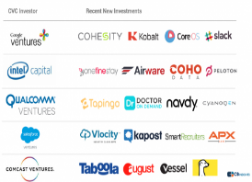
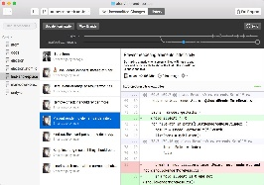

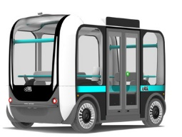


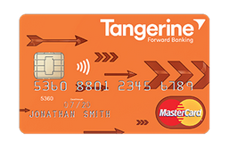


We are not claiming all these companies are using SAP S/4Hana – but we anticipate their journey into and through the area of
“Digital Transformation”
Preamble (providing the background of an SAP S/4Hana project)
The Digitalization expects us to aim for a Massive Transformation Purpose (MTP)
AirBnB community
90 x more listings per employee
Google Ventures – Investments
2.5 x more investments in early stage start-ups
10 x faster through design process
GitHUb SW-Development
109 x more repositories per employee
Valve Gaming
30 x more market cap per employee
Local Motors Automotive
1000 x cheaper to produce new car model 5 – 22 x faster process for a car to be produced (depending on the vehicle)
Tesla Automotive
30 x more market cap per employee
Quirky consumer goods
10 x faster product development (29 days vs 300 days)
Tangerine (formerly ING Direct Canada)
7 x more customers per employee
4 x more deposits per customer
Source:
Kodak - by the way… currently makes the way back…
The KODAKOne image rights management platform will create an encrypted, digital ledger of rights ownership for photographers to register both new and archive work that they can then license within the platform. KODAKCoin allows participating photographers to take part in a new economy for photography, receive payment for licensing their work immediately upon sale, and sell their work confidently on a secure block chain platform.

Slide 8
Preamble (providing the background of an SAP S/4Hana project)
Four pre-conditions for a successful SAP S/4HANA project
One project One aim -
…both paths must be handled equally
1A
SAP R/3 Transition path
A1
NON SAP R/3 Migration path
Choose the right individuals to be engaged (trained)
Train the Trainer allows you to address a larger number of employees while staying in budget. More teachers can translate into less money spent on travel, since employees can all learn from someone in their local network. Further, having multiple trainers enables you to initiate multiple learning tracks or classes going on at the same time, accelerating the completion of the objective overall. In order for this to work, however, you need to choose your champions according to more than just their location. As you're reading this, you're probably thinking of certain people who carry some authority among your staff. If you have the time, consider your employees' backgrounds, especially whether anyone has teaching experience or is practiced at leading meetings. Think outside the box as well; even a skill such as organizing events can be beneficial, especially when you're asking someone to develop a series of learning modules or ensure that every employee participated. And, of course, make sure all your designated trainers are willing to see the task through to the end.
Be prepared for mistakes and (hopefully) constructive criticism
Train the Trainer is a learning process. Even if your participants have years of experience in teaching, they may not have done so in the corporate environment. As with any learning process, if you don't allow your trainers to make mistakes, they may be hesitant to try something new again. And the same holds true for the managers overseeing the initiative. Allow enough time for preparation and practice. It's incredibly rare for something to go smoothly the first time you try it, even if you've spent a lot of time choosing the right trainers and researching the perfect subject-matter experts. Whether you're giving it or taking it, constructive criticism will play a direct role for you throughout the Train the Trainer process. Your trainers will be learning from someone who specializes in presentation. So, if they're told that a joke isn't landing or that they need to use a different method of demonstration, they should be prepared not to take it personally. The end goal of Train the Trainer is to maximize efficiency, not necessarily to introduce creative learning methods. At the same time, learners do connect with trainers when they are being genuine or authentic, so look for these traits when you're criticizing a trainer within your department.
Define a accurate planning and a determined schedule
TTT doesn’t simply stand for the delivery of the one or the other type of content. TTT has the clear aim to provide the feeling of safety and the fact of “being prepared” for the challenges to come. The people of the organization must be encouraged to gain and to grow confidence in the implementation (technology and processes) and impregnable trust in the strategy the management provides.
Track results - feedback and mitigate the process
As new trainers, your employees are most likely eager to know how well they taught and what they could do better the next time around. Even if they led training through in-person meetings, create reports using tracking analytics to show them who is seeking the next steps, or who is following up with "homework" assignments. You can also use tactics such as gamification to encourage friendly competition and reward progress.
Transition path
definition
From various SAP evolutions
SAP Basis and
guiding structures
accurate evaluation/
decision and enablement
*Not in scope of the
proposed project
We are able able to support and to develop the trained trainers’ and executives’ capabilities, with additional coaching support (on time & material)
Actual recording
of processes
(legacy SAP Environment)
Actual documentation
of processes
(non SAP Environment) –
Preparation for and migration to SAP S/4HANA
Specific Data Cleansing
& Mitigation effort
Specific Data Cleansing
& Mitigation effort
High-Level: TTT-Curriculum for countries running already prior Versions of SAP
Value Generation
for no SAP users.
Motivation over
“purpose & sense”
High Level: TTT-Curriculum for countries running
NON SAP Systems
Mapping to
corporate
SAP S/4 Hana processes, rules and definitions
Sophisticated
methodology
Certified trained Trainers
/ Super Users
Certified trained Trainers
/ Super Users
Training Delivery
by trained trainers in the
SAP-regions
Training Delivery
by trained trainers in the
former non-SAP-regions
OCM –
deliverables
Globally unified structure, methodology, technology and language…
Aim: Globally harmonized SAP S/4HANA operations, continuously supported
by dedicated “Certified Trainers / Super Users”
Globally harmonized SAP S74Hana–System...
…only the necessary will be locally customized.
Dashboards
KPIs & OKRs
Remark: Our TTT-model provides your organization not only with the advantage of reducing direct project cost – but it will also qualify you and the future users of the system to cope with all kind of changes to come in the future.

Slide 9
Why are we here, today?
We will understand why the implementation of SAP S/4 HANA is different, how such a project will be delivered successfully - and how you will manage to take your people, your organization and collaborators with you.
Having the people of your company by your side is key – it is NOT the technology causing the challenges.

Slide 10
Why are we here today? (providing the background of an SAP S/4Hana project)
What is the business world - where SAP S/4HANA is “born in”- look like
MRP Planning runs
Keeping resources on stock
Payment processes lasting days or even weeks
Over-week planning security
Predictable attitude customers
Firmly established hierarchy levels and decision trees
Traditional thinking and mental configurations form the early ages of industrialization
Payroll costs as the baseline for product pricing
Un-synchronized mass production of goods to any form of stock or MRP
The future of all our globalized
“real-time” business will be VUCA
What we leave behind…
A
Ambiguous
There is not a single correct answer
C
Complex
diversity of decision factors
…not a single truth,
anymore!
Massively divagating company goals and targets
Demand-synchronized interaction with thousands of costumers ordering in real-time and parallel
Planning blur (uncertainty) of what is currently “right” or “wrong”
(zero planning)
Parallel processing of complex (holistic) information structures to find out what might be relatively right at this particular point of time
Fault-tolerant style of co-operation and co-creation
Agile Management of kind of business cases
Non “in-stone-carved” organizational structures and moving decision making responsibility and trees.
Preventive interventions to early de-escalation of rising issues
AI-influences and support on all layers of decision making
Synchronized Lot-size “ONE” production and service delivery on demand.
A VUCA-World in “Real-Time”.
VUCA is the
“new” normal.
U
Uncertain
less and less future-proof
The more businesses operate in “real-time”- (synchronized) the more VUCA our world will become…
V
Volatile
Increasing number of changes
…but, the potential of the occurrence of a certain truth!
What we will call into our reality, instead….
Businesses in a globalized world must become “Real-time”
VUCA: The concept was stamped by the US Military and describes the challenges of the Management of staff in complex situations.

Slide 11
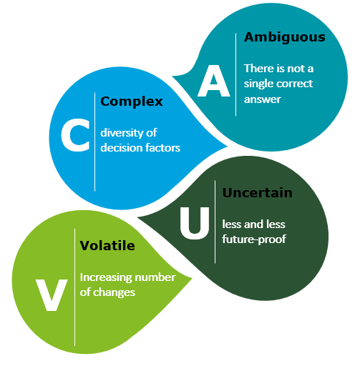
Why are we here today? (This correlation makes SAP S/4 HANA projects complex )
Technologies and processes to govern our future collaboration and co-creation
Automated Purchase order approval process
Procure to pay
Idea to offering
Market to order
Quote to Cash
Order to Cash
Forecast to Delivery
Final plan to report
Issue to resolution
Plan to Inventory
Hire to retire
Assets to Acquire
…
The humans’ business world becomes VUCA.
SAP High Performance Analytic Appliance (HANA)
The major benefit for you adapting this new technology
It is not only in the speed. OLTP transactions are not only improved by better performance but rather by a better Business Process based on smart software due to the advantages of SAP HANA as a platform.
Significant improvement in OLAP processes where now truly the SAP Business Suite on HANA can leverage the User’s BI experience at all levels, from operation, to higher Strategic Business Intelligence.
Integration + Integration + Integration – Finally you will be able to reduce your diverse Vendors’ footprints that your were collecting in the past 10 or 15 years. Don’t forget the rule of thumb. It will cost you 20% to 30% of your implementation and further maintenance costs to maintain connectivity, like for example Process Integration Software, at the same time SAP HANA new and flexible Smart Data Access offers you new possibilities to store Big data using smart tools like Hadoop, federating Data from several other systems and allowing you for a better and safer Business too Business interaction.
Online-Transaction-Processing
(OLTP)
End-to-End business processes being related….
Processes
Technology
Design Thinking
Source: SAP
agile
Chat Bots and conversational Interfaces
Virtual Reality / Augmented Reality
Human Machine Interfaces
Driverless Cars
AI & Automation
Internet Of Things (IoT)
Machine Learning
Serverless Architecture
Cyber Attacks on IoT Devices
Deep Learning
Voice Control
…
The global markets
Megatrends
(co-created)
Megatrends we have to cope with…
Source: Forbs, Dec. 2016
Disruptive Innovation
Client Orientation & Customer Focus
Digitalized Technologies
Entrepreneurship
Agility and Ability to create
Workplace of the future (independent working)
Digital Leadership
Collaboration & Co-Creation
Continuous Improvement / Innovation & Learning
Digitalized businesses
are aiming for…

Slide 12

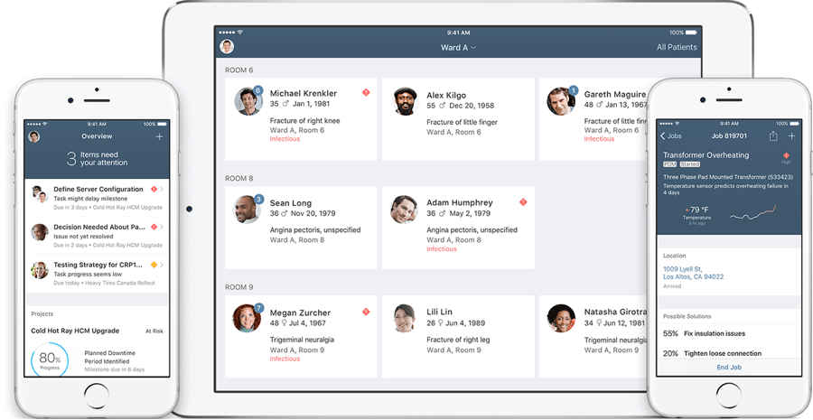

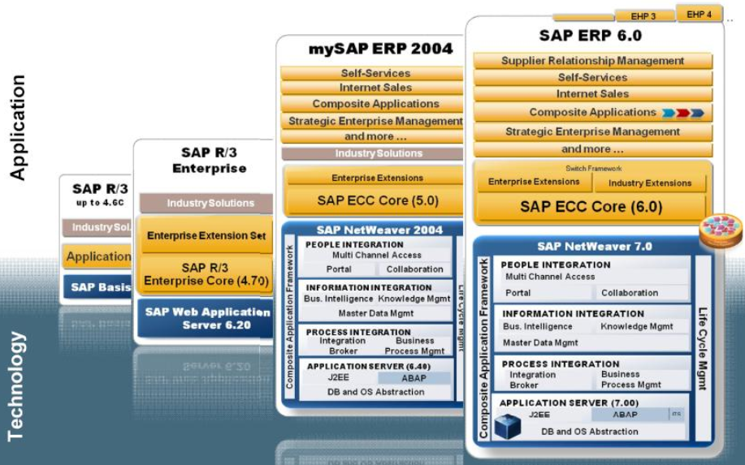
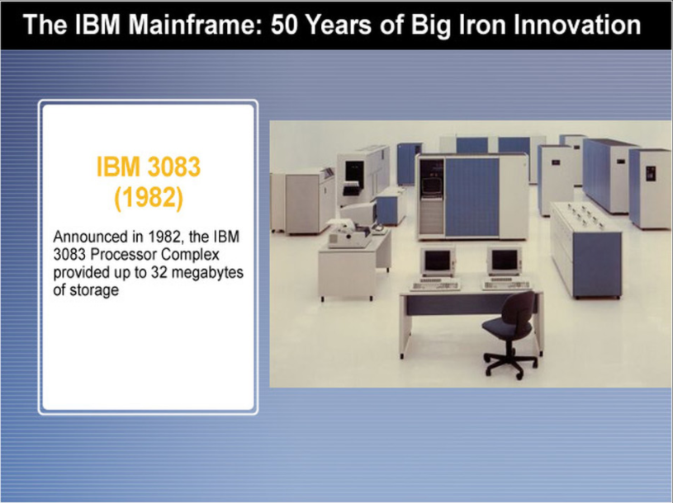
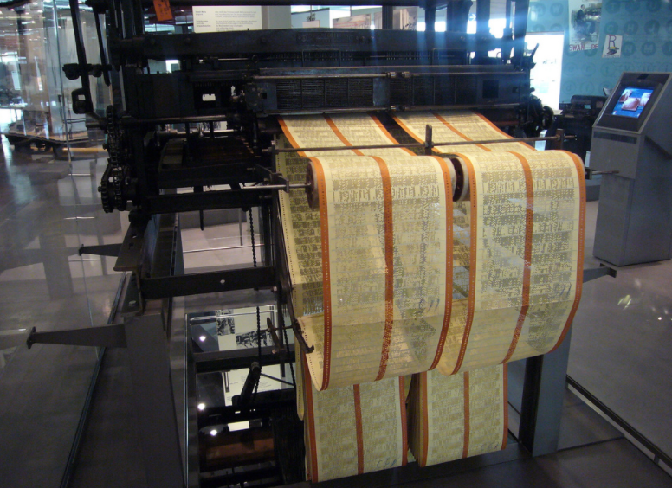
SAPs journey since the 1970’s – to the “Real-timification” or “Zero-Latency
Businesses operated in “Real-Time” require adapted processes, collaboration and responsibilities
The change of technology can be handled relatively easy. Tools and standard methods are there to support.
Here it is, where the challenges of managing the change are originated.
The “real-timification” demands significant and radical changes in the way a corporation organizes their business.
Some examples for “Real-time” Business Processes based on synchronous communication…
IoT (Preventive Maintenance)
Instant-Payments
Emotion Analytics that transform Human Machine Interaction (HMI)
Service Technician Education Program (STEP)
Compliance check & Multi-Ident
Follow the customer
Personalized Medicine
Production on Lot-size “ONE”
VR and Real-Time Simulation
AI and Self-acting robotics (Devices, Cars) and AI integration for consulting services
and many many more…
Time required to process a request…
Human-Machine
Integration (HMI)
Server less Computing
BIO-Computers, Quantum computers and DNA-Storage will provide computing power far beyond everything imaginable today
Preventive- and real-Time production
Of goods in “Lot-size one”
…Milliseconds or even less (2030)
The “real-timification” demands a paradigm shift in how we organize our collaboration.
2022
S/4HANA
…Seconds (2015)
2016
S/4
“synchronized”
Cloud-based technology (on premise, private or public cloud)
Server Farms and off-shore hosting
and integration of distrusted services
Client/Server Technology and Relational Databases and new programming languages
…Minutes (2012)
2015
Server / Hosting / Cloud
SAP / R3
“Un- synchronized”
…Hours (1995)
1992
SAP / R2
This mental concept describes the style of collaboration and responsibility a company in the 2010th and 20th operates in.
Some examples for “Off-time” Business Processes based on asynchronous communication…
Material Requirements Planning
Build-to-Production plan
Processes running for weeks for the creation of consolidated balance sheets
Grieving financial transactions for days
Procure-to-Warehouse
Approval processes reaching over corporate departments
Independent spheres of responsibilities
and many many more….
1979
Mass-Production of goods
…Days (1980)
Development of “ONE” standardized product for all possible purposes (plus market and customer specific amendments)
SAP-PPS
Baseline
Mainframe
…Weeks (1970)
No change - since the early days of industrialization.
1972

Slide 13

SAPs journey since the 1970’s – to the “Real-timification” or “Zero-Latency
SAP S/4HANA – Project requires a clear and unequivocal leading
Any SAP S/4HANA project
is visualized best
As the reader of this deck might anticipate an SAP S/4HANA project has to be considered far more complex than just an ordinary 1-2-1 lift and shift of a “realise-update” from “ERP” to “ECC”.
Moving your company’s business to SAP S4/HANA is NOT just an IT-Project - it is an evolutionary 1-2-n business transformation project, leading your users (and the full scale of your company’s organization) to completely new ways of thinning their business and collaboration.
Generally spoken, there are two options of defining the project for this journey
1-2-1 lift and shift-IT-Project
or alternatively
1-2-n Business Transformation Project.
Either way - you will have to perform 1-2-n Business transformation projects, anyway – as the global market will enforce it. The only decision you may take is – how to do the needed.
Factors
influencing
the
organization
on
their
journey
through
the change
  Real-Time & preventive Processes
  HANA Database & Infrastructure
  IoT – Leonardo
  Instant Payments
  Real-time Trading
The business world until 2012 (or SAP R/3 ECC)
Cultural Resistance
  People working in your organization developed a culture of collaboration
  Change resistance comes form uncertainty - and uncertainty comes from fear
Leading
HANA Technology
  SAP Fiori APPs
  Business Intelligence
  Acceleration speed & performance
  Embedded Software Solutions (SuccessFactors)
  Organizational Resistance
  Collective and individual treasures are at risk
  Peer pressure and group dynamics
  Requirements / interdependencies of existing processes (ensuring today’s operations)
Legacy Systems and existing data…
Emotional Resistance…
…is it what you will find behind everything
S4 Process Requirements
  Intersectional Collaboration
  Harmonized business structures and models
  High-Quality of Master data
  Complexity and regulations being in place
Individual mental resistance
  Emotional Resistance
  Cognitive Resistance
  Traditional habits and conditions granted by education and experience
Main-Problems: Accuracy & Consistency of Master data & un-predictable interdependencies of processes and legacy-systems and individual development.
by
a hourglass.
Main-Problems: Missing a vision, a purpose and a sense why this particular project was started. Anxiousness and uncertainty are the main “sponsoring thoughts” for reluctance.
In 2015 a “new” business world became real – business processes performed in “Real-Time”
The VUCA-World

Slide 14


SAPs journey since the 1970’s – to the “Real-timification” or “Zero-Latency
two views that contradict each other - at first sight (under this conditions the project tears)
Hey wait! We run our business – and we make profit! Why change?
John Kotter & Kurt Levin are describing what is key for any (complex) project in terms of Managing the Change: Any existing system or organization can only create something of a higher value (earn money) as long it finds itself in a stable status. A being needs a body – an organization needs a structure – everything needs a shape.
It is exactly this organizational structure, the habits of the evidently functioning procedures, which need to become “unfrozen” – only “unfrozen” and (in the consequence) flexible structures can be changed without being distorted - or remain unchanged.
Suddenly occurring flexibility in organizations, brought to the people by a project (here: SAP S4/HANA), quite often (not to say, always) leads to uncertainty, insecurity and unpredictability of results or future forms of collaboration. Nevertheless, this intermediate state is part of the project management process and has to be taken into account. As employees confront vagueness they will react with anxiousness and fear – reluctance to change is the result.
Once all obstacles, tasks and organizational changes have been mastered, the newly established system and structure must become stable again. The system must freeze for future performance and compliance.
Now we have to answer the question: How can we expect to freeze a system and a structure to compete in a VUCA world of the future.
On the following pages we provide the answer to this – at first sight - self-contradictory definition of task.
Yes – but, we need to anticipate the market trends for being still there also the future!
John Kotter (one Change Pope) says:
This
project
is a big
opportunity!
  Create - a sense of urgency
  Build - a guiding coalition
…used habits, convenience and commonly shared convictions for ensuring stability (this is how we make our money today…)
  Form - a strategic vision and initiatives
  Enlist - a volunteer army
…humans (and orgs.) dislike to leave their comfort zone behind – nevertheless change starts where the comfort zone ends
  Enable – action by removing barriers
  Generate – short term wins
…all change comes along with uncertainty - it is the nature of change. Uncertainty produces anxiousness and …fear.
  Sustain – acceleration
  Institute - change
…installed legacy systems, investments made and complexity in an “regulated” environment are representing obstacles
…Pulls the organization forward
Holds the individuals back…
Kurt Lewin (one Change Pope) says:
unfreeze – change – freeze again
Question: How can we realistically expect to “ freeze” a business model/scenario designed for a
VUCA world?!
Freeze flexibility!

Slide 15


The SAP S/4HANA project – are we clear about where we are and where we want to go - when we “Kick-off”?
How far do you intend to push your business?
Literally the ONE million Dollar question for each and every SAP S/4HANA project is: How quickly do you intent to take advantage from the effort you have invested?
If your thinking is tending to be short-term oriented and your desire is mainly to reduce the operational cost of an already existing (prior) system, you might decide to facilitate a “lift-and-shift” approach for your SAP S/4HANA project. The consequence and (most recently) downside of “lift-and-shift” approach for your project will necessarily be that you will have (almost) zero winning in additional business functionality and only a minimum of short-term advantages of being migrated to the newer technology (here: S/4 or even s/4 HANA). This kind of a project represents not more or less than an execution of your known business habitat in a renewed system landscape. On the upside you will have the chance of defining a fix-price project execution path – forcing your organization simplify to adopt the changes. It would not be wrong, if we would name such a project a “a change for the sake of staying what you are”. We consider this intention to be a valid option.
Is your thinking though strategy-oriented and you intend to anticipate the given moment a “S4/HANA business transformation” approach is providing a once in a life time opportunity to change the culture, the style of collaboration, the efficiency of your organization and power to innovate in your company now in the future.
We, as we are here to consult as experts on this topic, consider both CONSIDERATIONS AS VALLID and finally purposeful.
Nevertheless the next pages of this presentation will indicate very clearly and presumably at the end undisputed why most the of the recognized SAP-experts recommend to follow the “S4/HANA business transformation” approach – and NOT the lift-and-shift approach; even if that one seems to be cheaper. We will prove during this document: This thinking is a false doctrine.
The biggest of all mistake anyone can make, is to mix-up both of herein described project implementation procedures. Mixing both it will most likely lead to a massive explosion of cost – and not seldom the project will be dumped.
“Management of Change”
Provides, to all organizations, inspiring, meaningful, motivating, Team-enhancing and the Project-accelerating tools and methodologies.
“Change Management”
Puts the gear in, by the facilitation of “Change Management Deliverables” – but is always in danger to provide information and value that is not really understood, anticipated and appreciated.
Technical Challenges
“Change Management”
20 %
Organizational, human and
“Management of Change” Challenges
80 %
Project focus is: Cost
Cost for Maintenance might drop
Project focus is:
Gain advantages - Increase revenue and profit and raise the margin
24 / 7 interaction with the customer
Reliable, predictive Interaction
Production of LoT-size “ONE”
Agile
Concuss and controlled “Management of Change” towards “real-time” and synchronized agile operations – being capable to handle the challenges of the globalized completion.
…represents a full-size “Business Innovation project” . This type of a project unlocks the options and opportunities of real-time synchronized business relation with the customer. It enables your organization to compete successfully in the business habitat of the 21st century.
High
This is what your business is aiming for – this is the global markets “MEGATREND”
Impact of VUCA
on your project
The Implementation of “real-time” business models and synchronized customer interaction
…already represents a “Business Transformation project” roles & responsibilities in the organization must and will change – as the “new” possibilities can be activated
S/4HANA
Serverless
Architecture
…represents a “Technology adoption project” mainly for the staff working with the new technology – and possibilities coming along with it
You are running SAP r/3 ECC EHP XX, today…
S/4
on premise
Private cloud
Public clouds
Lot-size “ONE”
Personalized medicine
IoT
Preventive
maintenance
Zero Stock
…
…this project-type be tackled as “Lift & shift project”
standard Change Management might be applied – as well as “plain vanilla” project management
HANA
on premise
Private cloud
Public clouds
Traditional “Change Management”
based on deliverables.
hosted
In-house operations
Full “off-shore “ execution of such a project might be an option
R/3
waterfall
Low
hosted
In-house operations
High

Slide 16
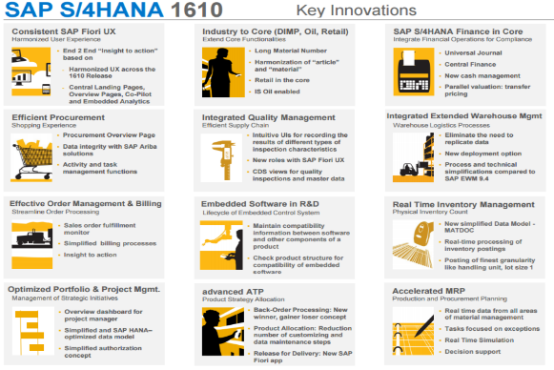
Everthing thing said during this presentation - brougt together on one slide
Proven: SAP S/4HANA has not fallen out of the sky!
What are the key benefits for a customer to move now to SAP S/4HANA?
SAP’s vision and strategy is to help customers run simple in the digital economy. To deliver on this mission, we are redefining how enterprise software creates value. SAP S/4HANA is designed to drive instant value across lines of business and industries with the ultimate sophistication: simplicity.
From a business value perspective, this means that SAP S/4HANA creates unique opportunities to reinvent business models and drive new revenues and profits. First, enterprises can now easily connect to people, devices, and business networks to deliver new value to their customers on any channel – the Internet of Things and Big Data become accessible to any business. Second, enterprises can dramatically simplify their processes, drive them in real time and change them as needed to gain new efficiencies – no more batch processing is required. And finally, business users can now get any insight on any data from anywhere in real-time: planning, execution, prediction, and simulation – decisions may be made on the fly with a high level of granularity for faster business impact.
From an IT value perspective, this means that SAP S/4HANA creates unique opportunities to simplify the landscape and help reduce total cost of ownership (TCO) with SAP HANA as the great simplifier. First, enterprises can now reduce their data footprint and work with larger data sets in one system (for example with industry or application function re-integrated that was stand alone before, to save hardware costs, operational costs, time and reduce complexity. Second, innovation is also made simple with leveraging an open platform (SAP HANA Cloud Platform) to drive advanced applications – for example, predicting, recommending, and simulating – while protecting existing investments. Third, business users can leverage a simple and role-based user experience based on modern design principles which minimizes training efforts while increases productivity as it combines information from various sources at the point where decisions are made. We also support customers with simple configuration: setting up the system and during its use. And finally, enterprises get choice of deployment: cloud, on premise, and even support of hybrid scenarios to drive quick time-to-value and reflect current reality of customer solution landscapes.
SAP S/4HANA is only built on SAP HANA because, as of today, only the SAP HANA platform can deliver such level of massive simplifications and innovations.
And lets start with a good repeat: What is SAP S/4HANA?
SAP S/4HANA Enterprise Management is SAP’s next-generation Digital Core and is a new product. With SAP S/4HANA, we are building on the success of the SAP Business Suite powered by SAP HANA with a completely new and re-imagined suite
SAP S/4HANA is running on SAP HANA for massive simplifications (simplified data model: no indexes, no aggregates, no redundancies) and innovations (for example, open in-memory platform for advanced applications predicting, recommending, and simulating)
SAP S/4HANA is natively designed with SAP Fiori UX, offering an integrated user experience with modern usability and instant insight on any device (role-based, three steps max to get the job done, mobile-first, consistent experience across lines of business)
SAP S/4HANA is natively connected to the Internet of Things (IOT) and business networks for real-time collaboration (planned: machine-to-machine, Ariba Network, Concur) in the networked economy
SAP S/4HANA is natively engineered for providing choice of deployment (on premise, cloud and hybrid)
SAP S/4HANA is natively born for easy adoption (guided, configuration, and easy on-boarding, from the discovery of the solution through cloud trials to deployment with pre-configured best practices)
In addition, SAP HANA Cloud Platform serves as open extension, agility layer for SAP S/4HANA. The extensions (APPs) built on the cloud platform can run against either deployment of SAP S/4HANA: in the cloud and on premise.
MTP
Social Technologies
Staff experts
on demand
Dashboards
Leverage
Assets
Autonomy
of teams
Community
& crowd
Algorithms
& Interfaces
SCALE IDEAS
for the creation of
exponential growth within your
organization
Social
Technologies
Real-timificaton &
Zero latency
Ex-perimentation
Algorithm
What is new in SAP S/4HANA?
In October 2016 (1610), SAP delivered a massive wave of simplification and innovation in the core of SAP S/4HANA. With this delivery, enterprises can drive unprecedented business value with innovative use-cases – in core financial and operational areas such as in logistics – taking full advantage of a simplified data model and a responsive user experience.
Key simplifications and innovations include:
Optimized working capital with new accounts payables and receivables cockpits
Decreased stock buffers with simplified data model in inventory management for real-time, high-volume processing
Increased visibility with real-time stock and material flow insight
Reduced manufacturing cycle time with streamlined material flow for internal requirements (MRP)
Augmented reactivity with real-time monitoring of production orders regarding flow and critical issues
Improved operational decisions with easy simulation of supply alternatives
Lower procurement costs with standard integration to the Ariba Business Network
Better customer service with new sales order fulfilment cockpit for instantly identifying bottlenecks and issues
Dashboards
Interface
processes
Engagement
Leveraged
assets
Interfaces
Autonomy
Experimentation
How is SAP S/4HANA available to the market?
SAP S/4HANA, on-premise edition, and SAP S/4HANA cloud edition are available for customers in all industries and regions.
SAP S/4HANA, on-premise edition follows a yearly innovation cycle and SAP S/4HANA, cloud edition follows a quarterly innovation cycle.
In October 2016 (1610) updates have been released for both, SAP S/4HANA, on-premise and cloud edition.
Crowd becomes
community

Slide 17
What are we confronted with every day in the project?
What does it mean for our daily business- & project-lives…

Slide 18
Various studies prove why SAP S/4HANA projects run into trouble
Proven: SAP S/4HANA has not fallen out of the sky!
#1: Scope creep and moving targets
Scope is everything that you are going to do and conversely, not going to do. So once you’ve figured out exactly what the project work is, usually via a Work Breakdown Structure, you need to freeze it and zealously guard against unplanned changes to it. So planned changes via a change control board are ok, since then the PM can issue a new schedule, risk and budget plan as needed. Otherwise, you will surely miss your target and make both the management and customer unhappy.
#7: Unsupported Project Culture
I was once asked to consult for a company and discovered that a complex project was being handled by an untrained secretary using 20 Excel spreadsheets. In this case, management clearly did not fully understand what it took to manage a project either in tools or using trained personnel. This is not easily solvable because it requires education of management and a cultural shift.
#8: The Accidental Project Manager*
This is similar to but not exactly the same as the unsupported project culture. In this instance, what typically happens is that a technical person (software developer, chemist, etc.) succeeds at the job. Based on that, gets promoted to project manager and is asked to manage the types of projects they just came from. The problem is they often don’t get training in project management and may well lack the social skills the job calls for. And so they flounder and often fail despite previous successes.
#2: Over allocated resources
Often there are too few resources working on too many projects at the same time. In conjunction with that, managers don’t seem to have a grip on what their resources are doing all the time. Team members are left to figure out for themselves what projects they should be working on and when. A better way for managers is to meet weekly to discuss resource usage perhaps using a spreadsheet to track.
The
SAP S/4HANA project will most recently run into trouble
#3: Poor communications
Many people on a project will know the project manager only through his or her communications. And they will know them by how their voice comes across over the phone or especially by how well-written their emails are. If the project manager is not a clear, unambiguous communicator, chaos and confusion will ensue.
#9: Lack of Team Planning Sessions
There is no more effective way to kick off a meeting than to have the entire team come together for a planning session. This enables everyone to not only work together on project artefacts (schedule, WBS) but also to bond as a team and buy into the project.
*ISBN- 978-0-471-41011-9
The Accidental Project Manager
#4: Bad Stakeholder Management
Stakeholders have a vested interest in the project for the good or sometimes to the detriment of the project. It is the project manager’s job not only to identify all stakeholders, but know how to manage and communicate with them in a timely fashion. A communication management plan helps here.
#10: Monitoring and Controlling
Many project managers will create a schedule and never (or rarely) update it. Or if they do, they’ll just fill in percent done, which is an arbitrary number often picked out of the air by the team member. Better if they record actuals such as date started, work accomplished and estimate of remaining work.
#11: Misaligned vision and leadership
Limited company vision. No perspective of where the organization is going. Why are we are investing time, money and resources without a goal. “Not being able to see how my role fits into the bigger picture.” I have left companies and projects primarily because things aren't a good fit for me. If leadership does not have a vision big enough for an individual’s personal goals and dreams to be achieved they will look elsewhere. Leadership acted differently when they are going to sell a company vs growing it. When a company's values contradict their business decisions, the mismatch begins to tear down the trust.
#5: Unreliable Estimates
Estimates are very often just guesstimates by team members who are trying to calculate the duration of tasks based on how long it took them last time. This may turn out to be totally accurate or may be completely wrong. And if wrong, leads to a flawed schedule and increased risk. Historical records kept between projects helps solve this.
#6: No Risk Management
Every project is unique and hence, has uncertainty. When we try to qualify and quantify that uncertainty, we call it risk. It is incumbent upon the project manager to proactively anticipate things that might go wrong. Once he has identified risks, then he and the team can decide on how to respond to (e.g., mitigate, avoid) those specific risks should they occur.
#12: Uncertainty during hard times and massive change
I saw a lack of faith from some folks at my own company during the recession. We've always had a strong people/family oriented culture, but during that time and a couple of years after we got away from it and several key people left. The company owner's fear of the business going under was getting in the way of us actually being able to solve problems that would help the business run better.
Source: Statistical evaluation of self-experienced project deliveries

Slide 19

1-2-N (full-scale) Business
Transformation / Innovation Project
Embracing your “new” business to profit from S/4HANA’s possibilities
Digitalization / Industry 4.0
Mental, emotional change
Management of Change
An SAP S4/HANA project needs to address both the rational change and the mental change in order to ensure the four factors for success of the business change:
Adopting your org.
for SAP S/4HANA
Mass-production of goods in “Lot size ONE”
Personalized Products (i..e. remedies & vaccinations)
Preventive Maintenance (IOT)
Product becomes a service (i.e. Jet plane Engines)
No asset operated – but a platform driven business
Leveraging the values of a community
Disruptive impacts on cost per unit
Smart contracts and instate payments
….
…
1-2-1 (half scale) lift and
shift-IT-Project
Change Management
Rational, intellectual Change
changing
to HANA technology
Implementation and centralization of competence centres
Implementation and Organizations of Shared Service Centres (local?, near-shore?, off-shore? – buy-in as a service?
…
…
…
…
…
…
…
Minimising impact on current business performance
Acceleration of the adoption of new system and processes
Embedding new ways of working and collaboration into the business
Sustainable adoption of the system implementation – and define the way you operate your business anew
changing
to S/4 processes
Accelerate processes
Real-time operational analytics
Re-imagined interface: Change from a function oriented user experience to a role oriented one
In Memory Data-Base Technology
Simplified data model
On premise technology vs. cloud
Business Warehouse to Hana-Data Base
COST focused
VALUE focused
Real time business: all business data in one place, on-demand realignment
Simplification: reduced data footprint, non-disruptive compatible views
Innovation: internet of things, business data, business network
Mental, emotional change
Misaligned vision and leadership
Compromised values, beliefs, and increased toxicity
New system challenges old ways of working → resistance to change («it has always been done this way»)
Lack of connection, appreciation, community and affinity
Uncertainty during hard times and massive change
Organizational structures & processes that create malaise and stagnation

Slide 20


Conclusion
Businesses operated in “Real-Time” require adapted processes, collaboration and responsibilities
The implementers business success will not come with SAP S/4Hana Technology (it might be enabled by it – but it will not be brought for free) – the implementers success will come due the application of “SCALE IEADS”
Massive Transformational Purpose (MTP)
SCALE IDEAS (implement 4 out of 10!)
Staffing of (expert) resources on demand
Community & Crowd must contribute to your business model
Algorithms (Artificial Intelligence)
Leveraged Assets (make your assets)
Engagement (make you product engaging with your customer)
Interface Processes connecting you to the external world
Dashboards (KPIs & OKRs) – as well as the concept around it
Experimentation (small batches fast testing of new ideas)
Autonomy (create a network instead of a solid block)
Social Technologies
From Destination to Acceleration…
…encouraging and enabling enterprises to pivot on demand and cope with fast moving targets.
This with the purpose of
unleashing sustained exponential growth
and the sense of igniting co-creation and creativity.
If SCALE IDEAS is applied (and implemented with SAP S/4HANA) in a suitable manner, the efficiency and the out-put of the organization will accelerate by factor 10!
1900
1920
1940
1960
1980
2000
2020
2040
2060

Slide 21
Thank you – for listening your questions, please

Slide 22





Appendix:
What does it mean to extract, transform and load (ETL) information from data sources.
Result: Infinite number of Business models possible, all based on
“Information, Platforms, Algorithms… “SCALE IDEAS”
What do you think?
As all this data is brought together and evaluated in “real time” – do you think this would provide additional businesses opportunities to your organization?
Opportunities originating from Information and platforms - causing zero extra cost or effort.
This is exactly, what SAP S4/HANA is here to enable.
All kind of data…
VIN
Timestamp
ABS
Oil Level
Road temperature
Volumetric sensors
Longitude / latitude
Longitude / latitude
Ignition Status
Begin / Ending
Odometer Reading (Odometer)
Windshield
wiper Information
Car weight
Average Speed
Fuel Consumption
DTC Code
Detection / Clearing
Throttle position
Fuel Level
RPM
Porsche sold:
237.778 cars in 2016.
Make / Model / Year
Positional Quality
Injector circuit malfunction
Trip Number
Hard breaking / Tire Pressure
Data Platform
“Automobile”
Event threshold
Battery level
Set belts / seat weight check
Airbags
Distance
Maximum speed
Steering wheel angle
Malfunction indicator light

Slide 23
Appendix:
Some of the Master brains for Innovation and Management
Peter F. Drucker (1990-2005)
Inventor of concepts we name today “Management”.
Innovation- and Lean Management…
Masaaki Imai (1930)
Founder and protagonist of the “Kaizen” Institute
…accelerates
itself.
Shingō Shigeo 1909 – 1990
Inventor of the Toyota Production System TPS based on Poka-Yoke
Carl Friedrich Gauss (1777-1855) & Bob Galvin (1922 – 2011)
Inventors of Six Sigma
Jeff Sutherland (1941) & Ken Schwaber (1945)
Inventors of the Agile Project Management methodology SCRUM
Terry Winograd (1946), Larry Leifer (1958) & David Kelley (1951)
Professors at Stanford and Princeton Universities, Founders of the IEDO Design Thinking company and board members of the Hasso Plattner Institute (SAP)
Disruptive Innovation
Innovation
IoT
Digitalization
Industry 4.0
Smart Technologies
Blockchain
…
Evolutionary
Innovation
Agility/Flexibility
Six Sigma
Design Thinking
Agile Management
Lean
Management
Lean
Administration
…
Efficiency
Innovation
Reliability/Predictability
Kaizen
Poka Yoke (TPS)
Lean Production
Lean Construction
Smart Supply Chain Management
…
Michael Malone (1942), & Samil Ismail (1965)
(Start-up) Business Investors, Professor at Singularity University and Authors of the book “Exponential Organizations”
Eric Rice (1978),
(Start-up) Business Investors, Owner of various Internet Start-Ups and Author of the book “The Lean Startup”
Don Beck (1937) & Clare W. Graves (1914-1986)
Inventors of the Management practice “Spiral Dynamics”
and many, many more…

