Slide 1


Slide 2

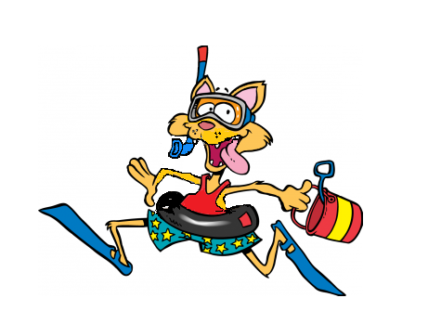
KataTonic
Kata Tonic

Slide 3
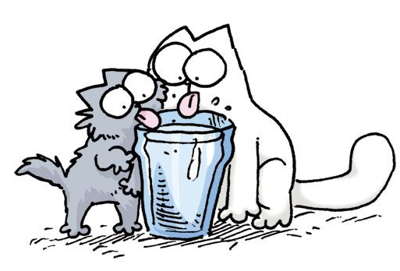
Kata Tonic

Slide 4
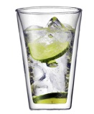
Kata Tonic

