Slide 1


When Cash Works Well
Each cycle will create more cash than the previous cycle by the mere design of the process
The bank balance increases without raising prices or reducing expenses

Slide 2

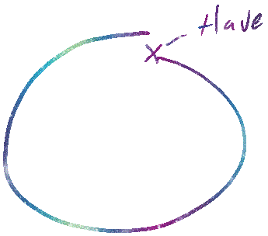

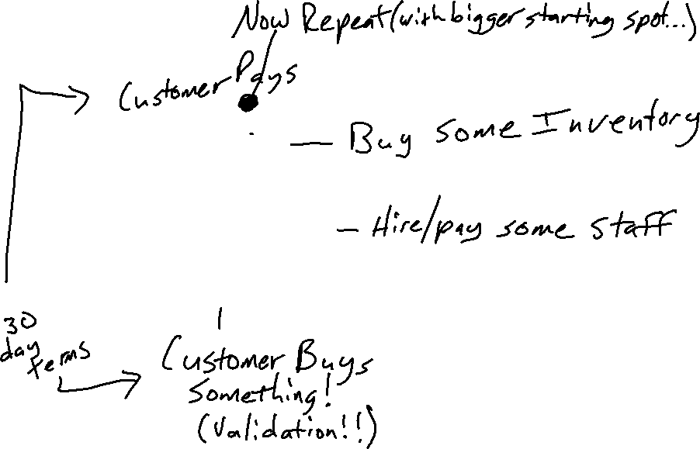



Every Business

