Slide 1
About Us
Sales
Path to
Success
Systems & Logistics

Slide 2
Dar-tech philosophy
dar-tech is successful when we partner with quality manufactures to bring unique chemistries to a customer base that we have strong, long-term relationships with, enabling success for all.
Notes:
We focus on growth executing our principals missions, acting as an extentsion of their sale team. Knowing that if we help them achieve their goals the opportunity to expand with them increases ( Unimin Sibelco, DCC, Tolsa…)
Focus on long-term relationship and stregic growth based off execution.

Slide 3
About the company
Dar-tech was founded in 1951
Headquartered in Cleveland Ohio
We are currently in our fourth generation of ownership
Privately held corporation with 6 principal owners
Strongest financial position in the company’s 67 year history.
Management team
  Brett Walburn – President
  Pete Marek – Vice President
  Tom Kramer – CFO
  Jim Benduhn – Srenior Vice President
  Jim Gacek – Vice President of Sales
18 total employees ( most in company history )
  11 Salespeople
  4 Customer Service Representatives
  4 Operations
Notes:
11 sales people ( averaging 17 years of experience in the industry, 11 years on average at dar-tech while adding three new employees in the last 12 months )
3 Customer Service Representatives – Avg. 18 years with dar-tech.
Operations – Avg. 14 years experience at dar-tech.

Slide 4
Principal Partnerships
Long-term relationships complementary products
Chemours ( formerly DuPont ) Titanium Dioxide 8 Years
Unimin Microcrystalline Silica and Clays 31 Years
Imerys Talc 26 Years
Sibelco Flame Retardants 4 Years
JM Huber Pergopak matting agent 20 Years
Borica Organic Titantes & Zirconates 11 Years
Burgess Pigment Kaolin Clays 43 years
TOLSA Sepiolite Rheological Additives 4 Years
CVC Thermoset Specialties Epoxy Resins , Modifiers, Curing Agents 24 years
Dominion Colour Corporation Organic and Inorganic Pigments 46 Years
Cimbar Performance Minerals Barium Sulphate, Bentonite Clay 26 Years
Hauthaway & Sons Polyurethane Dispersions 20 Years
PPG Industries Precipitated Silica 25 Years
CDF Corporations Drum and Pail Liners 38 Years
Omya Calcium Carbonate 8 Years
BYK Gardner Lab Instrumentation 24 Years
Minifibers Synthetic Wood Pulp 2 Years
AFCONA Additives 2 Years
PCC Polyols, Flame Retardants, Surfactants 1 Year

Slide 5

Markets Served
Notes:
Comparison from 10years prior
Coatings – 55%
Adhesives – 13 %
Plastics – 21%
Ink – 8%
Rubber – 8%
Misc – 5%
- Ceramics, Concrete, Textile, Ag. HI&I

Slide 6
Top Customers by Market
Coatings | Plastics | Ink
Sherwin-Williams | Seaman Corporation | Sun Chemical
PPG Industries | Radix Wire | INX
NB Coatings | SACO Polymer | Flint
Axalta Coatings | Rochling Glastic | Magnum
NOF Metal Coatings | Profusion | EMS
Akzo ( International Paint ) | Trinity | IIMAK
Red Spot | Hexpol | EFI
NB Coatings | Radici | International Paper
Alpha Coatings | Omnova | Sinkro
Protech Powder | Akro Chem | Braden Sutphin
Notes:
Comparison from 10years prior
Coatings – 55%
Adhesives – 13 %
Plastics – 21%
Ink – 8%
Rubber – 8%
Misc – 5%
- Ceramics, Concrete, Textile, Ag. HI&I

Slide 7
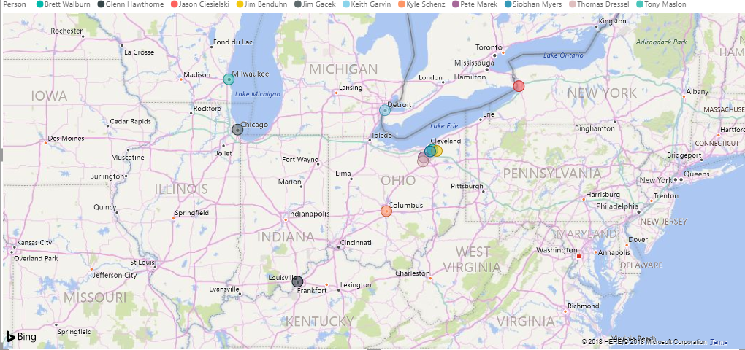
Dar-tech Territory
Notes:
Currently have customers in 35 states

Slide 8
Logistics
Main Location – Cleveland Ohio – 20+ Years in This Location
  69,516 SQ. Ft Leased (340,000 SQ. Ft Total Building)
NACD Responsible Distribution – Recertified June 2018
18 Million pounds shipments in Calendar Year 2017
    .003 error rate.
Buffalo, NY – 20+ Years in this Location – 65,000 SQ. Ft.
- Supporting a principal request
Greensboro, NC – 100,000 SQ Ft.
- Supporting a key customer request

Slide 9
Systems
ERP system is Take Stock: Wholesale Enterprise Package
      COA’s automated with shipping docs
      MSDS’ with each new product, or new revision
      Email Invoicing for customers
      Indefinite Sales Histories
CRM system is Vmobile
      Opportunity Tracking
      Pipeline reporting for Principal partners
      Focused Marketing activities
      User defined custom fields for detailed activities
      Integrated calendar activities
      Smart Device accessible
ProDecisions & Power BI
      Data reporting and analysis (ERP, CRM, and third party data

Slide 10
Communication and Transparency
Principal Liaison
Reporting
  Call reports
  Monthly Activity
  Prodecision Reports
  Pipeline (Opp. Tracking)
Joint Calls with Principals
Monday Meetings
Sales Training
Sales Meetings
Website
  Lead generation
Notes:
Internal resource for each principal – i.e. Product Managers/Principal Liaison???

Slide 11
Continuous Improvement
2017 Improvements
  Addition of 3 new positions in the sales department
    Jim Gacek added as VP of Sales
    Expansion westward with existing lines
  Power BI Software
    Analysis softeare for trends and opportunities
  CRM Data improvement to assist in targeted marketing activities
  2018 Goals
  Realigning customer service with sales team
  Complete integration of Power BI with CRM and ERP

