Slide 1

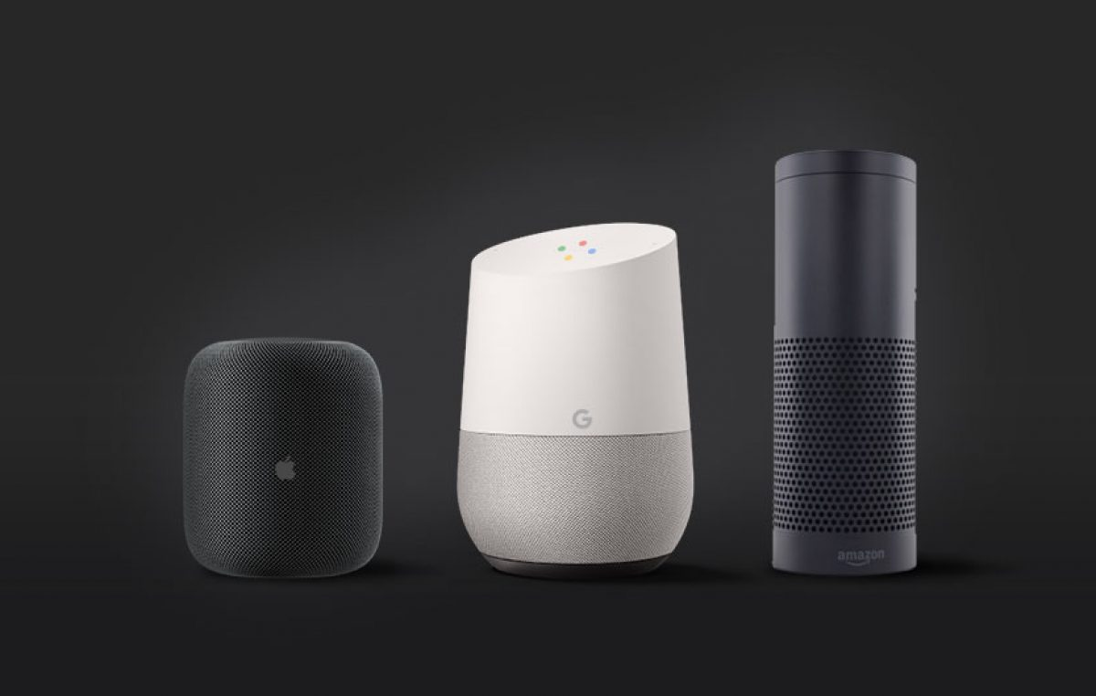
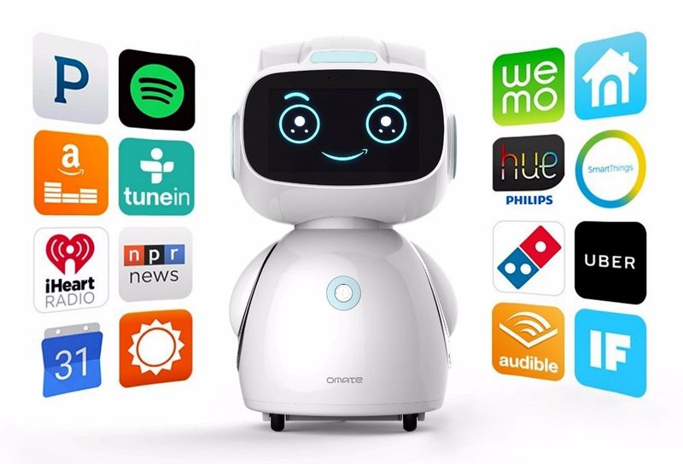
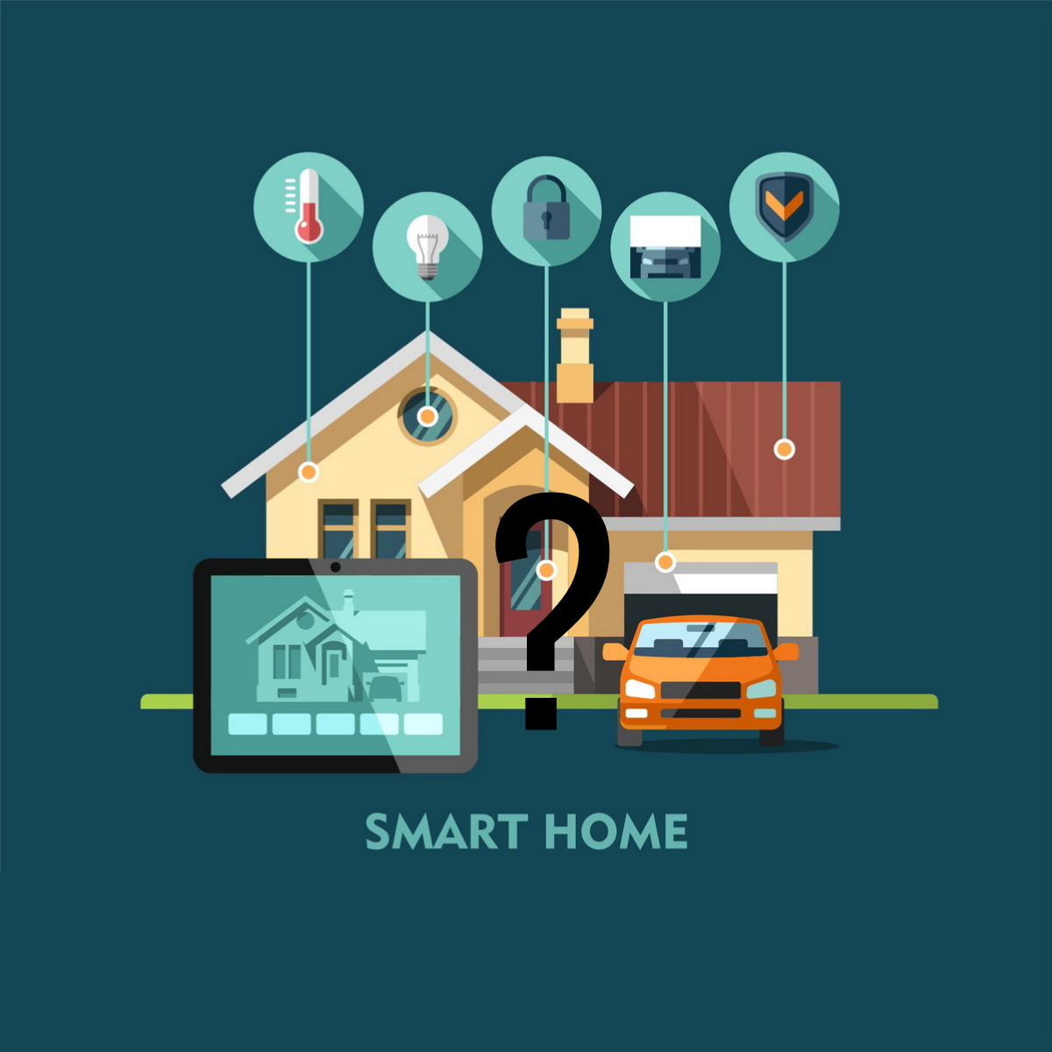
Your smart home integration professionals.
Chances are that by now you’ve heard of Google Home, Amazon Echo and Apple HomePod, theses speaker-powered, voice-activated smart assistants, hold the key to your smart home and your time and money saving.
With devices starting from $50 anyone can afford to start building a smart home.
WHAT EXACTLY IS A SMART ASSISTANT?
If you have ever used Siri on your iphone, Cortana on windows or Google Assistant on your smartphone, you have already interacted with a smart assistant. If you have not, think of these devices as an unpaid personal assistant that does all the mundane tasks around your home
Google Home, Amazon Echo and Apple Homepod all integrate virtual assistants with speaker hardware, which allows you to turn your home into an automated, voice-activated and app-controlled hub.
WHY DO I NEED SMART DEVICES?
The simple answer is, you don’t, If your happy turning your own electrical equipment on and off, finding the remote for the tv or walking to the other side of the house because you left a light on, then these devices aren’t for you. If you forget to add items to the shopping list or forget appointments because you can’t find a pen or your phone, then all is great.
But if your like me, there are more important and better ways to occupy your time, family time, pet time or time for yourself. This is what smart devices are for.

Slide 2
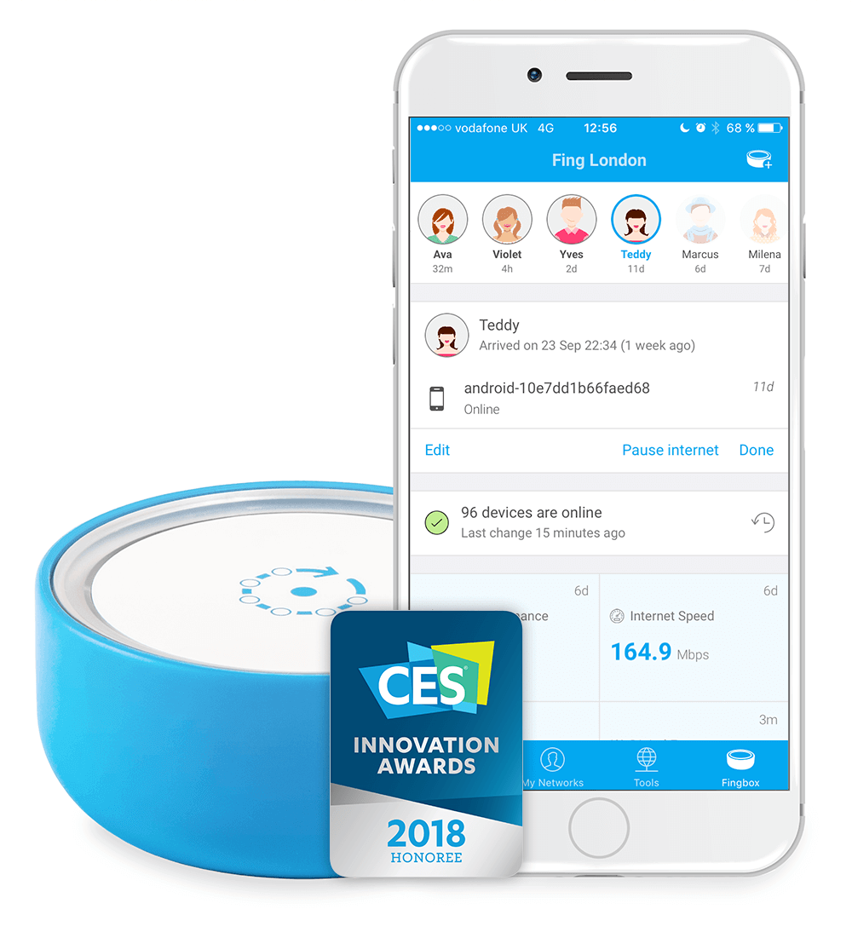
How we can help you take full advantage of your Smart Assistant and control your home.
Control blinds and curtains directly from your smartphone. Adjust your blinds from your sofa while watching TV. Set a time schedule and wake up in a perfect way or set an automation based on sun conditions and come home to a cooler environment.
Your personal wireless lighting system that lets you easily control your light and create the right ambiance for every moment. Bring your smart home to life with the most connected light in the world.
Smart Lock
Smart CCTV
Video Doorbell
Multi-room Audio
Lighting Control
Voice Assistant
Companion device to an existing garage door opener that securely allows one or more users to open, close, and monitor their garage door from anywhere in the world.
Get answers, play songs, tackle your day, enjoy your entertainment and control your smart home with just your voice.
VI Smart Homes This is What we do.
Watch over your home in crystal-clear 1080HD video, and see, hear and speak to visitors from anywhere. With instant mobile alerts and two-way talk, you can answer the door from your smartphone, tablet and PC.
Wireless Home Sound System that fill as many rooms as you want with great-sounding music, movies and TV. Stream via WiFi. Play whatever you’re craving. And amp up every moment with intense, pulse-pounding sound.
A smart lock is arguably the most important part of a truly smart, connected home. Not only will it allow you to come and go as you please, it will also monitor who is entering and leaving your home while you're away.
HD video quality, two-way audio, live streaming, free cloud recording, instant alerts, and other smart features, these security cameras let you watch over what you love from every angle, indoors and out, day and night.
Plus many, many, many more handy and time saving devices.
Contact us today to find out how we can help you.
VI is now offering Fingbox, a revolutionary device that connects directly to your modem\router, protecting your home from threats inside and out. Giving you peace of mind from external threats to your home and privacy.
Fingbox is also your gateway to total parental control, allowing you to monitor and control your kid's internet usage in an easily useable application for IOS, Android and PC.
Access scheduling - Create profiles for your kid's devices, tv's and gaming consoles, allow for scheduling during the week, or block access for any period of time with the push of your finger.
Remote Notification and Management - get push notifications to your phone when devices connect to the internet, control your internet access from any location in the world as long as you have data.
e: info@visionimmersion.com.au
w: www.visionimmersion.com.au
Make an appointment today to view our display home in action

