Slide 1
AntiFury Logo Design
Design Direction and Suggestions

Slide 2
Who are we
Brand Name: AntiFury
An online business selling dog training products
Our products are aimed at minimising the frustration of pet owners due to misbehaviour from their pets (e.g. constant barking or pet bed wetting), and giving them a peace of mind
The focus of our company is to bring fun and humorous designs to dog/pet training products.

Slide 3
Logo Design Direction
Evoke sense of fun and cheeky, humorous
Not overdone with imagery of dogs and colours (should not be tacky)
Design that is simple but clever
May potentially play on the initials AF as part of the logo graphics

Slide 4
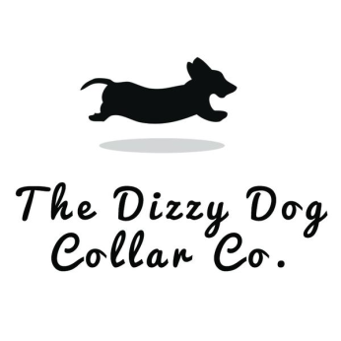



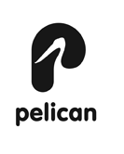



Logo Inspiration and mood board

