Slide 1
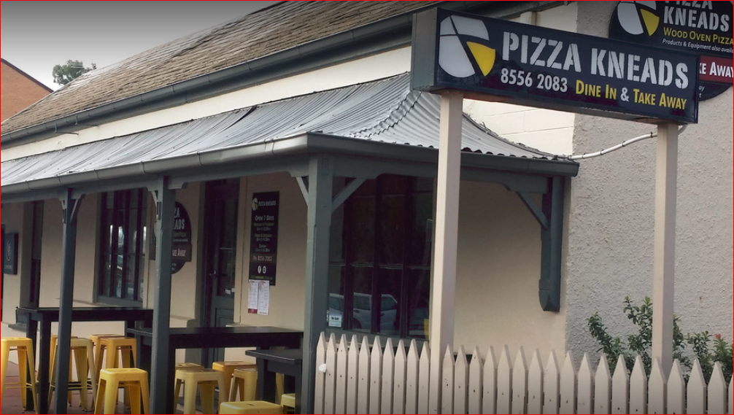
8a Hill Street Willunga

Slide 2
Branding – Fire and Stone
FIRE : Wood Fire Oven Food
Smell of smoke from the oven
STONE: Regions was settled as a Slate Mining Town
Food is cooked on Stone / Bricks

Slide 3
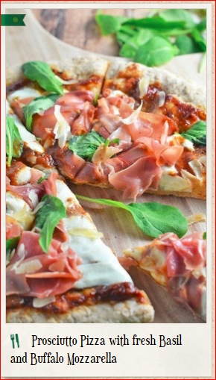
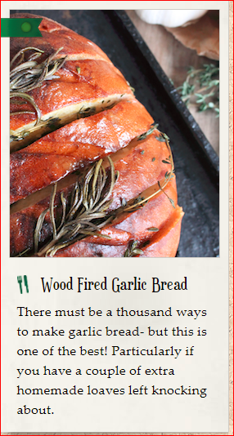
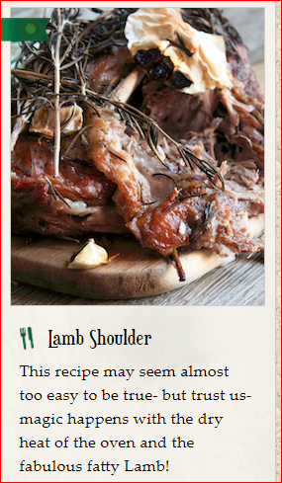
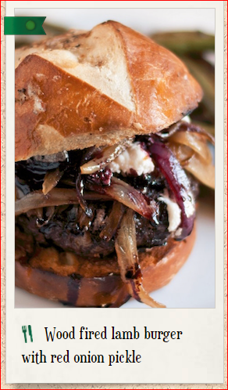
Outback style food ( Weekends)
The shop will expand on the wood fire concept and broaden the menu to offer Weekend travellers with a premium casual “ Outback” style food in an authentic wood fire oven

Slide 4
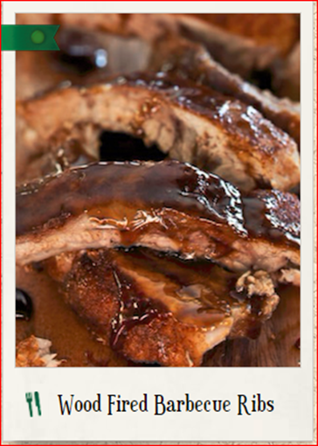
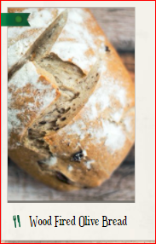
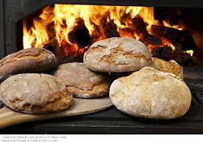
Outback style food ( Weekends )
Regular menu offer
Weekend Markets Offer

Slide 5
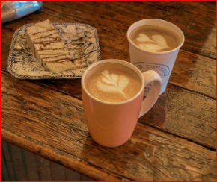
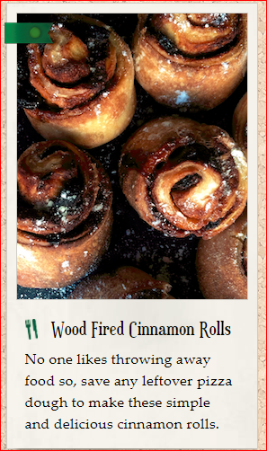
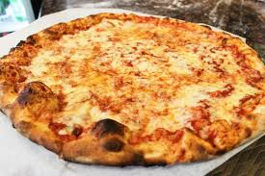
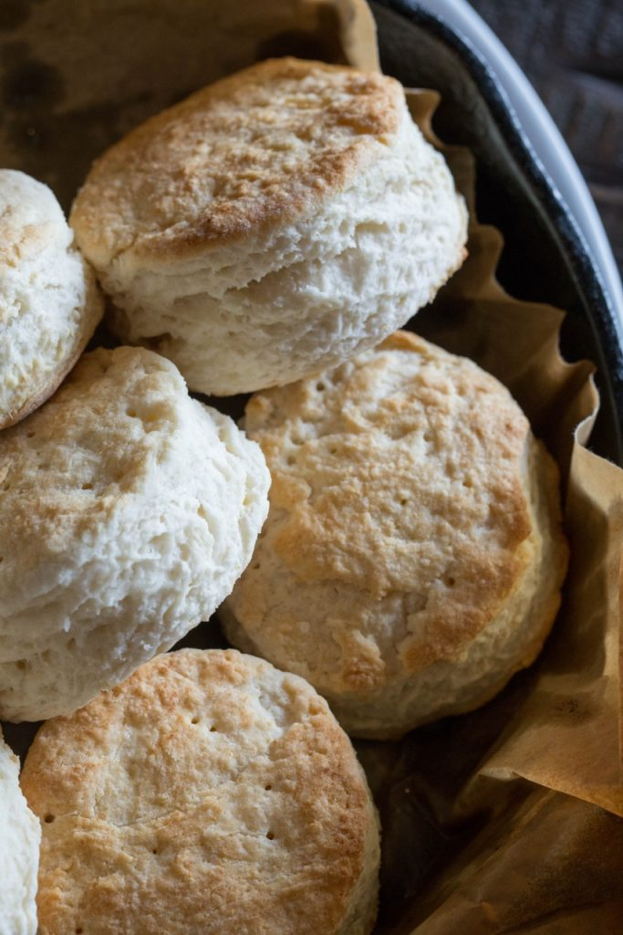
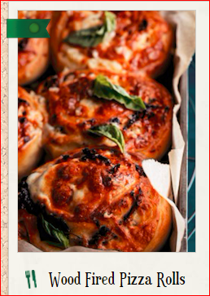
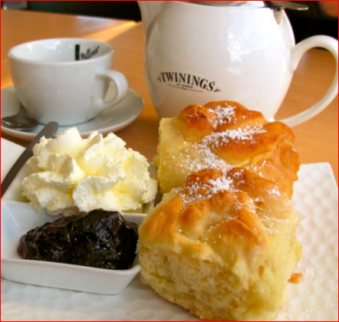
Café – Coffee, Snacks….
During the week the shop will be open for locals and high aged teens for a coffee and cake / snacks using the Wood Fire Oven

Slide 6


Supporting the community

Slide 7
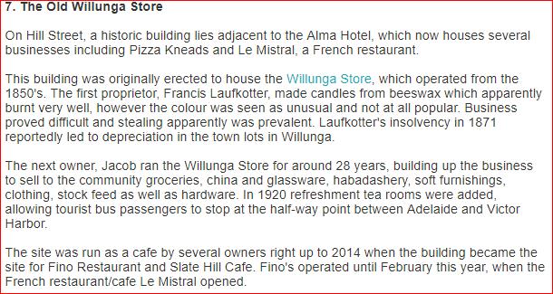
History of the Site

