Slide 1

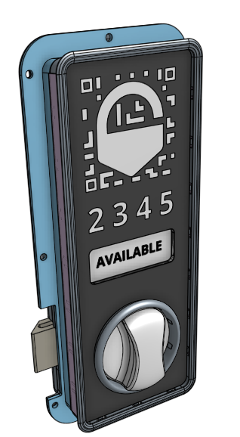
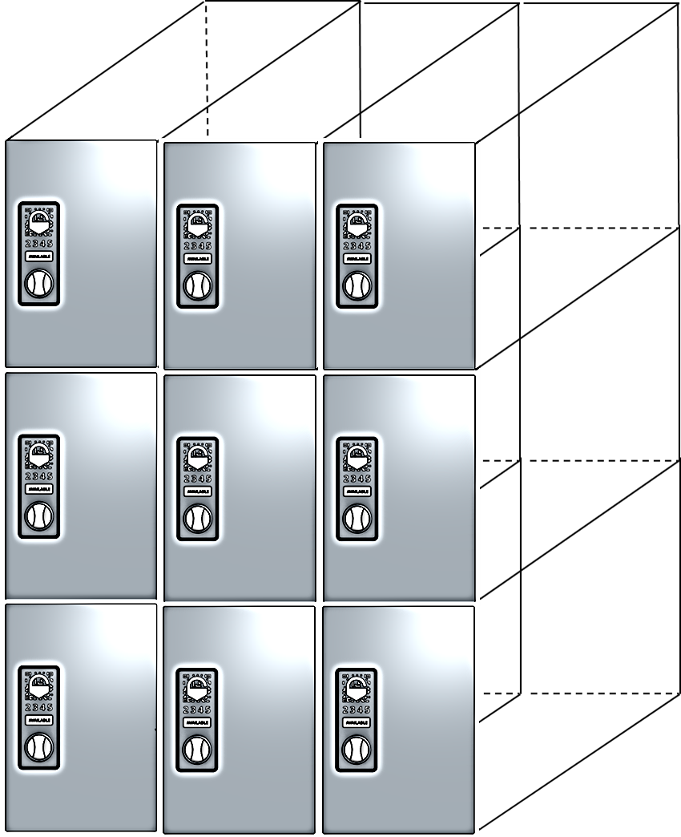





TM
The Future of Mobility
Overview
BinBox is the future of mobility. A mobile enabled locker system that provides individuals an app to safely secure items. BinBox is a system that consists of three different components: our app, unit, and lock.
Key Features
Binbox Smart Lock uses Bluetooth and eliminates the inconvenience of keys or pad locks – your phone is your key
GPS location services allow users to easily find lockers and check availability
Point of Sale (POS) system integrated into the platform
Interchangeable lockers to adapt to demand, usage, seasons, and more
External kiosk provides members the option to store phone
Each unit is equipped with USB charger
Variable pricing is based on the size of the unit
Ideal for Many Venues
Coworking Space
Ski Resorts
Waterparks
Tool Rentals
Theme Parks
Binbox – The Future of Mobility
www.binboxlocker.com

Slide 2
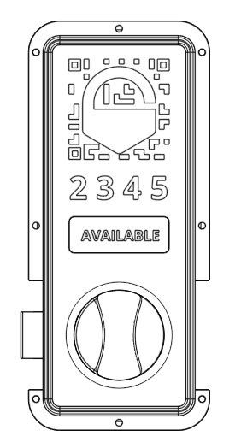
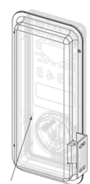
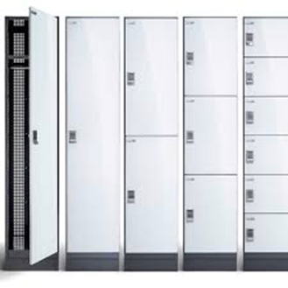


Binbox Locking System (BLS)
The Binbox Locking System (BLS) solution provides users with a simple and easy way to store their belongings with the Binbox app. The software in our lock is completely configurable toward hourly, daily, weekly, or monthly use
Hardware
Off-the-grid lockers require no external power or internet
Wi-Fi/4G Kiosk unit support new user integration, as well as solves any phone/network related issues
Multi-year internal battery
Digital display shows locker and battery status
Metal structural frame resists damage and tampering
Left or Right installation available
Retrofits onto most lockers, wooden or metal
Enclosed case protects the embedded software
Phone App
No administrator required
Only requires once a year charging of less than 1 minute per locker without any training (charging service can be purchased separately)
Allows for on-demand rentals of any time period from minutes to months
Users only pay for what they use
Credit card processing to validate trusted users
Variable pricing options to best match supply and demand
Binbox – The Future of Mobility
www.binboxlocker.com

Slide 3
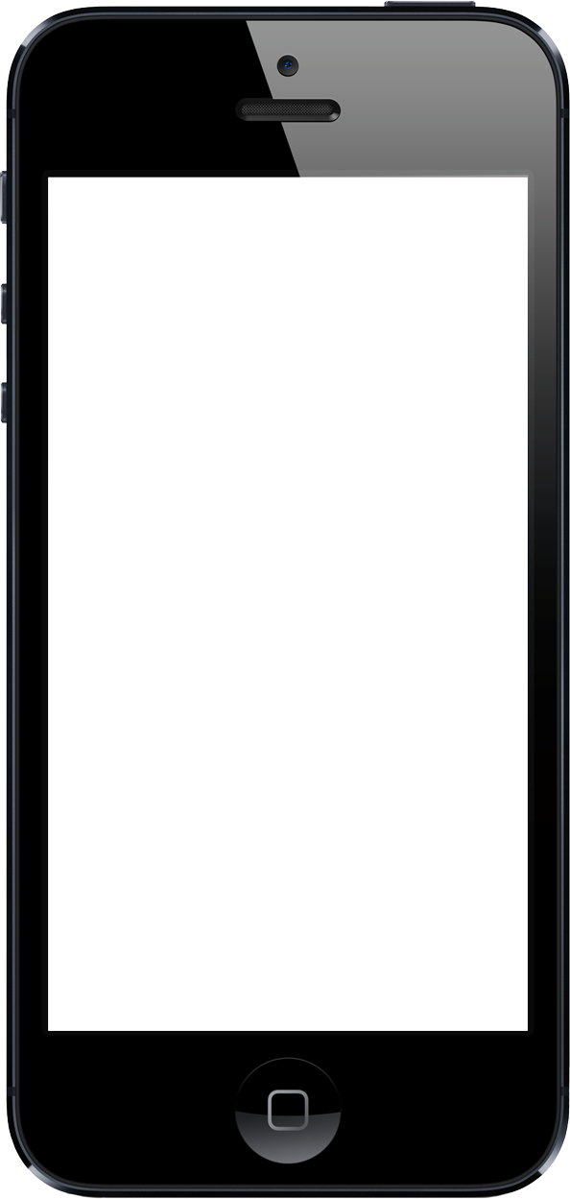
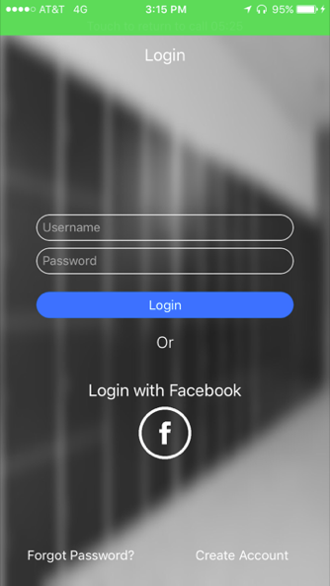
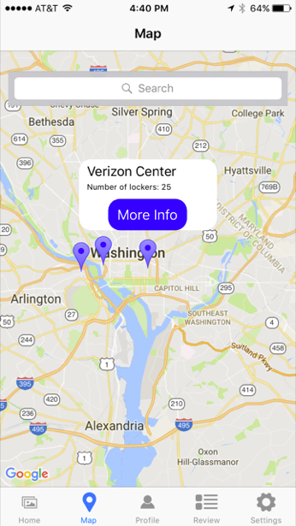
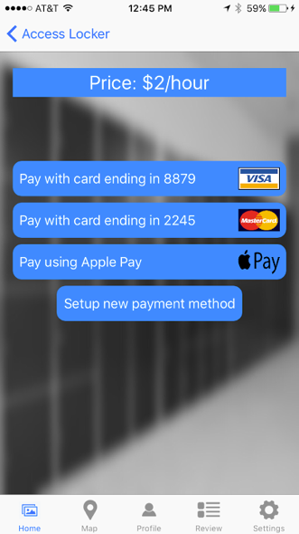


Additional Information
Application
BinBox offers app based keyless entry to all of our units. Our keyless lock allows customers to access the unit via Bluetooth. Simply search for nearby units on our app, pick the best location for you, and rent it.
Revenue Share Program
Ideal when capital dollars are allocated for higher profit centers, but there is a desire to provide an added convenience for members and employees.
  No out-of-pocket expense for the property
  Generous revenue share program resulting in increased cash flow
  Property oversees day-to-day management with minimal operational requirements
  Trouble shooting and problem resolution via the web for efficient support
Contact Binbox for Additional Information
Daniel Flynn
Presidentn & CEO
dan@binboxlockers.com
(617) 817-5425
Eric Herring
Chief Technology Officer (CTO)
eric@binboxlockers.com
(202) 853-0506
Jeff Mullen
Chief Operations Officer (COO)
jeff@binboxlockers.com
(856) 904-8643

