Slide 1
Zambia
This is quite a good map of the provinces of Zambia but would be interested to see a refreshed version of it.
Must be fully editable (not a picture)
Possibly a version showing major roads would be useful if possible
Lusaka

Slide 2
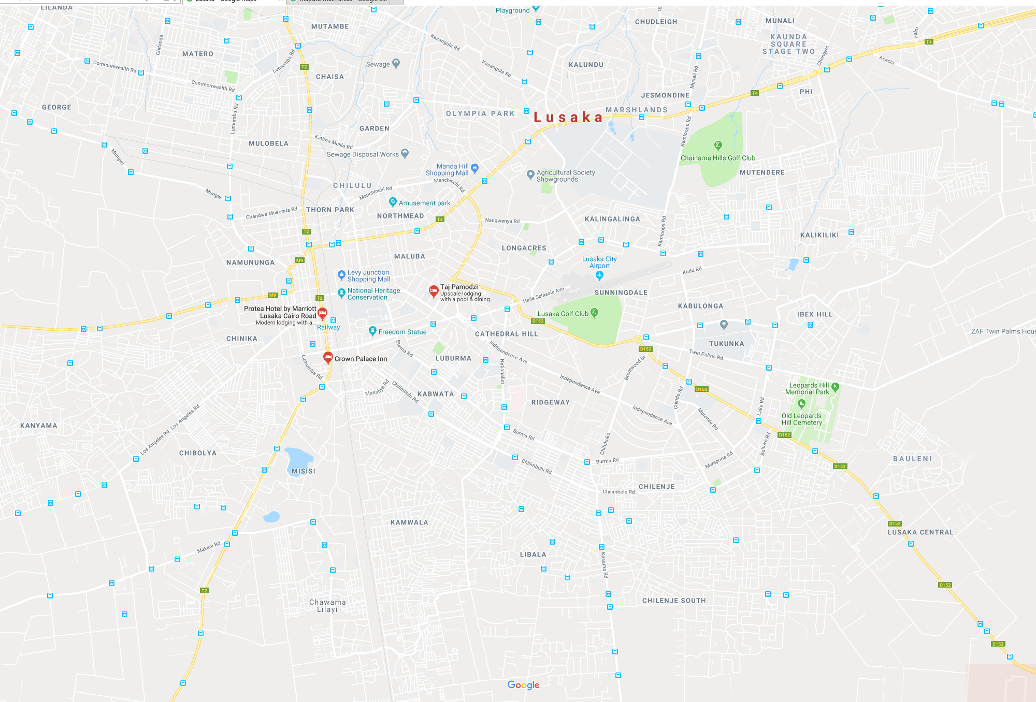
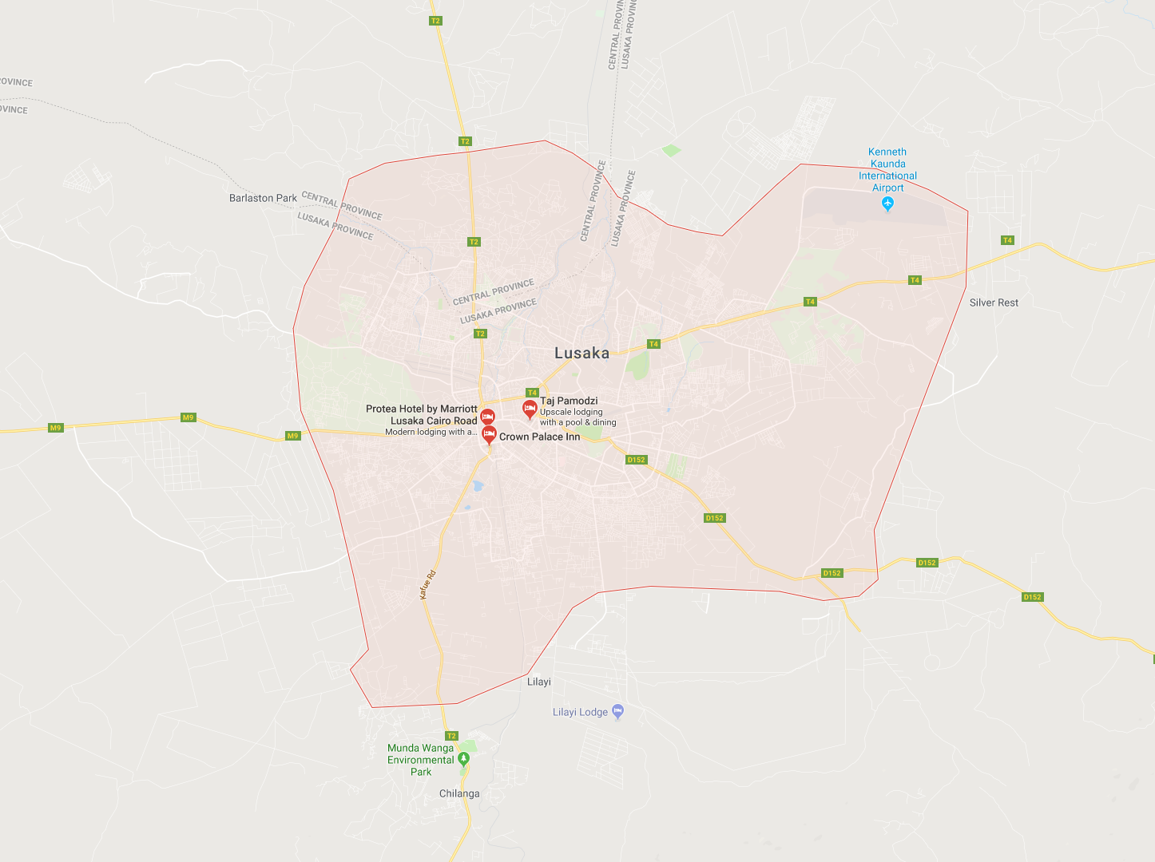
ZAMBIA - Lusaka City Map
If possible an editable map of the Lusaka city layout
Ideally showing main roads and areas

Slide 3
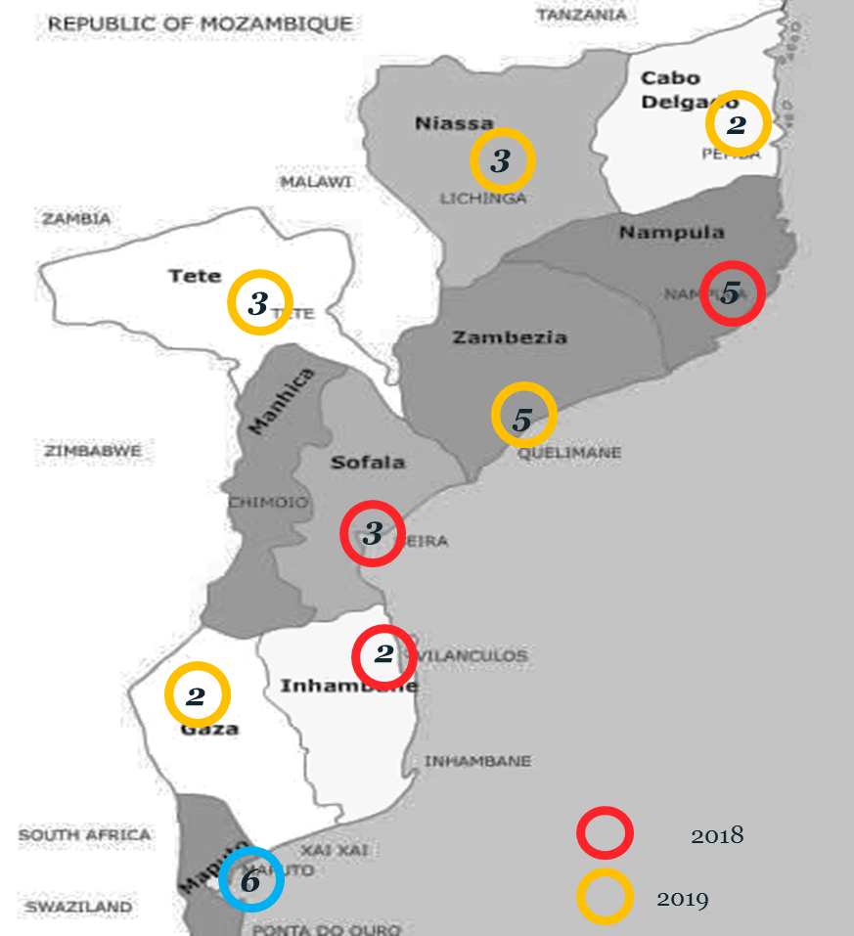
Mozambique
I need a refreshed provincial map of Mozambique
Must be fully editable
Don’t need the colored circles and numbers

Slide 4
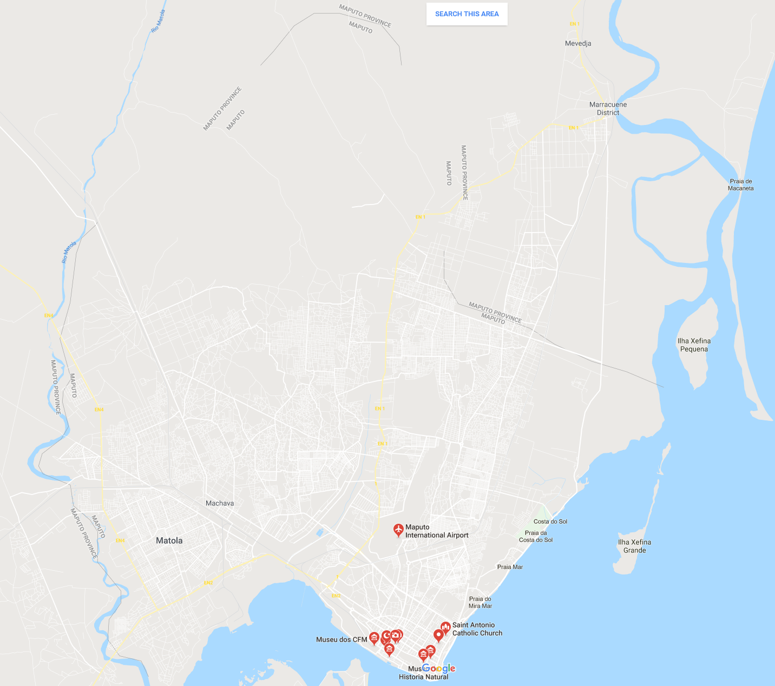
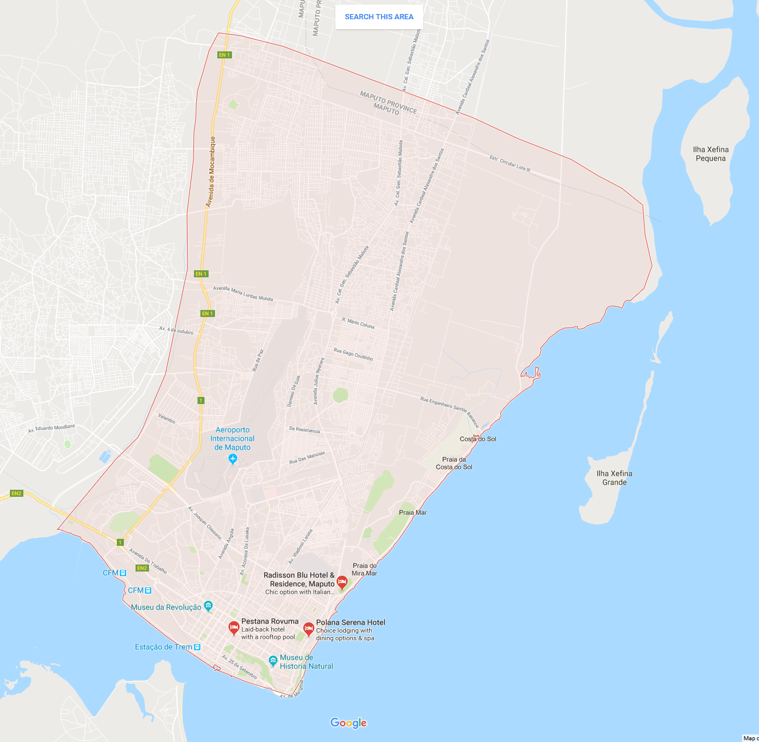
MOZAMBIQUE - Maputo City Layout
If possible an editable map of the Maputo city layout

Slide 5
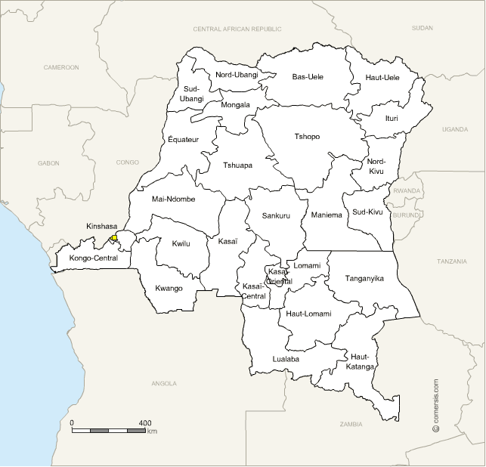
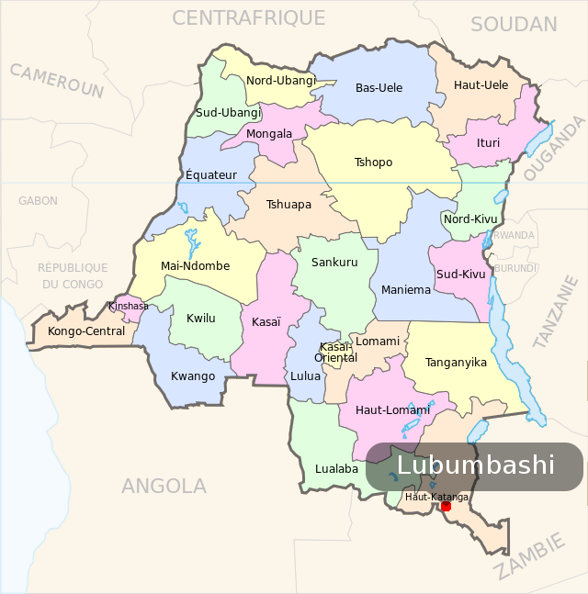
Democratic Republic of Congo

Slide 6
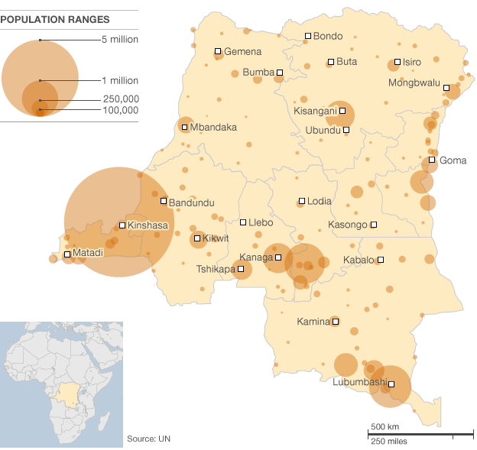
I need a fully editable provincial map of the DRC (from the previous slide)
If possible a version showing major cities based on population (over 250,000) from the map to the left on this slide.

Slide 7
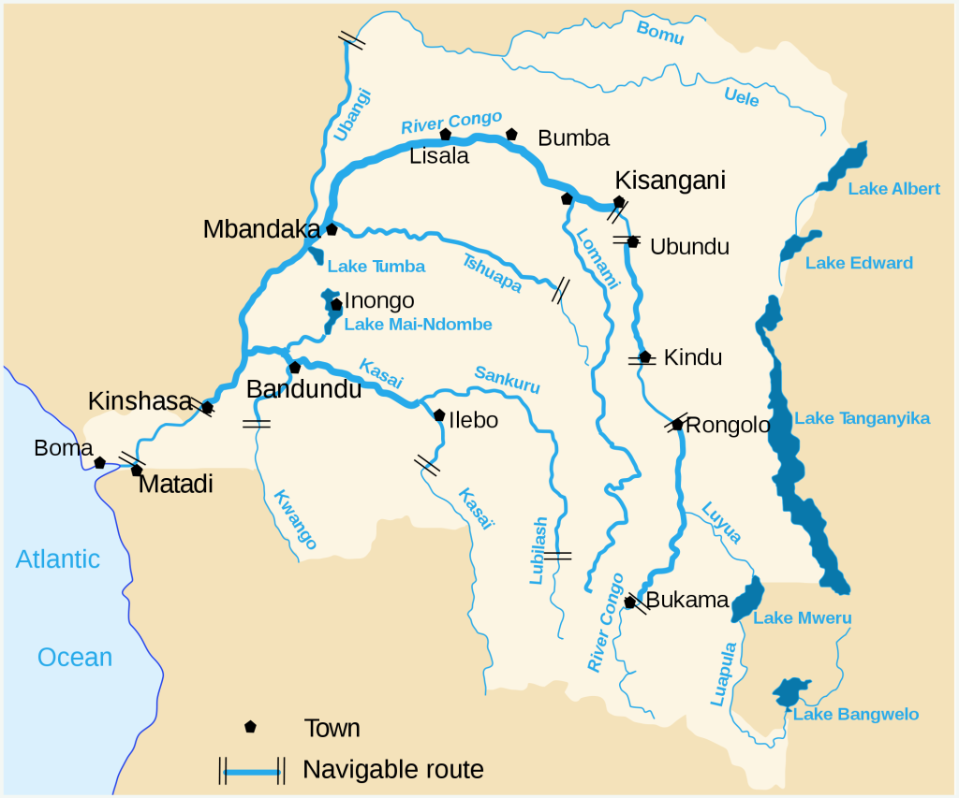
I need a version of this map in the same format as the maps you have created for the earlier slides

Slide 8
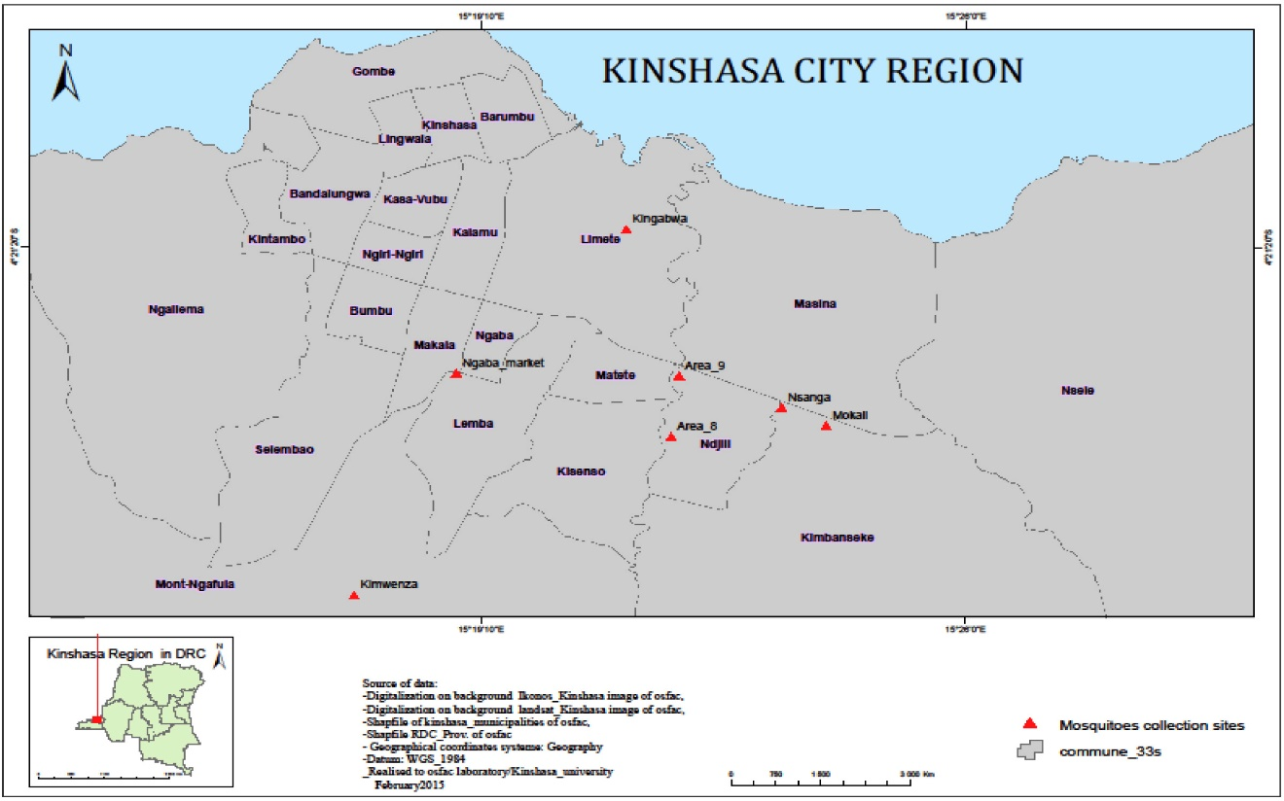
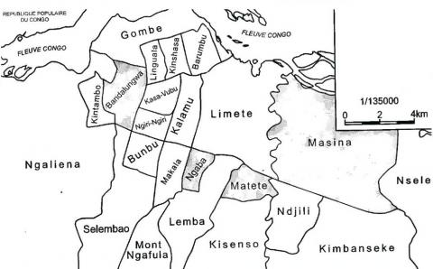
DRC- Kinshasa regions/communes
If possible an editable map of the Kinshasa city layout
Ideally showing the areas/communes from the below maps

Slide 9
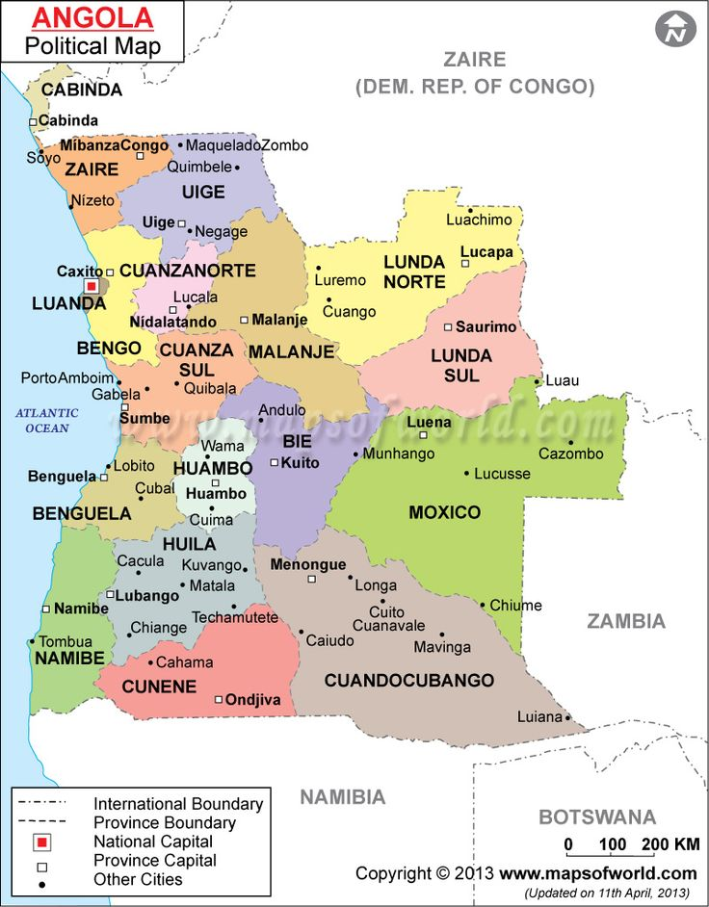
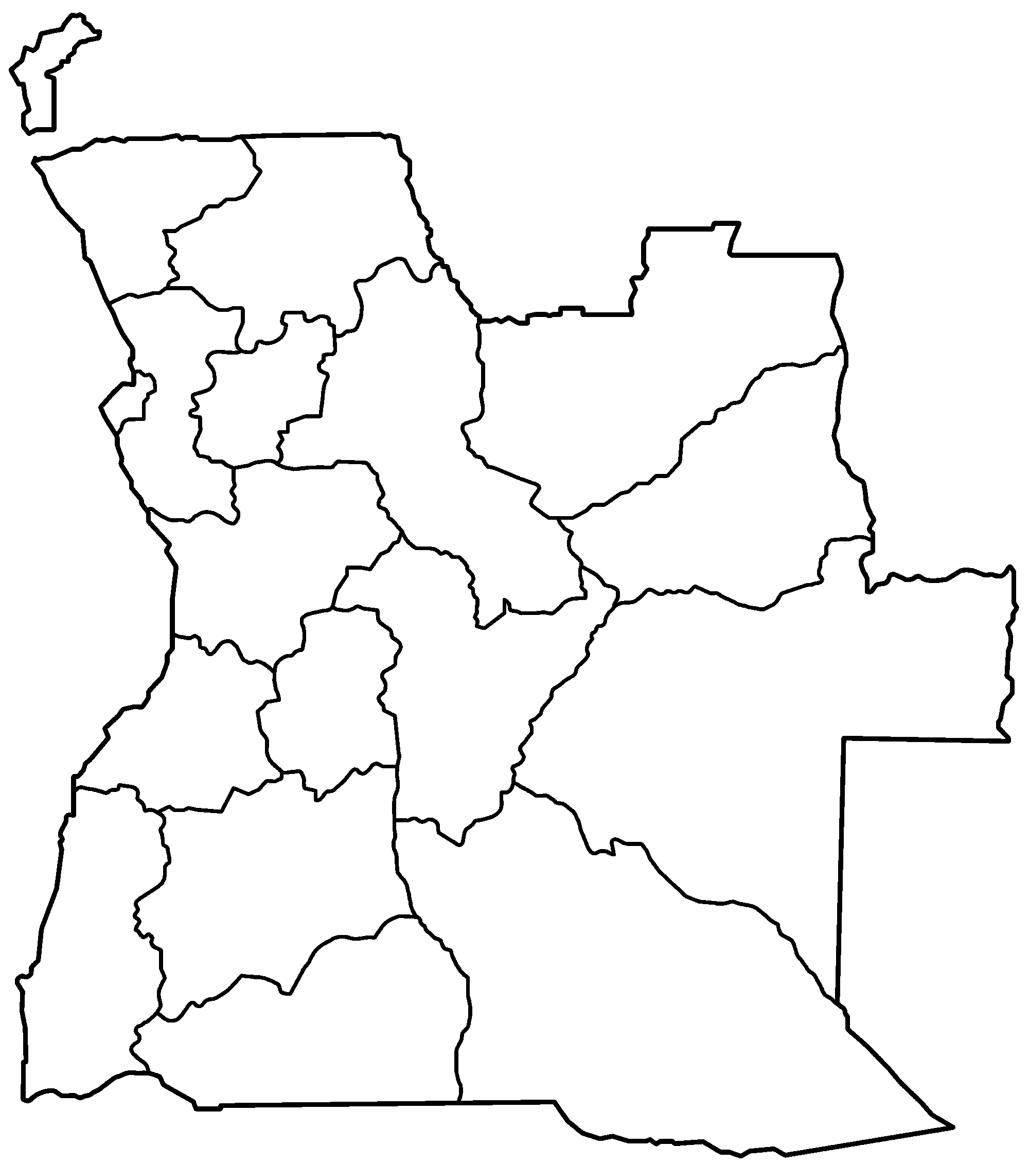
Angola
I need a fully editable provincial map of Angola
If possible a version showing major cities based on population (over 250,000) if you can find that info

Slide 10
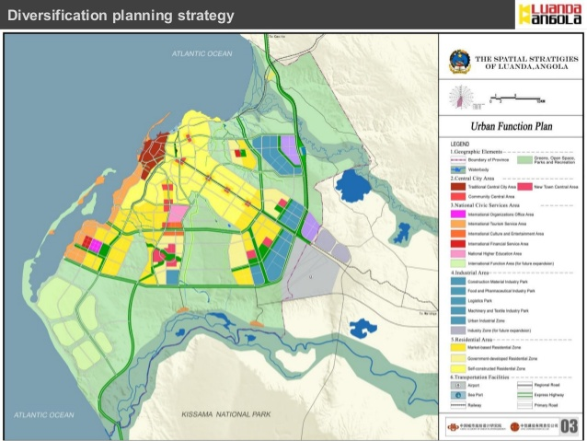
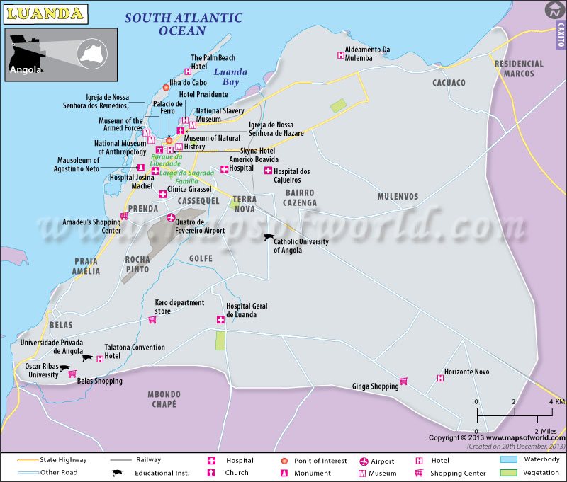
ANGOLA - Luanda City Layout
If possible an editable map of the Kinshasa city layout
Ideally showing the areas/communes from the below maps

Slide 11
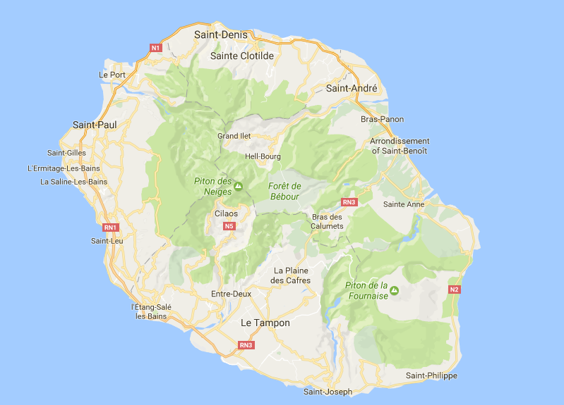
Reunion island
I need a fully editable provincial map of Reunion island
Should be the same format as the earlier maps

Slide 12
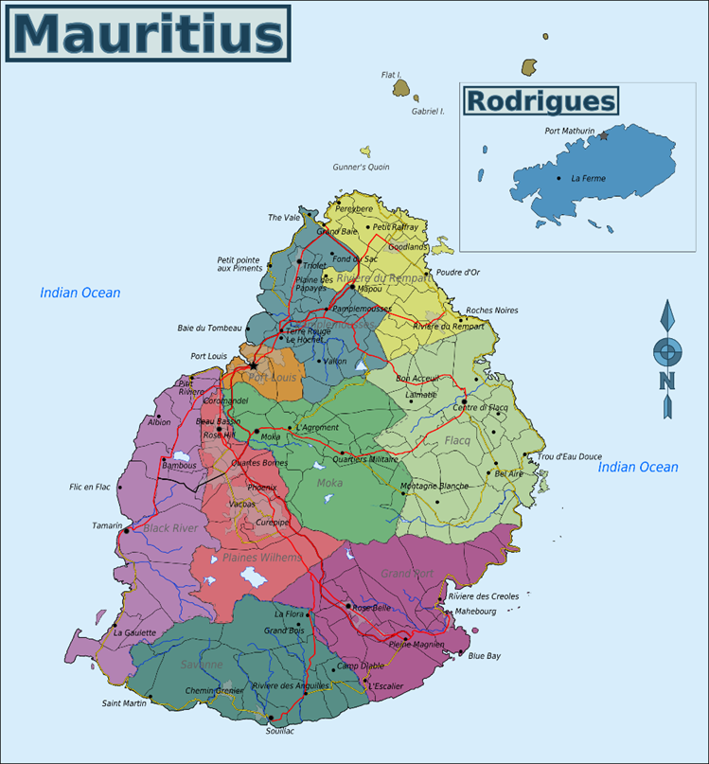
Mauritius
I need a fully editable provincial map of Mauritius
Should be the same format as the earlier maps

