Slide 1
Spark Mentoring & Coaching
I have trained as a life coach and will be launching my new career so wanted to get a logo, business card, website etc
My focus will be on individual coaching not corporate coaching so I want it to feel accessible not too formal in style or colours – I want to specialise in working with Women
I want the logo to stand out in a cluttered landscape of coaches, counsellers, health and wellness practitioners etc – I’m open to the logo with or without the words Mentoring & Coaching
My favourite colours are teal, turquoise, grey, mint green, following happy colour palette that jumped out at me, I like muted colours
Following slides for reference imagery I like, the 2nd slide is 2 particular Buddhist symbols I love, the lotus and mindfulness

Slide 2
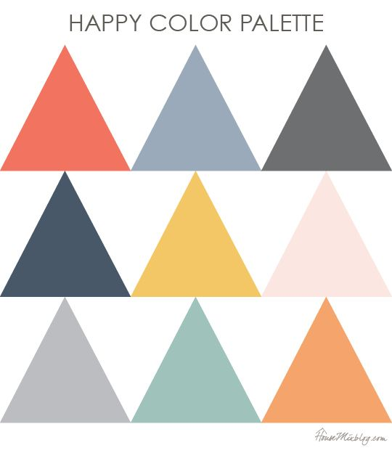

Slide 3

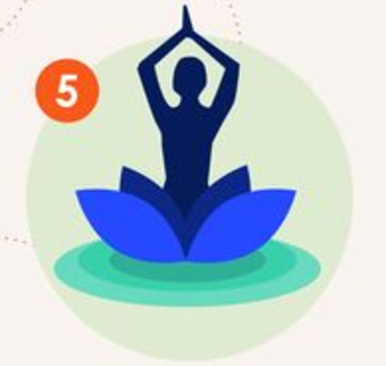





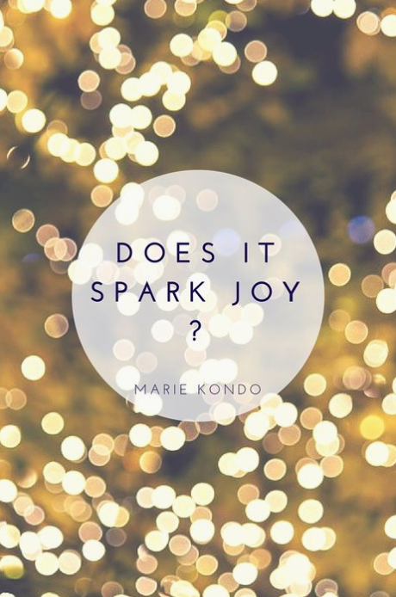

Slide 4


