Slide 1


WDYT Design Specification
Updates to submission

Slide 2
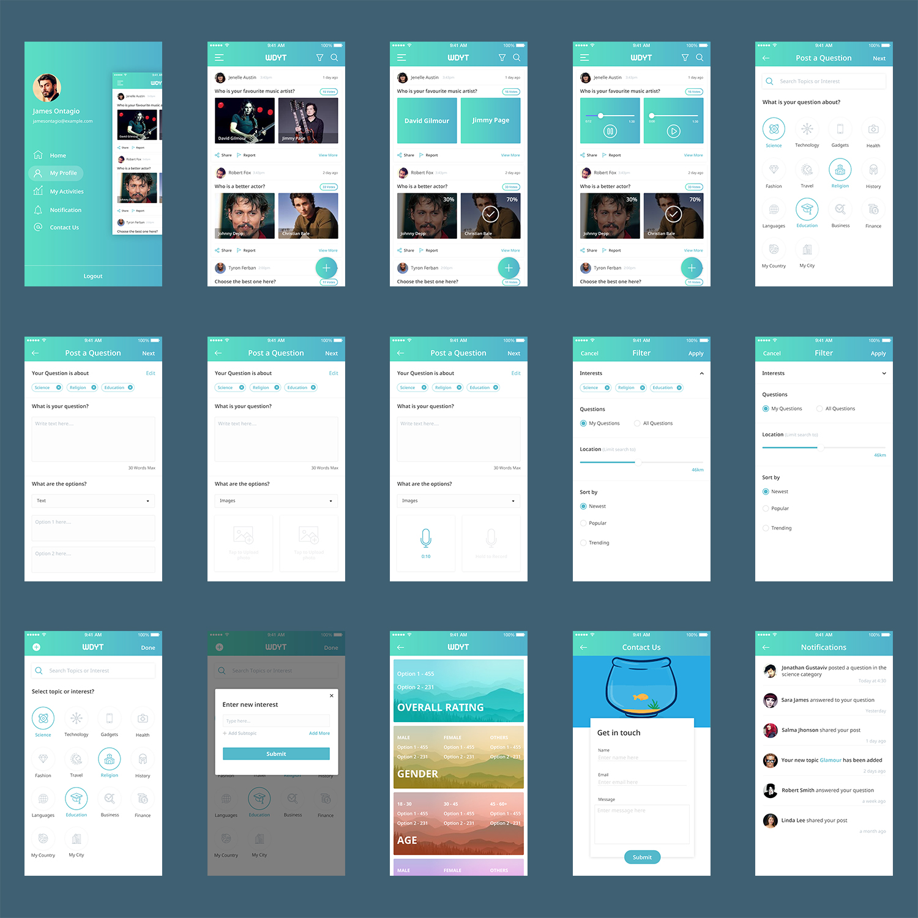
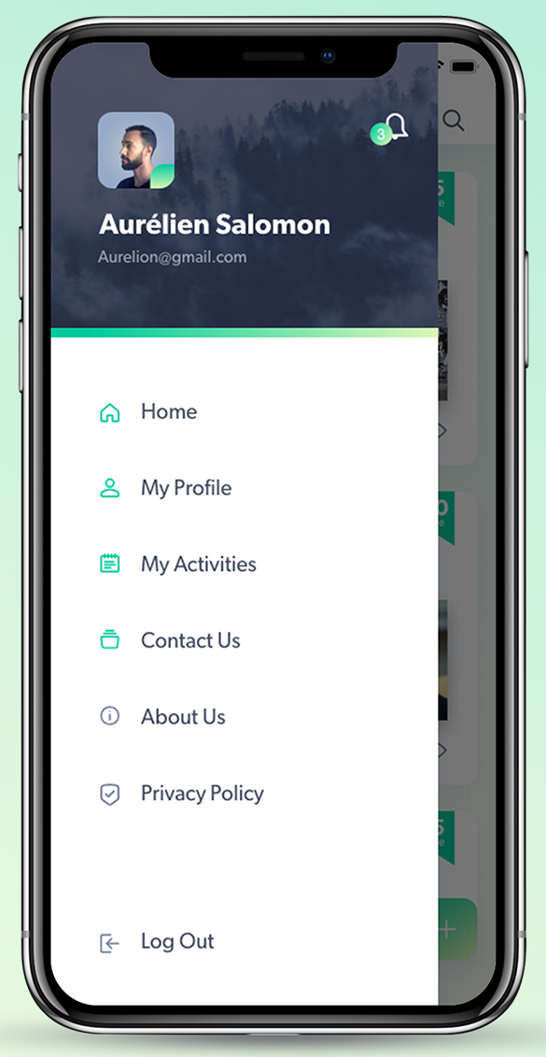
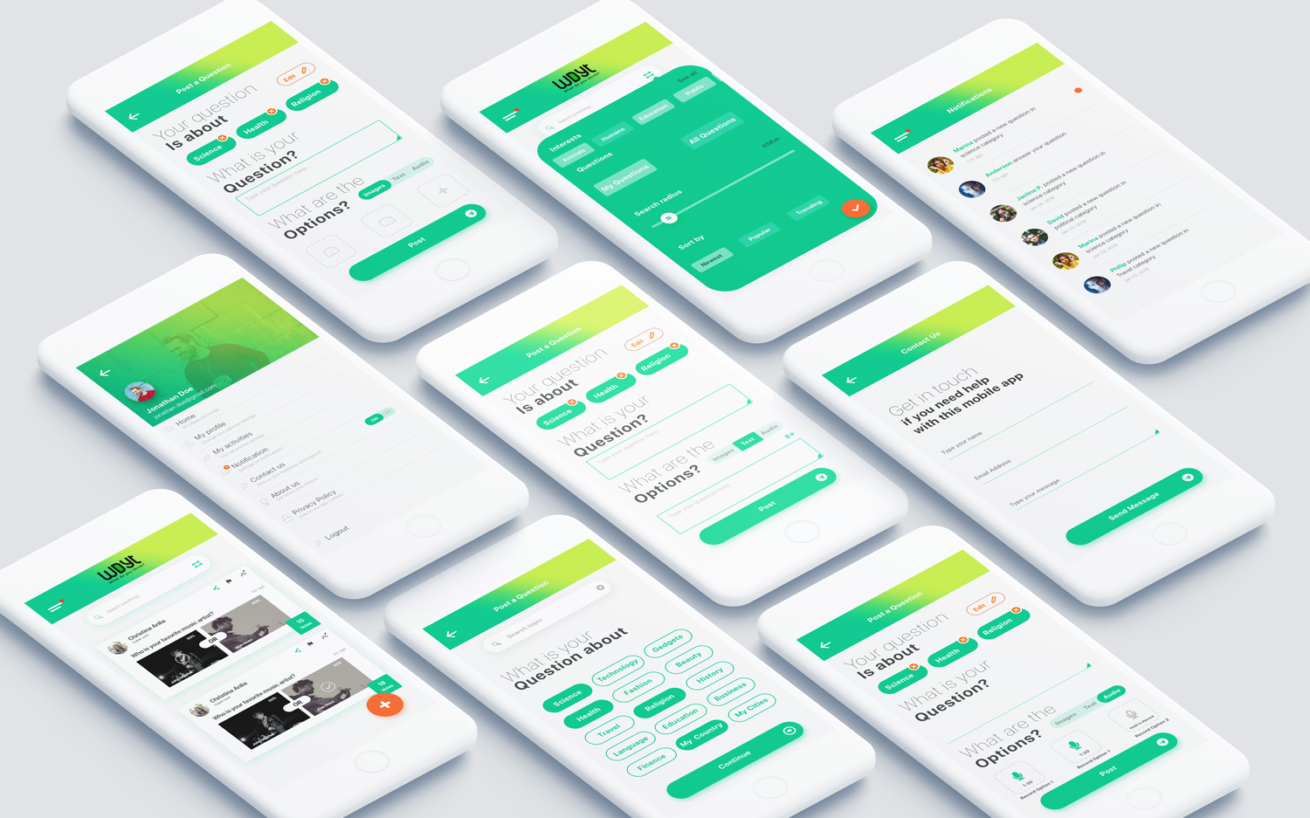
Profile Screen
Please make this picture bigger. Up to 50% bigger
Please use icons as similar to this as possible
Please move this button from contact us to notifications.

Slide 3
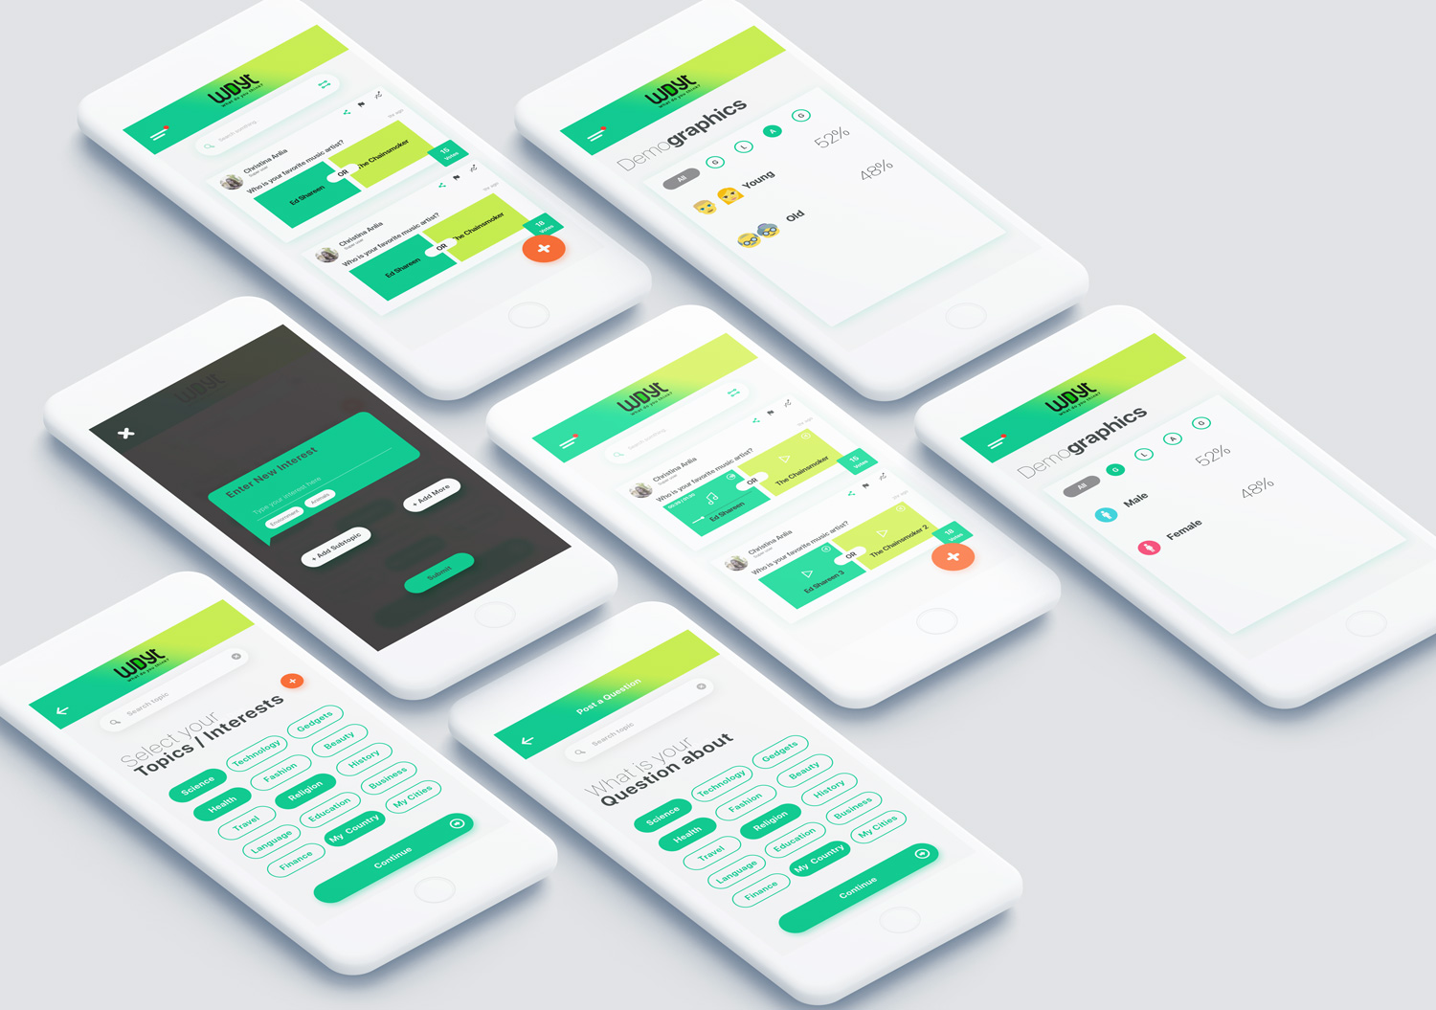
Profile - Select Interest
Rename “Select your interests”

Slide 4
Add Interest
Please remove the + Add subtopic button.
Please increase transparency of background a little.

Slide 5
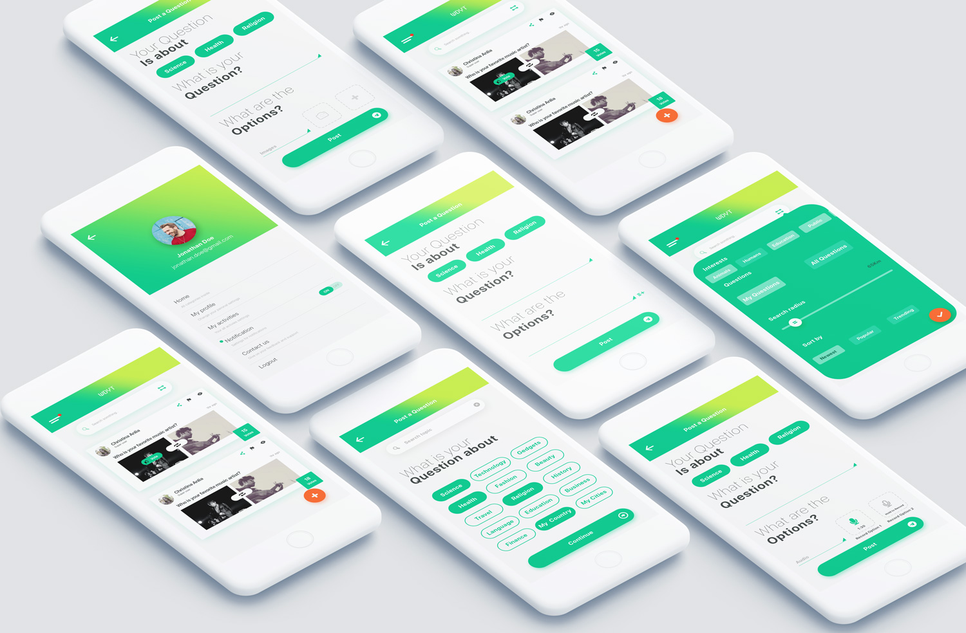
Post a Question – Select Interest
This design is good

Slide 6
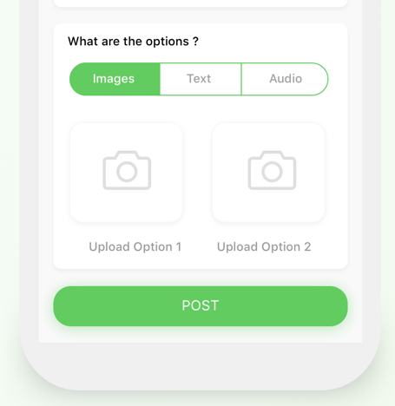
Post a Question - Images
Please take away box with + sign in it. Just need the two camera boxes.
Please go back to the previous version i.e. take away the text box and option to delete interests (in orange). Keep Edit button and inline selector.
Please keep the words in the text field “Type your question here”.
Please add “30 words max”.
Please add wording “Upload option 1” and “Upload option 2”

Slide 7
Post a Question - Audio
Please go back to the previous version i.e. take away the option to delete interests (in orange).
Keep edit button.
Keep inline selector.
Please add the words in the text field “Type your question here”.
Please add “30 words max”.
Only need two record boxes. Please just keep two.

Slide 8
Post a Question - Text
Please go back to the previous version i.e. take away the text box and option to delete interests (in orange).
Keep edit button.
Keep inline selector
Please add the words in the text field “Type your question here”.
Please add “30 words max.”
Need two places to add text options. Currently I only see one. User should not have to click to add another text option, it should be there as soon as they select text options.

Slide 9
Home Screen - Images
Please increase size of the circle with a tick in it by up to 20%.
Please increase the size of the font for percentage to a little bigger.
Maintain this base design. I like orange as the secondary theme.

Slide 10
Home Screen - Text
This is good. Please can you also show what it looks like when text is selected.

Slide 11
Home Screen - Audio
This is good. I am not sure what is in the top right hand corner of the boxes? Please can you clarify this.
Please can you also show one set of options without text included.
Please can you also show what audio looks like when selected.

Slide 12
Contact Us
Please change wording to “Get in touch if you need help”.

Slide 13
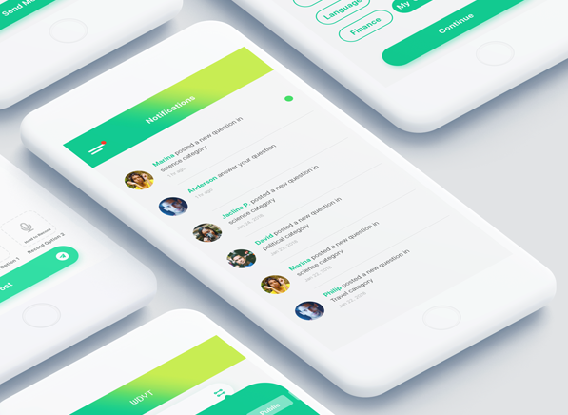
Notifications
Maintain this base design.

Slide 14
Filters
This is good.

Slide 15
Demographics
This is good. Please can you add a slider/selector to select between option 1, option 2 and total.

