Slide 1


WDYT Design Specification
Updates to submission

Slide 2
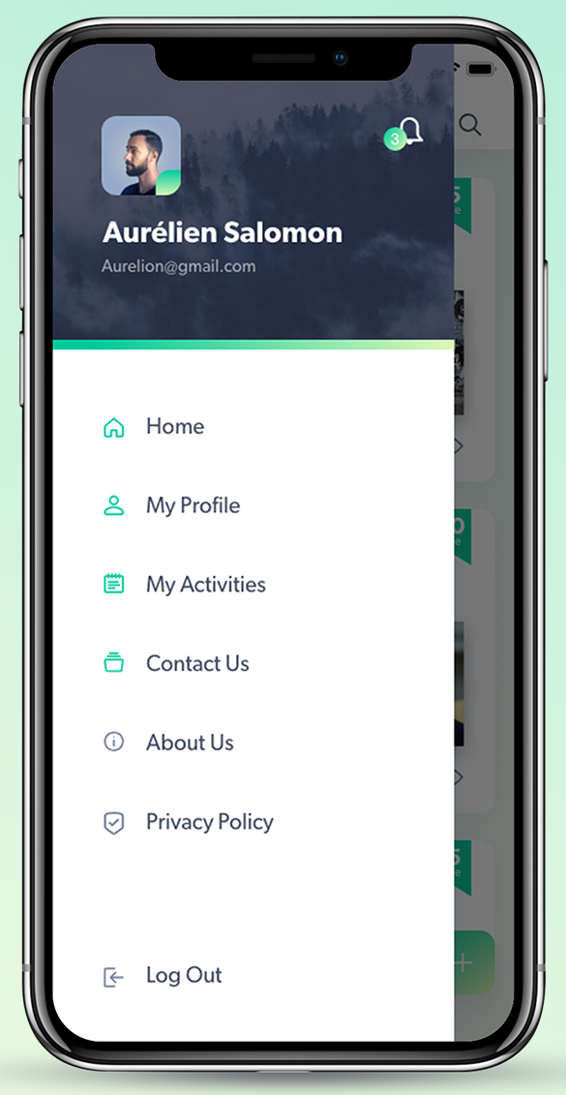
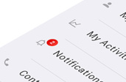
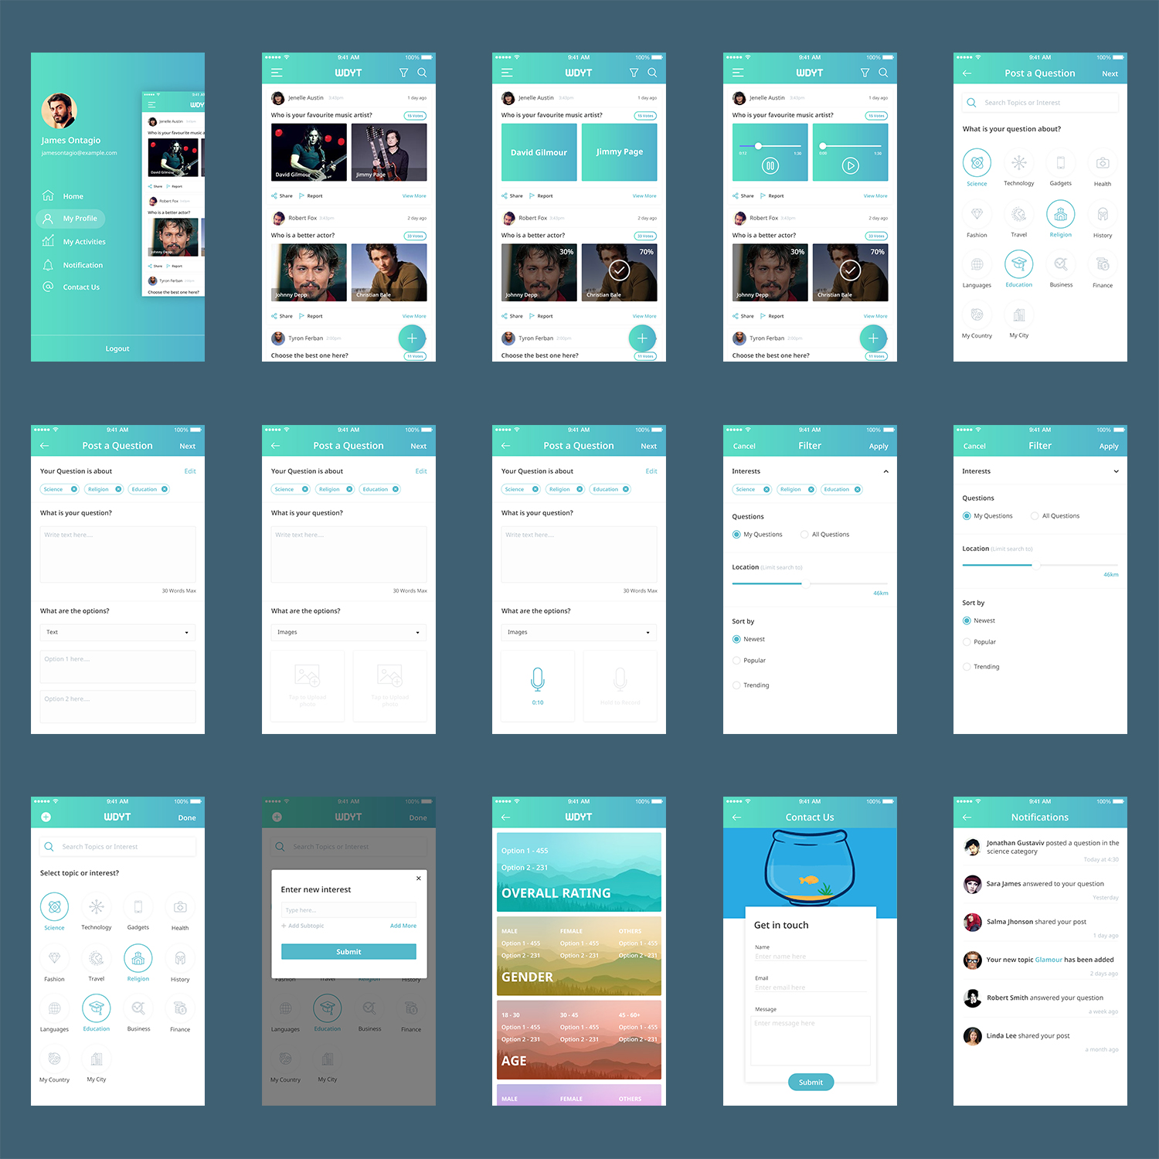
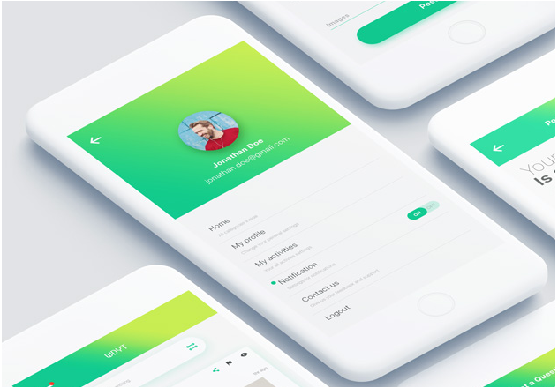
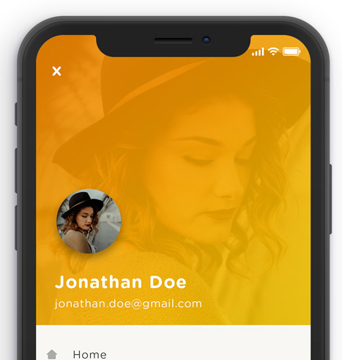
Profile Screen
Please use orange colour for notification counter.
Maintain this base design
Add these items and the icons. Please separate Log Out item as show here.
Add these icons
Please use this design for dp, but convert to green theme.

Slide 3
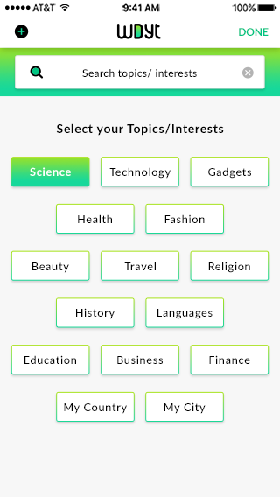
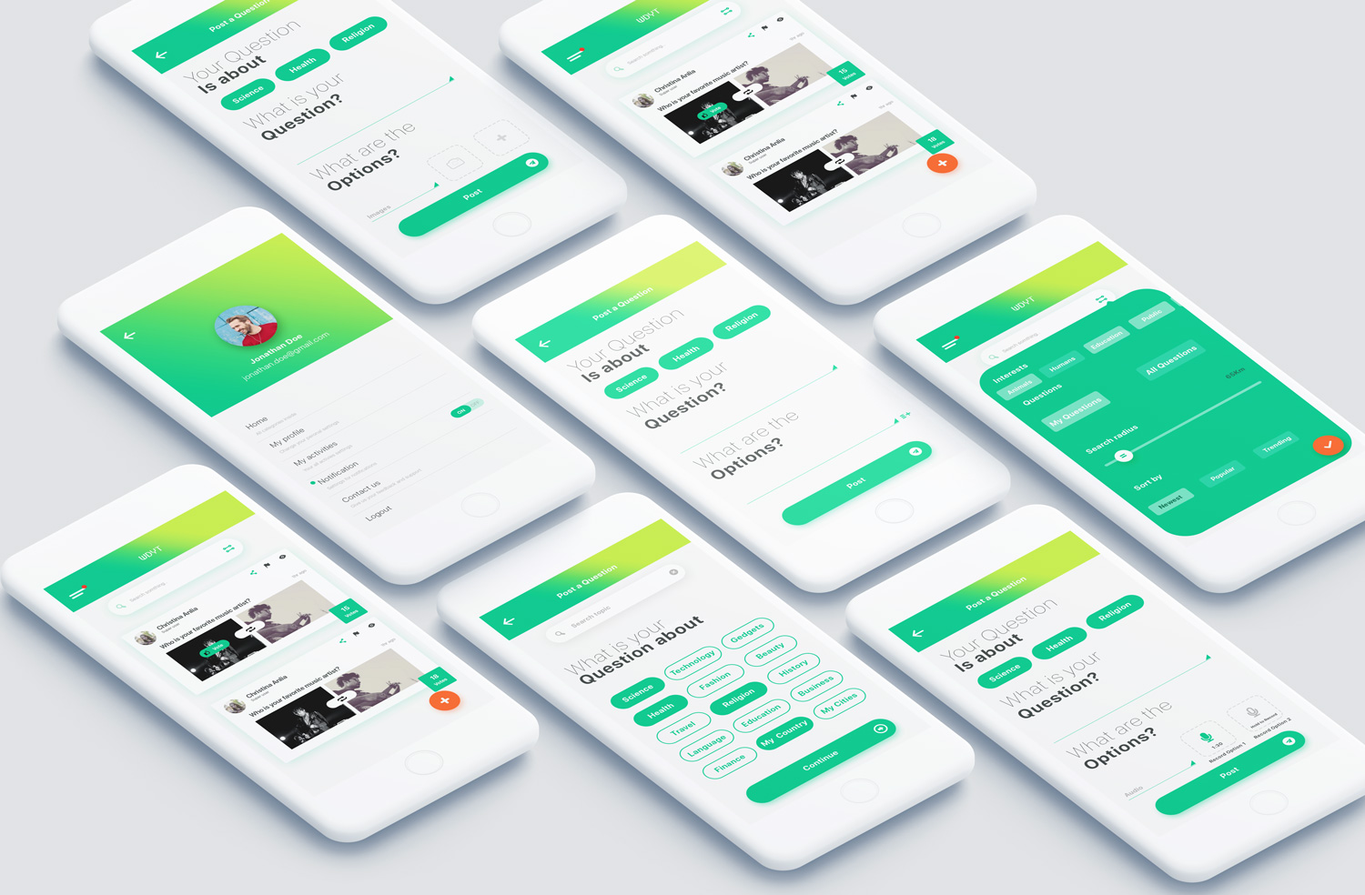
Profile - Select Interest
You did not give me a design for this page - please can you give me a design. Should be similar to design on right.

Slide 4
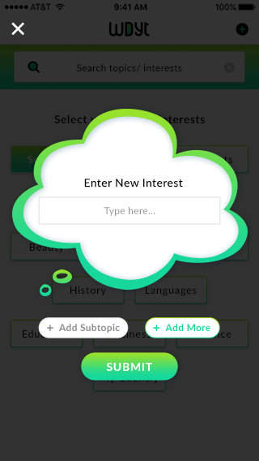
Add Interest
You did not give me a design for this page - please can you give me a design.

Slide 5
Post a Question – Select Interest
This design is good
Maintain this base design

Slide 6
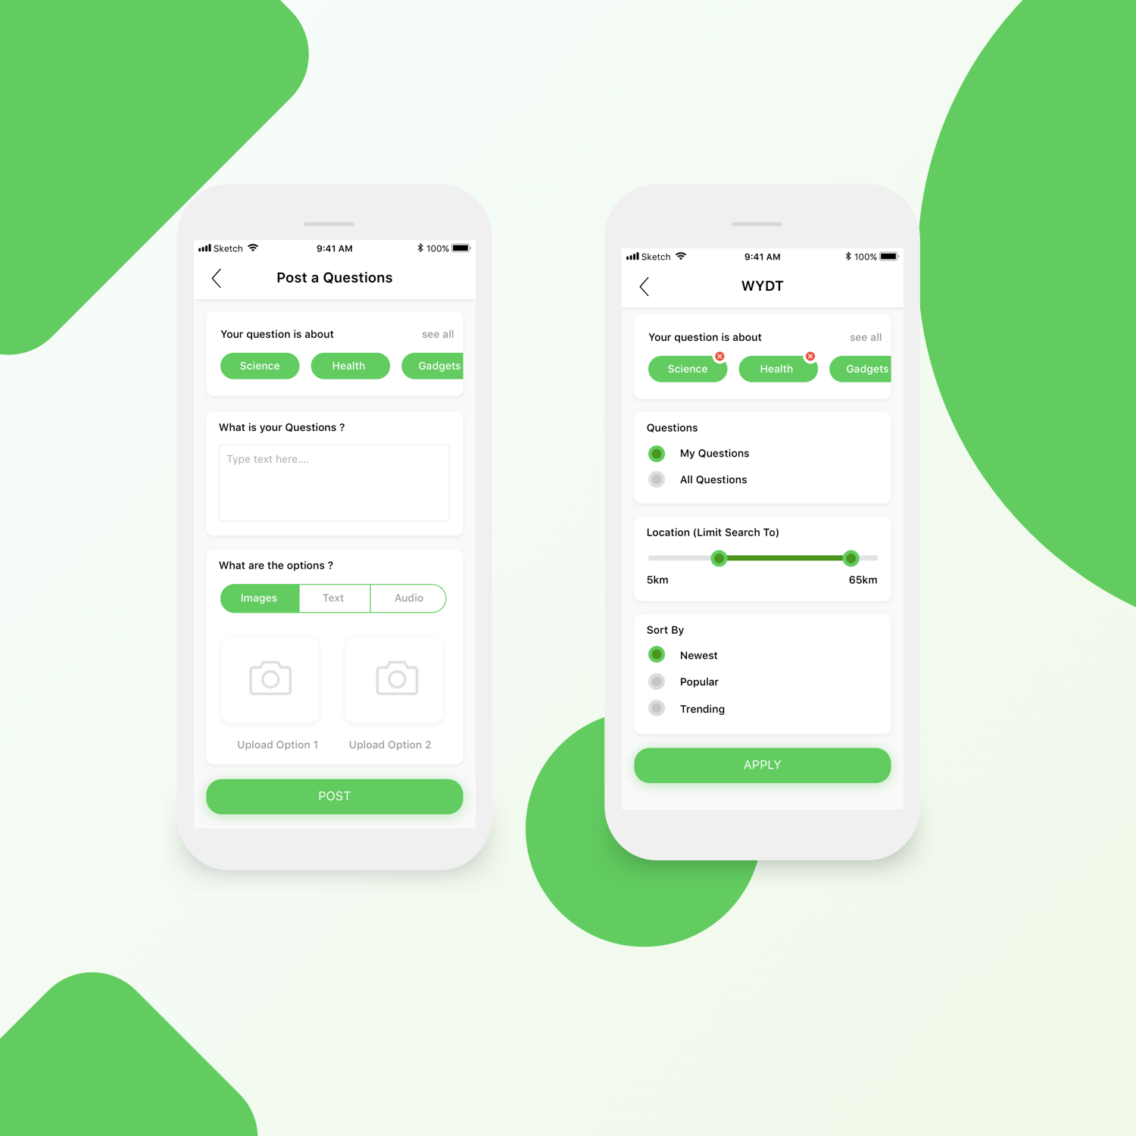
Post a Question - Images
Please add option to delete interests (in orange).
Please add an option to edit.
Please add a text box and add 30 words max.
Please add in line image/txt/audio selector.
Please do continue to be creative with design. This should not just be a copy and paste.
Maintain this base design

Slide 7
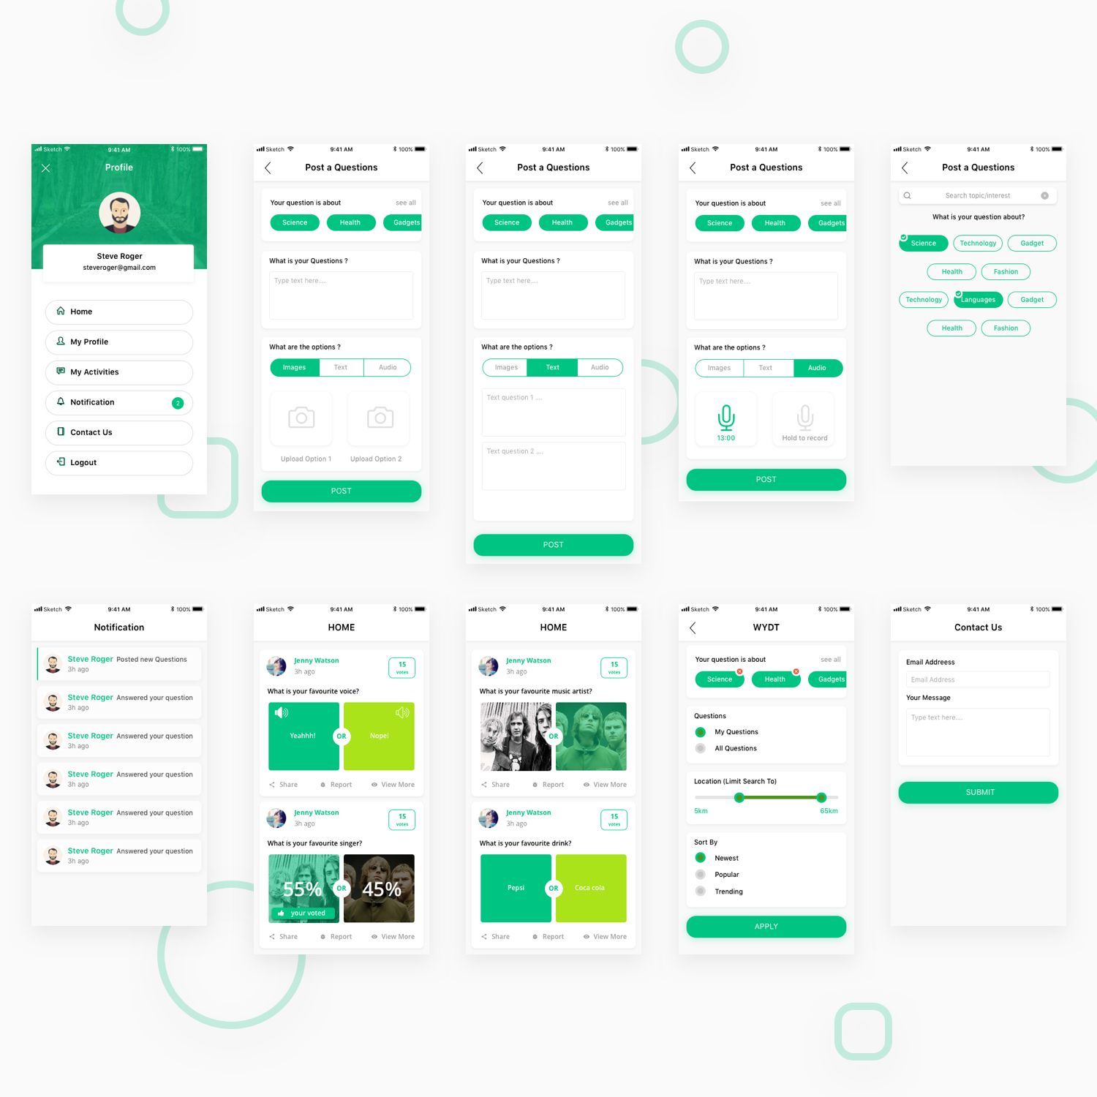
Post a Question - Audio
Please add option to delete interests (in orange).
Please add an option to edit.
Please add a text box and add 30 words max.
Please add in line image/txt/audio selector.
Please do continue to be creative with design. This should not just be a copy and paste.
Maintain this base design

Slide 8
Post a Question - Text
Please add option to delete interests (in orange).
Please add an option to edit.
Please add a text box and add 30 words max.
Please add in line image/txt/audio selector.
Please do continue to be creative with design. This should not just be a copy and paste.
Maintain this base design

Slide 9

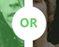
Home Screen - Images
Please increase size of the orange circle for posting new questions.
Please change eye icon to stats icon. Here is an example of stats icon, but please feel free to use a better one.
Please change the graphic between the two image options to this.
When option selected, it should look like the this (with the OR in the middle of the two images)
Please do continue to be creative with design. This should not just be a copy and paste.
Maintain this base design. I like orange as the secondary theme.

Slide 10
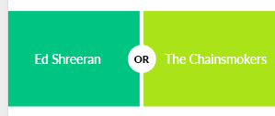
Home Screen - Text
You did not design the text screens. Please can you give me a design for this screen.
Please include all changes from previous slide.
I quite like the way text is shown here. However if you have any better ideas really keen to see these.
Please do continue to be creative with design. This should not just be a copy and paste.
Maintain this base design. I like orange as the secondary theme.

Slide 11
Home Screen - Audio
You did not design the audio screens. Please can you give me a design for this screen.
Please include all changes from previous slide.
I quite like the way audio is shown here, but would need to follow existing colour theme. If you have any better ideas really keen to see these.
Please do continue to be creative with design. This should not just be a copy and paste.
Maintain this base design. I like orange as the secondary theme.

Slide 12
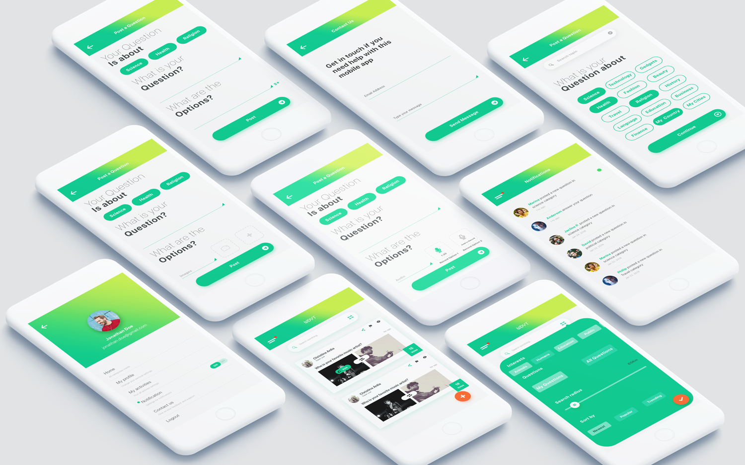
Contact Us
Please change wording to “Get in touch” and in the same style as here.
Please include field for users to add their name also.
Maintain this base design.

Slide 13
Notifications
Maintain this base design.

Slide 14
Filters
Please add option to edit interests
Maintain this base design.

Slide 15
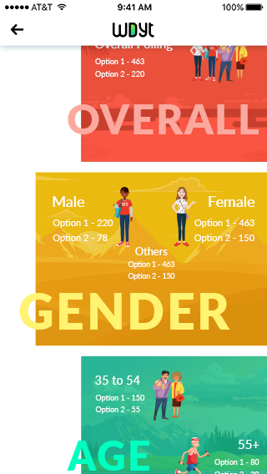
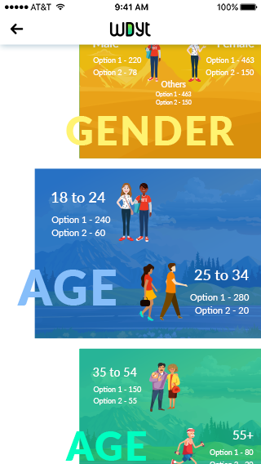
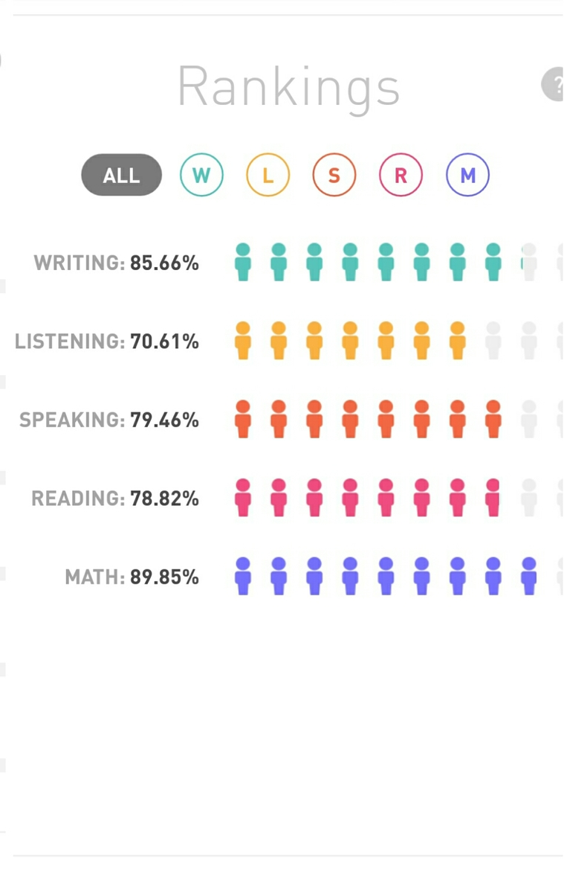
Demographics
You did not design the demographics screen. Please can you give me a design for this screen.
On the left is the current screens I have.
One idea I like is here on the right. Replace the W with G for Gender. The L will be for Location, replace the S with A for Age. Then replace the writing, listening, speaking ….etc with the different categories within the demographics. E.g. when user clicks on G, they should see Male, female and

