Slide 1
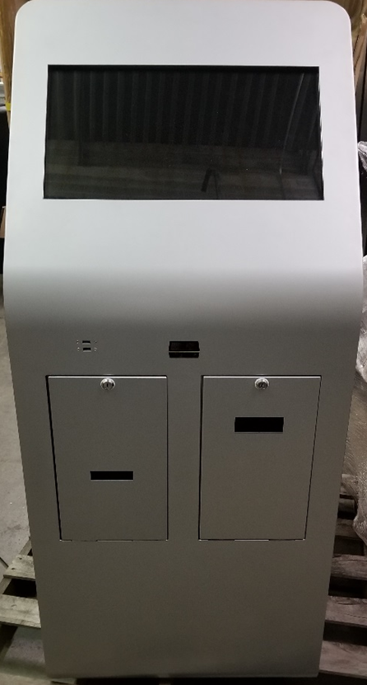


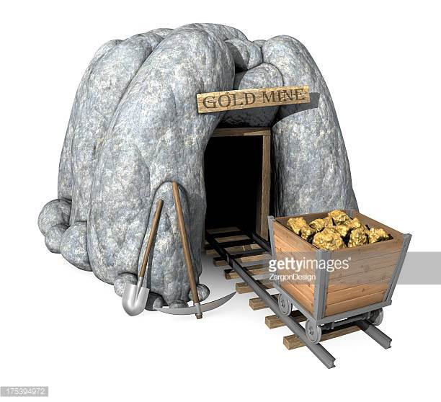
SAMPLE ONLY
Do not what to
Look like cartoon
Place LOGO here
PRIZE MINE
DO NOT COVER
Sample of image I like

