Slide 1


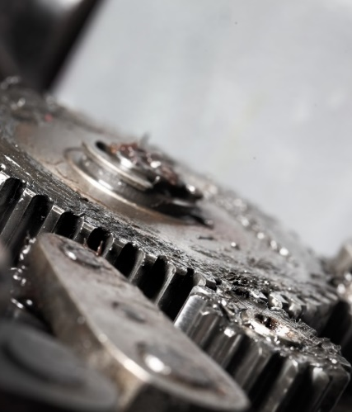

HEAVY DUTY DEGREASER
Fats, oils and grease are quickly and effectively separated from metals and plastics using Green Earth’s heavy duty degreaser. This military grade product dries quickly, and a simple surface wash with clean water will guarantee no residual remains on the cleaned area. It is engineered to permanently remove stubborn problems for the toughest industrial and commercial cleaning applications.
Heavy duty degreasers are being used by professionals in a diverse range of industries including:
Hospitality,
Transportation
Oil, Gas & Mining
Military
Marine
Manufacturing
Green Earth Heavy Duty Degreaser counters the need for conventional, caustic and environmentally hazardous chemicals typically used in industry. Additional benefits:
It is formulated from a variety of readily available plants and minerals. The natural ingredients mean it is fully biodegradable, and will not contaminate or pollute the environment.
Oils and greases are easily separated from the degreaser solution and the Green Earth Heavy Duty Degreaser can be re-used or recycled for even greater savings.
There are no environmental charges or disposal fees after use.
is non-corrosive and will not damage metal or plastic surfaces.
It is safe for the user. Many of the standard work-safe procedures are a thing of the past as there are no VOC’s, it is non-toxic, nonhazardous, non-flammable and non – cancer forming.
The active ingredients behind all Green Earth cleaning, solvent and lubricating products are combinations of various readily biodegradable plants and naturally occurring minerals. Green Earth’s proprietary, renewable; chemical/mechanical process creates a truly unique product that is safe for human use and
All Green Earth active ingredient formulas are effective as a result of the creation of electrically charged particles known as micelle. When activated in water, micelles repel each other in a ceaseless random movement. Measuring only 2 – 4 nanometers in size, their extreme surface-area-to-volume ratio enables far greater efficacy than conventional technologies or formulas. Micelles do not produce a chemical reaction that generates new compounds when introduced into another material or the environment, instead they break down carbon based compounds into smaller particles that can be easily assimilated and metabolized by normal soil or water microorganisms.
The active ingredients behind all Green Earth cleaning, solvent and lubricating products are combinations of various readily biodegradable plants and naturally occurring minerals. Green Earth’s proprietary, renewable; chemical/mechanical process creates a truly unique product that is safe
Green Earth Chemicals Are
Do Not Contain
-Bio Based
-Readily Biodegradable
-Non-Toxic
-Non-Corrosive
-Non-Caustic
-Non-Flammable
-Non-Cancer Causing
-Non-Hazardous
-Ozone Depleting Substances
-Petroleum Distillates
-Glycol Ethers
-Caustics
www.greenearthenergy.ca

