Slide 2
Who We Are
Pro Electric Motor Service, Inc. was founded in 2017 to acquire the assets of Hayes and Lunsford Electric Motor Service
Hayes and Lunsford had been in business since 1926 and has been serving the Carolina’s out of the current location in Greenville for the past 20 years
The entire team at Hayes and Lunsford has transitioned to Pro Electric Motor Service to ensure no disruption in taking care of our customers
Our mission is to consistently provide quality and performance to our clients, safely and honestly, while maintaining a rewarding work environment

Slide 3
What We Do
Repair Services
  Providing quality electric motor repairs & services, specializing in Servo Motor Repair, Rewind Services, Mechanical Repair, Pump Repair, and more...
Field Services
  Specializing in, Infrared Scanning, Surge Testing, Motor & Brush Surveys, Vibration Trending & Analysis, Motor installation or Removal, Laser Alignment, and more.....
New Products
  Robust product offering of Electric Motors, Motor Accessories, Drives & Controls, Gearmotors & Reducers, and more....

Slide 4
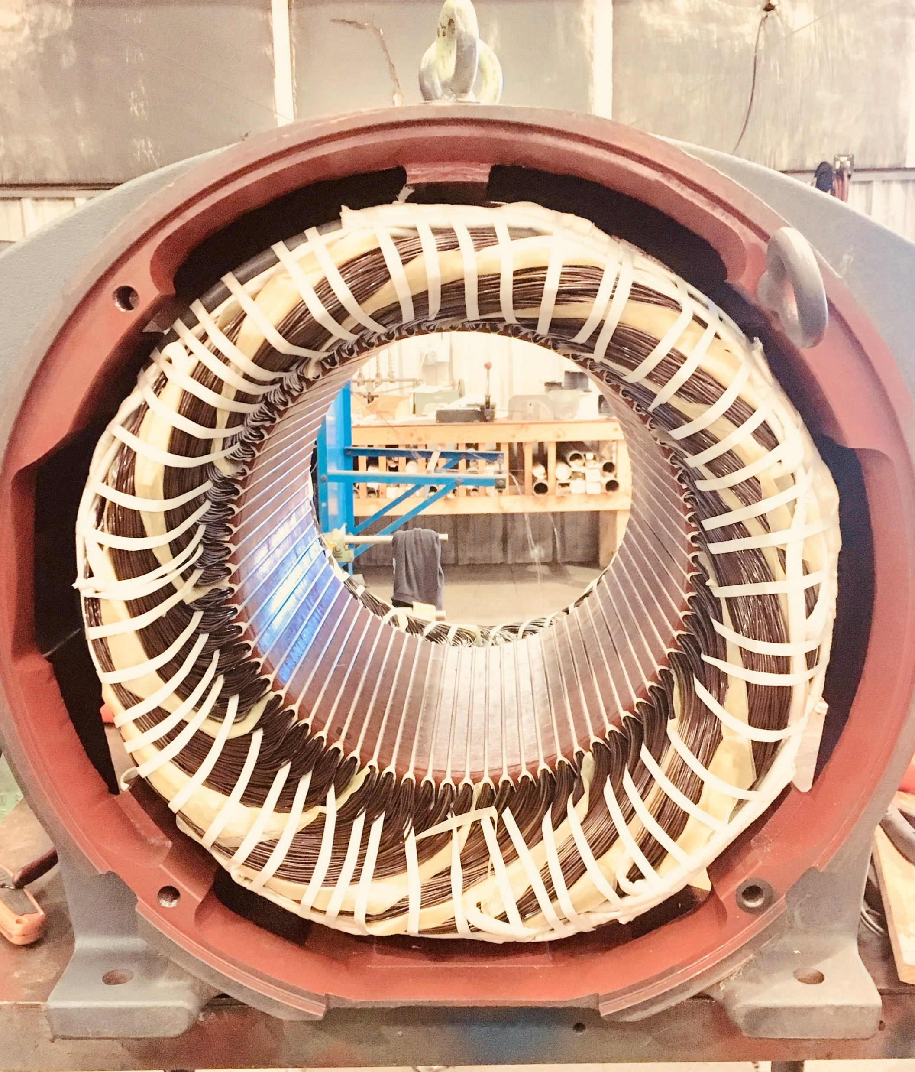
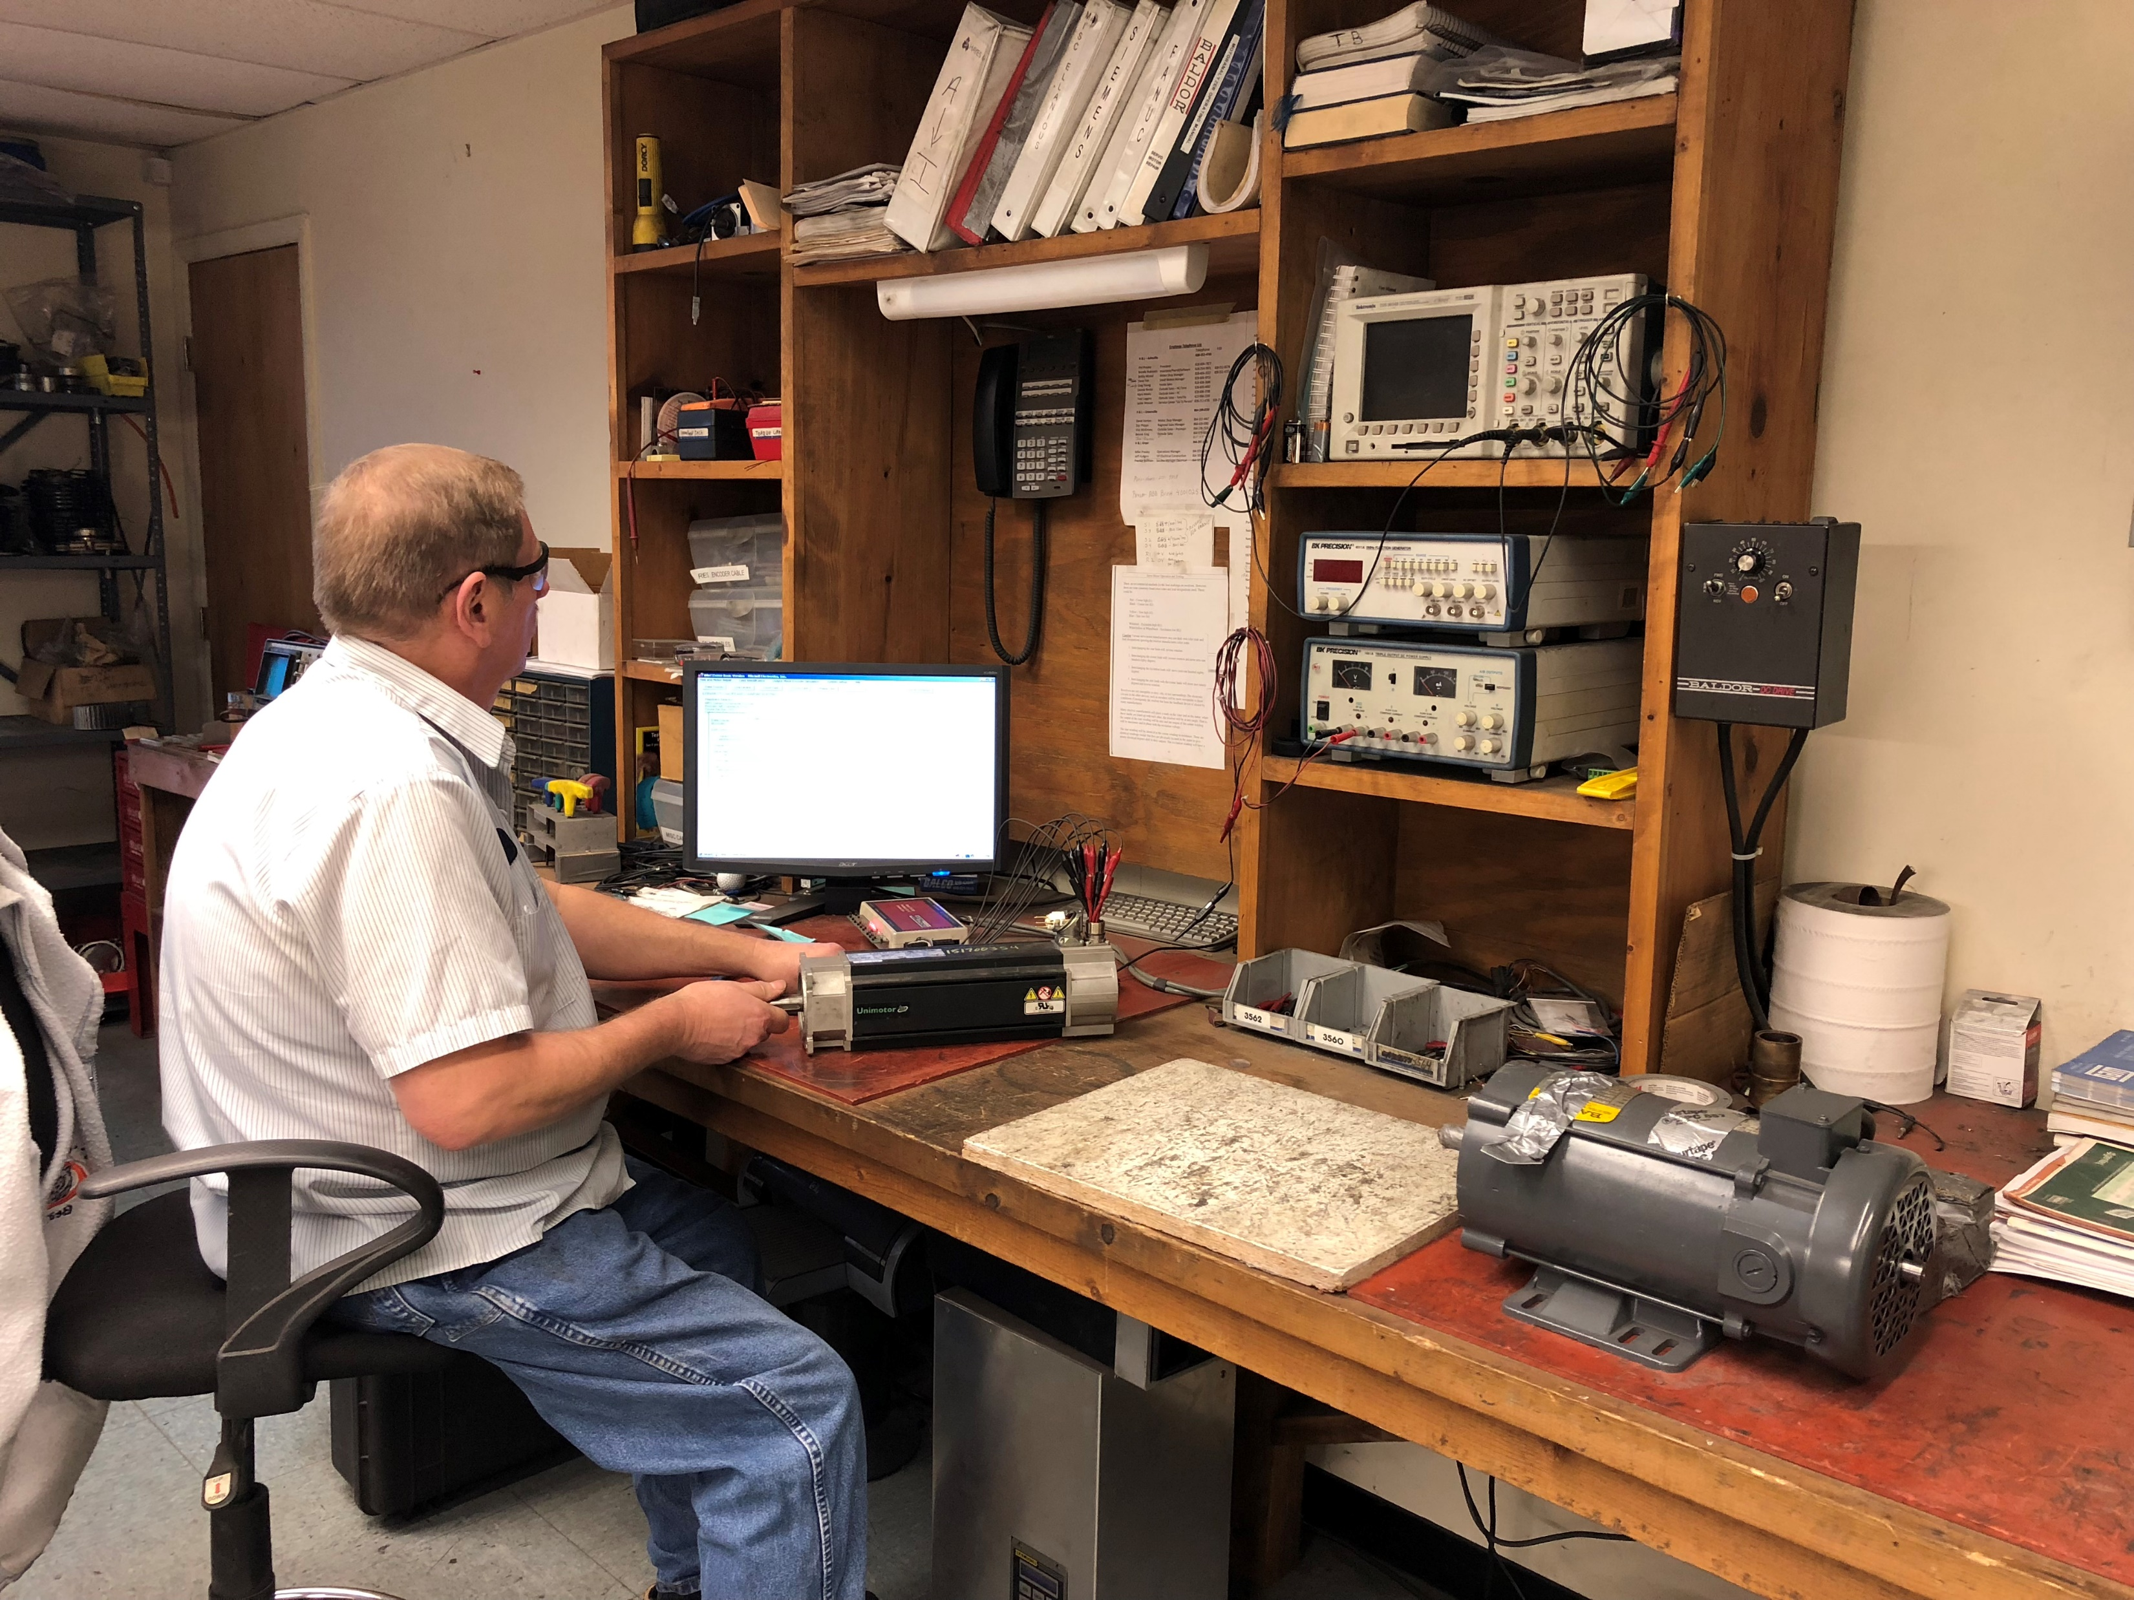
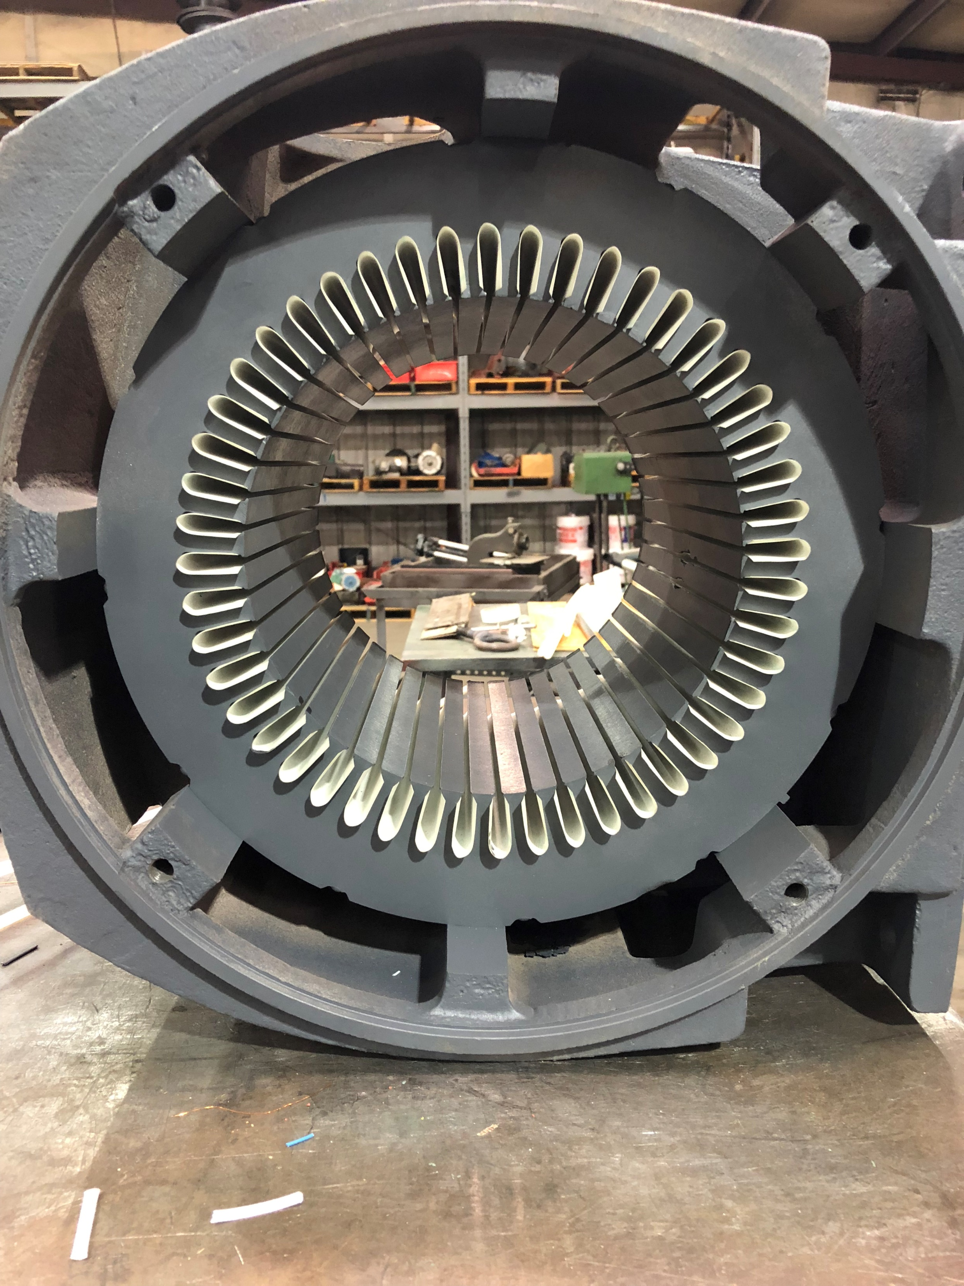
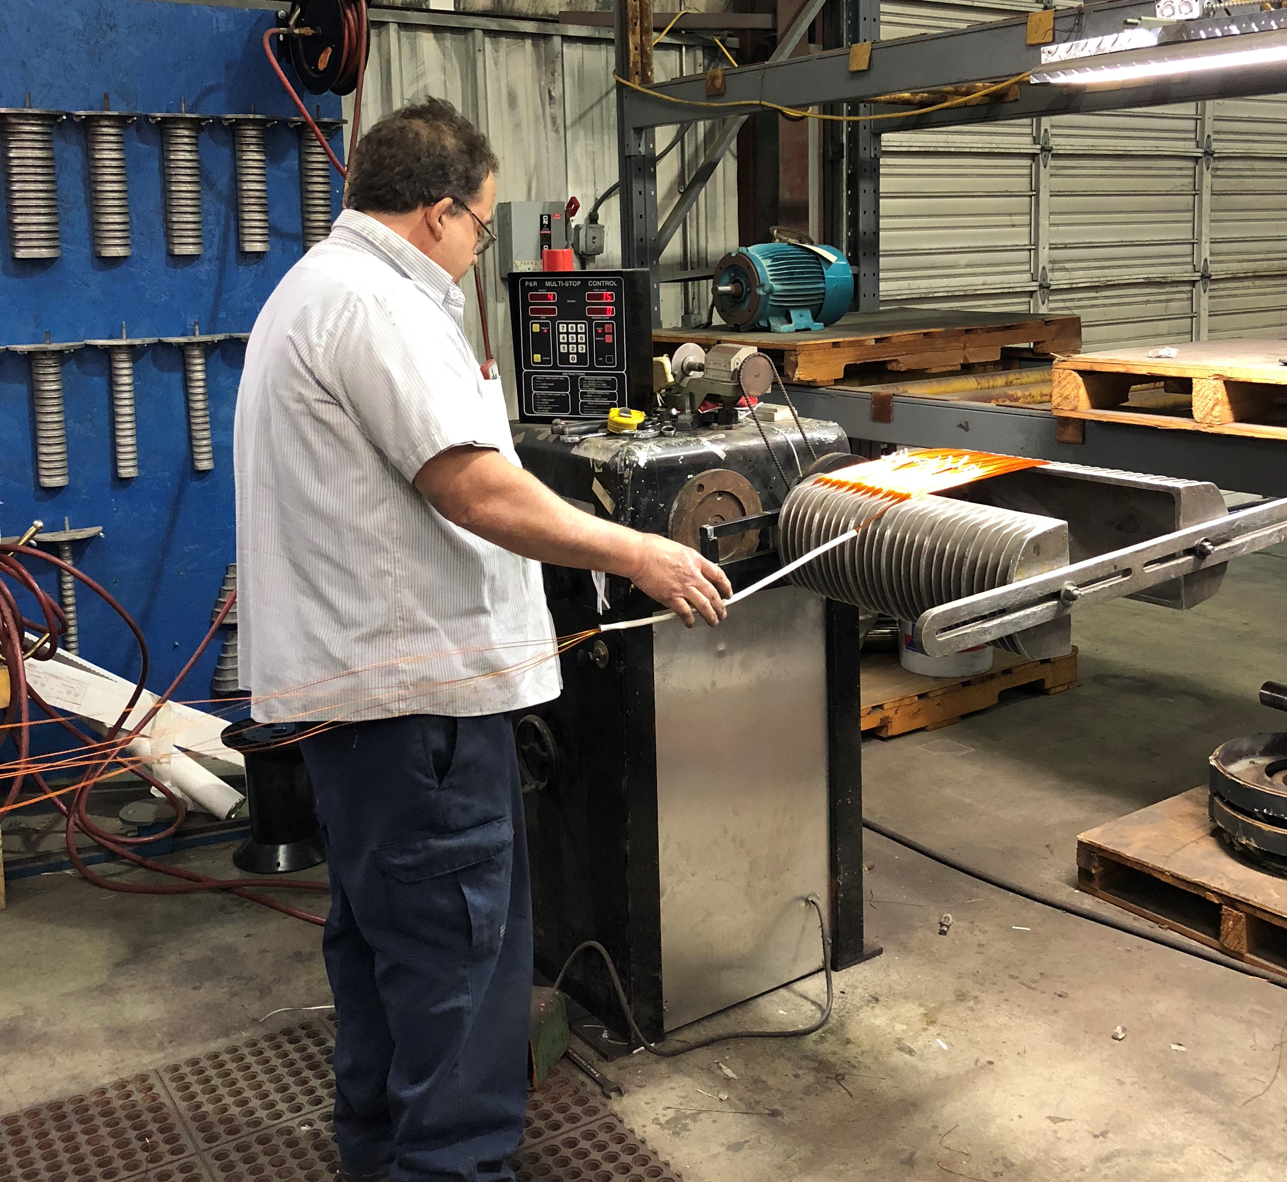
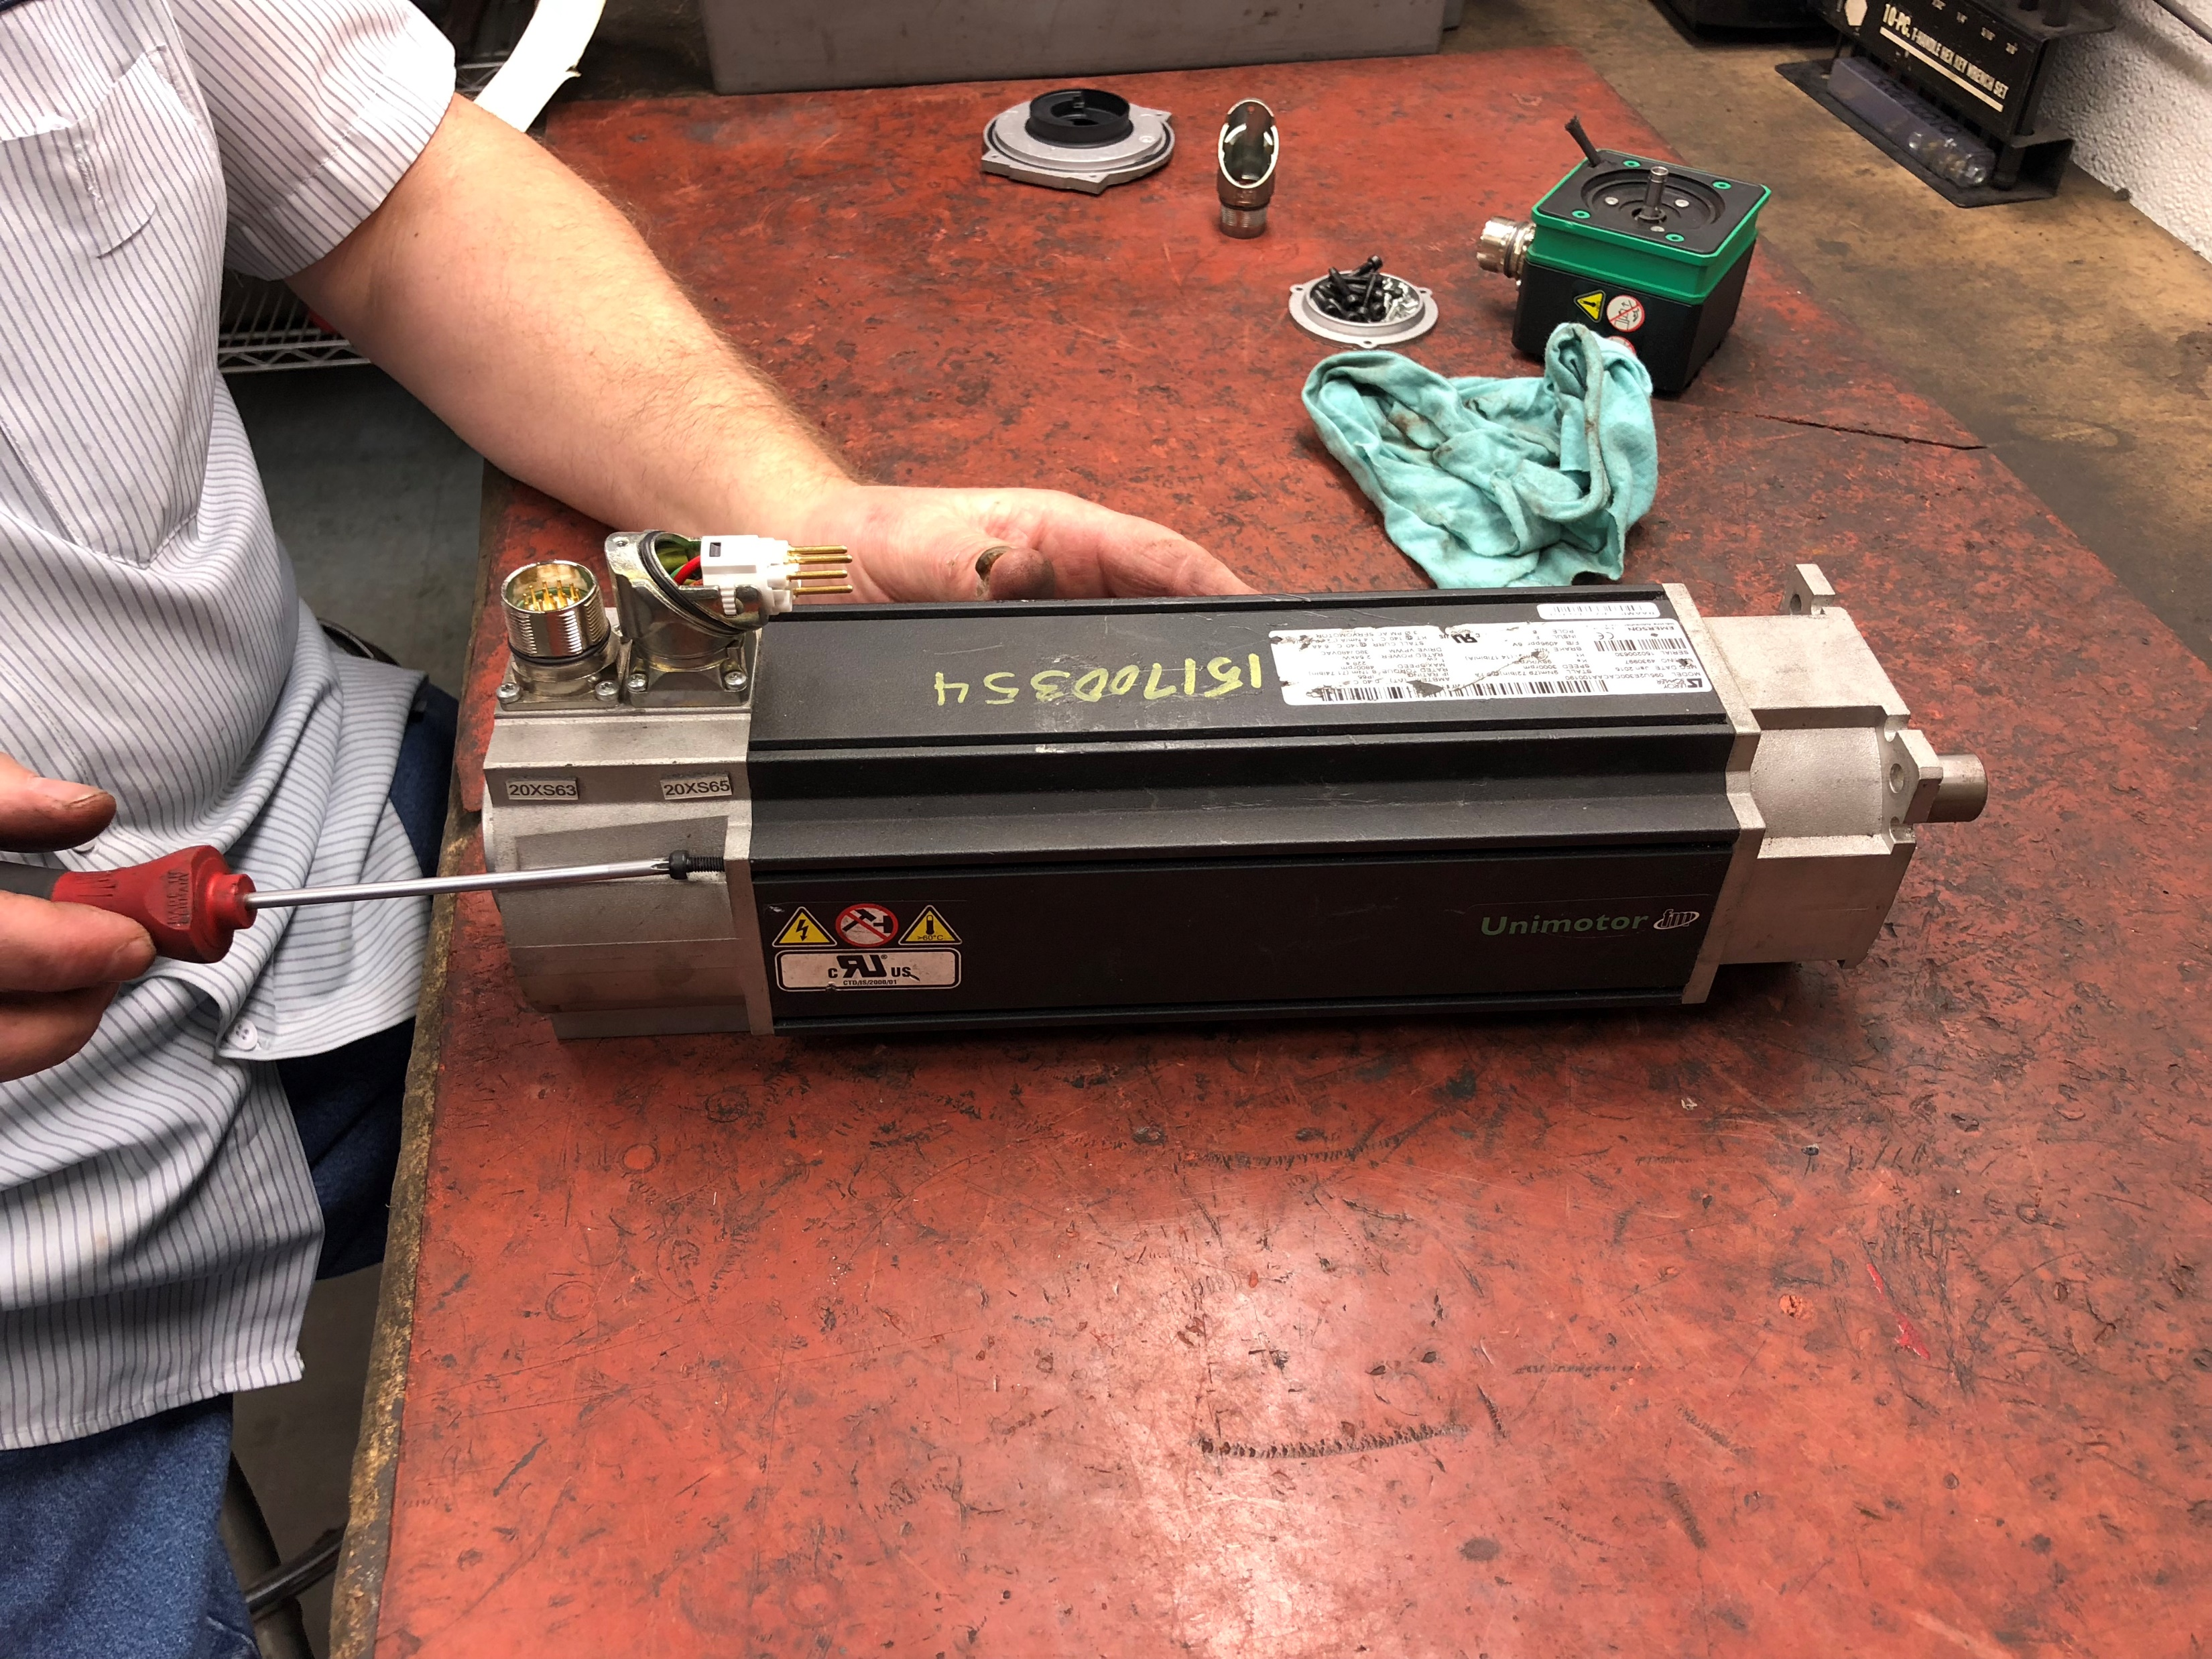
Repair Services
Rewind Services
  AC up to 4160 volts
  DC up to 500 volts
  Winding redesign
Servo Motors
  AC and DC Servo Motors
  Magnetic integrity testing
  Encoders, Resolvers & Tach Generators
Pumps
  Centrifugal / Submersible
  Sump / Circulating
  Rotary Gear
Mechanical Repair
  Armatures turned & undercut
  Custom machine work

Slide 5
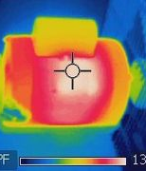
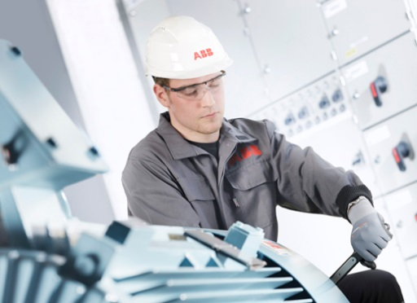
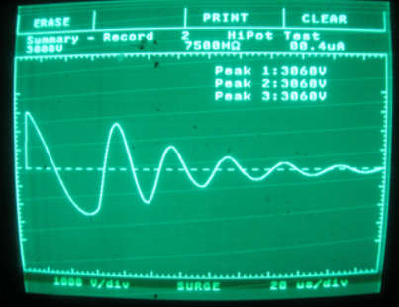
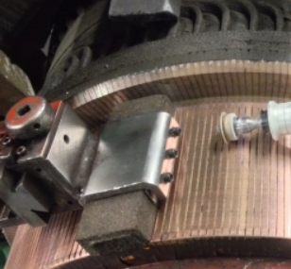
Field Service
Infrared Scanning
  Our trained technicians evaluate all equipment at your location
  Detailed report with corrective actions are provided and reviewed to determine next steps
Surge Testing
  Our trained technicians perform the necessary tests and provide a condition report on the status of your motors insulation system
Motor & Brush Surveys
  With our brush survey, we provide the means to evaluate the condition and operating efficiency of your motor brush
Vibration Analysis
Motor Installation or Removal

Slide 6
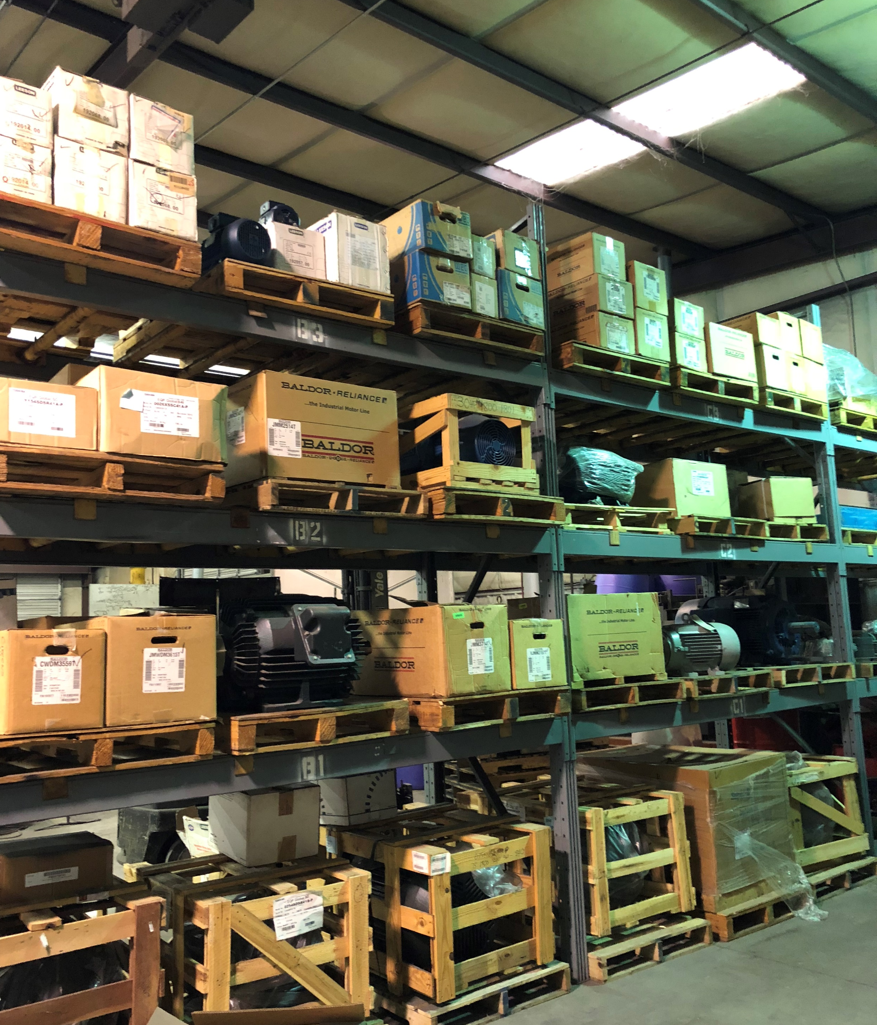
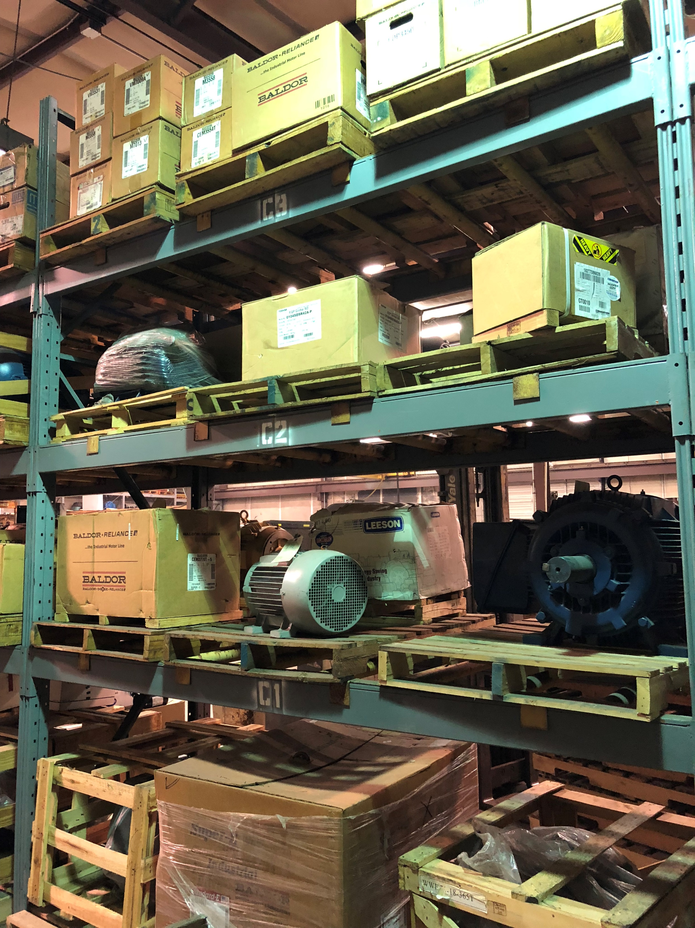
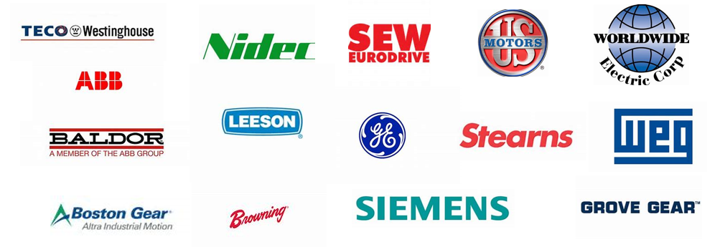
New Products
Electric Motors
  ABB, Baldor, GE, Leeson
  Marathon, Magnatec, TECO
  Siemens, Toshiba, etc…..
Motor Accessories
  Adjustable motor bases
  Worm gear speed reducers
  Bearings / Carbon brushes
Drives & Controls
  Baldor, Benshaw
  Control Techniques, KB
  Leeson, TECO etc…..
Gearmotors & Reducers
  Baldor, Boston Gear
  Browning, Dodge, Grove
  Lesson, Perfection Gear
  Siemens & SEW Eurodrive

Slide 7
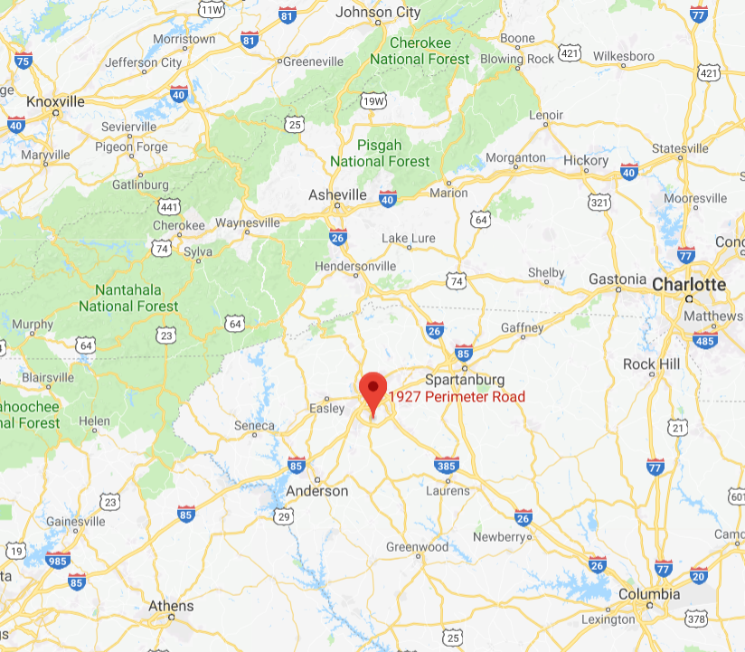
Taking care of you electric motor service needs!!
Serving the South East
(SC, NC & TN)
10,000 sq. ft. facility
Servo and Rewind capabilities
Machine shop on site
Large crane capacity
Pick up and delivery within our territory
Large inventory in stock and ready for delivery
24 / 7 Service
Member of EASA
Contact us at
864-299-0250
or visit us at
www.proelectricmotor.com

