Slide 1
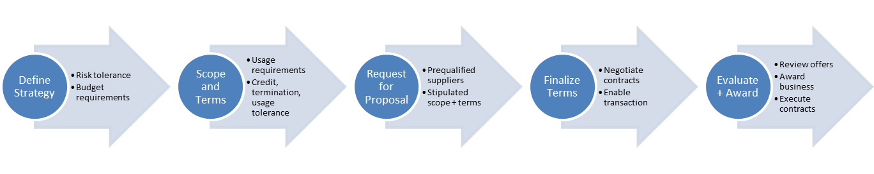









Strategic Energy Supply Advisors
# OF
CLIENTS
Over 15 Years experience in North American deregulated markets
Comprehensive understanding of every aspect that affects energy prices and how to help clients manage and reduce energy spend.
Strategic sourcing of power and natural gas to manage risk and reduce cost
Recommend ideal product structure and supplier
Review and negotiate electricity sales and purchase agreements with Supplier(s) to ensure a fair an balanced contract
Complete understanding of the Mexican Market regulatory landscape and the legal process for market participation.
+400
CLIENT
RETENTION
97%
ENERGY
SPEND
$1.4 Billion USD
$700 Million USD
CLIENT
SAVINGS
Mexico Clients
Maria Jose Treviño
mjtrevino@acclaimenergy.com

Slide 2
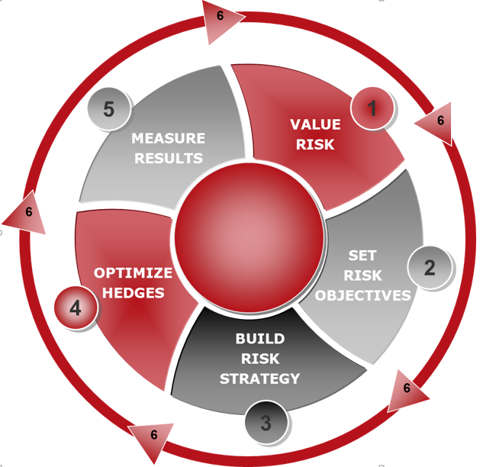
Strategic Energy Supply Advisors
# OF
CLIENTS
Over 15 Years experience in North American deregulated markets
Comprehensive understanding of every aspect that affects energy prices and how to help clients manage and reduce energy spend.
Strategic sourcing of power and natural gas to manage risk and reduce cost
Recommend ideal product structure and supplier
Review and negotiate electricity sales and purchase agreements with Supplier(s) to ensure a fair an balanced contract
Complete understanding of the Mexican Market regulatory landscape and the legal process for market participation.
+400
CLIENT
RETENTION
97%
ENERGY
SPEND
$1.4 Billion USD
$700 Million USD
Maria Jose Treviño
mjtrevino@acclaimenergy.com
CLIENT
SAVINGS
Mexico Clients

