Slide 1
United States of America
Strategy Analysis and Recommendations – Feb 2017
STRICTLY PRIVATE & CONFIDENTIAL

Slide 2
Executive Summary
We have conducted a detailed strategic analysis of the U.S. in order to determine the best places for FRV to play in the market
FRV should be in the following core anchor States:
California
Georgia
Alabama
Indiana
These anchor States can serve as a basis for a more regional strategy:
West
California + Oregon, New Mexico, Nevada, and Arizona
Southeast
Georgia and Alabama + Mississippi and Tennessee
Great Lakes
Indiana + Ohio and Michigan
The Great Lakes has economic and some regulatory drivers and while demand is not as strong as in the West or Southeast, there is less competition given its an early stage and underserved market with opportunities for first or early movers
The West has a thriving market with solid demand based on both regulatory and economic drivers and while competitive there is room for smart, fast moving developers
The Southeast has strong economic drivers and while demand is not as strong as in the West there is less competition given its an early stage market

Slide 3
Background
Purpose of this analysis is to define FRV development strategy in the U.S.
Focus on Investment Tax Credit (ITC) window: 2017-2021
Looking for first power purchase agreement (PPA) execution in 12-18 months
Near term focus on opportunistic M&A - ideally with a strategic focus based on this analysis and initial set of recommendations
Emphasis on medium (2-3 year) and longer term (3-5 year) strategy
Focus on creditworthy off-takers that can sign 20+ year PPAs for 50+MW projects
Key questions:
Which geographical regions and specific States to focus on in the medium to longer term?
Which potential off-takers are best to target/pursue?
What is intersection of various metrics and screens that indicate an attractive and sustainable market for FRV?
How should FRV develop their human resources around the strategy?

Slide 4
Market Screening and Analysis
Level 1 – screen based on quantitative analysis of fundamental demand drivers and economics
Level 2 – screen based on competitive assessment – contracted assets
Level 3 – screen based on competitive assessment – uncontracted pipeline
Level 4 – detailed view on each of the four selected FRV anchor markets. Pending.
Utility-Scale Solar Demand
Strategy
Off-Taker
Analysis
Competitive Landscape

Slide 5
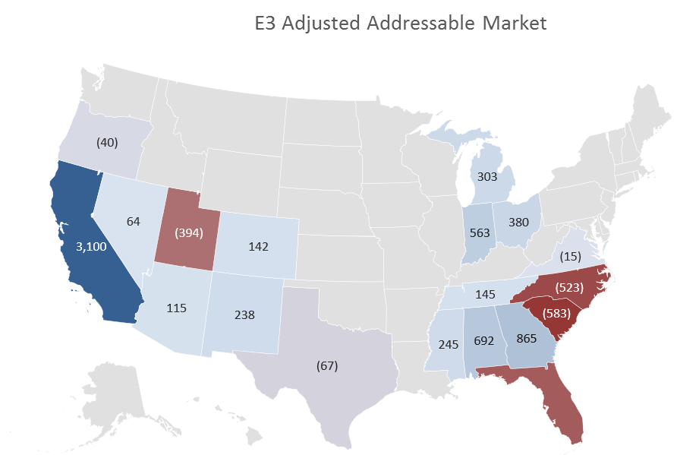
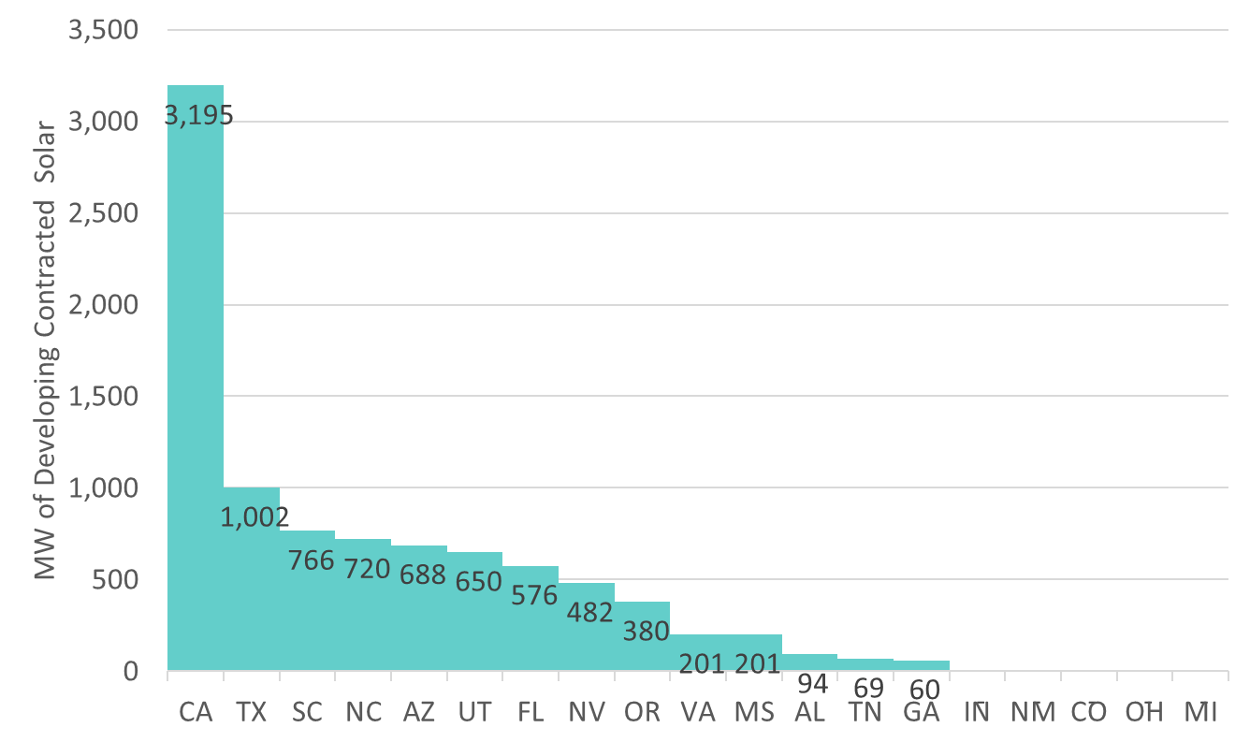
Level 2 Screen: Total Addressable Market
Total Addressable Market = Level 1 screen minus contracted 50+MW projects in development
Red States indicate that there is more contracted 50+MW than the addressable market indicating high levels of potential competition or barriers to entry without M&A
(462)
Source: GTM, E3 Analysis

Slide 6
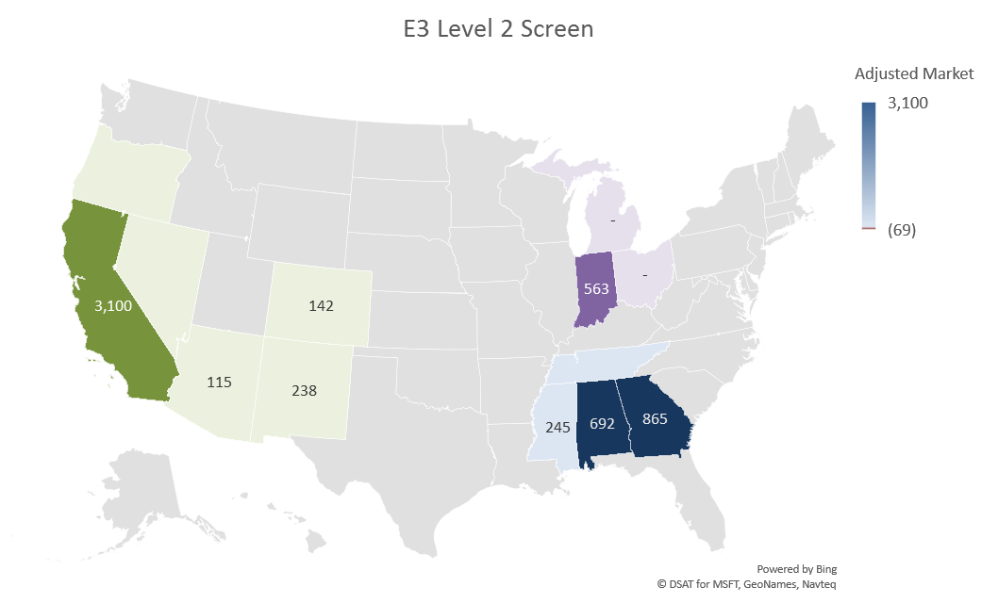
Summary – Level 2 Screen Results
States with regulatory demand:
CA, AZ, CO, and NM
States with economic demand (e.g. high power cost, load growth, and/or retiring generation):
IN, GA, AL, and MS
FRV anchor States?
CA, GA, AL, and IN
Regional strategy?
West, Southeast, and Great Lakes
E3/FRV Level 2 Screen
Total Adjusted Market after Level 2 Screen:
6.1 GW
6

Slide 7
Background
Plus Additional Analysis

