Slide 1
Section III Update – February 8, 2017

Slide 2
Workstream 3: Market & Technology Research
Program Governance
Overall Status
G
Recent Achievements
Timeline
Participated in initial project kick-off calls across the project team and NYPA stakeholders
Coordinated initial project plan with other workstreams, including specific milestones for market and technology vendor analysis and deliverables
Provided general examples of DER business models
Commit
Target
Status
Milestone
Design initial survey
Determine survey participants
Develop vendor taxonomy
Complete surveys
Diagram business cases and bundles
Develop strategic recommendations
Prepare and present output to steering committee
2/24
2/24
G
3/3
3/3
G
3/10
3/10
G
3/31
3/31
G
Next Steps
3/31
3/31
G
Begin to identify potential platform and DER provider survey candidates
Begin to define platform provider survey questions
Begin to define DER service provider survey questions
4/14
4/14
G
4/26
4/26
G
Issue | Description | Proposed Resolution | Owner | Timing

Slide 3
Initial Business Model Examples

Slide 4


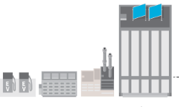





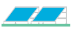
Traditional DER Business Models Leveraging Wholesale Value
Demand response and DER aggregation has evolved into a tool for planning, operation and control strategies of both utilities and ISOs/RTOs through various price and volume-based measures. Currently, demand response is developing within the domain of distributed energy resource (DER) management. The expanding deployment of DERs calls for new business and revenue models to provide growth opportunities.
DR Participation in ISO Markets With an Aggregator Facilitating the Process
Utility Demand Response Programs Through and Aggregator
Aggregator
Information
Aggregator
Monetary
Service Payment
Capacity
Energy
Ancillary Services
Revenue Streams
Base pay
Performance pay
Performance + base pay
Electricity
Service Payment
Payments for electricity services, subscription fees
DER ‘Broker’
Allocate dispatch
Technology and equipment, DRMS
Compensation to resource activated
Revenue
One time payment
Availability payment
Performance payment
DER ‘Broker’
Allocate dispatch
Measurement
Technology and equipment
Compensation for resource activated
Information
Bids, dispatch signals
Information
Energy usage, availability,
control signals
Information
Service requirements, dispatch signals, availability
Information
Energy usage, availability, control signals
ISO/RTO
Load Resource
Utility
Load Resource
Service Provision
Load modification in response to control signal
Service Provision
Load modification in response to control signal
Revenue
Utility bill credit
Source: GTM Research
Notes:
These DR businesses tend to earn revenues through subscription fees (i.e. payments from the utility linked to the provision of the DR management software, etc.) or brokerage fees (i.e. keeping a share of the revenue earned from the sale of the DR resource to the utility).

Slide 5
Dispatchable DERs Can Provide Value Across All Levels of the Grid
Distributed energy resources (DERs) including fuel-based distributed generation, solar PV and energy storage can provide a wide range of values at three levels of the grid: the customer level (behind the meter), the distribution level (utility) and the system level (ISOs/RTOs in restructured markets; vertically-integrated utilities in regulated markets).
Representative Value Streams for Behind-the-Meter Distributed Energy Resources
ISO/RTO PROGRAMS
3rd PARTY PROGRAMS
Value Drivers
Retail electricity prices
Retail demand charges
Demand growth
Wholesale capacity prices
Wholesale energy prices
Wholesale ancillary services prices
Reformed markets for wholesale-level value streams
Emerging markets for distribution-level value streams
UTILITY PROGRAMS
DISTRIBUTION LOSSES
BLACKSTART
POWER QUALITY
CONGESTION CHARGES
VOLTAGE SUPPORT
RELIABILITY / RESILIENCY
VOLTAGE SUPPORT
FREQUENCY REGULATION
SYSTEM PEAK CHARGES
LOADING / RELIABILITY
SPIN / NON-SPIN RESERVES
DEMAND CHARGES
T&D DEFERRAL
ENERGY
ENERGY CHARGES
CAPACITY / RA
CAPACITY
Customer Value Streams
Distribution Value Streams
System Value Streams
Note: Value streams may not be readily accessible due to regulations and traditional business processes.

Slide 6





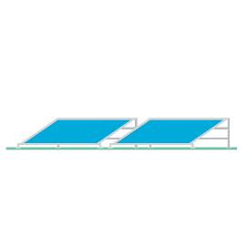
New York is Laying the Groundwork for Distributed Energy Resources in Wholesale Markets
The NYISO has been directed by FERC to make enhancements to existing mechanisms which will give DR providers and DER resources more opportunities to participate in wholesale markets. In order to allow for appropriate compensation of services, market changes should alighn with FERC Orders 719 and 745. Efforts to integrate DERs into NYISO consider the following five building blocks:
Integrate DERs into the energy and ancillary services markets by providing opportunities for resources to take advantage of economic scheduling and real-time locational prices.
Provide open access for DERs to participate in wholesale markets by animating markets to leverage demand-side contributions.
Recognizing that DERs will most likely participate in the form of an aggregation, NYISO expects “better telemetry data for operations and monitoring functions, and after-the-fact revenue quality meter data from individual resources for measurement and verification, and settlements.”
Treat DERs comparably with other supply resources participating in NYISO’s Energy, Capacity and Ancillary Services markets. “The NYISO intends for the DER program to align incentives and compensation based on the flexibility and measured performance of the DER (or aggregation), and market clearing prices based on the needs of the system.
Although the transactions will be happening at the wholesale level it is important to appropriately represent the impacts of DERs on the bulk power system at the corresponding interface. Typically the interface of distributed resources with the bulk power system is the transmission level substation load bus associated with the distribution network.
Wholesale and Retail Market Relationships and Coordination
Wholesale service provided through DSP* as a ‘super aggregator’
DSP
Wholesale service provided to ISO
Retail service provided to DSP
Aggregator
Wholesale service direct to ISO
Retail service direct to DSP
Distributed Energy Resources
Wholesale Services
Retail Services
Source: NYISO
*Distributed System Platform

Slide 7




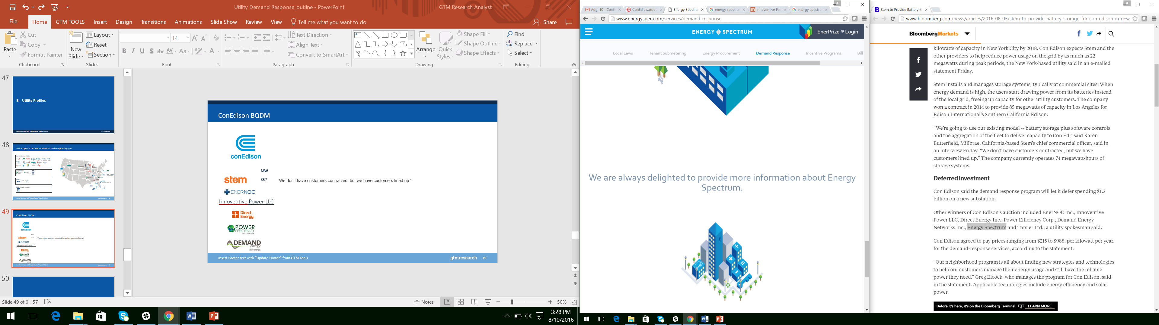


The Development of the Brooklyn-Queens Demand Management (BQDM) Program
Wholesale and Retail Market Relationships and Coordination
BQDM Non-Wires Alternative
In the summer of 2014, Consolidated Edison (Con Edison) realized increasing demand in three Brooklyn-Queens neighborhoods: Ridgewood, Richmond Hill and Crown Heights would overload electric sub-transmission feeders serving the Brownsville No.1 and No. 2 substations. Expansion of the existing substation infrastructure was expected cost ratepayers $1.2 billion. Con Edison proposed the Brooklyn-Queen Demand Management (BQDM) Program¹ as a non-wires alternative to defer building the substation until 2026.
During the 2017 and 2018 summer seasons, the BQDM program will replace the existing Con Edison Commercial System Relief Program (CSRP) in the designated neighborhoods. BQDM makes use of $200 million for incentive programs to defer the upgrade and provide system relief over the 2017 and 2018 summer seasons through a menu of Customer Side and non-traditional Utility Side Solutions.
Customer side solutions (41 MW, $150 million)
Utility side solutions (11MW, $50 million)
An additional 17 MW of relief will be provided from traditional utility infrastructure investment, totaling 69 MW of load reduction from the program. Con Edison utility expenditures for BQDM will be treated as 10 year capital assets with regulated return and performance incentives. The CSRP demand response program will continue to run outside of BQDM neighborhoods.
In addition to CSRP, Con Edison also runs a Distribution Load Relief Program (DLRP). Customers enrolled in DLRP can also participate in NYISO wholesale market DR programs in addition to BQDM DR, however in the case of an event BQDM activation must take priority.
e
Wholesale service provided through DSP as a ‘super aggregator’
Wholesale service provided to ISO
Retail service provided to DSP
Aggregator
Wholesale service direct to ISO
Retail service direct to DSP
Distributed Energy Resources in BQDM Territory
Wholesale Services
Retail Services
Innoventive Power LLC
*Distributed System Platform
¹ New York State Department of Public Service Case 14-E-0302

Slide 8


Green Mountain Power Stacks Benefits to Improve Economics of Residential Energy Storage
Green Mountain Power Residential Energy Storage Offering
 | Option 1 | Option 2 | Option 3
Projected No. Units | 75 | 225 | 200
Ownership | End-customer | End-customer | GMP
Control | End-customer | Partial GMP Control | GMP Control
Utility Services | None | Dispatched to address peaks in Forward Capacity Market (FCM) 75% of the time; Dispatched to address peaks in Regional Network Service (RNS) 50% of the time | Dispatched to address peaks in Forward Capacity Market (FCM) 100% of the time; Dispatched to address peaks in Regional Network Service (RNS) 75% of the time; Energy arbitrage when available
Utility Benefits | $0/year | $81,000/year | $124,000/year
Customer Services | Backup power, solar self-consumption, TOU shifting | Backup power, solar self-consumption, TOU shifting [not mutually exclusive with utility services at all times] | Backup power, solar self-consumption, TOU shifting [not mutually exclusive with utility services at all times]
Customer Costs/Benefits | $6,500 plus installation costs paid by customer to GMP | $6,500 plus installation costs paid by customer to GMP; bill credit of $31.76/month received for 10 years | No upfront cost; rate rider paid of $37.50/month paid for 10 years
Green Mountain Power (GMP), a 265,000-customer Vermont utility and subsidiary of Canadian energy company Gaz Métro, partnered with Tesla to offer approximately 500 7-kWh energy storage systems to its residential customers
Customers have three options:
Option 1: Buy the system outright and maintain full control
Option 2: Buy the system outright and grant access to GMP in return for a monthly bill credit
Option 3: Lease the system from GMP through a rate rider and allow GMP full access
During non-outage conditions, GMP will aggregate and dispatch the systems to mitigate capacity and transmission costs, in addition to realizing energy arbitrage opportunities when available (option 3 only)
Source: Green Mountain Power, GTM Research

