Slide 1
Engineering Layout and Opinion of Probable Cost
January 6, 2017
JD Pool Pumped Storage Project

Slide 2
Work Completed to Date
Review of MWH Conceptual Layout
Evaluation of single upper reservoir configuration
Two alternatives (7,100 / 11,800 AF)
Modified waterway profile
Preliminary Sizing and Layout of Power Complex
Preliminary Cost Opinion and Project Schedule
Operating Characteristics and Market Products

Slide 3
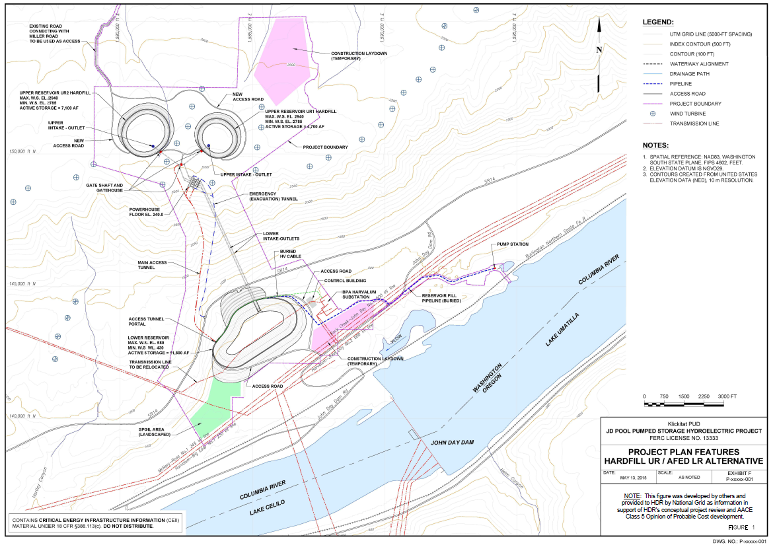
Previous Study – Plan View (11,800 AF)

Slide 4
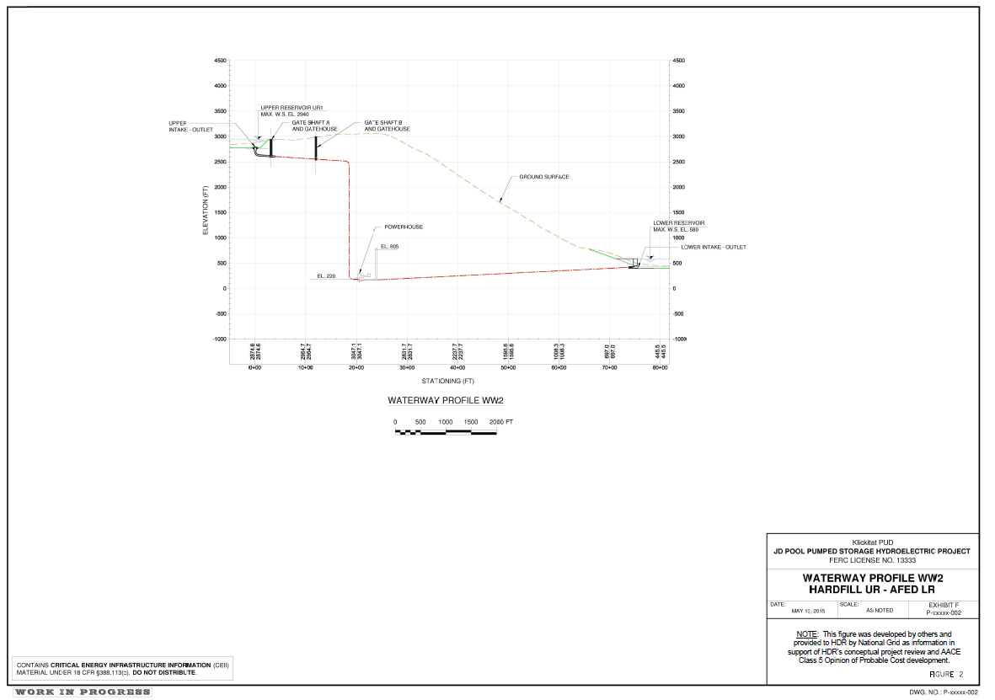
Previous Study – Waterway Profile

Slide 5
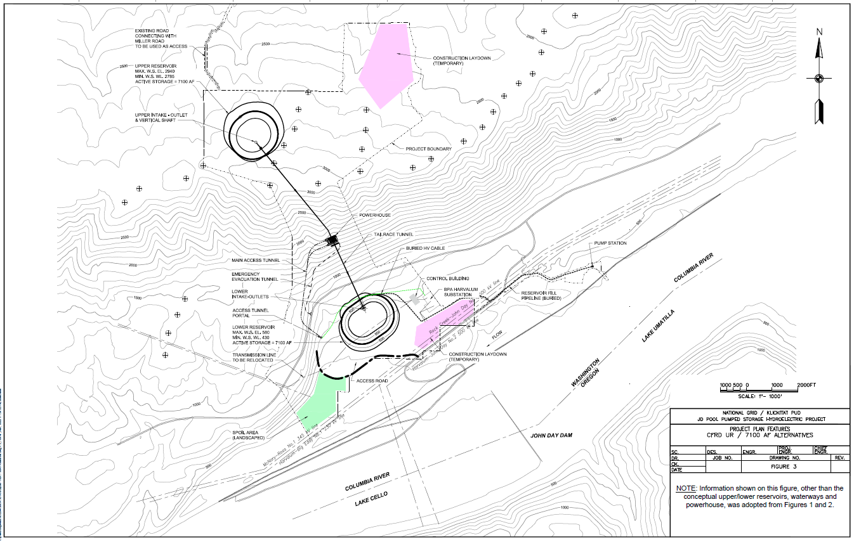
Alternative 1 – Plan View (7,100 AF)

Slide 6
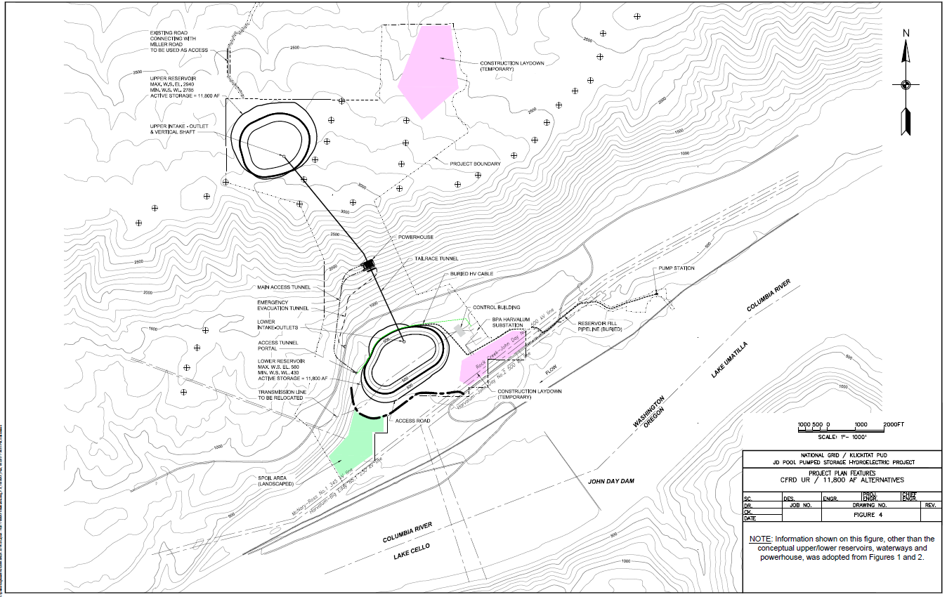
Alternative 2 – Plan View (11,800 AF)

Slide 7
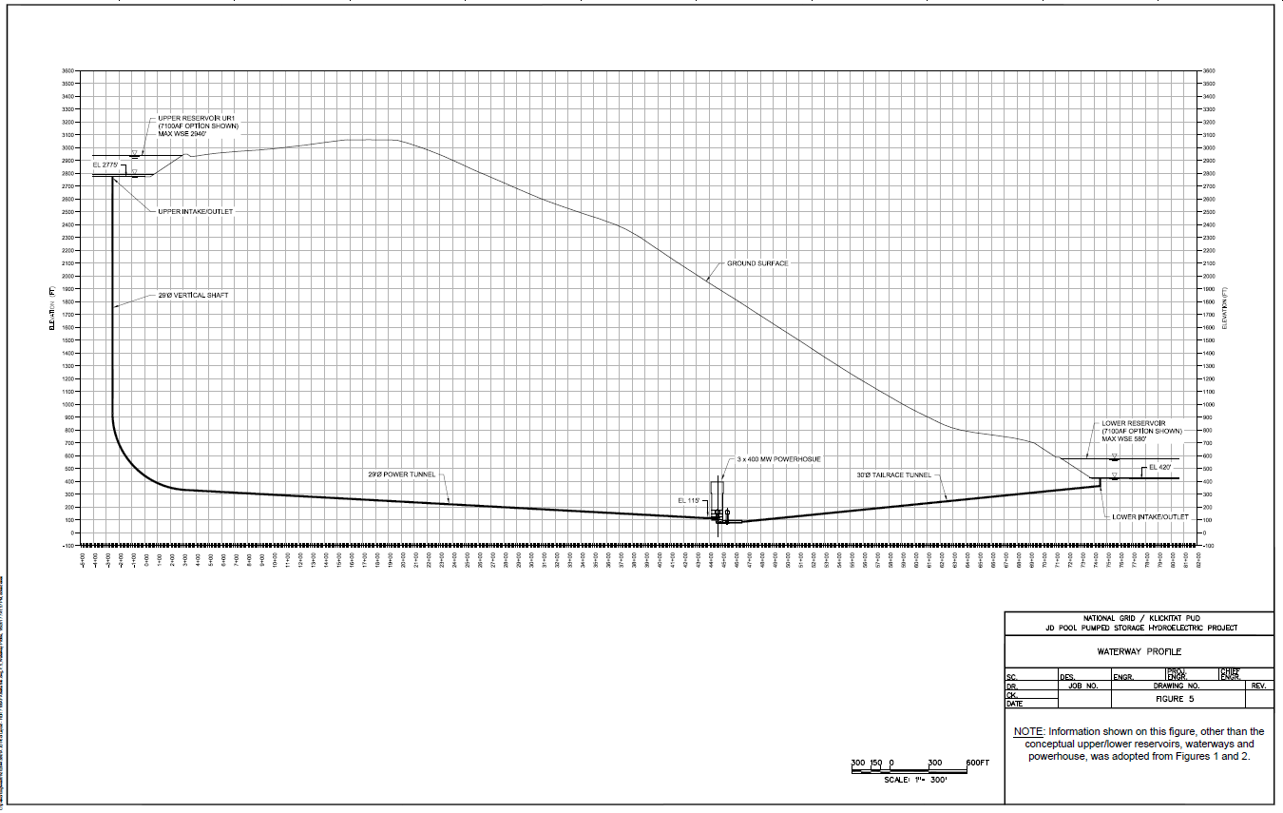
Alternatives 1 and 2 – Waterway Profile

Slide 8
Energy and Capacity Summary
 | Alternative 1 | Alternative 2
Gross Pool (AF) | 7,100 | 11,800
Energy Storage (MWh) | 14,745 | 25,506
Unit Capacity and Configuration (MW) | 1,200 (3x400) | 1,200 (3x400)
Storage Duration at Full Load (hours) | 14 | 20

Slide 9
Opinion of Probable Cost
 | Alternative 1 | Alternative 2
Direct Costs
Reservoirs and Dams¹ | $448,100,000 | $714,000,000
Powerhouse Structure Civil Works | $138,000,000 | $138,000,000
Water Conveyance System | $265,000,000 | $265,000,000
Powerhouse E/M Equipment | $850,000,000 | $850,000,000
Additional Directs² | $444,915,000 | $484,800,000
Subtotal Direct Construction OPCC | $2,146,015,000 | $2,451,800,000
Owner’s Indirect Costs (20%) | $429,203,000 | $490,360,000
Total Construction Direct and Indirect OPCC | $2,575,218,000 | $2,942,160,000
Estimated OPCC ($/MW; $/MWh) | $2,146,000; $175,000 | $2,452,000; $115,000
Notes:
1 – No spillway is assumed to be required for either alternative.
2 – These additional directs are itemized in HDR’s study report.
Transmission, interconnection, and land costs are not included in this cost opinion.

Slide 10
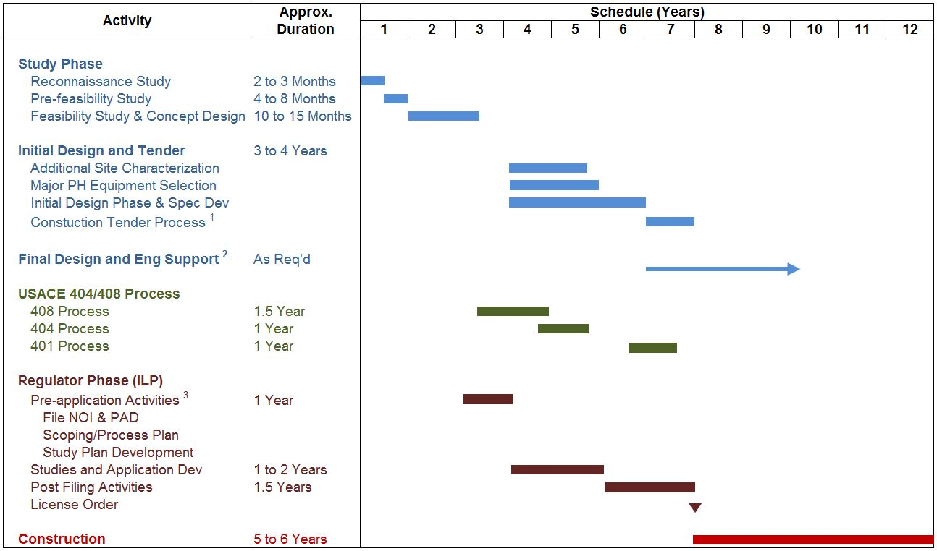
Conceptual Development Schedule

Slide 11
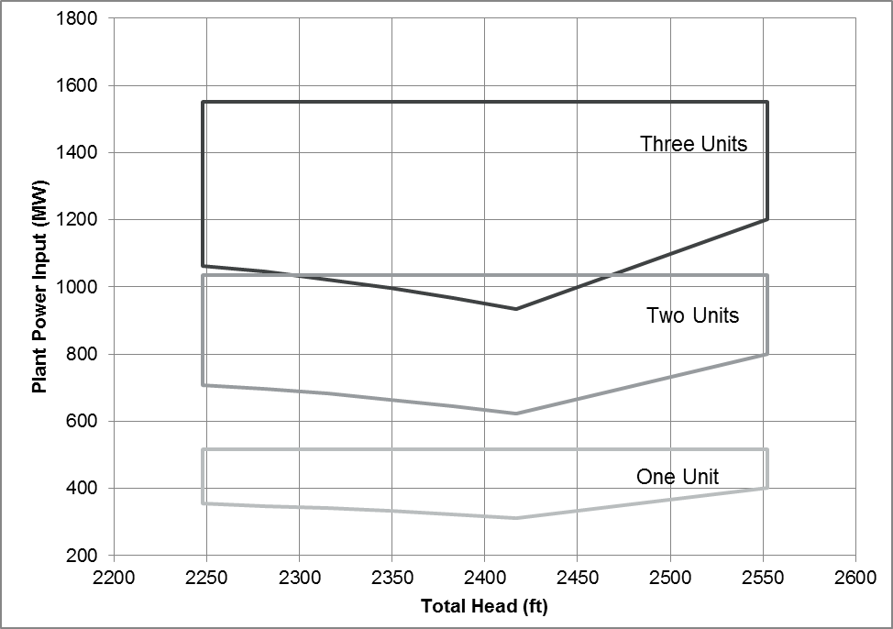
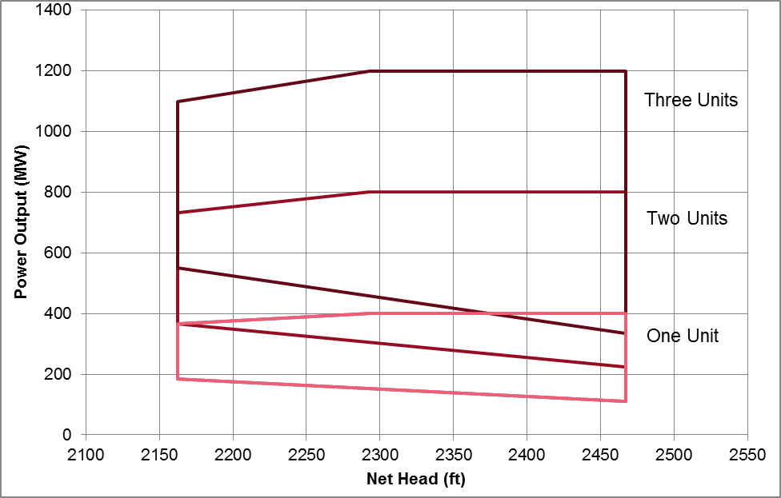
Summary of Operating Characteristics
3 x 400 MW Configuration
Pumping Efficiency (%) | 89.7
Generating Efficiencies (%) | 84.2 – 87.6 (1,400 – 2,400 cfs)
Plant Cycle Efficiency (%) | ~78

Slide 12
Summary of Market Products
 | Generate Mode |  |  | Pump Mode
 | Min MW | Max MW | Incremental Reserves MW | Min MW | Max MW | Decremental Reserves MW
@ Min Head | 183 | 1,099 | 916 | 354 | 1,552 | 1,198
@ Max Head | 111 | 1,200 | 1,089 | 401 | 1,552 | 1,151
Spinning Reserves: Full range of unit operations in < 3 min (gen), < 4 min (pump)
Non-Spin Reserves: Full range of unit operations in < 6 min (gen), < 8 min (pump)

