Slide 1
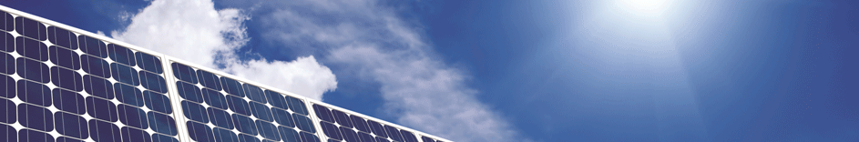
CDG Project Economics
1/6/2017

Slide 2
Business Models
We interviewed 6 CDG developers with varying business models to assess project costs.
Business models
EPC only (sell @ COD)
Vertical (development through ownership)
Both (keep some & sell some)
Builders and buyers in early talks about what is sellable
Some buyers are saying sellers might be in for a surprise on pricing
Some new players were a bit unprepared and had wrong numbers (inverter replacement, high capacity factor)

Slide 3
Developer Survey and Assumptions
Value Assumptions
2.8MW DC, 2.0MW AC
80% of production receiving MTC, 20% at value stack
13.4% Capacity factor
NY-Sun incentive from Rest of State Block 8 or ConEd Block 2
Inverter replacement Year 12, $280K

Slide 4
Rest of State EPC Costs
Range from $1.45 - $1.85 a watt including:
Land procurement
Engineering
Equipment procurement
Permitting
Construction finance
Construction
Interconnection: $196,000-$420,000
Customer acquisition $0.20 a Watt (price seems high due to new business model)
Agriculture land conversion penalty
Decommissioning reserve $60k
Certain upstate projects may have EPC costs as high as $2.15/Watt given very high interconnection or land costs that sometimes pencil out for O&R
Notes:
Not all expenses are incurred on every project:
Agriculture land conversion penalty
Decommissioning reserve $60k

Slide 5
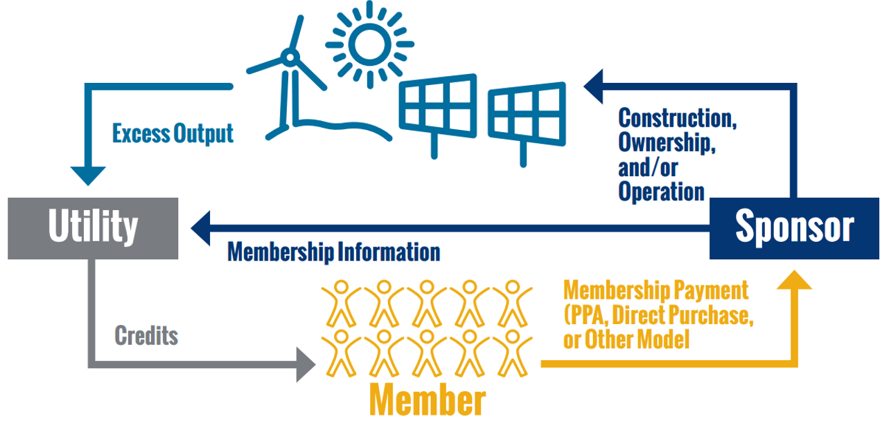
CDG Revenue Structure

Slide 6
Summary Outputs (Pre-Tax IRR Heat Map) Tranche 1
Developer interviews revealed a pre-tax IRR of 3.25% was required for project viability. Under NEM, low cost projects are viable in most parts of the state. Medium to high cost projects are viable in Central Hudson, O&R, and ConEd only.
Notes:
Low cost is an anomaly. Due to interconnection issues there are not many low cost projects. Most will likely fall into medium and high.

Slide 7
Pipeline vs Tranche Capacity
Based on existing pipeline projects, we anticipate the O&R tranches will fill rapidly.

Slide 8
Orange & Rockland Revenue
Developers see the highest potential profit in O&R.
Each percentage point of pre-tax IRR equates to ~$248,000 in developer revenue on a 2.8MW DC project ($0.089/Watt DC)
Assuming a Medium project cost and developer pricing to maximize revenue, total developer revenue above the 3.25% IRR (“extra profit”) over all three O&R Tranches equals ~$11.8M.

Slide 9
Upstate Tranche Capacity vs. MW Block Capacity
The NY-Sun Commercial/Industrial MW Block program as of today has about 835 MW remaining in Rest of State. The combined tranches for ROS utilities (non ConEd) have 2.47GW of combined capacity. Many future projects will not have the NY-Sun incentive.

Slide 10
VDER / Interconnection Timeline
First group of projects with prelim review pay for CESIR
90 day window closes for Tranche Zero
Projects with CESIR completed more than 60 days pay 25%
Second group of projects with prelim review pay for CESIR
Prelim review projects pay 25%
Initial queue reset
Prelim review projects CESIR completed
Property Owner Consent
Projects with CESIR completed less than 60 days pay 25%
Session
1/24
3/7
4/18
5/9
12/23
5/30
6/11
8/8
10/31
Notes:
We expect a large number of projects to pay for CESIR & upgrades prior to the order and right after the order. This will fill the MW block up quite quickly. We expect tranche 3 to be limited NY-Sun incentive availability

